Slide 1
Further Resources
Module 6
Notes:
Module 6: Further Resources:
Approximate time: Four minutes
---
Image source: PowerPoint Stock Images

Slide 2
Opening Prayer
Let us pray, (Pause)... Let us be still and recognize the presence of God with us and in us.
In the name of the Father, and of the Son, and of the Holy Spirit,
Good and loving God, our source of love and light,
Thank You for bringing us together today in a spirit of generosity.
We offer You this prayer in gratitude.
May we honour one another by keeping an open mind.
May we voice our truth and listen with an open heart.
May we discern Your will to unite us in a fruitful outcome.
We ask for Your wisdom and grace to use our talents for the betterment of others.
With the guidance of the Holy Spirit,
And the loving intercession of Our Lady of Good Counsel,
Through Christ our Lord,
In the name of the Father, and the Son and the Holy Spirit,
Amen.
Notes:
READ:
Opening Prayer:
Let us pray,
(Pause)... Let us be still and recognize the presence of God with us and in us.
In the name of the Father, and of the Son, and of the Holy Spirit,
Good and loving God, our source of love and light,
Thank You for bringing us together today in a spirit of generosity.
We offer You this prayer in gratitude.
May we honour one another
By keeping an open mind.
May we voice our truth
And listen with an open heart.
May we discern Your will
To unite us in a fruitful outcome.
We ask for Your wisdom and grace
To use our talents for the betterment of others.
With the guidance of the Holy Spirit,
And the loving intercession of Our Lady of Good Counsel,
Through Christ our Lord,
In the name of the Father, and the Son and the Holy Spirit,
Amen.
---
Prayer source: “Opening Prayer for a Meeting,” Prayers and Spiritual Programs, The Catholic Women’s League of Canada

Slide 3
The League’s National Website cwl.ca
National Manual of Policy and Procedure – Manuals, #615
Train the Trainer Guide – Manuals, #642
Handbook for Secretaries – Manuals, #612
Guide to Simplifying Meetings – Manuals, #636
Executive Orientation – Workshops, #828
“Public Presence and Member Development” module – available on the Executive Orientation Workshop page.
Newsletter Template - Crest, Stationery and Other Council Supplies, #145A
Notes:
READ:
National website, cwl.ca
National Manual of Policy and Procedure (Manuals, #615)
Train the Trainer Guide (Manuals, #642)
Handbook for Secretaries (Manuals, #612)
Guide to Simplifying Meetings (Manuals, #636)
Executive Orientation (Workshops, #828)
“Public Presence and Member Development” module is available on the Executive Orientation page.
Newsletter Template (Crest, Stationery and Other Council Supplies, #145A)

Slide 4
Books
The Elements of Style. Shrunk, W. and White, E., 1999
The Chicago Manual of Style. The University of Chicago Press, 2009
The Only Grammar Book You’ll Ever Need. Thurman, S and Shea, L., 2003
On Writing Well. Zinsser, W., 2016
How to Win Friends and Influence People. Carnegie, D., 1998
Digital Body Language. Dhawan, E., 2023
Notes:
READ:
Books:
The Elements of Style. Shrunk, W. and White, E., 1999 ($7.00)
The Chicago Manual of Style. The University of Chicago Press 2009 ($10.00)
The Only Grammar Book You’ll Ever Need. Thurman, S and Shea, L., 2003 ($13.00)
On Writing Well. Zinsser, W., 2016
How to Win Friends and Influence People. Carnegie, D., 1998
Digital Body Language. Dhawan, E., 2023
---
Image source: PowerPoint Stock Images

Slide 5
Other References
This Photo by Unknown Author is licensed under CC BY-SA
Towards Full Presence: A Pastoral Reflection on Engagement with Social Media. Dicastery for Communications.
“Message of His Holiness Pope Francis for the 57th World Day of Social Communications”
Notes:
READ:
Other References
Towards Full Presence. A Pastoral Reflection on Engagement with Social Media. Dicastery for Communications.
“Message of His Holiness Pope Francis for the 57th World Day of Social Communications”
---
Image source: PowerPoint Stock Images

Slide 6
Notes:
READ:
Questions?
---
Image source: PowerPoint Stock Images

Slide 7
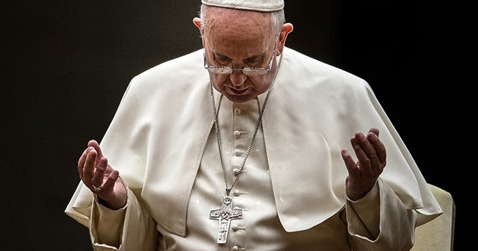
Closing Prayer
May the Lord Jesus, the pure Word poured out from the heart of the Father, help us to make our communication clear, open and heartfelt.
May the Lord Jesus, the Word made flesh, help us listen to the beating of hearts, to rediscover ourselves as brothers and sisters, and to disarm the hostility that divides.
May the Lord Jesus, the Word of truth and love, help us speak the truth in charity, so that we may feel like protectors of one another.
(Pope Francis)
Notes:
READ:
Closing Prayer:
“May the Lord Jesus, the pure Word poured out from the heart of the Father, help us to make our communication clear, open and heartfelt.
May the Lord Jesus, the Word made flesh, help us listen to the beating of hearts, to rediscover ourselves as brothers and sisters, and to disarm the hostility that divides.
May the Lord Jesus, the Word of truth and love, help us speak the truth in charity, so that we may feel like protectors of one another” (Pope Francis).
---
Prayer source: “Message of His Holiness Pope Francis for the 57th World Day of Social Communications.” vatican.va/content/francesco/en/messages/communications/documents/20230124-messaggio-comunicazioni-sociali.html
Image source: PowerPoint Stock Images

