Slide 1
Best Practices
Module 4
Notes:
Module 4: Best Practices
Approximate time: 10 minutes (without discussion)
---
Image source: PowerPoint Designer

Slide 2
Opening Prayer
Let us pray, (Pause)... Let us be still and recognize the presence of God with us and in us.
In the name of the Father, and of the Son, and of the Holy Spirit,
Good and loving God, our source of love and light,
Thank You for bringing us together today in a spirit of generosity.
We offer You this prayer in gratitude.
May we honour one another by keeping an open mind.
May we voice our truth and listen with an open heart.
May we discern Your will to unite us in a fruitful outcome.
We ask for Your wisdom and grace to use our talents for the betterment of others.
With the guidance of the Holy Spirit,
And the loving intercession of Our Lady of Good Counsel,
Through Christ our Lord,
In the name of the Father, and the Son and the Holy Spirit,
Amen.
Notes:
READ:
Opening Prayer:
Let us pray,
(Pause)... Let us be still and recognize the presence of God with us and in us.
In the name of the Father, and of the Son, and of the Holy Spirit,
Good and loving God, our source of love and light,
Thank You for bringing us together today in a spirit of generosity.
We offer You this prayer in gratitude.
May we honour one another
By keeping an open mind.
May we voice our truth
And listen with an open heart.
May we discern Your will
To unite us in a fruitful outcome.
We ask for Your wisdom and grace
To use our talents for the betterment of others.
With the guidance of the Holy Spirit,
And the loving intercession of Our Lady of Good Counsel,
Through Christ our Lord,
In the name of the Father, and the Son and the Holy Spirit,
Amen.
---
Prayer source: “Opening Prayer for a Meeting,” Prayers and Spiritual Programs, The Catholic Women’s League of Canada

Slide 3
Addressing Email
The TO (address to) line should include the primary audience of the message.
CC (carbon copy) should include anyone who doesn’t need to act on the content of the message but should know the message was sent and be aware of the content.
BCC (blind carbon copy) is used when sending an email to an address list; everyone should be BCC’d to preserve privacy. For example, when sending out a newsletter by email, all recipients should be BCC’d.
Notes:
READ:
Addressing Email:
The TO (address to) line should include the primary audience of the message.
CC (carbon copy) should include anyone who doesn’t need to act on the content of the message but should know the message was sent and be aware of the content.
BCC (blind carbon copy) is used when sending an email to an address list; everyone should be BCC’d to preserve privacy. For example, when sending out a newsletter by email, all recipients should be BCC’d.
---
Image source: PowerPoint Stock Images

Slide 4
Use Reply All only when everyone needs to know your response.
Notes:
READ:
Use Reply All only when everyone needs to know your response.
---
Image source: PowerPoint Stock Images

Slide 5
Notes:
READ:
When creating emails, clearly state the purpose of the email in the subject line. Make it meaningful and ensure it conveys the message you are about to send.

Slide 6
Creating Emails
The salutation addresses the group that the message is being sent to. For example, “Dear members.”
The body of the message includes information. Keep messages short. For longer emails, explain the purpose and required response at the beginning of the email body.
The signature should include a closing salutation and contact information if needed.
Using all CAPITALS or underline is equivalent to shouting! Bold should be used sparingly.
Notes:
READ:
Creating Emails:
Use meaningful subject lines. The subject line should convey the intent of the message.
The salutation addresses the group that the message is being sent to. For example, “Dear members.”
The body of the message should include important information. For example, when sending meeting minutes, include the action items in the body of the message. Keep messages short. For longer emails, explain the purpose and required response at the beginning of the email body.
The signature should include a closing salutation and contact information if needed.
Note: Using all capitals or underline within an email is equivalent to shouting. Bold should be used sparingly.
Questions for Discussion:
What is a set of keywords that could be used by the group in the subject line of emails?
What are some examples of meaningful subject lines?
---
Image source: PowerPoint Stock Images

Slide 7
Email Attachments
When attaching documents to an email:
Create a list of all attachments in the body of the email. This ensures the recipient can tell if any attachments are missing.
Attachments should be in formats that are commonly used. The most widely readable format is PDF. Most audiences can also read Microsoft 365 formats (Word, Excel, PowerPoint).
Respond to action emails within 24-48 hours if possible. It is not necessary to have an answer, but giving a timeline within which an answer will be supplied is considerate.
Notes:
READ:
Email Attachments: When attaching documents to an email:
Create a list of all attachments in the body of the email. This ensures the recipient can tell if any attachments are missing.
Attachments should be in formats that are commonly used. The most widely readable format is PDF. Most audiences can also read Microsoft 365 formats (Word, Excel, PowerPoint).
Respond to action emails within 24-48 hours if possible. It is not necessary to have an answer but giving a timeline within which an answer will be supplied is considerate.
---
Image source: PowerPoint Stock Images

Slide 8
Letters
Letters are generally used for formal communication, including formal invitations, requests for donations or sponsorship, formal thank you letters and congratulatory letters.
Letters directed outside of the League are always signed by the president.
If expecting a response, consider the time required to receive mail.
Email can be used to send formal letters as an attachment that includes the president’s signature.
Notes:
READ:
Letters
Letters are generally used for formal communication, including formal invitations, requests for donations or sponsorship, formal thank you letters and congratulatory letters.
Letters directed outside of the League are always be signed by the president.
If expecting a response, consider the time required to receive mail.
Email can be used to send formal letters as an attachment that includes the president’s signature.
---
Image source: PowerPoint Stock Images

Slide 9
Notes and Cards
These are primarily used for informal communication, including informal appreciation, congratulatory messages or an invitation to an event.
Notes:
READ:
Notes and cards are primarily used for informal communication, including informal appreciation, congratulatory messages or an invitation to an event.
---
Image source: PowerPoint Stock Images

Slide 10
Newsletters
Newsletters can be formal or informal and are a great resource to share news, showcase activities and promote the League.
A newsletter template is available for download from the national website.
Notes:
READ:
Newsletters:
Newsletters can be formal or informal and are a great resource to share news, showcase activities and promote the League.
A newsletter template is available for download from the national website under resources (#145a).
Possible questions for discussion:
Would you like to have a newsletter?
What kinds of information should a newsletter include?
Who might want to volunteer to work on one?
---
Image source: PowerPoint Stock Images

Slide 11
Social Media
Social media refers to a computer-based technology that facilitates the sharing of ideas, thoughts and information through virtual networks and communities.
Examples currently being used by the League include Facebook, Instagram, X (formerly known as Twitter), Pinterest and YouTube.
Social media is a public forum. Any information posted to social media may last forever.
Keep posts short and simple.
If you are interested in using social media, do your research.
Notes:
READ:
Social Media: The term “social media” refers to a computer-based technology that facilitates sharing ideas, thoughts and information through virtual networks and communities.
Examples currently being used by the League include Facebook, Instagram, X (formerly known as Twitter), Pinterest and YouTube.
Social media is a public forum. Any information posted to social media may last forever.
Keep posts short and simple.
If you are interested in using social media, do your research.
The National Manual of Policy and Procedures includes Council Facebook Guidelines. The manual is available on the national website, cwl.ca.
Pope Francis has written Towards Full Presence. A Pastoral Reflection on Engagement with Social Media for further reflection on this topic. It is available on the Vatican website at press.vatican.va/content/salastampa/it/bollettino/pubblico/2023/05/29/0404/00890.html.
Possible questions for discussion:
What are your experiences with social media
What social media do you prefer to use?
Do you have any concerns about social media?
---
Image source: PowerPoint Stock Images

Slide 12
Telephone Calls
Guidelines to follow when you leave a telephone message:
Speak slowly and clearly and remember to smile.
Introduce yourself.
Mention why you are calling.
Make sure your details are clear.
Is the message to convey information only (i.e., date and time of a meeting)?
If you need a call-back, ensure you slowly repeat the telephone number twice.
Telephone trees are optional for members. Ensure you have permission to share information and are specific about who will get it.
Notes:
READ:
Telephone Calls: These are guidelines to follow when you leave a telephone message:
Speak slowly and clearly and remember to smile.
Introduce yourself.
Mention why you are calling.
Make sure your details are clear.
Is the message to convey information only (i.e., the date and time of a meeting)?
If you need a call-back, ensure you slowly repeat the telephone number twice.
Telephone trees are optional for members. Ensure you have permission to share information and are specific about who will get it.
---
Image source: PowerPoint Stock Images

Slide 13
Meetings
Agendas should be provided for all formal meetings.
It may be helpful to resend meeting information as a reminder the day before or the day of the meeting. This ensures that information is easily found at the top of someone’s inbox.
Guide to Simplifying Meetings also includes further information on meetings.
Notes:
READ:
Meetings:
Agendas should be provided for all formal meetings.
It may be helpful to resend meeting information as a reminder the day before or the day of the meeting. This ensures the information is easily found at the top of someone’s inbox.
Guide to Simplifying Meetings (#636) also includes further information on meetings and is available on the national website.
---
Image source: PowerPoint Stock Images

Slide 14
Virtual Meetings/Webinars
Virtual meetings can be used in place of or combined with in-person meetings.
Run through any presentation before the meeting to ensure any technical issues have been worked through.
People may be unfamiliar with the application being used. More detailed information may need to be included in the invitation to support all members.
Highlight which time zone the meeting time is in.
Notes:
READ:
Virtual Meetings/Webinars:
Virtual meetings can be used in place of or combined with in-person meetings.
Run through any presentation before the meeting to ensure any technical issues have been resolved.
People may be unfamiliar with the application being used. More detailed information may need to be included in the invitation to support all members.
For virtual meetings, highlight which time zone the meeting time is in.
---
Image source: PowerPoint Stock Images

Slide 15
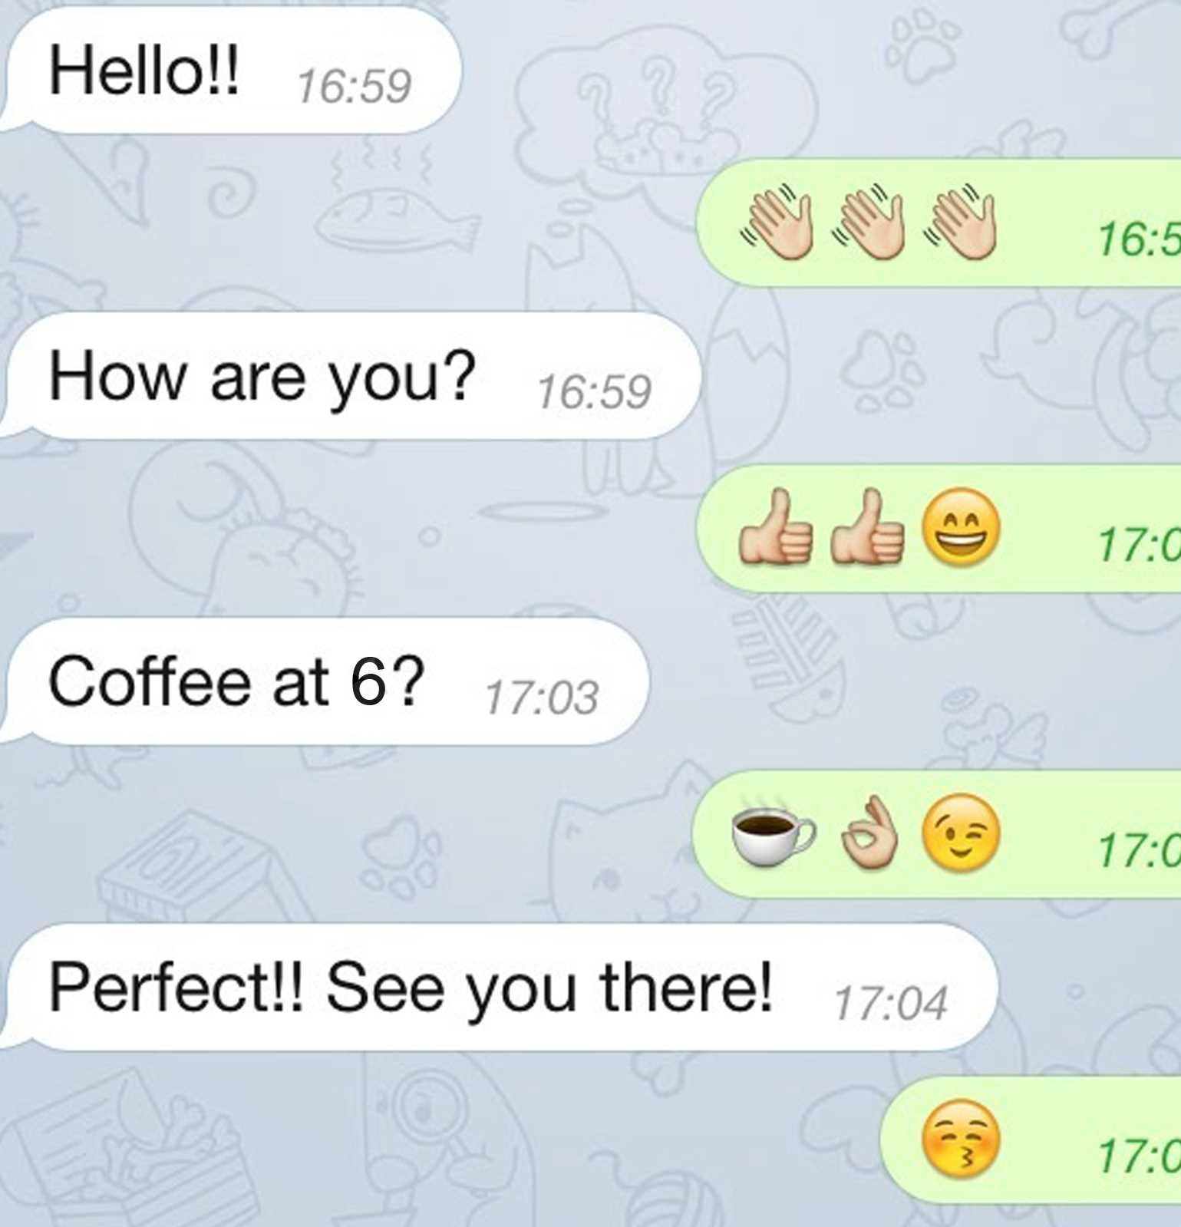
Text Messages
Text messages are used for informal communication, mostly between individuals.
Be aware of the time of day when you are sending text messages.
Notes:
READ:
Text messages are used for informal communication, mostly between individuals. Be aware of the time of day when you are sending text messages.
Possible questions for further discussion:
Do you use text messages?
How do you use them?
---
Image source: PowerPoint Stock Images

Slide 16
Questions?
Notes:
READ:
Questions?
---
Image source: PowerPoint Designer

Slide 17
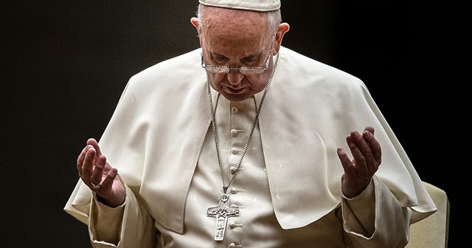
Closing Prayer
May the Lord Jesus, the pure Word poured out from the heart of the Father, help us to make our communication clear, open and heartfelt.
May the Lord Jesus, the Word made flesh, help us listen to the beating of hearts, to rediscover ourselves as brothers and sisters, and to disarm the hostility that divides.
May the Lord Jesus, the Word of truth and love, help us speak the truth in charity, so that we may feel like protectors of one another.
(Pope Francis)
Notes:
READ:
Closing Prayer:
“May the Lord Jesus, the pure Word poured out from the heart of the Father, help us to make our communication clear, open and heartfelt.
May the Lord Jesus, the Word made flesh, help us listen to the beating of hearts, to rediscover ourselves as brothers and sisters, and to disarm the hostility that divides.
May the Lord Jesus, the Word of truth and love, help us speak the truth in charity, so that we may feel like protectors of one another” (Pope Francis).
---
Prayer source: “Message of His Holiness Pope Francis for the 57th World Day of Social Communications.” vatican.va/content/francesco/en/messages/communications/documents/20230124-messaggio-comunicazioni-sociali.html
Image source: PowerPoint Stock Images

