Slide 1
Principles of Effective Communication
Module 2
Notes:
Module 2: Principles of Effective Communication
Approximate time: 13 minutes (without discussion)
---
Image source: PowerPoint Designer

Slide 2
Opening Prayer
Let us pray, (Pause)... Let us be still and recognize the presence of God with us and in us.
In the name of the Father, and of the Son, and of the Holy Spirit,
Good and loving God, our source of love and light,
Thank You for bringing us together today in a spirit of generosity.
We offer You this prayer in gratitude.
May we honour one another by keeping an open mind.
May we voice our truth and listen with an open heart.
May we discern Your will to unite us in a fruitful outcome.
We ask for Your wisdom and grace to use our talents for the betterment of others.
With the guidance of the Holy Spirit,
And the loving intercession of Our Lady of Good Counsel,
Through Christ our Lord,
In the name of the Father, and the Son and the Holy Spirit,
Amen.
Notes:
READ:
Opening Prayer:
Let us pray,
(Pause)... Let us be still and recognize the presence of God with us and in us.
In the name of the Father, and of the Son, and of the Holy Spirit,
Good and loving God, our source of love and light,
Thank You for bringing us together today in a spirit of generosity.
We offer You this prayer in gratitude.
May we honour one another
By keeping an open mind.
May we voice our truth
And listen with an open heart.
May we discern Your will
To unite us in a fruitful outcome.
We ask for Your wisdom and grace
To use our talents for the betterment of others.
With the guidance of the Holy Spirit,
And the loving intercession of Our Lady of Good Counsel,
Through Christ our Lord,
In the name of the Father, and the Son and the Holy Spirit,
Amen.
Prayer source: “Opening Prayer for a Meeting,” Prayers and Spiritual Programs, The Catholic Women’s League of Canada

Slide 3
Written Communication
These principles apply to any written communications, including reports, communiqués, memos, newsletters, emails and text messages.
Notes:
READ:
Written Communication: These principles apply to any written communications, including reports, communiqués, memos, newsletters, emails and text messages.
---
Image source: PowerPoint Designer

Slide 4
Keep it Clear and Simple
Use simple sentence structures and vocabulary.
Be specific by using precise terms and being factual.
Use short sentences that contain one complete thought.
Keep to one topic in each paragraph.
Omit words that do not convey valuable information.
Notes:
READ:
Keep it clear and simple:
Use simple sentence structures and vocabulary.
Be specific by using precise terms and being factual.
Use short sentences that contain one complete thought.
Keep to one topic in each paragraph.
Omit words that do not convey valuable information.
---
Image source: PowerPoint Designer

Slide 5
Use Active Voice
Examples
Incorrect: The luncheon was catered by the president.
Correct: The president catered the luncheon.
Notes:
READ:
Use active voice—it has a direct, clear tone. For most writing, the active voice is a more effective way to communicate ideas, themes and facts. The one League exception is minutes, which should be expressed in a passive voice.
Examples:
Incorrect: The luncheon was catered by the president.
Correct: The president catered the luncheon.
Invite participants to offer other examples.
Definitions:
Active Voice: The active voice focuses on the person who performs an action. For example, the president chaired the meeting.
Passive Voice: The focus of the passive voice is the object being acted upon. For example, the meeting was chaired by the president.

Slide 6
Avoid jargon, idioms, pronouns, acronyms and cultural references.
Incorrect: Within the League (jargon), actions speak louder than words (idiom), especially when we (pronoun), the members of the CWL (acronym), advocate Catholic social teaching (cultural reference).
Correct: Within the Catholic Women’s League (CWL), members strive to live their Catholic values and to reach out to those in need.
Note: When acronyms are used, the first reference in the document should have the name written out in full, with the acronym following in parenthesis. For example: the Catholic Women’s League (CWL).
Notes:
READ:
Avoid jargon, idioms, acronyms and cultural references when speaking to those outside the League.
Incorrect: Within the League (jargon), actions speak louder than words (idiom), especially when we (pronoun), the members of the CWL (acronym), advocate Catholic social teaching (cultural reference).
Correct: Within the Catholic Women’s League, members strive to live their Catholic values and to reach out to those in need.
When acronyms are used, the first reference in the document should have the name written out in full, with the acronym following in parenthesis. An example is the Catholic Women’s League (CWL).
Definitions
Jargon: Special words or expressions used by a particular profession or group that are difficult for others to understand, such as due diligence or hard copy. For example, within The Catholic Women’s League of Canada, we often refer to the League. This may not mean anything to anyone outside the organization.
Idiom: Phrases established by usage as having a meaning different from the literal meaning of the words or phrases, such as “raining cats and dogs,” meaning raining heavily, or “when pigs fly,” meaning never. Within the League, we have sometimes heard someone say, “Actions speak louder than words” or “Leave no stone unturned.”
Pronoun: The use of first and second person pronouns as substitutes for proper nouns, e.g., “I”, “me” “we”, “you” is not appropriate in a formal communication, but may be appropriate for workshops and other informal documents.
Acronym: This is an abbreviation formed from the initial letters of other words and pronounced as a word, for example, CWL (Catholic Women’s League) and WUCWO (World Union of Catholic Women’s Organisations).
Cultural References: Ideas that relate to a specific culture; things that only someone who understands a specific culture could understand. For example, our reference to Catholic social teaching.

Slide 7
Structure the Writing
Put important things first.
Develop a clear and logical structure.
Ensure that the opening sentence engages the reader and explains the importance of the message.
Notes:
READ:
Structure the writing:
Put important things first.
Develop a clear and logical structure.
Ensure that the opening sentence engages the reader and explains the importance of the message.
In simple terms, introduce the topic, explain it, including any required action, and summarize it.
Include who, what, where, when and why.
Avoid strong claims and hype.
Do not use absolutes like always or never.
Definitions
Strong Claim: Making a claim that is specific and debatable. For example, The Catholic Women’s League of Canada is the largest Catholic women’s organization in Canada.
Hype: Exaggerating the importance, quality or benefit of something. For example, The Catholic Women’s League of Canada is the only organization of women in Canada.
---
Image source: PowerPoint Designer

Slide 8
Spelling and Punctuation
Pay attention to spelling and grammar.
Use proper punctuation.
Notes:
READ:
Spelling and Punctuation:
Pay attention to spelling and grammar.
Use proper punctuation.
---
Image source: PowerPoint Designer

Slide 9
Use Formatting to Aid Understanding
Fonts should be easy to read.
Limit to one or two commonly used fonts.
Tables and figures are very valuable for organizing and communicating data in a way that makes it easy for a reader to understand, analyze and interpret.
Notes:
READ:
Use Formatting to Aid Understanding:
Fonts should be easy to read.
Limit to one or two commonly used fonts.
Tables and figures are valuable for organizing and communicating data in a way that makes it easy for a reader to understand, analyze and interpret.
Definition
Font: A set of letters, numbers and symbols in a specific style and size. For example, Times New Roman, 12-point.

Slide 10
Verbal Communication
How something is communicated is as important as the content of the message.
Tone – vary voice strength, tone or pitch according to the subject and audience (formal, informal, enthusiastic, humorous).
Volume – use appropriate volume for the space and audience.
Speed – use moderate speed, slightly slower than regular conversational speech.
Notes:
READ:
Non-Verbal Communication: How something is communicated is as important as the content of the message.
Tone – vary voice strength, tone or pitch according to the subject and audience (formal, informal, enthusiastic, humorous).
Volume – use appropriate volume for the space and audience.
Speed – use moderate speed, slightly slower than regular conversational speech.
---
Image source: PowerPoint Designer

Slide 11
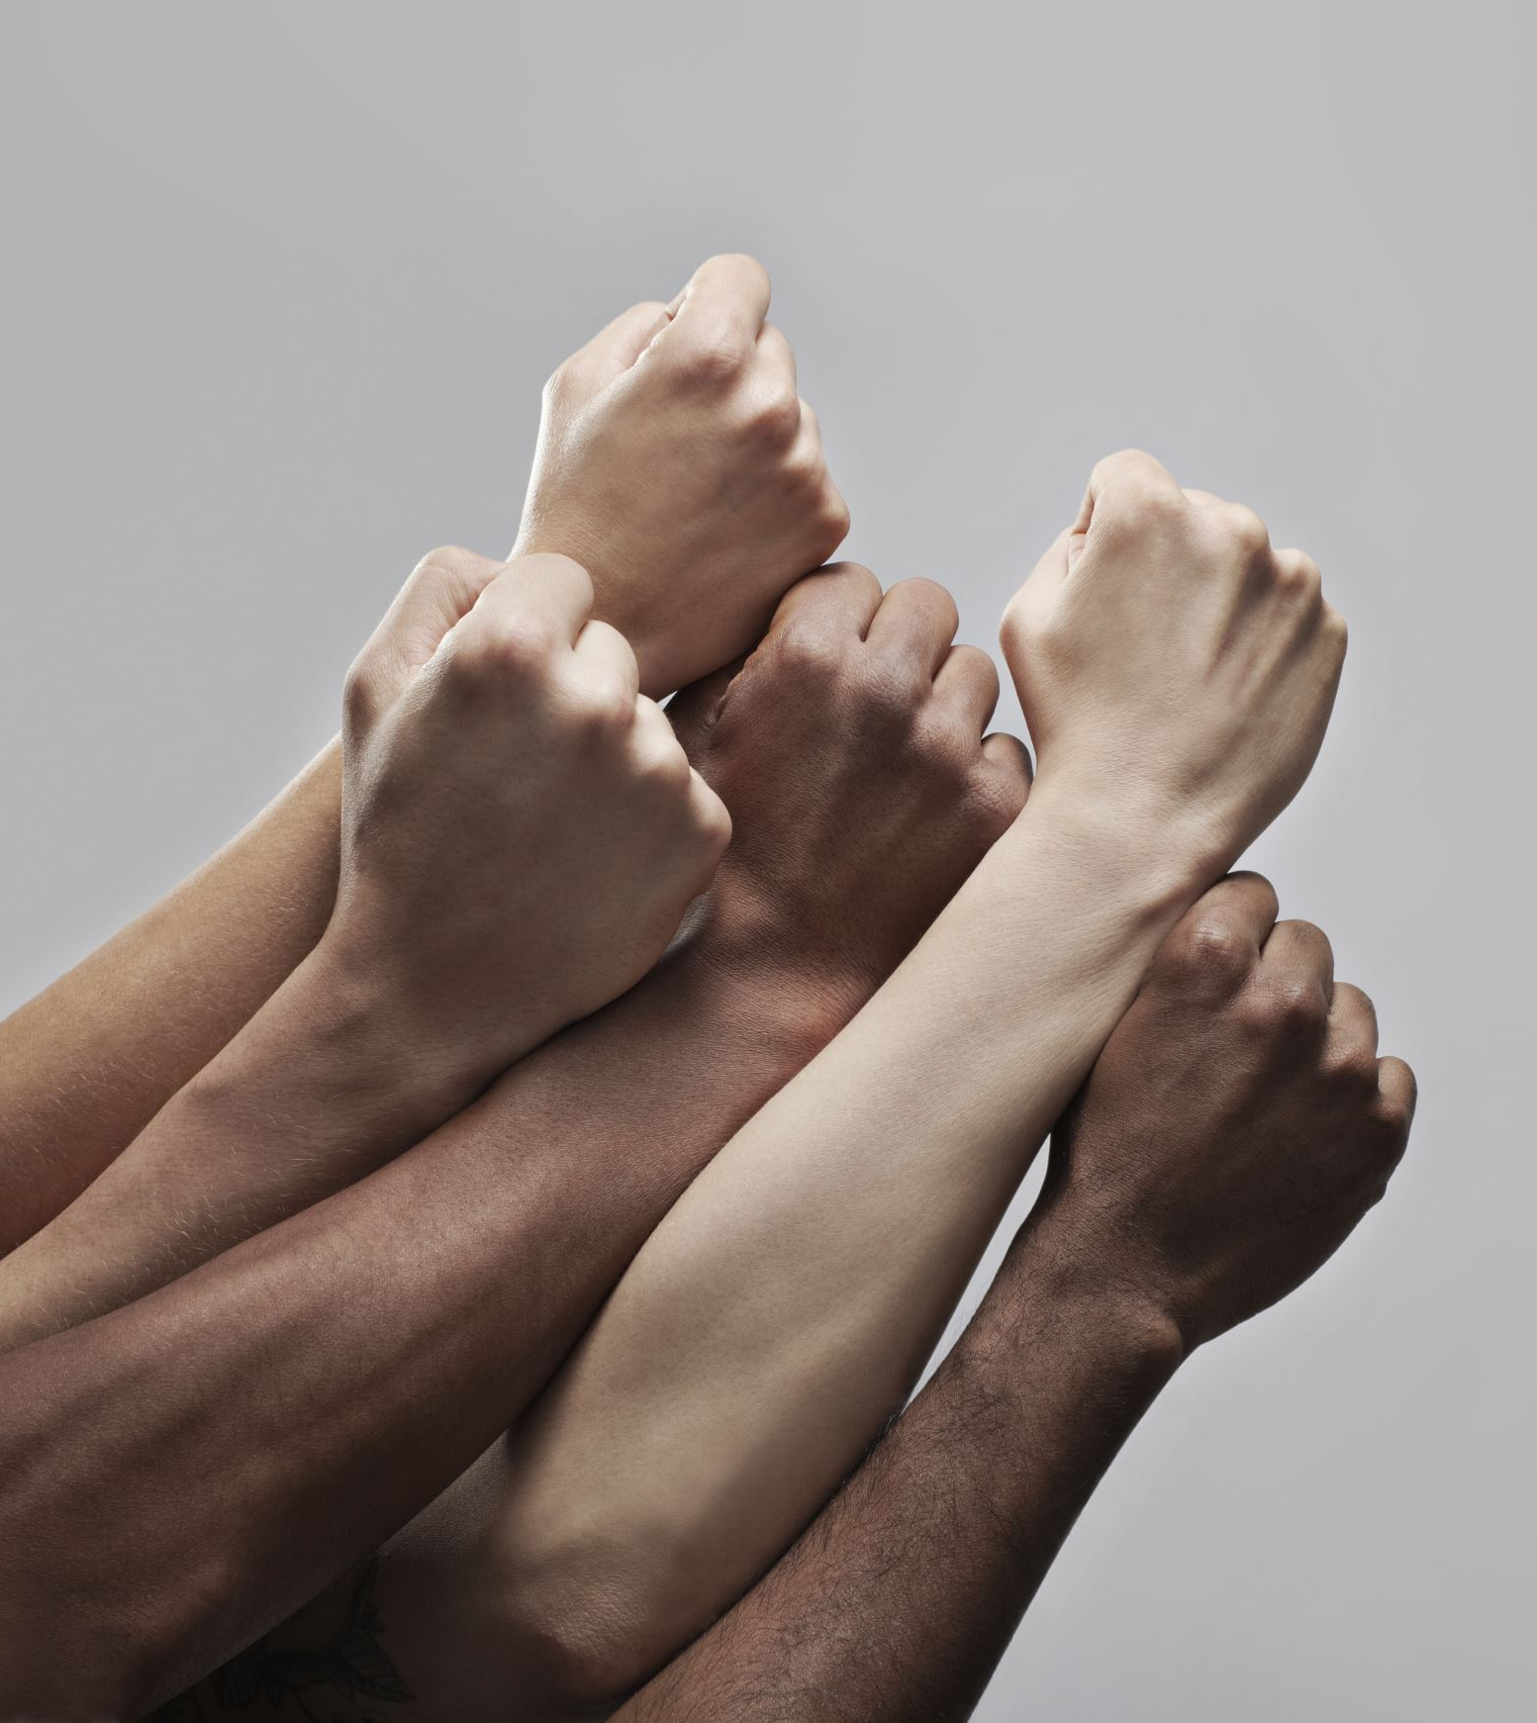
Body Language
Body language is the use of physical behaviour, expressions and mannerisms to communicate non-verbally.
It is often done instinctively rather than consciously.
Facial expressions can communicate a wealth of emotion.
When you interact with others, you’re continuously giving and receiving wordless signals. Be aware of the messages you are sending.
Notes:
READ:
Body Language:
Body language uses physical behaviour, expressions and mannerisms to communicate non-verbally.
It is often done instinctively rather than consciously.
Facial expressions can communicate a wealth of emotion.
When you interact with others, you’re continuously giving and receiving wordless signals. Be aware of the messages you are sending.
Ask for examples of body language from the audience to illustrate these points.
---
Image source: PowerPoint Designer

Slide 12
Eye Contact
Some cultures encourage eye contact when speaking with others.
Other cultures do not.
Notes:
READ:
Eye Contact: Some cultures encourage eye contact when speaking with others, while others do not.
Possible questions for discussion:
Will this difference impact how you make eye contact when presenting or speaking to a diverse group?
What might be “appropriate” eye contact for different cultures?
---
Image source: PowerPoint Designer

Slide 13
Gestures and Movement
Be aware of your gestures and movement and use both appropriately.
Finger-pointing at people should be avoided.
Large gestures may be used to make a specific point.
Notes:
READ:
Gestures and Movement:
Be aware of your gestures and movements and use both appropriately.
Finger-pointing at people should be avoided.
Large gestures may be used to make a specific point.
Again, we could make some references to different cultures.

Slide 14
Physical Space and Touch
It is important to respect everyone’s personal space and boundaries.
Ask permission before touching someone.
Notes:
READ:
Physical Space and Touch:
It is important to respect everyone’s personal space and boundaries.
Ask permission before touching someone.
Possible questions for discussion:
Are there exceptions to these rules?
Can you think of specific examples of how this may apply in different cultures?
What about between women and men?
Adults and children?
---
Image source: PowerPoint Designer

Slide 15
Presentations
The national website, cwl.ca, has resources for presentations.
These include the Train the Trainer Guide and the “Public Presence and Member Development” module of the Executive Orientation.
Notes:
READ:
The national website, cwl.ca, has resources for presentations. These include the Train the Trainer Guide and the “Public Presence and Member Development” module of the Executive Orientation.
---
Image source: PowerPoint Stock Images

Slide 16
Listening Skills
Active listening includes responses that demonstrate that you understand what the other person is trying to tell you about his or her experience.
Active listening is designed to encourage respect and understanding. You are gaining information and perspective.
When communicating, practice using active listening skills. Pay attention and show that you are listening.
Notes:
READ:
Listening Skills: Active listening exercises could include any combination of the following:
Active listening includes responses that demonstrate that you understand what the other person is trying to tell you about his or her experience.
Active listening is designed to encourage respect and understanding. You are gaining information and perspective.
When communicating, practice using active listening skills. Pay attention and show that you are listening.
In a synodal church, active listening will become an even more important skill as we learn how to listen to others in our faith communities.
---
Image source: PowerPoint Stock Images

Slide 17
What Are Some Active Listening Skills?
Give the speaker your undivided attention.
Maintain appropriate eye contact.
Nod and smile occasionally.
Keep your posture open and interested.
Encourage the speaker with small verbal comments like “yes” and “uh huh.”
Provide feedback by paraphrasing, such as, “What I'm hearing is...” or “Sounds like you are saying...”
Ask questions to clarify “What do you mean when you say...” or “Is this what you mean…?”
Be candid, open and honest in your response.
Assert your opinions respectfully.
Notes:
READ:
Active Listening Skills: Invite the participants to suggest listening skills.
Give the speaker your undivided attention.
Maintain appropriate eye contact.
Nod and smile occasionally.
Keep your posture open and interested.
Encourage the speaker with small verbal comments like “yes” and “uh huh.”
Provide feedback by paraphrasing, such as, “What I'm hearing is...” or “Sounds like you are saying...”
Ask questions to clarify “What do you mean when you say...” or “Is this what you mean…?”
Be candid, open and honest in your response.
Assert your opinions respectfully.

Slide 18
Listening Skills Exercise
Notes:
Practice listening: Break the group into pairs. Have each pair sit facing each other. Each member in the pair takes turns answering a question and having the other listen.
Offer a question or prompt. Examples include:
What is something you are grateful for today?
What is your favourite League moment?
What is your favourite bible quote? Where is it from?
What is the most important part of life to you?
After the exercise, get the participants to volunteer answers to the following.
READ:
Did you find yourself thinking about your answer rather than listening?
Were you able to be present with the person who is sharing?
Are you uncomfortable with the silences?
---
Image source: PowerPoint Designer

Slide 19
Questions?
Notes:
READ:
Questions?
---
Image source: PowerPoint Designer

Slide 20
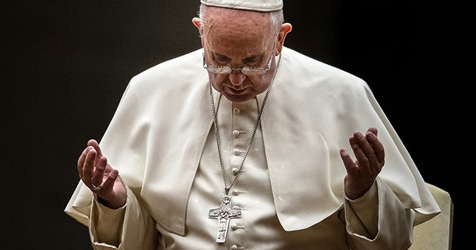
Closing Prayer
May the Lord Jesus, the pure Word poured out from the heart of the Father, help us to make our communication clear, open and heartfelt.
May the Lord Jesus, the Word made flesh, help us listen to the beating of hearts, to rediscover ourselves as brothers and sisters, and to disarm the hostility that divides.
May the Lord Jesus, the Word of truth and love, help us speak the truth in charity, so that we may feel like protectors of one another.
(Pope Francis)
Notes:
READ:
Closing Prayer:
“May the Lord Jesus, the pure Word poured out from the heart of the Father, help us to make our communication clear, open and heartfelt.
May the Lord Jesus, the Word made flesh, help us listen to the beating of hearts, to rediscover ourselves as brothers and sisters, and to disarm the hostility that divides.
May the Lord Jesus, the Word of truth and love, help us speak the truth in charity, so that we may feel like protectors of one another” (Pope Francis).
---
Prayer source: “Message of His Holiness Pope Francis for the 57th World Day of Social Communications.” vatican.va/content/francesco/en/messages/communications/documents/20230124-messaggio-comunicazioni-sociali.html
Image source: PowerPoint Stock Images

