Slide 1
Members’ Communication Guide
A Familiarization Workshop
Notes:
Members’ Communication Guide: A Familiarization Workshop
Approximate time for all modules: 50 minutes
Based on the information in the Members’ Communication Guide, this workshop will review the basics of communication and help you to share them with your members.
---
Image source: PowerPoint Stock Images

Slide 2
Introduction
Module 1
Notes:
Module 1: Introduction
Approximate time: Eight minutes (without discussion)
---
Image source: PowerPoint Stock Images

Slide 3
Opening Prayer
Let us pray, (Pause)... Let us be still and recognize the presence of God with us and in us.
In the name of the Father, and of the Son, and of the Holy Spirit,
Good and loving God, our source of love and light,
Thank You for bringing us together today in a spirit of generosity.
We offer You this prayer in gratitude.
May we honour one another by keeping an open mind.
May we voice our truth and listen with an open heart.
May we discern Your will to unite us in a fruitful outcome.
We ask for Your wisdom and grace to use our talents for the betterment of others.
With the guidance of the Holy Spirit,
And the loving intercession of Our Lady of Good Counsel,
Through Christ our Lord,
In the name of the Father, and the Son and the Holy Spirit,
Amen.
Notes:
READ:
Opening Prayer:
Let us pray,
(Pause)... Let us be still and recognize the presence of God with us and in us.
In the name of the Father, and of the Son, and of the Holy Spirit,
Good and loving God, our source of love and light,
Thank You for bringing us together today in a spirit of generosity.
We offer You this prayer in gratitude.
May we honour one another
By keeping an open mind.
May we voice our truth
And listen with an open heart.
May we discern Your will
To unite us in a fruitful outcome.
We ask for Your wisdom and grace
To use our talents for the betterment of others.
With the guidance of the Holy Spirit,
And the loving intercession of Our Lady of Good Counsel,
Through Christ our Lord,
In the name of the Father, and the Son and the Holy Spirit,
Amen.
---
Prayer source: “Opening Prayer for a Meeting,” Prayers and Spiritual Programs, The Catholic Women’s League of Canada

Slide 4
Background to Developing the Guide and Workshop
Strategy G1.F1: Improve, streamline, and expedite internal and external communication
Notes:
READ:
Background to Developing the Guide and Workshop: As part of the five-year strategic plan, the effective communication working group was assigned strategy G1.F1 Improve, streamline, and expedite internal and external communications.
---
Image source: PowerPoint Designer

Slide 5
A Three-Year Project
Collated and analyzed internal and external communication methods
Reviewed governing regulations
Conducted research – annual report and general survey
Collated over 1,300 responses
Conducted focus group studies
This Photo by Unknown Author is licensed under CC BY-SA
Notes:
READ:
The working group started in September 2021. The group:
collated and analyzed internal and external communication methods currently used by members.
reviewed governing regulations regarding communication.
created a set of questions that were included in the annual reports to evaluate the status of communication within the League.
created a general survey that resulted in more than 1,300 responses.
The final version was then further reviewed in a set of focus groups consisting of general members.
---
Image source: PowerPoint Designer

Slide 6
Purpose and Scope
Increase the effectiveness of communication within and from the League.
Help improve, streamline and expedite internal and external communications.
Notes:
READ:
The purpose and scope of the guide are to:
increase the effectiveness of communication within and from the League.
help improve, streamline and expedite internal and external communications.
---
Image source: PowerPoint Designer

Slide 7
Goals of Communication
Create a relationship and emotional engagement with an audience.
Convey information and instructions in a clear, concise and timely manner.
Assign and distribute tasks.
Establish a way to receive feedback.
Notes:
READ:
The goals of communication are to:
create a relationship and emotional engagement with an audience
convey information and instructions in a clear, concise and timely manner
assign and distribute tasks
establish a way to receive feedback
---
Image source: PowerPoint Designer

Slide 8
Major Facets of Communication
The three major facets to communication are:
content
process
audience
Notes:
READ:
The three major facets of communication are:
content
process
audience
---
Image source: PowerPoint Designer

Slide 9
Content
What is the purpose of the content you are creating?
Information, i.e., a report on an event that took place.
Background for a decision that will need to be made?
Is it a call to action?
Anticipate and answer common questions on the content.
Notes:
READ:
Content:
What is the purpose of the content you are creating?
Is it for information only? For example, a report on an event that took place.
Is it background for a decision that will need to be made?
Is it a call to action?
Try to anticipate and answer common questions on the content.
Optional Discussion: What questions do you need to ask yourself about the content before creating it?

Slide 10
Process
How are you going to communicate this information?
When are emails sent, and who is included?
When an email is received, is an acknowledgement returned?
Who will reply to common questions?
Notes:
READ:
Process: What process will you be using? Ask for feedback from the audience. Some possible points for discussion include:
How are you going to communicate this information?
When are emails sent, and who is included?
When an email is received, is an acknowledgement returned?
Who will reply to common questions?

Slide 11
Audience
An audience is a person or a group of people who reads a particular communication or attends a presentation.
Before preparing any communication, determine your audience and decide which communication style to use.
Notes:
READ:
An audience is a person or group who reads a particular communication or attends a presentation. Before preparing any communication, determine your audience and decide which communication style to use.
---
Image source: PowerPoint Designer

Slide 12
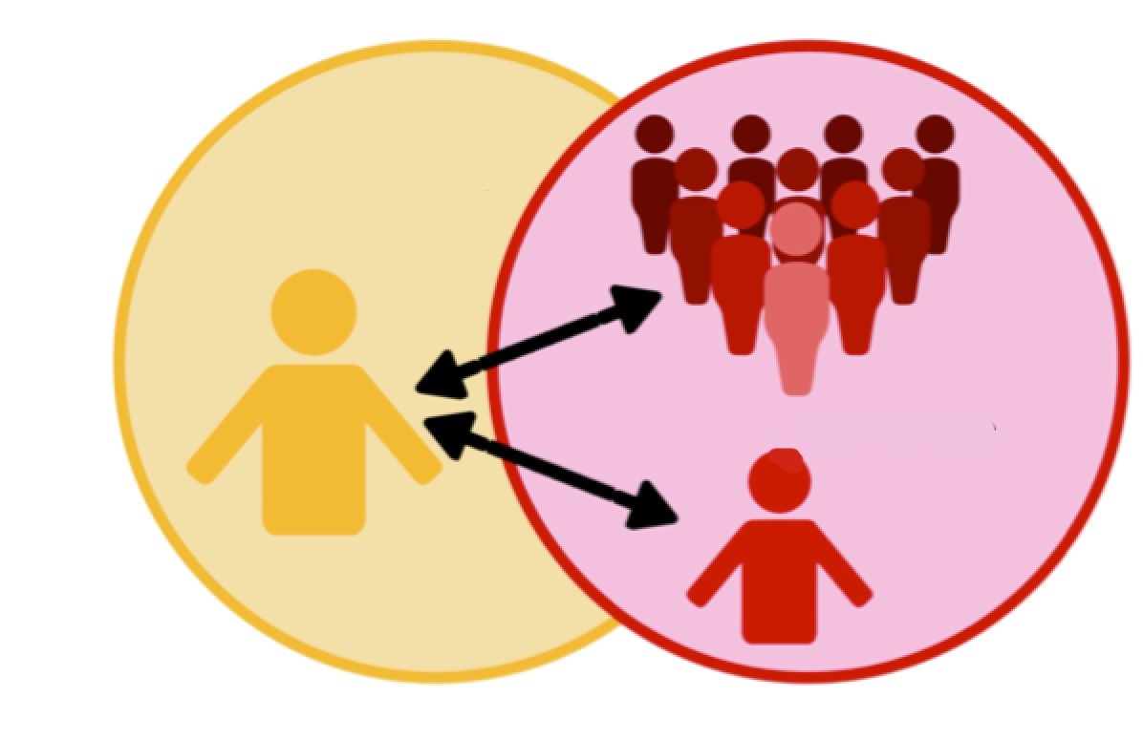
Audience
Who are they?
How much do they know about the subject?
How will it benefit them?
What format would they prefer?
Notes:
READ:
Before preparing any communication, you must determine who your audience is. This will determine your communication style. Some questions you might ask are:
Who are they?
How much do they know about the subject?
How will it benefit them?
What format would they prefer?
---
Image source: PowerPoint Designer

Slide 13
Know the Audience
Who are they?
To what demographics do they belong?
What level of information do they have about the subject?
What is the context of the information?
What is the benefit for the audience?
What format do they prefer to receive information in? (I.e., memo, email, text, magazine, formal presentation.)
Notes:
READ:
Know the audience. What possible questions could be asked?
Who are they?
To what demographics do they belong?
What level of information do they have about the subject?
What is the context of the information?
What is the benefit for the audience?
What format do they prefer to receive information in? (I.e., memo, email, text, magazine, formal presentation.)
Ask participants for other suggestions of questions that could be asked.
---
Image source: PowerPoint Designer

Slide 14
Types of Audiences
Those with no special or expert knowledge.
May need more background.
Will expect more definitions, examples or visuals.
Those with specific or expert knowledge.
Style and content may be specialized or technical.
Jargon may be appropriate only with experts.
Notes:
READ:
Knowing the audience will help you to tailor your communication. Those with no special or expert knowledge may need more background information and will expect more definitions, examples or visuals. For those with specific or expert knowledge, the style and content may be specialized or technical, and jargon may be appropriate.
---
Image source: PowerPoint Stock Images

Slide 15
Additional Considerations
Be aware of the customs, arts, social institutions and achievements of the different cultural groups that belong to the community.
Ask members for their preferred communication methods and balance that with the available time, skills and energy.
Notes:
READ:
Additional Considerations:
Be aware of the customs, arts, social institutions and achievements of the different cultural groups that belong to the community.
Ask members for their preferred communication methods and balance that with the available time, skills and energy.
Let’s break into small groups of no more than four to discuss either of these points. After five minutes, share as a large group.
---
Image source: PowerPoint Designer

Slide 16
Questions?
Notes:
READ:
The next modules will clarify some of the topics; however, do you have any questions now that we can address?
---
Image source: PowerPoint Stock Images

Slide 17
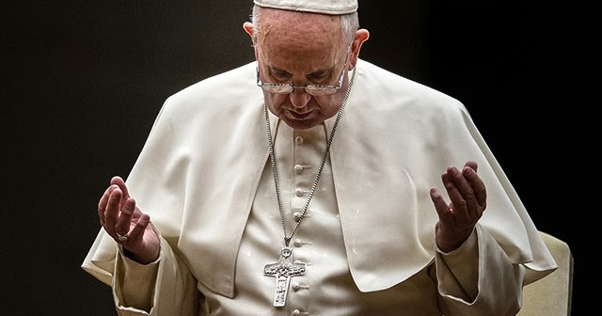
Closing Prayer
May the Lord Jesus, the pure Word poured out from the heart of the Father, help us to make our communication clear, open and heartfelt.
May the Lord Jesus, the Word made flesh, help us listen to the beating of hearts, to rediscover ourselves as brothers and sisters, and to disarm the hostility that divides.
May the Lord Jesus, the Word of truth and love, help us speak the truth in charity, so that we may feel like protectors of one another.
(Pope Francis)
Notes:
READ:
Closing Prayer:
“May the Lord Jesus, the pure Word poured out from the heart of the Father, help us to make our communication clear, open and heartfelt.
May the Lord Jesus, the Word made flesh, help us listen to the beating of hearts, to rediscover ourselves as brothers and sisters, and to disarm the hostility that divides.
May the Lord Jesus, the Word of truth and love, help us speak the truth in charity, so that we may feel like protectors of one another” (Pope Francis).
---
Prayer source: “Message of His Holiness Pope Francis for the 57th World Day of Social Communications.” vatican.va/content/francesco/en/messages/communications/documents/20230124-messaggio-comunicazioni-sociali.html
Image source: PowerPoint Stock Images

