Slide 1
Mentoring Workshop Before You Start
Presentation Time: Approximately 50–60 minutes.
Practice, practice, practice!​
Print the PowerPoint presentation using the print layout called “Notes Pages” so that you know what to say with each slide.​ Consider putting these pages into a binder or folder so you do not lose track of the order during the presentation.
If having a small group discussion and using Zoom, prepare the breakout rooms beforehand. If in person, have paper available on each table.
If using Zoom, you may want a cohost to monitor the chat, hands up, answers to questions, etc. ​
Ask everyone to mute before you start and tell people how you want them to let you know when they want to speak—raising hands (really or by using the icon), unmuting or something else.​
The presentation time will vary depending on how much sharing you allow.​ Depending on how quickly things move along, you may decide to arrange for a health break.
Move this presentation to the next slide, ready to start.​
Notes:
This information is to be reviewed by the presenter ahead of time.

Slide 2
Mentoring Workshop
The Catholic Women’s League of Canada
Notes:
READ:
Welcome everyone to The Catholic Women’s League of Canada’s Mentoring Workshop! Mentoring has been around for a long time, and as you will discover through this workshop today, it is also a wonderful opportunity to develop and share our God-given gifts. We hope that you will all enjoy today’s workshop. We will now begin in prayer.
---
Image source: Clipart-library.com

Slide 3
Opening Prayer
Father, Creator God, Who formed us in Your image and gifted us.
Jesus, Saviour God, Who came and walked with us and showed us the way.
Holy Spirit, Who inspires us and gives us courage to be all that we can be,
we ask that You bless us today as we come together, to prayerfully discern
our gifts, and open our hearts to Your invitation to use these gifts as
we continue to journey as members of the League, in our service to God
and to all of God’s people.
Glory be to the Father, the Son and the Holy Spirit; as it was in the beginning,
is now and ever shall be, world without end, through Christ, Our Lord.
AMEN
Notes:
READ:
Be still within and without. Let us place ourselves in the presence of the Lord. God is here with us now as we pray together.
Ask everyone to join in prayer.
Father, Creator God, Who formed us in Your image and gifted us.
Jesus, Saviour God, Who came and walked with us and showed us the way.
Holy Spirit, Who inspires us and gives us courage to be all that we can be,
we ask that You bless us today as we come together, to prayerfully discern
our gifts, and open our hearts to Your invitation to use these gifts as
we continue to journey as members of the League, in our service to God
and to all of God’s people.
Glory be to the Father, the Son and the Holy Spirit; as it was in the beginning,
is now and ever shall be, world without end, through Christ, Our Lord.
AMEN
---
Prayer source: Workshop 817 – Mentoring: A Workshop

Slide 4
Agenda
Welcome/Opening Prayer/Introductions
2. What is a Mentor?
3. What Does Mentorship Mean to You?
4. Qualities of a Good Mentor and Good Mentee
5. Benefits of Mentoring?
6. Mentoring = Discipleship
7. Is this Situation Mentoring?
8. Tips for Effective Mentoring/Skills of a Good Mentor
9. Mentoring in the League
10. Wrap Up and Closing Prayers
Notes:
READ:
Today, we will explore the meaning of mentorship. This is the agenda for this workshop, which lists the items we will review:
Welcome/Opening Prayer/Introductions
What is a Mentor?
What Does Mentorship Mean to You?
Qualities of a Good Mentor and Good Mentee.
Benefits of Mentoring?
Mentoring = Discipleship
Is this Situation Mentoring?
Tips for Effective Mentoring/Skills of a Good Mentor
Mentoring in the League
Wrap Up and Closing Prayers

Slide 5
Introductions
Hi, my name is…
And I am pretty good at…
Notes:
Interactive Exercise/Icebreaker: Approximately 5 minutes.
If in person, it is suggested that people sit in groups and introduce themselves to the people at their table.
If online, ask people to raise their hand and introduce themselves (time permitting/number of attendees).
READ:
To begin our workshop today, I would like to take a few minutes for everyone to introduce themselves. I would like each of you to introduce yourselves by saying, “Hi, my name is _____________________, and I think I am pretty good at __________________.” If you want to add more than one thing you think you are good at, feel free to toot your own horn!
After the exercise:
I hope everyone enjoyed meeting or getting to know a little more about each other. Isn’t it wonderful to know you’re in the company of such talented women?
---
Image source: Microsoft 365 Stock Images

Slide 6
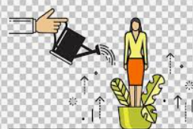
What is a Mentor?
Definition of a Mentor
A mentor is an experienced and trusted advisor who provides guidance,
encouragement and support to
develop someone with less experience.
Notes:
READ:
We will now start with the definition of a mentor: A mentor is an experienced and trusted advisor who provides guidance, encouragement and support to develop someone with less experience.
Sound complicated? Today our goal is to help you better understand the role of a mentor and simplify what a mentor is.
---
Image source: Clipart-library, PowerPoint Stock Images

Slide 7
What Does Mentorship Mean to You?
Notes:
Group exercise: Approximately 10 minutes.
READ:
We have covered the “official” definition of a mentor; however, what does mentorship mean to you?
If presenting online, ask the participants to use a paper to jot down some of the answers to the questions below.
If presenting in person: Please take 10 minutes to share what mentorship means to you, considering the following?
Have you had a special someone in your life that you think of as a mentor?
What did that person do or say that made a difference in your life?
Share a story of a mentoring experience from your past.
If time allows, ask participants to share their experiences. The presenter can share a personal mentoring experience from their past to get things started.

Slide 8
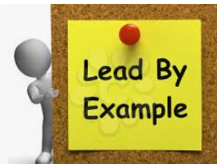
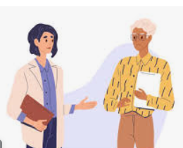
Qualities of a Good Mentor
Relevant expertise or knowledge.
Enthusiasm for sharing that expertise.
A respectful attitude.
Eager to invest in others.
Ability to give honest and direct feedback.
Active listening and empathy.
Willing to be a sponsor.
Notes:
READ:
Now that we’ve defined what a mentor is and what mentorship means to you let’s review some of the qualities a good mentor may possess.
Relevant expertise or knowledge: A good mentor has relevant expertise or knowledge on a specific subject or activity. This can be expertise in a specific area of the League or someone who knows how to plan an event, such as funeral receptions, bazaars or other fundraisers.
Enthusiasm for sharing that expertise: Someone who is happy to help.
Someone with a respectful attitude: Someone happy to share and help but without taking over.
Eager to invest in others: Someone who is happy to help and takes pride in someone else’s success.
The ability to give honest and direct feedback: Someone who can be honest and give constructive feedback without being hurtful.
Active listening and empathy: A good listener but guides with compassion.
Willing to be a sponsor: Someone willing to be your go-to person when you need encouragement and affirmation in your decisions.
---
Image source: freerangestock.com/photos/49590/lead-by-example-note-means-mentor-or-inspire.html and PowerPoint Stock Images

Slide 9
Qualities of a Good Mentee
Commitment to being mentored
Willing to receive objective and constructive feedback
Comfortable being stretched beyond a comfort zone
Clear and honest communication
Confidence and trust
Patient, responsive and respectful of mentor's role and time
Notes:
READ:
Now that we have reviewed some of the qualities of a good mentor let’s review what qualities a good mentee has. After all, the mentor-mentee relationship is a partnership with each person playing her part.
Commitment to being mentored: The mentee needs to be open to learning proactively and be motivated to succeed. If you’re not committed to your goal, no amount of mentoring can help.
Willing to receive objective and constructive feedback: The mentor may need to provide objective and constructive feedback. As the mentee, you need to be willing to hear that feedback, not take it personally, but use that information to help you succeed.
Comfortable being stretched beyond a comfort zone: At some point, you may be presented with a situation that stretches you beyond your comfort zone. As a mentee, you need to be willing to take on that challenge. This is how you continue to learn and grow.
Clear and Honest Communication: Be honest and let the mentor know if you don't understand something. Remember that your mentor is not a mind reader. They can only help you if you are honest about what you need.
Confidence and Trust: Have confidence in yourself and your decisions. However, you also need to have confidence and trust in your mentor.
Patient, responsive and respectful of mentor’s role and time: As a good mentee, you need to be respectful of your mentor’s time and confidences. Respect any personal confidences your mentor may share. Also be respectful of your mentor’s time. Respect that they do want to help you but may have other commitments to deal with as well.
---
Image source: PowerPoint Stock Images

Slide 10
Benefits of Mentoring
Mentoring is:
An opportunity to share and to experience
An opportunity to teach and learn
An opportunity to encourage and be encouraged
An opportunity to nurture and be nurtured
An opportunity to enable and be enabled
An opportunity to develop and share God-given gifts
Notes:
READ:
We have all been mentored, and all of us, perhaps without even knowing it, have probably done some mentoring. Sometimes, mentoring someone can seem like a lot of work. So, what are some of the benefits of mentoring someone?
Mentoring is:
An opportunity to share and to experience
An opportunity to teach and learn
An opportunity to encourage and be encouraged
An opportunity to nurture and be nurtured
An opportunity to enable and be enabled
An opportunity to develop and share God-given gifts
This list can be summarized with two main facts.
There is a lot of satisfaction in knowing that you are helping someone develop and grow.
As a mentor, you get just as much out of mentoring someone as your mentee.
---
Image source: PowerPoint Stock Images

Slide 11
Mentoring = Discipleship
The concept of mentoring is best described by the term “discipleship.”
Christ calls us to a relationship with Himself, but also into relationship with others.
Some of us sing, others dance; Some are excellent listeners, and some bake wonderful bread.
We are all gifted.
Notes:
READ:
The concept of mentoring is best described by the term “discipleship.”
Christ calls us to a relationship with Himself but also into relationships with others.
God has gifted us and asks us to share those gifts with others.
Some of us sing, others dance, some are excellent listeners, and some bake wonderful bread.
We are all gifted.
Activity: Allow about three minutes. If presenting in person, provide paper on the tables. If presenting online, ask the attendees to jot down their responses on paper of their own.
I would like you all to jot down at least five of your gifts.
After the allotted time… Look over your lists. These are some of the gifts you have been given by the Creator God, who asks you to use these gifts in service to others.
---
Image source: PowerPoint Stock Images

Slide 12
Is This A Mentoring Opportunity?
An elderly woman would like someone to help her write her family history.
“Sue” has just accepted the position of chairperson of social justice (or other position) and she is a relatively new member.
A family has moved into the parish and the mom would like to connect with other women in the parish.
Notes:
Activity:
If presenting in person, the attendees can discuss at their table or in groups.
If presenting online, breakout rooms can be used for the same purpose.
READ:
Next, we will review if you think each of these three situations is a mentoring opportunity. (Read each situation one at a time).
An elderly woman would like someone to help her write her family history.
“Sue” has just accepted the position of chairperson of social justice (or other position), and she is a relatively new member.
A family has moved into the parish, and the mom would like to connect with other women in the parish.
Now, I would like you to take a few minutes in your group to review each of these situations and discuss the question: What role could you play in each of these situations?
After five minutes, read each point and take one or two answers from the attendees.
---
Image source: PowerPoint Stock Images

Slide 13
Tips for Effective Mentoring
A mentor’s role is to guide, inspire, support and encourage their mentee.
Consider then what this might look like.
As a mentee, if you needed help or had a problem to resolve, what would you want from your mentor?
As a mentor, what would you do or say to help your mentee resolve a problem?
Notes:
READ:
This activity will be self-reflective. A mentor’s role is to guide, inspire and encourage their mentee. Consider then what this might look like.
Let’s take a few minutes to reflect on these two questions.
As a mentee, what would you want from your mentor if you needed help or had a problem to resolve?
As a mentor, what would you do or say to help your mentee resolve a problem?
I ask that you write down your thoughts about these two questions. (Give 3–5 minutes.)
I hope that everyone found that activity helpful. Everyone is different and may look at situations differently. Your needs and when you think you need help may differ greatly than someone else’s. I hope this time of reflection has helped you identify when you would reach out to someone for mentoring.

Slide 14
Important Skills for Mentors
Consider the following tips:
Listen
Encourage
Respect
Be non-judgemental
Inspire
Motivate
Notes:
READ:
If you find yourself in a situation where someone has asked you to mentor them, help them with a task or resolve a problem, then consider these tips:
Listen: Get clarity on what the mentee needs. Probe asking open-ended questions.
Encourage: Show genuine interest. Giving positive feedback helps to build confidence.
Respect: Offer advice and provide input and suggestions without taking over. This will also help develop trust in the relationship.
Be non-judgemental: Accept that everyone is different and will handle things differently.
Inspire: Share your experiences and insights. Sometimes, sharing your failures provides the biggest lessons.
Motivate: Celebrate and acknowledge achievements—this reaffirms good decision-making and motivates them to take on more roles in the future.
---
Image source: PowerPoint Stock Images

Slide 15
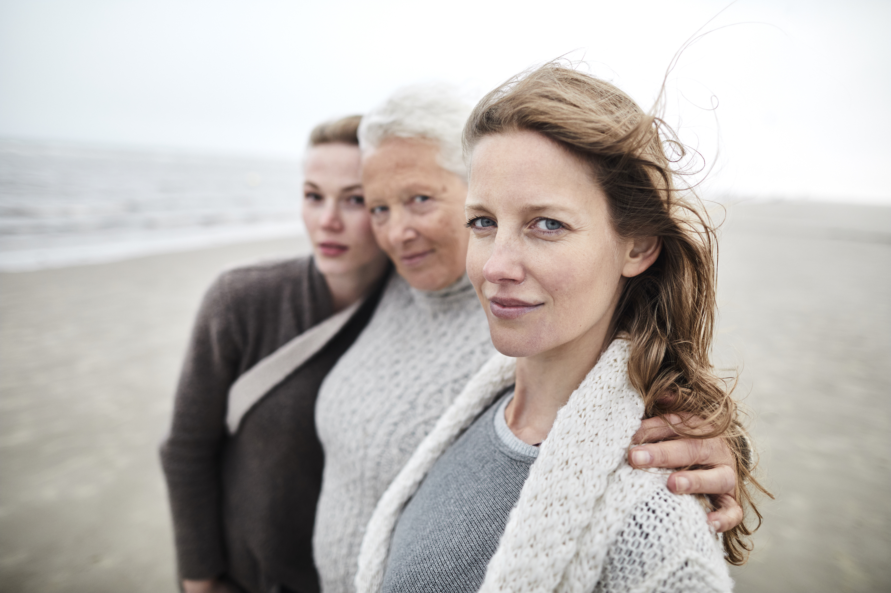
Mentoring in the League
Is mentoring part of the League’s story?
How could mentoring be used in parish councils?
How can mentoring be used at other levels of the League?
Notes:
READ:
Let’s review the role of mentoring in the League. Consider the following points one at a time, and please feel free to raise your hands to share your thoughts.
Do you believe that mentoring is part of the League’s story?
If YES – HOW? (If no one shares, share one of your own stories.) The League is more than one hundred years old. There have been many women who have gone before us, and we are here today, standing on the shoulders of those who have gone before us.
How could mentoring be used in parish councils?
Do you see a way mentoring would be helpful in your parish council? Examples may include with new members, new executive positions, new events or activities.
How can mentoring be used at other levels of the League?
At diocesan, provincial or national levels?
How can mentoring be effective at those other levels?
---
Image source: Microsoft Stock Images

Slide 16
Conclusion
“Your talent is God’s gift to you. What you do with it, is your gift back to God.” Leo Buscaglia
Mentoring is a significant role.
Creator God has gifted all of us.
Let us all prayerfully consider our response to Jesus’ invitation to help others.
Notes:
READ:
Mentoring is a significant role: Each of us faces or will face situations in which we are called to mentor, listen, respond compassionately and encourage.
Creator God has gifted all of us: We all have the opportunity to develop and use what we have been given. Next time you face that opportunity, the Lord would want you to say YES.
Let us all prayerfully consider our response to Jesus’ invitation to help others.
The greatest reward for a mentor is to see that person take on more active roles and grow in confidence.

Slide 17
Closing Prayer
A Prayer of Thanks for Godly Mentors
Thank You, Father, that You have guided me through my life and
blessed me with various spiritual mentors along the way.
Thank You for the men and women You have used throughout my Christian life
to teach and encourage me and to share their godly wisdom as well as their gentle correction.
Give me an understanding heart and a teachable spirit,
so that I may take to heart the spiritual lessons that You would have me learn,
and may I be used by You to fulfil the good works that You have prepared for me to do.
In Jesus' name I pray,
Amen.
Notes:
READ:
Now, please join me in reciting our closing prayer:
In the name of the Father…
A Prayer of Thanks for Godly Mentors
Thank You, Father, that You have guided me through my life and
blessed me with various spiritual mentors along the way.
Thank You for the men and women You have used throughout my Christian life
to teach and encourage me and to share their godly wisdom as well as their gentle correction.
Give me an understanding heart and a teachable spirit,
so that I may take to heart the spiritual lessons that You would have me learn,
and may I be used by You to fulfil the good works that You have prepared for me to do.
In Jesus' name I pray,
Amen.
---
Prayer source: A Prayer of Thanks for Godly Mentors, prayer.knowing-jesus.com/prayer/a-prayer-of-thanks-for-godly-mentors-1429

Slide 18
Thank You!
Notes:
READ:
Thank you all for taking the time to attend today.

