Slide 1
Joy of Leadership: discovering new opportunities Before You Start
Presentation Time: Approximately 45 minutes
This workshop can be presented in person or online.
Practice, practice, practice!
Print the PowerPoint presentation using the print layout called “Notes Pages” so that you know what to say with each slide.
You may want a co-host to monitor the chat, hands up, answers to questions, etc.
Ask everyone to mute before you start and tell people how you want them to let you know that they want to speak—raising hands (really or by using the icon), unmuting or something else.
Move this presentation to the next slide, ready to start.

Slide 2
THE Joy of Leadership
The Catholic Women’s League of Canada
Module 4:
Discovering New Opportunities
Notes:
READ:
Welcome to Discovering New Opportunities or, where do we go from here.
My name is ______________ and I look forward to sharing this presentation with you. I am happy that you were able to join me today. I hope that this program will help you on the road to discovering new opportunities for you and your council.
At this time, please turn off any electronics that may interfere with the program.
If presenting in person:
We have prepared a handout for you—please use it to make notes. We will use this flip chart to record any activities.
If presenting online:
Today, I would also like to welcome my assistant, ________________, who will be managing the chats for me so that I don’t miss any of your comments. Feel free to comment anytime! When you registered for this presentation, we sent you a file with a handout of all the slides. Please use them to make notes.
Before we begin, please join me in prayer.

Slide 3
Opening prayer
Heavenly Father, unseen Companion of our life, give us faith and eager expectancy as we begin this fresh stage of our journey.
Take from us all fear of the unknown and teach us to wrest treasures from the darkness.
As the days come and go, may we find that each one is laden with many opportunities and enriching experiences…
Amen.
(prayerist.com)
Notes:
READ:
Heavenly Father, unseen Companion of our life, give us faith and eager expectancy as we begin this fresh stage of our journey.
Take from us all fear of the unknown and teach us to wrest treasures from the darkness.
As the days come and go, may we find that each one is laden with many opportunities and enriching experiences…
Amen.
---
Source: Excerpt from prayerist.com/prayer/anewschoolyear

Slide 4
Outline of program
How to discover new opportunities
Building on what we have
Keeping members engaged
Project planning
Leadership workshop
Questions
Closing prayer
Notes:
READ:
Today we will cover several topics regarding discovering new opportunities.
First, we will look at how to discover new opportunities for you and your council.
Then we will look at building on what we have.
We will talk about ideas on how to keep members engaged.
What a project is and the tools available to plan projects.
We will talk about ideas on how to plan a leadership workshop.
I will be happy to answer any questions you may have.
We will conclude this session with a prayer.

Slide 5
Discovering new opportunities
With reference to the League, how can you discover new opportunities?
You
Your Council
Notes:
READ:
As a member of the League, please take a few minutes to think about what discovering new opportunities mean to:
you personally
your local parish council.
Provide time for discussion and feedback.
---
Image source: PowerPoint Stock Images

Slide 6
Discovering new opportunities for you
“We have gifts that differ according to the grace given to us: prophecy, in proportion to faith; ministry, in ministering; the teacher, in teaching; the exhorter, in exhortation; the giver, in generosity; the leader, in diligence; the compassionate, in cheerfulness.”
(Romans 12:6-8)
Showcase your talents or skills.
Can you list your talents or skills?
Notes:
READ:
For you, as a League member, opportunities are plentiful. Let’s read the quote on the slide.
“We have gifts that differ according to the grace given to us: prophecy, in proportion to faith; ministry, in ministering; the teacher, in teaching;
the exhorter, in exhortation; the giver, in generosity; the leader, in diligence; the compassionate, in cheerfulness” (Rom 12:6-8).
You can showcase your talents and skills. All of us have gifts—unique skills and talents.
We will now have an activity where each of us will be asked to list our skills and talents.
Provide time for discussion and feedback.
If presenting in person: Use a flip chart to list the skills.
If presenting online: Use breakout rooms (three to five minutes so all members in a group can share) or use the chat feature.
---
Image source: PowerPoint Stock Images

Slide 7
Discovering new opportunities for you
Share what you know.
Can you list what you would like to share?
“You may not be perfect in many things, but many things cannot be perfect without you. Stay special in your own little ways.”
(Kelly’s Treehouse)
Notes:
READ:
Share what you know.
“You may not be perfect in many things, but many things can’t be perfect without you. Stay special in your own little ways” (Kelly’s Treehouse).
Please take a few minutes to think about what you would like to share with your sisters, such as playing an instrument, cooking, teaching, etc.
---
Image source: PowerPoint Stock Images

Slide 8
Discovering new opportunities for you
Learn something new.
Build confidence.
Notes:
READ:
You can learn new things when your sisters share their skills with you—sharing is caring. For example, learn about financial matters, a new recipe or how to save money. It is a give-and-take relationship. They give and become more confident while you learn and become more confident.
Your strengths of being creative, helpful, smart or thoughtful build confidence. This building of confidence leads to opportunities to take the lead and be on the road to a leadership role.
---
Image source: PowerPoint Stock Images

Slide 9
Discovering new opportunities for your Council
Discover what we know
Keep members engaged
Project planning
Leadership workshop for your council
Notes:
READ:
How can you help council members discover their opportunities?
Let’s discover what we know to build on our foundation.
In this ever-changing world, your council needs to keep members engaged.
I am sure that in your council, there is a wealth of knowledge and experience. Tap into it by asking members to contribute to a plan or project. Any project undertaken should be planned with a goal for success. In the Joy of Leadership, you will find a project planning form that you can use to plan a project effectively.
Include a leadership workshop as part of your succession planning.

Slide 10
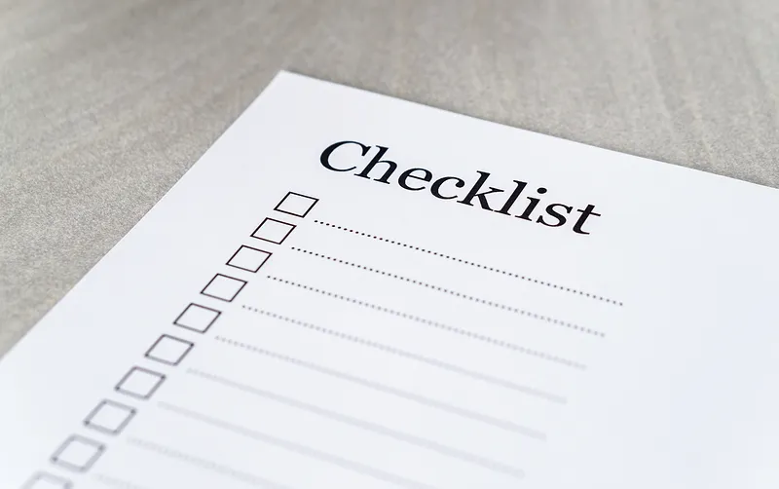
Discover what we know For Your parish council
Build on your foundation.
Knowing your council members is key.
Use the Welcome Program to learn about your members and their:
Passions
Interests
Skills
Strengths
Notes:
READ:
Your council has a solid foundation that you can build on. Each member is valuable—knowing them is crucial to your council’s future growth.
Utilize the Welcome Program and the new and renewing membership forms to get to know members and their:
passions – what drives them?
interests – what are they busy doing?
skills – what are their special skills?
strengths – what are their unique strengths?
---
Image source: rawpixel.com/image/5917664

Slide 11
Discover what we know For Your parish council
Complete the New Member Information Form (Addendum 1.1 of the Welcome Program)
Complete the Renewing Member Information Form (Addendum 1.2 of the Welcome Program)
Create a committee to review the forms and create groups with similar interests.
Notes:
READ:
Do you know if all new members of your council have completed the New Member Information Form found in the Welcome Program? What about renewing members? This helps with planning activities at the parish council level.
Use the membership forms from the Welcome Program to collect information. The New Member Information Form is an important tool for gaining knowledge about each member’s interests and talents, which benefit both the member and the parish council when planning activities. As this is a new form based on the three core values of faith, service and social justice, it is strongly recommended that all members (new and returning) complete this form initially.
In future years, have returning members complete the Renewing Member Information Form annually. This will help ensure their records are updated and provide the council with information on each member’s current interests are.
Create a committee (two or three members) to review forms and create groups of members with similar interests.

Slide 12
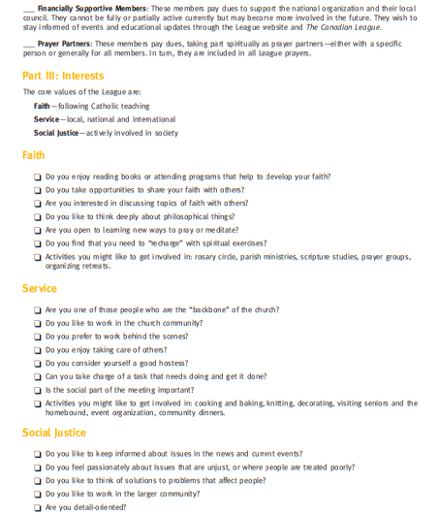
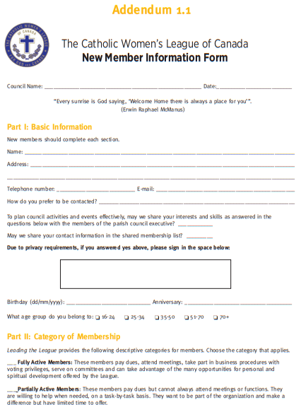
Notes:
READ:
We now have a sample of the New Member Information Form recommended for completion by new members. Have the form available as a handout.
Part I: Basic Information
Name, address, telephone number, email address, preference for being contacted, birthday, anniversary and age group.
Includes permission to share skills and interests with members of the parish council executive.
Due to privacy requirements, this form includes permission to share contact information on a shared membership list.
Part II: Category of Membership
Fully Active Members: Pay dues, attend meetings, participate in business procedures with voting privileges and serve on committees.
Partially Active Members: Pay dues, cannot always attend meetings or functions, are willing to help when needed and have limited time to offer.
Financially Supportive Members: Pay dues to support the national organization and their local council. They cannot be fully or partially active but may be in the future and wish to stay informed of events and updates.
Prayer Partners: Pay dues, take part spiritually as prayer partners with a specific person or generally for all members and are included in all League prayers.

Slide 13
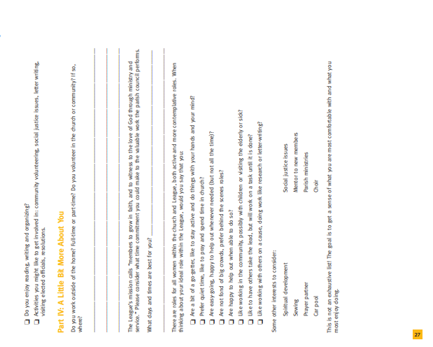
Notes:
READ:
Part III: Interests
Based on the core values of faith, service and social justice, members check off the boxes in the areas they are interested in.
Part IV: A Little Bit More About You
This is not an exhaustive list! Instead, the goal is to get a sense of what members are most comfortable with and what they enjoy doing most. All of us are unique and valuable to our council.

Slide 14
Notes:
READ:
The Renewing Member Information Form helps ensure information and records are current. It provides members with an opportunity to share their passion, skills and interests. Members get what they are looking for and councils can serve their needs—a win-win situation.

Slide 15
Keeping members engaged and informed
Create a positive environment – be dynamic and flexible.
Encourage new ideas.
Collaborate with other councils.
Support new initiatives.
Recognize and appreciate member contributions.
Find new ideas and inspiration.
Notes:
READ:
Keep members engaged by creating a positive environment for all members. It needs to be dynamic and flexible to the needs of the council.
Be open and ready to try new suggestions. Encourage new ideas and be open to implementing them.
Collaborate with other councils to bring in speakers or host workshops.
Support new initiatives.
Recognize and appreciate members’ contributions—everyone wants to feel valued and appreciated.
Be ready to find new ideas and inspiration from research, communiqués, The Canadian League, Spotlight, League websites (national, provincial, diocesan and parish councils) and strategic planning resources. There are always more ideas or inspiration to be found from these resources—take advantage of them.
Councils are not based on a cookie-cutter system. Each council is diverse in culture, age and location.
Do all your council members participate? If members enjoy being part of a council and are appreciated, they are more likely to participate actively and help the council reach its goal.

Slide 16
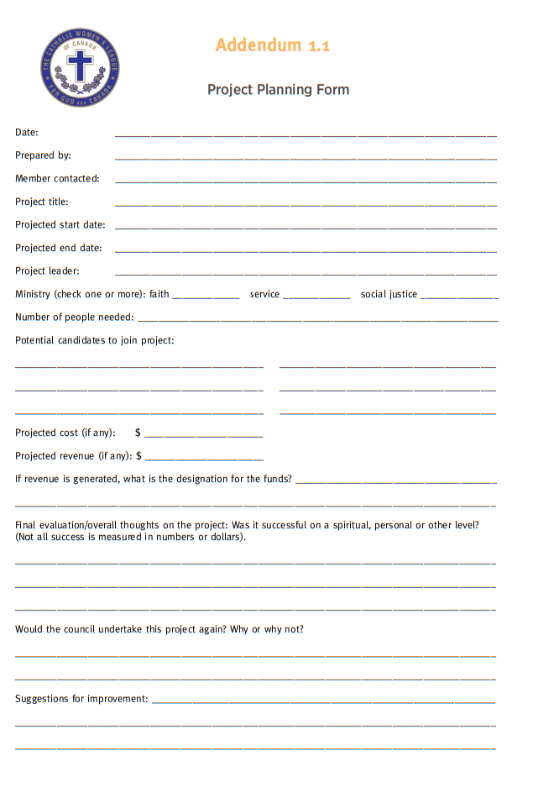
Project planning
What is a project?
Create a list of activities or events.
Take an idea and map it on the Project Planning Form (Addendum 1.1 Joy of Leadership)
Notes:
READ:
What is a project? Any event or activity planned by your council is termed as a project. Can you list successful activities or events that your council has organized?
If presenting in person: Use a flip chart to list the skills and have copies of the forms available.
If presenting online: Use breakout rooms (three to five minutes so all members in a group can share) or the chat feature.
Now that we have a list of projects, let us take one idea and map it on the Project Planning Form (Addendum 1.1 in the Joy of Leadership) (5-10 minutes)

Slide 17
Notes:
READ:
Example of filling in the form (A Lenten Retreat)
We will use the Lenten Retreat to fill in the form—please work with me when filling this out.
Date: Current date
Prepared by: League member name
Member contacted: League member name
Project Title: Lenten Retreat
Projected start date: March 4, 2023 at 9:00 a.m.
Projected end date: March 4, 2023 at 12:00 noon.
Projects Lead: Spiritual executive
Ministry (check on or more): Faith
Number of people needed: Minimum 20
Potential candidates to join project: Member #1, member #2, member #3
Projected cost: $100.00 for retreat facilitator
Projected revenue: $15.00 per member
If revenue is generated, what is the designation for funds?: Retreat facilitator stipend, breakfast items, printed handouts.
Final evaluation/overall thoughts: Successful spiritual event
Would the council undertake this project again? Why or why not? Yes, we would undertake this event as our annual retreat as it is spiritually fulfilling.

Slide 18
Project planning
Use a project planning form to organize and plan for a successful event.
Create subcommittees under faith, service and social justice ministries (e.g., fundraising, Welcome Program).
Encourage members to discover and embrace non-elected leadership opportunities.
Notes:
READ:
Use the Project Planning Form to organize and plan for each project.
Create subcommittees. For example, pastoral care could be under faith, parish activities under service and fundraising for people experiencing homelessness under social justice. You could list the many committees that can be formed to suit your council’s needs.
Encourage members to lead those non-elected leadership opportunities.
---
Image source: PowerPoint Stock Images

Slide 19
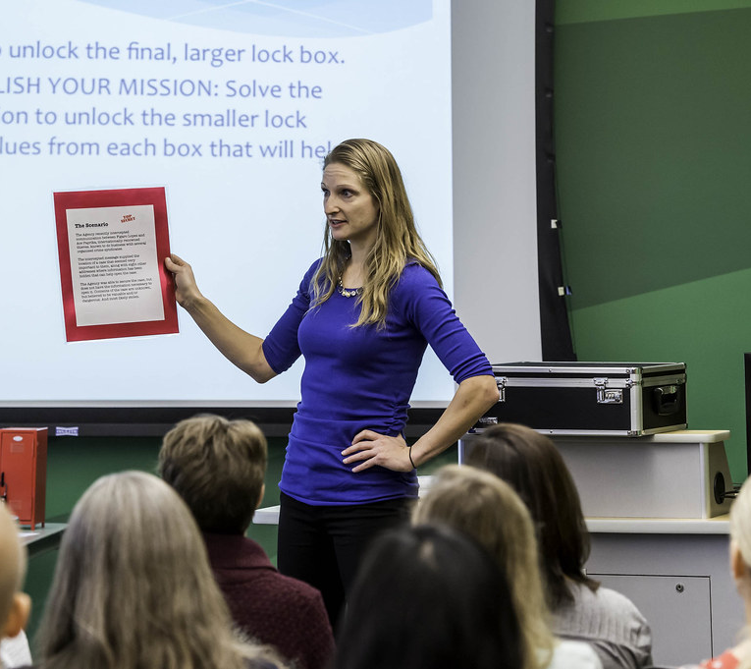
Leadership workshop
A workshop can be a valuable tool in discerning members gifts, talents and skills.
It can assist members in understanding leadership concepts.
It is a fun way of sharing information and experiences.
A workshop should be flexible and adaptable to the needs of each council.
Notes:
READ:
A workshop can be a valuable tool to assist members in discerning their gifts, talents and skills.
It can assist members in understanding leadership concepts and taking on leadership positions confidently and willingly.
It is a fun and interactive method of sharing information and experiences that can enhance a member’s confidence and engagement in League activities.
The workshop should be flexible and adapted to the needs of each council and its members, especially regarding accepting leadership opportunities.
---
Image source: flickr.com/photos/codnewsroom/32422562630

Slide 20
Leadership workshop
A workshop can be condensed to use as a program or as a full-day experience.
They can follow a standard format.
Participant involvement is key to a successful workshop.
Notes:
READ:
A workshop can be condensed to use as a program at council meetings or presented as a full-day experience.
Workshops can follow a standard format that includes a welcome and opening prayer, an overview of what to expect, specific topics to be covered, scheduled break times, a closing summary, an evaluation and a closing prayer.
Getting participants involved is key to a successful workshop. Everyone needs to participate.

Slide 21
Leadership workshop
Participants should understand the big picture.
Follow up with members attending.
With preparation, any member can present a workshop.
See the Train the Trainer Guide to aid in presenting a workshop.
Notes:
READ:
After a workshop, participants should understand the big picture and their role in getting there.
Follow up with members attending to offer further clarification, encouragement or new workshops.
With preparation, knowledge and self-confidence, any member can present a workshop to her League sisters, or several councils can collaborate to present a workshop.
Further information on presenting a workshop can be found in the Train the Trainer Guide.

Slide 22
It’s a journey
Education is the key to learning.
Learning is the key to knowledge.
Knowledge is the key to understanding.
Understanding leads to self-improvement.
Self-improvement leads to confidence.
Confidence reduces fear.
Lack of fear leads to willingness to take on leadership roles.
Notes:
READ:
Education is the key to learning.
Learning is the key to knowledge.
Knowledge is the key to understanding.
Understanding leads to self-improvement.
Self-improvement leads to confidence.
Confidence reduces fear.
Lack of fear leads to willingness to take on leadership roles.

Slide 23
In Conclusion
Where are we now as a council in developing leaders?
Where would we like to be?
Notes:
READ:
In conclusion, let’s pause and ask ourselves the questions…
Where are we now as a council developing leaders?
And…
Where would we like to be?
You may want to write down or share some of your own ideas.

Slide 24
Questions?
Notes:
READ:
I hope we helped discover new opportunities for you and your council. I’ll be happy to answer any questions you may have.
Leave a few minutes for questions.
I would now like to end our session with a prayer.
---
Image source: PowerPoint Stock Images

Slide 25
CLOSING prayer
Father, we want to thank You for being with us throughout this workshop.
Your presence has been in this place from the start to the end.
Lord, as we leave this place, let us go out there and be the salt and light.
May we put into practice what we have discussed and learned.
Help us to make a difference in this world for the glory of Your name.
In Jesus’ name, we believe and pray. Amen.
(Adapted from Thankfulness Prayer, connectusfund.org)
Notes:
READ:
Father, we want to thank You for being with us throughout this workshop.
Your presence has been in this place from the start to the end.
Lord, as we leave this place, let us go out there and be the salt and light.
May we put into practice what we have discussed and learned.
Help us to make a difference in this world for the glory of Your name.
In Jesus’ name, we believe and pray. Amen.
---
Source: Adapted from Thankfulness Prayer, connectusfund.org/8-best-closing-prayers-for-meetings

