Slide 1
Joy of Leadership: Leadership in the League Before You Start
Presentation Time: Approximately 45 minutes
This workshop can be presented in person or online.
Practice, practice, practice!
Print the PowerPoint presentation using the print layout called “Notes Pages” so that you know what to say with each slide.
You may want a co-host to monitor the chat, hands up, answers to questions, etc.
Ask everyone to mute before you start and tell people how you want them to let you know that they want to speak—raising hands (really or by using the icon), unmuting or something else.
Move this presentation to the next slide, ready to start.

Slide 2
THE Joy of Leadership
The Catholic Women’s League of Canada
Module 3:
Leadership in the League
Notes:
READ:
Welcome to Leadership in the League. My name is ______________ and I look forward to sharing this presentation with you. I am so happy that you were able to join me today. I hope that this program will help you to learn more about how you can become an effective leader and encourage others to do the same.
At this time, please turn off any electronics that may interfere with the program.
If presenting in person:
We have prepared a handout for you—please use it to make notes. We will use this flip chart to record any activities.
If presenting online:
Today, I would also like to welcome my assistant, ________________, who will be managing the chats for me so that I don’t miss any of your comments. Feel free to comment anytime! When you registered for this presentation, we sent you a file with a handout of all the slides. Please use them to make notes.
Before we begin, please join me in prayer.

Slide 3
Opening prayer
“We ask that You would open our ears so that we may hear your voice.
Open our minds so that we may receive Your eternal wisdom.
Open our spirits so that we may know Your leading and guidance.
And open our hearts so that we may receive Your wonderful love…
Amen.”
(Excerpt from Opening Prayer for Worship or a Church Service)
Notes:
READ:
“We ask that You would open our ears so that we may hear your voice.
Open our minds so that we may receive Your eternal wisdom.
Open our spirits so that we may know Your leading and guidance.
And open our hearts so that we may receive Your wonderful love…
Amen.”
---
Source: Excerpt from Opening Prayer for Worship or a Church Service, lords-prayer-words.com/times/opening_prayer.html

Slide 4
Outline of program
How do we define leadership?
What makes an effective leader and who are they?
Leadership: Is it an attribute or skill?
Exercise to identify your skills.
Basic leadership attitudes and skills.
Short- and long-term leadership opportunities.
How to promote leadership in members.
Continuing the leadership journey.
Notes:
Each time you click, a new item will appear on the list.
READ:
Today we will cover several topics about leadership.
First, when we think of leadership, what is our definition?
When we picture an effective leader, what are her attributes?
Do we believe that leadership is an attribute or a skill we learn on our life’s journey?
We will have an opportunity to do a short exercise that will help you to identify some of your attributes and skills.
Then we’ll talk about basic attributes that every leader should have.
What are some leadership opportunities within the League? Let’s look at them.
We know that many members do not consider themselves leaders. How can we help them recognize their potential?
And then, where do we go from here?
So, buckle your seatbelts and come on the journey with me to learn more about leadership.

Slide 5
What makes a leader effective
Please complete the sentence with one or two descriptive words.
An effective leader is…
Notes:
READ:
We know that leadership means different things to different people. When you think about a person you believe is an effective leader, what qualities does that person have? How do they show that they are an effective leader?
Please take a few moments and complete the sentence in one or two descriptive words.
An effective leader is…
Here’s an example: An effective leader is trustworthy.
---
Image source: PowerPoint Stock Images

Slide 6
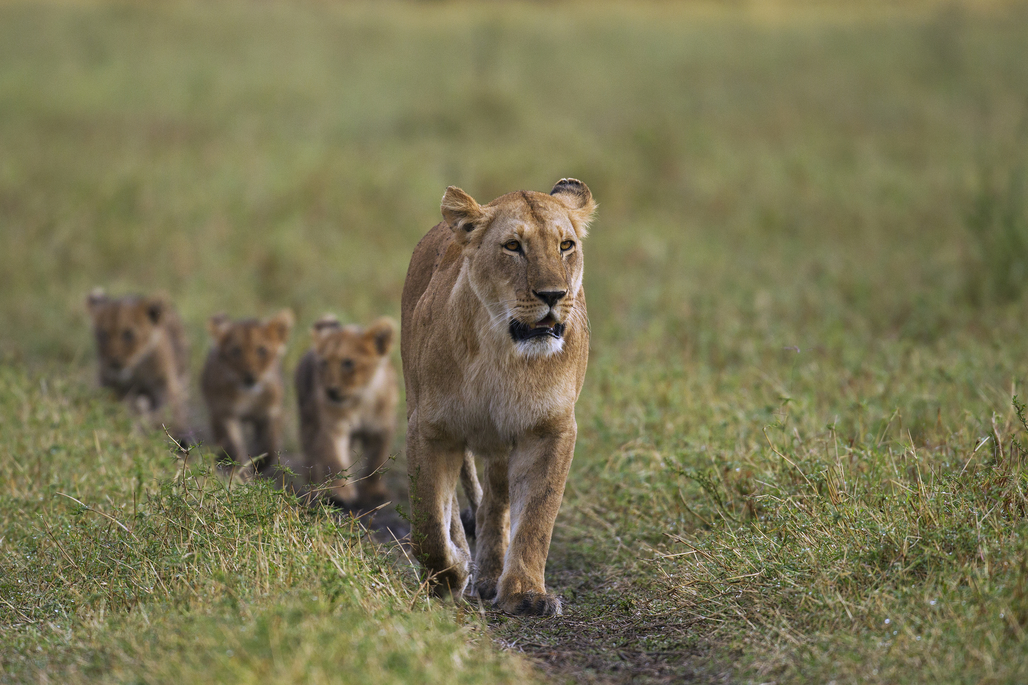
An effective leader is…
Notes:
READ:
Here are some images to help you.
If presenting in person: Write the description of an effective leader on the flip chart.
If presenting online: Put your description of an effective leader in the chat box.
---
Image source: PowerPoint Stock Images

Slide 7
Who are some effective leaders?
Who are some effective leaders you have encountered or have read about?
Why do you think that are they effective?
Notes:
READ:
Do you know someone from your life experience who demonstrates these attributes and skills?
Someone in your family?
Your council?
In general?
Why do you think that they are effective?
If presenting in person: Write the description of an effective leader on the flip chart.
If presenting online: Put the description of an effective leader in the chat box.
---
Image source: PowerPoint Stock Images

Slide 8
Leadership: an attribute or Skill?
You may have been born with some abilities that you will be naturally good at.
These can be strong points on which you can build your other skills and abilities learned through training and practice.
Notes:
READ:
Leadership is both an attribute and a skill.
Yes, some leaders are what we consider “born leaders.” They may have been born with certain attributes, but life experiences usually bring out those attributes; for the most part, they have developed skills through learning and experiences.

Slide 9
Exercise to identify your Skills
Notes:
READ:
According to the experts, the average person has up to 700 skills ready to be used at any time! You do not have to excel at a skill to claim you have it. If you feel you are competent or perform the skill as well as most people, you have that skill.
---
Image source: PowerPoint Stock Images

Slide 10
I like to help others.
I am a good listener.
I can handle several roles or projects at a time.
I can take direction and complete assigned tasks.
I understand and can perform basic computer tasks.
I am comfortable with learning new computer technology.
I like using social media to connect with friends.
I am good at making decisions.
I can plan and budget finances.
I can express myself well in both verbal and written communication.
I accept responsibility for my actions.
I am good at following instructions.
I am comfortable speaking to a group of people.
I can bring disagreements to a successful conclusion.
I like instructing others.
I can organize projects.
I like working with others to reach a common goal.
I enjoy coming up with new ideas.
I like to keep myself informed.
I am good at managing my time.
I have a great sense of humour.
I am good at recognizing the skills of others.
I am good at delegating.
Other: ______________________________
Notes:
READ:
Please take a few minutes to review the list of skills you see on the slide. Can you think of others? Choose one or two and think of a time when you have used these skills. Don’t be afraid to toot your own horn—it’s not bragging—we all have gifts.
Consider providing a personal example to get the ball rolling.

Slide 11
Review the skill exercise
Notes:
READ:
I hope this exercise taught you a few things about yourself. Were there any surprises when you identified your skills?
If presenting in person: Does anyone want to share their story when they used one of the skills?
If presenting online: Does anyone want to share their story? Please put them in the chat box.
As we continue this program, I am sure you will see that you have the skills to be an effective leader because each one of us was gifted with unique talents. And remember, we have each other!
---
Image source: PowerPoint Stock Images

Slide 12
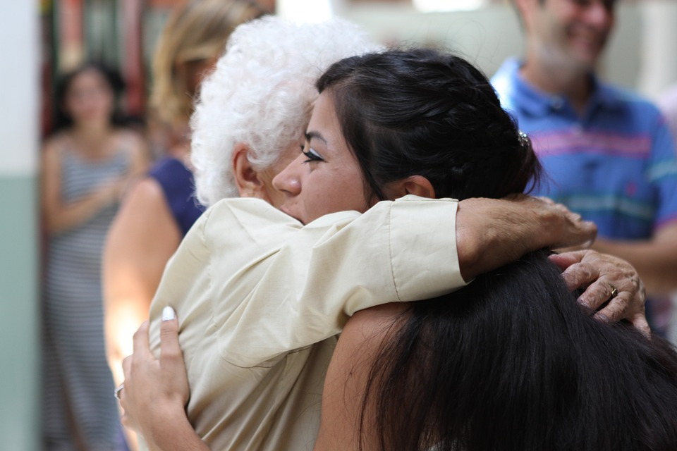
Basic attributes are important
A good leader should:
have integrity
be people-oriented
be joyful and hope-filled
Notes:
READ:
So, let’s review some basic leadership attributes:
A good leader should have integrity: Someone with integrity practices honesty consistently because people often follow the example of their leaders. If you hold yourself up to a high standard, you indirectly encourage your team to be accountable and stay committed to the values of the League.
A good leader should be people-oriented: Successful leaders have a natural ability to build relationships. This allows you to build teams, motivate them and help them achieve results.
A smile goes a long way to lighten a room. Romans 12 urges us to be “joyful in hope.”
---
Image source: PowerPoint Stock Images

Slide 13
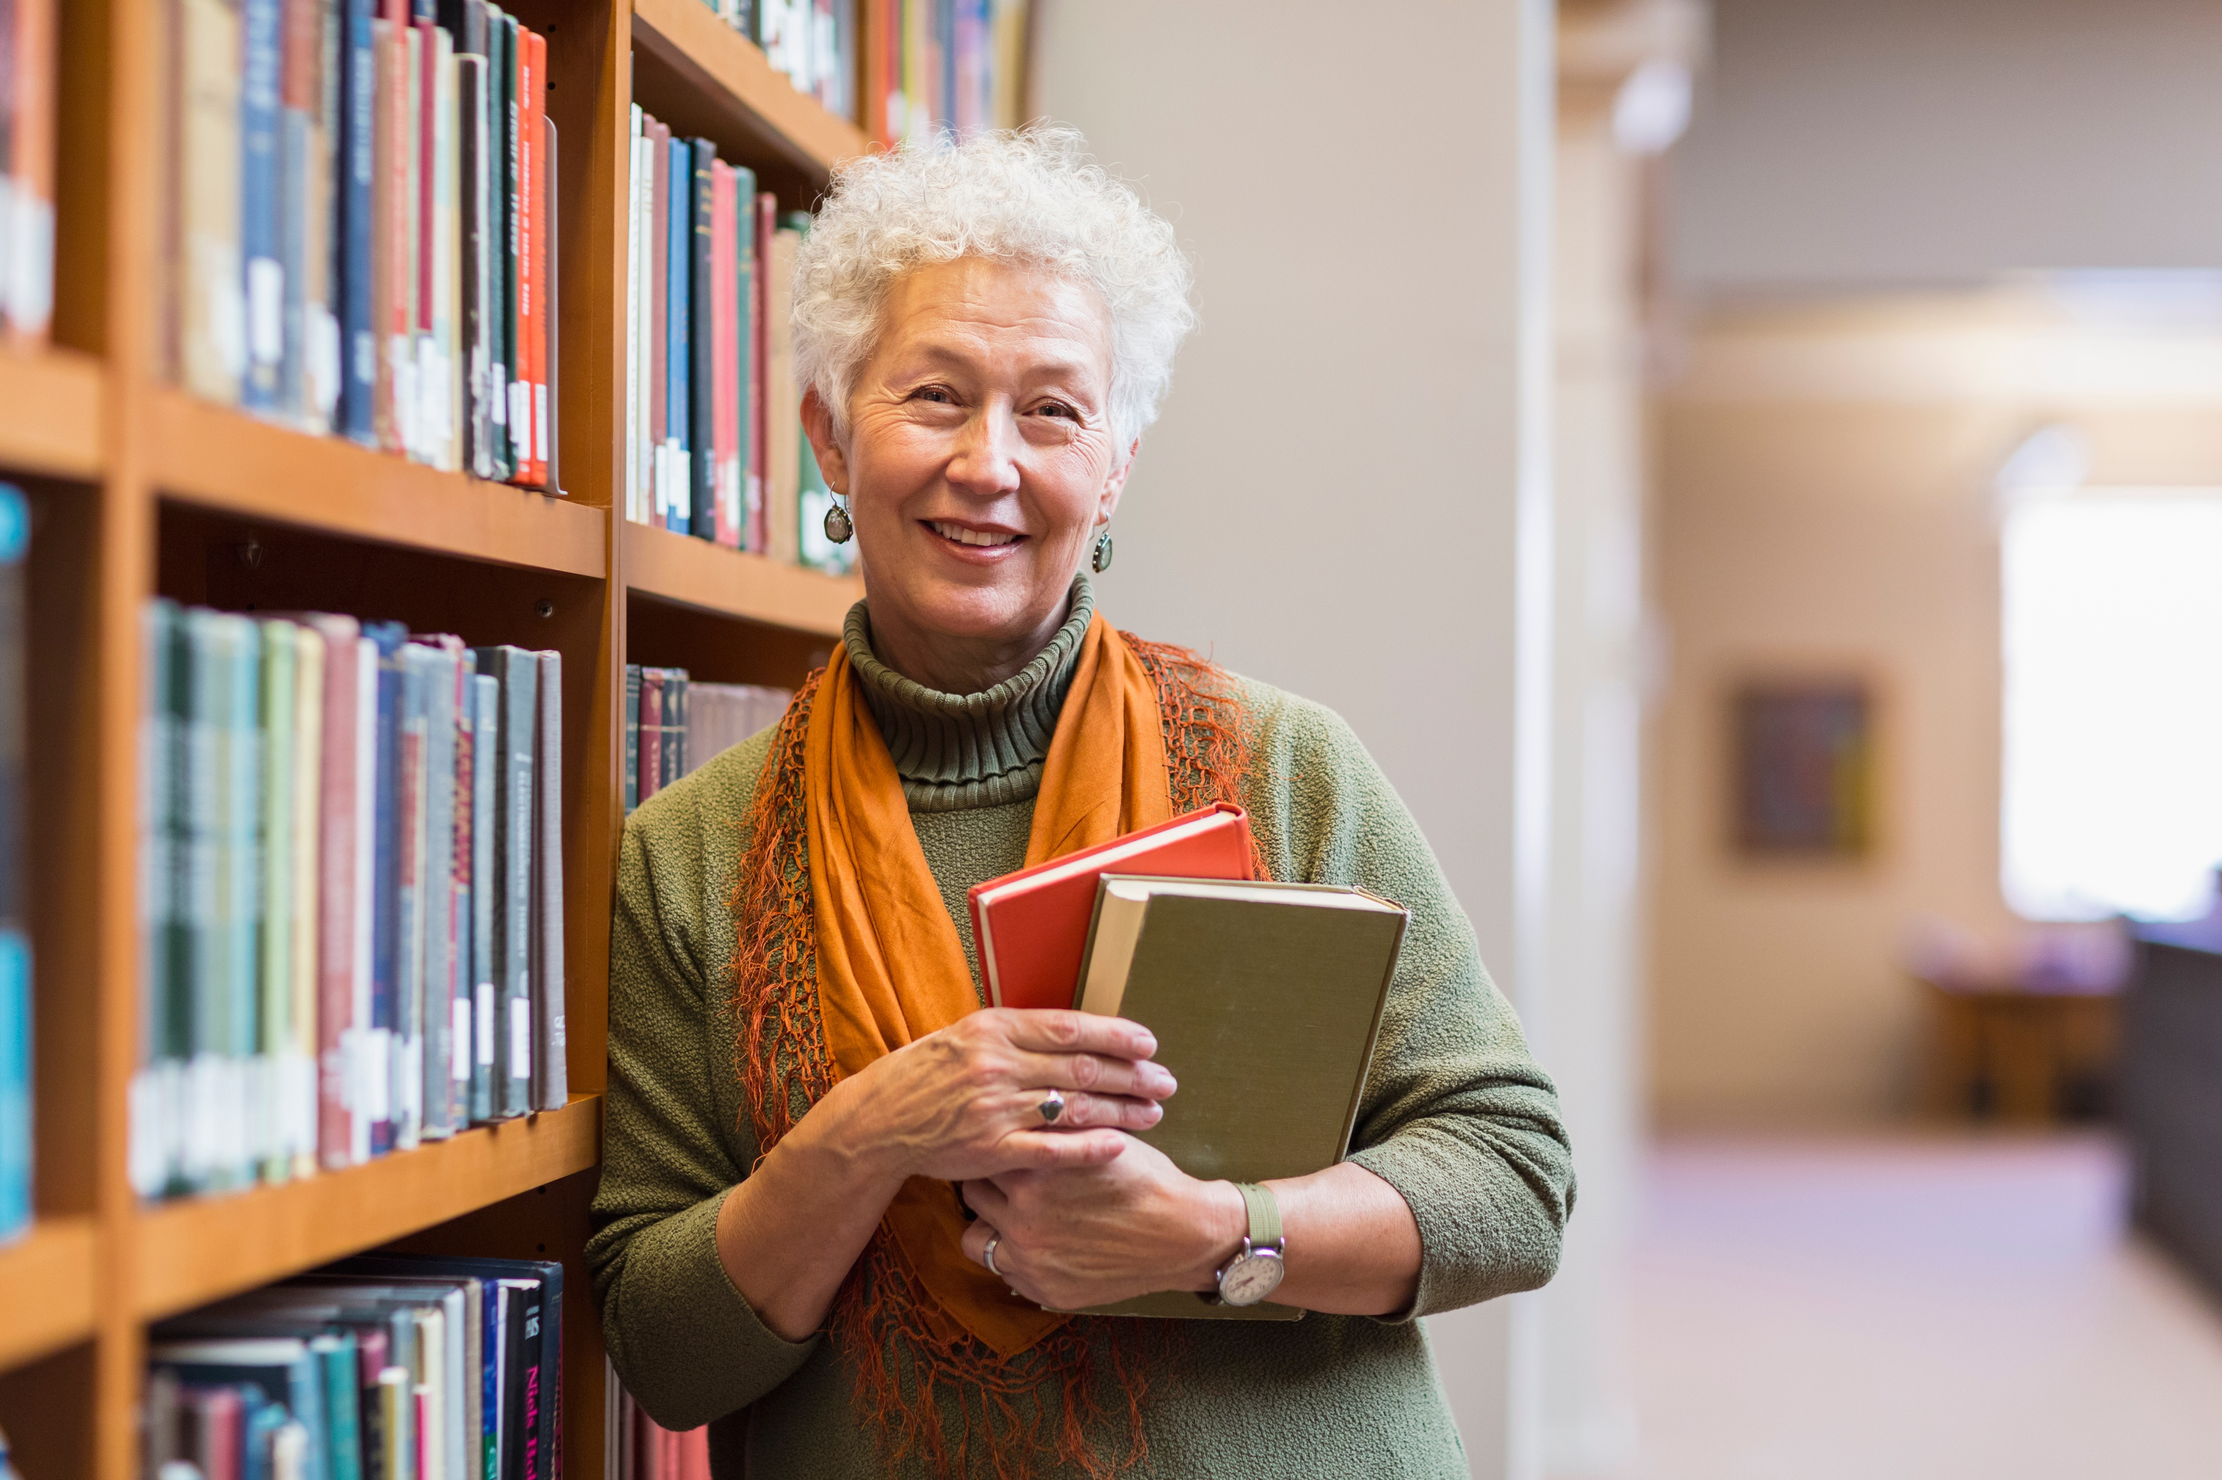
Basic attributes are important
Be a good listener.
Have a positive self-image.
Be empathetic.
Have a willingness to learn.
Notes:
READ:
Listening is more than hearing what the other person is saying. It is paying close attention and responding appropriately. It is being aware of how your body language and tone affect the other person.
You should have a positive self-image. Be yourself—everyone else is taken. By being your authentic self, you will attract people to follow you.
Be empathetic. Give people your full attention in meetings, be curious about their lives and interests and offer constructive feedback.
A good leader should be open to keep on learning and be adaptive to change.
---
Image source: PowerPoint Stock Images

Slide 14
Leadership Skills
Cast a vision.
Motivate others.
Communicate effectively.
Delegate responsibility.
Notes:
READ:
Yes, a leader should have the basic attributes, but some may be learned through training and life experiences. The following are essential to being an effective leader:
A leader must be a visionary. You have to be able to see the big picture and what is possible and be able to communicate that to your team.
Leaders motivate people by involving them in decisions, inspiring them, trusting them to do the job, challenging them to do more and appreciating, rewarding and celebrating them.
As a leader, you must be able to convey information and instructions and ensure understanding of that information by establishing a way to receive feedback.
Being a leader is not a stand-alone position. It’s very lonely at the top if you don’t have followers. Build a team and get things started. Then step back and allow the team to function according to their skills and talents.
---
Image source: PowerPoint Stock Images

Slide 15
Leadership Skills
Make sound decisions.
Act as a positive role model.
Build a team environment.
Mentor and teach.
“A good leader inspires people to have confidence in the leader; a great leader inspires people to have confidence in themselves.”
(Eleanor Roosevelt)
Notes:
READ:
As a leader, you will sometimes need to make decisions. Make sure they are based on reliable information after discussing and testing possible solutions.
You’ll always want to be the example others want to follow—so be a positive role model.
Share your knowledge and experience by mentoring others. The position of vice-president is an excellent apprenticeship opportunity. Encouraging participation of life members allows them to mentor us. There are hundreds of years of experience in the League. Let’s share it!
And once you’ve passed on that knowledge, allow others to thrive. Eleanor Roosevelt once said, “A good leader inspires people to have confidence in the leader; a great leader inspires people to have confidence in themselves.”
---
Image source: PowerPoint Stock Images

Slide 16
Leadership opportunities
Within the League, there are many opportunities to lead. Some are short-term; some are long-term.
This gives members opportunities to choose.
Can you describe some short-term projects within your council?
What would you consider long-term projects?
Notes:
READ:
Sometimes we think that being a leader requires years of dedication or commitment. Yes, if you are on the council executive, there is a two-year term commitment. But there are many other opportunities to practice your leadership.
Think about your council. What are some short-term projects?
What are some long-term ones?
On pages 17 and 18 in The Joy of Leadership are examples of more projects to consider.

Slide 17
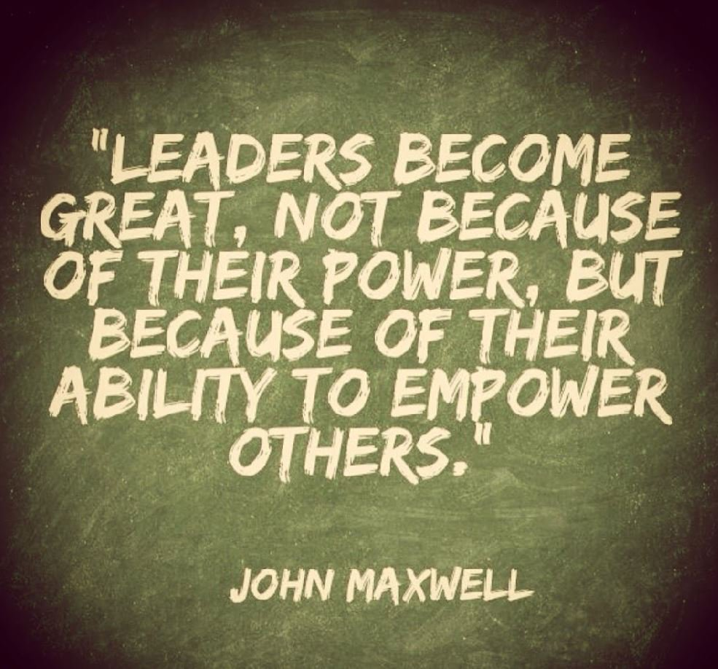
Promoting leadership in members
Have a shared vision.
Model leadership.
Inspire by your actions.
Embrace change and new ideas.
Encourage participation.
Delegate responsibility.
Mentor and motivate.
Empower others.
Notes:
READ:
We may not think of ourselves as leaders, but each one of us has been gifted with unique talents. Leadership comes from within—from the core of our passions, interests and commitments.
As a member of the League, you are part of a national organization of women who act through prayer, faith development, ministry, education and advocacy on social justice. You already have a shared vision.
We model leadership by who we are and how we act and inspire others. “You don’t inspire your teammates by showing them how amazing you are. You inspire them by showing them how amazing they are” (Robyn Benincasa).
Effective leaders embrace change and welcome new ideas. We create new leaders by encouraging participation and delegating responsibility. Having great people on our team and then micromanaging them makes no sense. We need to be their mentor and motivate them to do their best—inspire them to do things they never thought they could.
We can’t do everything alone. We have to rely on people. Remember, “Leaders become great, not because of their power, but because of their ability to empower others” (John C. Maxwell).
---
Image source: PowerPoint Stock Images

Slide 18
It’s a journey
Education is the key to learning.
Learning is the key to knowledge.
Knowledge is the key to understanding.
Understanding leads to self-improvement.
Self-improvement leads to confidence.
Confidence reduces fear.
Lack of fear leads to willingness to take on leadership roles.
Notes:
READ:
Education is the key to learning.
Learning is the key to knowledge.
Knowledge is the key to understanding.
Understanding leads to self-improvement.
Self-improvement leads to confidence.
Confidence reduces fear.
Lack of fear leads to willingness to take on leadership roles.

Slide 19
Continuing the journey
Be courageous.
Reach out to your sisters.
Embrace life experiences.
Learn as you go.
Take small steps but work forward.
Understand that it’s a life-long journey.
Enjoy the journey.
Notes:
READ:
So…
Grab your courage.
Reach out to your sisters—there are thousands out there and a few right here beside you. Learn from them. Share your successes and failures—we learn from both.
Embrace every day as a new experience. Be open to change.
Never stop learning. Each day is a new opportunity to grow.
Take small steps, sometimes large leaps, just keep moving forward.
We’re on a journey together—let’s enjoy it.
---
Image source: PowerPoint Stock Images

Slide 20
Questions?
Notes:
READ:
I hope we helped you learn more about yourself and how you can use your skills and talents to be a great leader and encourage others to become great leaders.
I’ll be happy to answer any questions you may have.
I would now like to end our session with a prayer.
---
Image source: PowerPoint Stock Images

Slide 21
CLOSING prayer
Dear Lord,
My desire is to consistently welcome your guidance into how I lead.
I want your presence and perfect wisdom to illuminate
my thoughts, decisions, and actions.
I know that this illumination is possible,
and through welcoming it, I will be a more effective and joyous servant leader.
Amen.
(Excerpt from The Power of Receptiveness for Servant Leaders)
Notes:
READ:
Dear Lord,
My desire is to consistently welcome your guidance into how I lead.
I want your presence and perfect wisdom to illuminate my thoughts, decisions, and actions.
I know that this illumination is possible, and through welcoming it, I will be a more effective and joyous servant leader.
Amen.
---
Source: Excerpt from The Prayer of Receptiveness for Servant Leaders, triuneleadershipservices.com/4-prayers-will-take-servant-leadership-next-level-part-1/

