Slide 1

Government Relations Workshop: Part One
Collaboration with Government Working Group
Strategy: Examine and improve the process of communication and advocacy with all government levels that will allow for respectful dialogue and constructive feedback

Slide 2


Welcome One and All!
Image source: pexels.com/search/welcome%20meeting/
Notes:
Consider providing some time for participants to introduce themselves and learn a bit about each other. (3–5 minutes)

Slide 3

Opening Prayer
Dear God, we ask for the guidance of Your Holy Spirit as we in the Catholic Women’s League continue to work on social justice issues for all of God’s people and for all of creation.
Help us to be still so that we may be open to the Lord’s whisper, like a gentle breeze, to be able to clearly hear Your call to serve our brothers and sisters.
We believe Your word that all people are created in the image and likeness of God, that we are all one body in Christ.
Help us to use our gifts to take meaningful actions, engaging with governments and organizations so that everyone’s economic, political, social and religious rights are respected.
We ask through the intercession of our patroness, Our Lady of Good Counsel, who will shepherd us on the way. Amen.
Notes:
READ TOGETHER:
Dear God, we ask for the guidance of Your Holy Spirit as we in the Catholic Women’s League continue to work on social justice issues for all of God’s people and for all of creation.
Help us to be still so that we may be open to the Lord’s whisper, like a gentle breeze, to be able to clearly hear Your call to serve our brothers and sisters.
We believe Your word that all people are created in the image and likeness of God, that we are all one body in Christ.
Help us to use our gifts to take meaningful actions, engaging with governments and organizations so that everyone’s economic, political, social and religious rights are respected.
We ask through the intercession of our patroness, Our Lady of Good Counsel, who will shepherd us on the way. Amen

Slide 4
Introduction to
Government Relations Workshop
Notes:
This is part one of a three-part workshop that can be presented in one long session with a lunch break in between or as three separate but connected workshops.
All three parts of the workshop will include a PowerPoint with speaker notes that can be used in various ways. This will ensure participants do not need to take detailed notes as they will receive the key content.
Priorities for all three parts of the workshop include:
A format designed to make the workshop easy to use in any parish council. There is no need for a trainer to conduct the workshop. These are user-friendly resources.
Options for dialogue, discussion and interaction are found throughout the workshop.
A variety of presentation formats are included.
Opportunities to explore local concerns/situations for government collaboration are included.
Links and video clips are embedded within the PowerPoints allowing their use without Internet access.
The three main parts of this presentation are:
Part One: Background into why the League collaborates with governments
Part Two: Key principles of Catholic social teaching (CST) driving the League’s collaboration work
Part Three: Collaboration skills

Slide 5

For our discussions today, I remind you of the following guidelines:
Confidentiality
Respect
Notes:
READ:
For our discussions today, I remind you of the following guidelines:
Confidentiality: To ensure comfort in sharing, we dedicate ourselves to the confidentiality of what is shared. Please do not presume that it is acceptable to tell a friend what was shared in your group. Please do not use a person’s name if you share a personal story. Instead, to protect confidentiality, say something like “Someone I know….”
Respect: Ensure everyone has a chance to speak—time is limited, and we want everyone to have the opportunity to share their ideas.

Slide 6
Why are Government Relations Important to the League?
Notes:
READ:
The main reasons why members collaborate with governments include:
CST is a long tradition that is based on sacred scriptures.
Sacred scripture dates back to our roots in Judaism and the Old Testament. We will explore how fundamental collaboration is to our faith.
Baptism reflects God’s call for each Catholic to be priest, prophet and king, as well as a disciple in the church inspired by the Spirit, to live this discipleship every day.
Through the Second Vatican Council, we are called to “read the signs of the times” and be Christ for others in today’s world.
The Reign of God: “But strive first for the kingdom of God and his righteousness, and all these things will be given to you as well” (Mt 6:33). “Your kingdom come. Your will be done, on earth as it is in heaven” (Mt 6:10). All of these reasons for advocacy, come together in this line from the Our Father. We work together to further the reign, the kingdom of God.

Slide 7
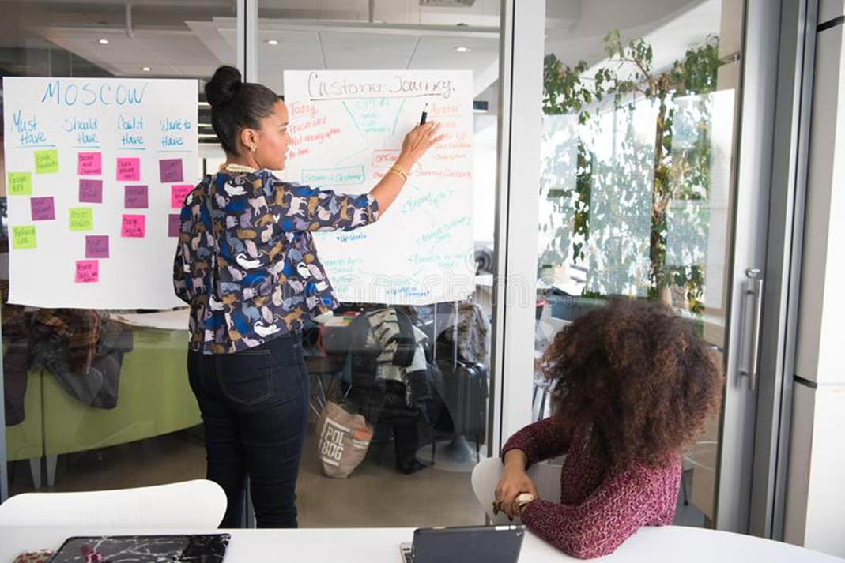
Why Do We Collaborate With Governments?
Image Source: dreamstime.com/two-women-having-meeting-inside-glass-panel-office-public-domain-image-free-119666520
Notes:
READ:
Why do we collaborate with governments? (Invite quick responses from the participants. Any answer is welcome).
Part one of this workshop will answer this question from a faith perspective.

Slide 8

Why Do We Collaborate With Governments?
Sacred Scripture
Image Source: pexels.com/search/collaborate/
Notes:
READ:
Why do we collaborate with governments? Our sacred scriptures are filled with passages calling us to engage with our society to work together to bring about God’s reign of justice and peace.
“But strive first for the kingdom of God and his righteousness, and all these things will be given to you as well” (Mt 6:33-34).

Slide 9
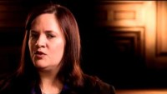

Why Do We Collaborate With Governments?
Sacred Scripture
https://www.youtube.com/watch?v=aMYBCy1FyUc
(8 minutes)
Notes:
READ:
Why do we collaborate with governments? Sacred scriptures: “… As you did it to one of the least of these… you did it to me” (Mt 25:40).
“The word that came to Jeremiah from the Lord: Stand in the gate of the Lord’s house, and proclaim there this word, and say, Hear the word of the Lord, all you people of Judah, you that enter these gates to worship the Lord. Thus says the Lord of hosts, the God of Israel: Amend your ways and your doings, and let me dwell with you in this place. Do not your trust in these deceptive words: ‘This is the temple of the Lord, the temple of the Lord, the temple of the Lord.’ For if you truly amend your ways and your doings, if you truly act with one another, if you do not oppress the alien, the orphan, and the widow, or shed innocent blood in this place, and if you do not go after other gods to your own hurt, then I will dwell with you in this place, in the land that I gave of old to your ancestors for ever and ever. Here you are, trusting in deceptive words to no avail. Will you steal, murder, commit adultery, swear falsely, make offerings to Baal, and go after other gods that you have not known, and then come and stand before me in this house, which is called by my name, and say, ‘We are safe!’—only to go on doing all these abominations? Has this house, which is called by my name, become a den of robbers in your sight? You know, I too am watching, says the Lord” (Jer 7:1-11).
As you watch this video, consider the following questions that we will briefly discuss at the end of the clip.
Identify one piece of information that was new to you.
What did you hear that supports or explains why collaboration with government is important for League councils?
Click to begin the video clip: Scripture in the Life of the Church. (8 minutes)

Slide 10
Why Do We Collaborate With Governments?
Sacred Scripture
Identify one piece of information that was new to you.
What did you hear that supports or explains why collaboration with government is important for League councils?
(5–7 minutes)
Notes:
READ:
Now that you have watched the video, let’s discuss the following:
Identify one piece of information that was new to you.
What did you hear that supports or explains why collaboration with government is important for League councils? (5–7 minutes)

Slide 11

God’s Call for Justice
Image source: pexels.com/search/break%20chains/
(3 minutes)
Notes:
READ:
As I read this scripture quote, close your eyes and listen for the message of God’s justice.
“Is not this the fast that I choose: to loose the bonds of injustice, to undo the thongs of the yoke, to let the oppressed go free, and to break every yoke? Is it not to share your bread with the hungry, and bring the homeless poor into your house; when you see the naked, to cover them, and not to hide yourself from your own kin? Then your light shall break forth like the dawn, and your healing shall spring up quickly; your vindicator shall go before you, the glory of the Lord shall be your rearguard. Then you shall call, and the Lord will answer; you shall cry for help, and he will say, Here I am” (Isa 58: 6-9).
Can you think of any actions that you personally or as a League council have taken to address one of these calls by God to justice? (Brainstorm: 3 minutes)
Another example that highlights the connection between our sacred scripture and God’s call for justice in our relationships is that the biblical understanding of justice found its highest expression in how a community treats its weakest members.

Slide 12
Why Do We Collaborate With Governments?
Catholic Social Teaching
Image Source: pexels.com/search/collaborate/
Notes:
READ:
Why do we collaborate with governments? Catholic social teaching.

Slide 13


A Brief History of Catholic Social Teaching and Social Justice
https://www.youtube.com/watch?v=fyb9M5Z7oas
(3 minutes)
Notes:
READ:
This short video will give you a brief history of Catholic social teaching, beginning with St. Augustine up to recent popes who have repeatedly written about its priority in our lives as baptized Catholics. I invite you to write down the popes mentioned and the themes of Catholic social teaching as you watch the film.
Show the video (3½ minutes), then ask the women to identify a council activity that supports one or more of the Catholic social teachings. (3 minutes)
Feel free to show the video a second time to help with the discussion.
---
Link: youtube.com/watch?v=fyb9M5Z7oas

Slide 14
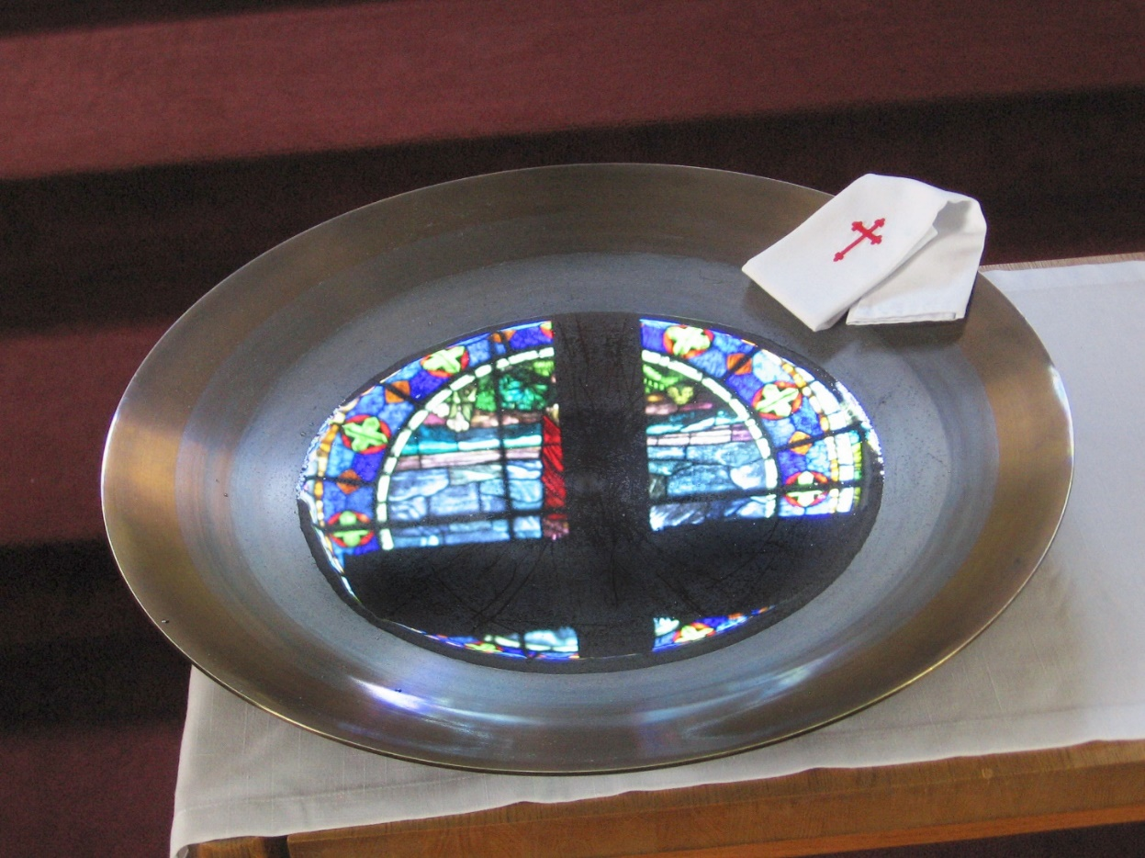
Why Do We Collaborate With Governments?
Baptism
Image Source: freeimages.com/photo/baptismal-font-5-1178903
Notes:
READ:
Why do we collaborate with governments? Baptism.

Slide 15
Foundational to Our Baptism:
The Call to Holiness and Mission
“At the heart of baptism is membership in the Church. It is not private and following Jesus does come with all kinds of strings attached.”
  (Fr. James Mallon)
“In virtue of their baptism, all the members of the people of God have become missionary disciples.”
(Pope Francis)
Notes:
READ:
Social justice is foundational to our baptism—it is one of the pillars of the church and our faith. In the words of the Catechism of the Catholic Church, “Holy Baptism is the basis of the whole Christian life, the gateway to life in the Spirit… and the door which gives access to the other sacraments. ...We become members of Christ, are incorporated into the Church and made sharers in her mission” (1213).
As Fr. James Mallon, founder of the Divine Renovation Ministry, wrote in his book Divine Renovation: From a Maintenance to a Missional Parish, “The idea that the call to holiness and mission is rooted not in ordination or in religious profession but in baptism had been so forgotten that it was revolutionary. We are called to holiness because we are baptized. We are called to mission, to evangelize, to share the Good News because we are baptized.”
It is this baptism, as Pope Francis has explained, that allows us to walk together “as befits [our] common baptism as members of the People of God in shaping the future church… Walking together is a way for lay people to further their baptismal mission through joining the ordained in the discernment gifted by the Spirit to all the baptized,” writes Dr. Moira McQueen of the Canadian Catholic Bioethics Institute in her book, Walking Together: A Primer on the New Synodality.

Slide 16
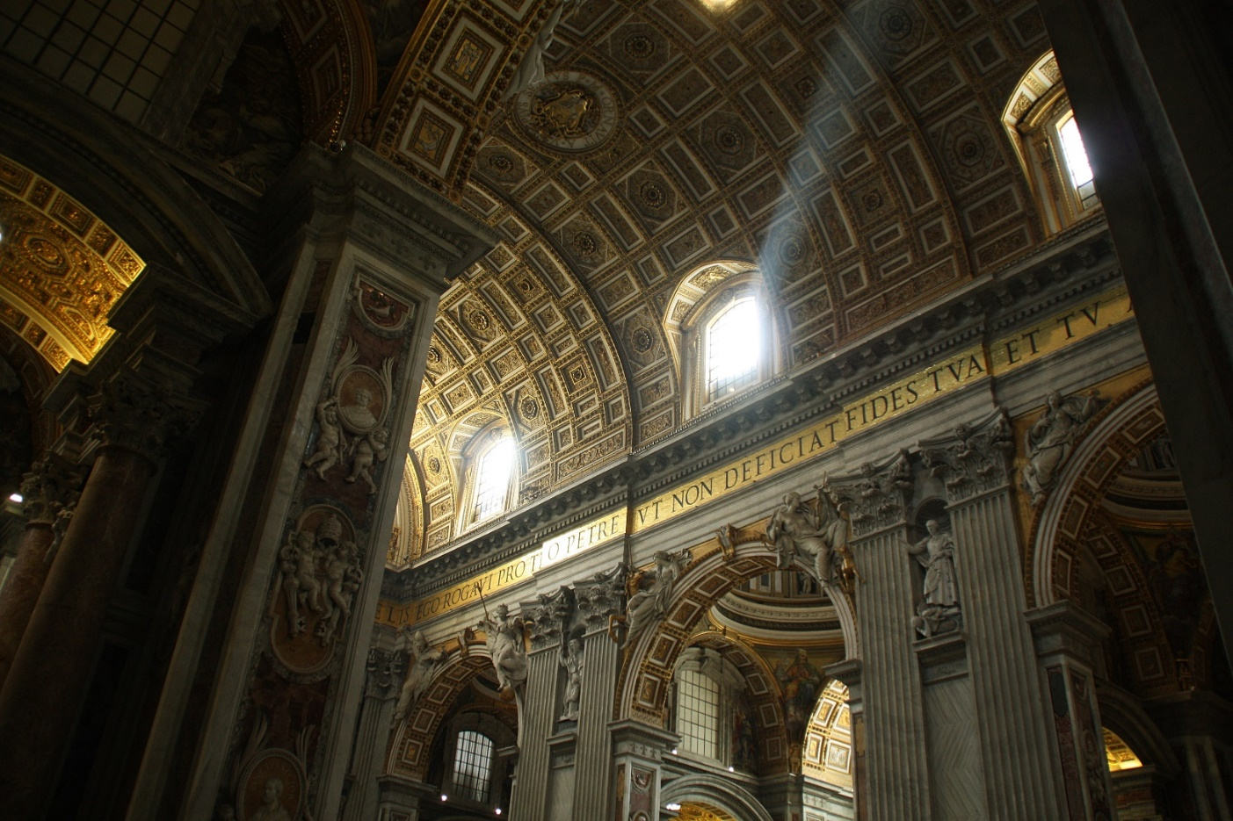
Why Do We Collaborate With Governments?
Vatican II: Reading the Signs of the Times
Notes:
READ:
Dr. McQueen further states, “A major thrust of the Second Vatican Council is that the whole People of God is now the emphasis: a communion, a joint membership of every individual by virtue of the sacrament of baptism.”
This focus helps drive our commitment to “read the signs of the times” to help us find God’s will in our lives.

Slide 17

Synodality: The Vision of Walking Together
(3 minutes)
Notes:
READ:
We have come to a new awareness of the role of synodality in the church. This vision of walking together—synodality—“reflects the spirit and intent of the Second Vatican Council… which… emphasized our common baptism as the essential qualification for membership in the Body of Christ, in which each one of us has a specific vocation and purpose. This radical equality conferred by baptism needs to be recalled and revitalized in every aspect of Church life until it is more adequately realized by all, especially among the laity.” (ibid).
Invite discussion around this quote. How might this “walking together” look in my life? In the life of my parish council? (3 minutes)

Slide 18
Social Justice is Rooted in Vatican II
  the call to holiness is universal
  the call to mission is universal
  “The faithful are by baptism made one body with Christ… [they share] in the priestly, prophetical, and kingly functions of Christ; and they carry out for their own part the mission of the whole Christian people…”
  (Pope Paul VI, Lumen Gentium)
Notes:
READ:
You can summarize the central theological insights of all 16 Vatican II documents in the following phrases—the universal call to holiness and the universal call to mission. Building on these two insights, we read in the Vatican II document Lumen Gentium (Light of the Nations) that, “The faithful are by baptism made one body with Christ… [they share] in the priestly, prophetical, and kingly functions of Christ; and they carry out for their own part the mission of the whole Christian people….” What an inspiring, moving and challenging call for us to be Christ in our world and to be Christ for others. This is the faith to which we are called to live!
In one of Pope Paul VI’s decrees, Apostolicam Actuositatem (The Apostolate of the Laity), he begins by stating that “lay people are called to their vocation through Baptism. Their apostolate is directed to the goal of the church itself, which is to spread the kingdom of Christ for the reign of God, to enable all people to share in redemption, and to enter into relationship with Christ. The Christian vocation, by its very nature, is also a vocation to apostolate, to which everyone is called” (Margaret Lavin, Vatican II: Fifty Years of Evolution and Revolution in the Catholic Church).
“We are part of an incredible moment in the church. A new breed of lay Catholics, eager, passionate, and committed to the fullness of their baptismal call, are presenting themselves for service to the church” (ibid).

Slide 19
Vatican II: Gaudium et Spes
(Joy and Hope)
“The joys and the hopes, the griefs and the anxieties of the men of this age, especially those who are poor or in any way afflicted, these are the joys and hopes, the griefs and anxieties of the followers of Christ. Indeed, nothing genuinely human fails to raise an echo in their hearts” (Gaudium et Spes).
“…Let it be recognized that all the faithful, whether clerics and laity, possess a lawful freedom of inquiry, freedom of thought and of expressing their mind with humility and fortitude in those matters on which they enjoy competence” (ibid).
(3–5 minutes)
Notes:
READ:
This document was the last and longest published document from the council and is the first constitution published by an ecumenical council to address the entire world. Gaudium et Spes (Joy and Hope) clarified and reoriented the role of the church’s mission to people outside of the Catholic faith. It was the first time the church took explicit responsibility for its role in the larger world.
One of this wonderful document’s shining, prophetic calls was to, “Read the signs of the times….” In the words of the late Karl Barth, one of the most influential theologians of the 20th century, “Take your Bible and take your newspaper, and read both.”
Click once to reveal each of the two quotes:
“The joys and the hopes, the griefs and the anxieties of the men of this age, especially those who are poor or in any way afflicted, these are the joys and hopes, the griefs and anxieties of the followers of Christ. Indeed, nothing genuinely human fails to raise an echo in their hearts” (Gaudium et Spes).
“…Let it be recognized that all the faithful, whether clerics and laity, possess a lawful freedom of inquiry, freedom of thought and of expressing their mind with humility and fortitude in those matters on which they enjoy competence” (ibid).
Have a brief discussion and encourage participants to focus on one word, phrase or sentence that strikes or touches them. Share what that word(s) might be and explain. (3 minutes)

Slide 20
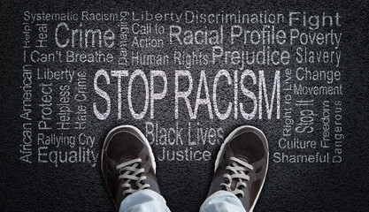
Why Do We Collaborate With Governments?
…THY KINGDOM COME
Image Source: stock.adobe.com/ca/search/free?k=justice+social&search_type=autosuggest
“But strive first for the kingdom of God and his righteousness, and all these things will be given to you as well” (Matthew 6:33).
Notes:
READ:
“Entering God’s kingdom is a metaphor for doing God’s will, and God’s will as revealed through Jesus is that people should take care of one another” (Joseph Martos, Deconstructing Sacramental Theology and Reconstructing Catholic Ritual).
So the prophet speaks, “He has told you, O mortal, what is good; and what does the Lord require of you but to do justice, and to love kindness, and to walk humbly with your God?” (Mic 6:8).
Religious rituals versus justice in the land is a theme that runs through the Old Testament (e.g., 1 Samuel 15:22, Isaiah 1:11-17, Jeremiah 6:20, Proverbs 21:3) and into the New Testament. When a religious scribe responds to Jesus that loving God and one’s neighbour “is much more important than all burnt offerings and sacrifices,” Jesus replies, “You are not far from the kingdom of God.” (Mk 12:33-34).

Slide 21
Seek First the Reign of God
“When he came to Nazareth, where he had been brought up, he went to the synagogue on the sabbath day, as was his custom. He stood up to read, and the scroll of the prophet Isaiah was given to him. He unrolled the scroll and found the place where it was written:
‘The Spirit of the Lord is upon me, because he has anointed me to bring good news to the poor. He has sent me to proclaim release to the captives and recovery of sight to the blind, to let the oppressed go free, to proclaim the year of the Lord’s favour’” (Lk 4:16-19).
(3–5 minutes)
Notes:
READ:
“When he came to Nazareth, where he had been brought up, he went to the synagogue on the sabbath day, as was his custom. He stood up to read, and the scroll of the prophet Isaiah was given to him. He unrolled the scroll and found the place where it was written: ‘The Spirit of the Lord is upon me, because he has anointed me to bring good news to the poor. He has sent me to proclaim release to the captives and recovery of sight to the blind, to let the oppressed go free, to proclaim the year of the Lord’s favour’” (Lk 4:16-19).
Michael N. Okińczyc-Cruz (Oak-inczy-c Crooz), Executive Director of Coalition for Spiritual and Public Leadership, notes, “Jesus witnessed in these and countless others, a deep and divine yearning for dignity, respect, and hope. He understood their yearning for water, bread, shelter, land, safety, and justice. It moved him deeply, because liberation from the yoke of oppression is always to be at the center of God’s reign.”
Lead a group discussion on this quote, using these suggested questions: (3–5 minutes)
Can you describe an action you have taken to answer the call of Jesus in this passage to further the reign of God—to bring about justice here on earth?
Can you share an activity/project your parish council has taken to address one of these calls from Jesus in the passage?

Slide 22
The Reign of God and Jesus’ Call –
Justice in the World
“Action on behalf of justice and participation in the transformation of the world fully appear to us as a constitutive dimension of the preaching of the Gospel, or, in other words, of the Church’s mission for the redemption of the human race and its liberation from every oppressive situation.”
(Justice in the World, 1971 Synod of Bishops)
Notes:
READ:
The 1971 Synod of Bishops’ document, Justice in the World, declared, “Action on behalf of justice and participation in the transformation of the world fully appear to us as a constitutive dimension of the preaching of the Gospel, or, in other words, of the Church’s mission for the redemption of the human race and its liberation from every oppressive situation.”
It would not be inaccurate to say that we pray a prayer like this almost every day—often more than once a day. Yet, we don’t usually connect this prayer and the relationship between the sacred scriptures, Catholic social teachings, the baptismal call to be priest, prophet and king, and Vatican II’s key teachings. What, you may ask, brings all of this together with the reign of God and Jesus’ call to build this reign?
Why the words of the Our Father, “Thy kingdom come, thy will be done on earth as it is in heaven.” Think about it! Let’s live it!

Slide 23

Government Relations:
Over 100 Years of Faith and Service in Action
Notes:
READ:
The League has had many successes to celebrate over 100 years. League members make a difference and will continue to do so. Watch this video and learn more!
There are many stories of successful initiatives by the League. This resource will help parish councils with government relations.
After watching this video, invite participants to reflect on the following questions for discussion later.
Where have you seen success or been successful?
What are the main takeaways from these successes?

Slide 24
Notes:
READ:
We will now watch a short video that provides a brief history of some League resolutions.
(1 minute)
Invite comments on the video.

Slide 25

Why Do We Collaborate With Governments?
Notes:
READ:
Why do we collaborate with government? Because we are members of The Catholic Women’s League of Canada!

Slide 26
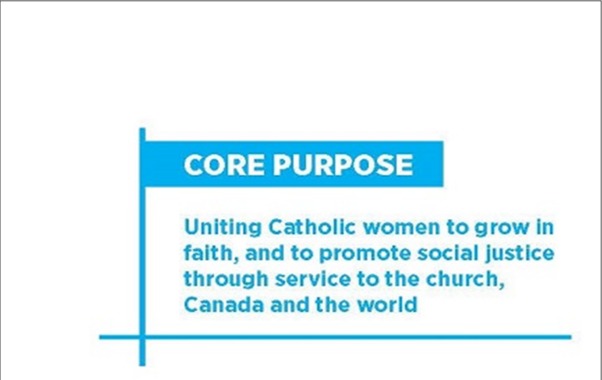
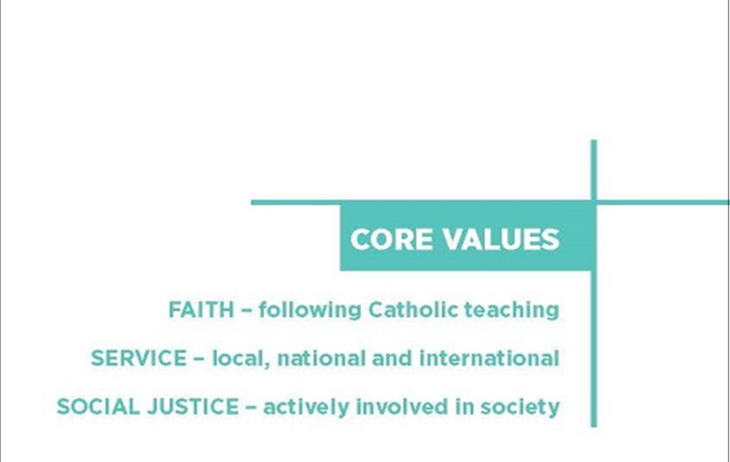
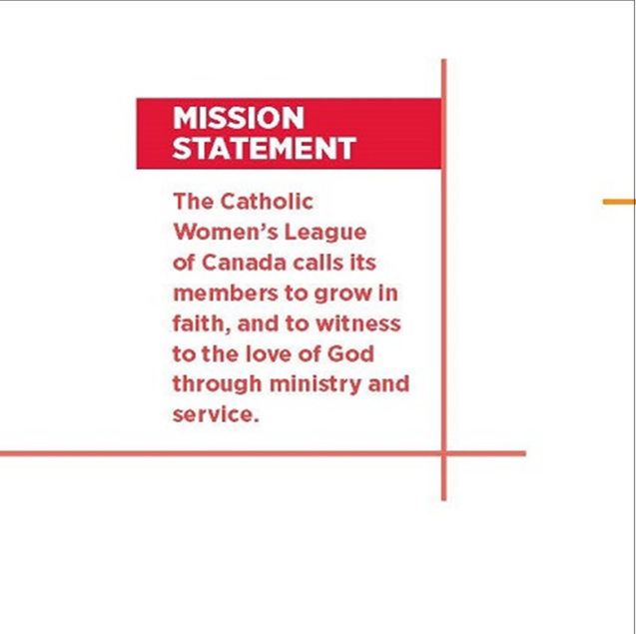
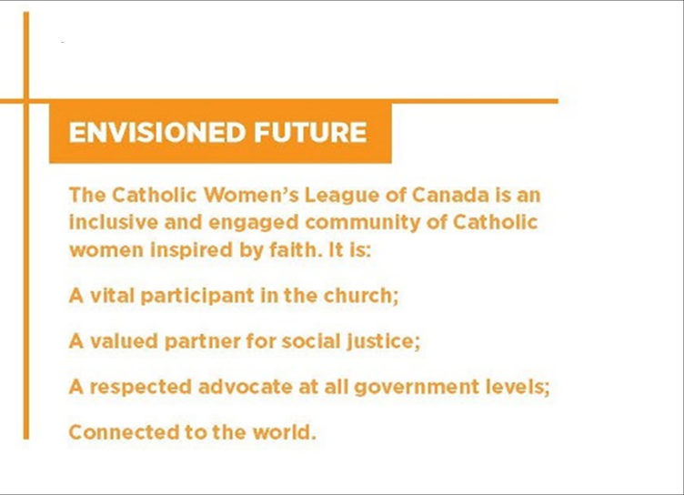
Why is there still a Catholic Women’s League after more than 100 years?
Notes:
READ:
On page 11 of The Catholic Women’s League of Canada Plans Strategically booklet, you will find the key descriptors of the League.
Each time you click, the slide will advance.
A core purpose is the reason an organization exists.
Click once to display the core purpose and read out loud.
The League’s core purpose is “Uniting Catholic women to grow in faith, and to promote social justice through service to Canada and the world.”
Click once to display the question. Then ask participants the question and have a discussion. (3 minutes)
Why is there still a Catholic Women’s League after more than 100 years?

Slide 27
What do you believe is the driving force for members?
Notes:
READ:
Core values are an organization’s fundamental beliefs that dictate its membership’s behaviour.
Click once to display the core values and read out loud.
The League’s core values are:
Faith – following Catholic teaching
Service – local, national and international
Social justice – actively involved in society
Click once to display the following question. Ask participants the question and have a discussion. (3 minutes)
What do you believe is the driving force for members?

Slide 28
What words are important to you in a League mission statement?
Notes:
READ:
A mission statement is a short statement that identifies the scope of an organization’s operations, i.e., what it does and how it is accomplished.
Click once to display the mission statement and read the statement.
The League’s mission statement is, “The Catholic Women’s League of Canada calls its members to grow in faith, and to witness to the love of God through ministry and service.”
Click twice to display the question. Then ask participants the question and have a discussion.
(3 minutes)
What words are important to you in a League mission statement?

Slide 29
What is most important to you that the League must take into the future?
Notes:
READ:
The envisioned future is a vivid description of what an organization strives to become.
Click once to display the envisioned future and read out loud.
“The Catholic Women’s League of Canada is an inclusive and engaged community of Catholic women inspired by faith.
It is:
A vital participant in the church;
A valued partner for social justice;
A respected advocate at all government levels;
Connected to the world.”
Click twice to display the following question. Ask participants the question and have a discussion. (3 minutes)
What is most important to you that the League must take into the future?

Slide 30
Sending Forth Prayer
Dear God, we pray for justice and peace, especially for those who are in greatest need of God’s healing and of our help.
We thank you for giving us the grace to defend those who cannot defend themselves and for the strength and talents of members of the Catholic Women’s League who bring healing and transformation to others.
We thank you for the blessing these Catholic women are in improving the lives of God’s children and of all creation.
We thank our patroness, Our Lady of Good Counsel, for her sure and constant guidance.
We pray you will always keep our hearts and minds open to your call when needs arise to create social justice in our local communities and across our country. Amen.
Notes:
Pray together:
Dear God, we pray for justice and peace, especially for those who are in greatest need of God’s healing and of our help.
We thank you for giving us the grace to defend those who cannot defend themselves and for the strength and talents of members of the Catholic Women’s League who bring healing and transformation to others.
We thank you for the blessing these Catholic women are in improving the lives of God’s children and of all creation.
We thank our patroness, Our Lady of Good Counsel, for her sure and constant guidance.
We pray you will always keep our hearts and minds open to your call when needs arise to create social justice in our local communities and across our country. Amen.

