Slide 1
The Catholic Women’s League of Canada Resolutions Workshop
A Guide to the:
Development, Adoption and
Review of Resolutions
Notes:
This workshop has been prepared to assist members in researching and developing a resolution in preparation for its adoption. It also contains information for the review of a resolution by a resolutions subcommittee.
Resolutions play a significant part in the League’s work by providing a voice for members to governments and organizations on topics of interest and concern. As far back as 1922, at a national convention, members were challenged to “take up some work of a national character that affects into the life of the whole country.”
Resolutions can be a powerful tool ”to infuse a Christian spirit into the temporal order” (Decree on the Apostolate of the Laity). The League can serve the Roman Catholic Church’s mission and be a Christian witness through resolutions. Through the intercession of our patroness, Mary, Our Lady of Good Counsel, prayer should accompany the resolution development process, asking the Holy Spirit to “give light to our minds and strength to our wills.”

Slide 2
Objectives of the workshop
To provide guidelines and suggestions that will aid members in developing, writing and implementing resolutions.
To overview the required procedures for the development, submission and adoption of resolutions and their subsequent review and disposition by the next levels of the League.
To facilitate understanding of the disposition of resolutions submitted by provincial councils to the national council.
Notes:
The information in this workshop is based on the Resolutions Handbook, which sets out policies and procedures to guide the resolutions process.
Review objectives on the slide.

Slide 3
Getting Started
Notes:
This section of the workshop provides background for taking an idea for a resolution through to starting the actual development of the resolution by putting together a committee.

Slide 4
Developing an idea
Check the national website (cwl.ca) for a list of current and archived resolutions and any published position paper on the topic.
Every adopted national resolution establishes the League’s position on the topic. This is separate from a position paper.
Topics addressed in archived resolutions could be considered for a new resolution, but only if there has been a change and the issue is again relevant or emergent.
Ensure that the resolution will conform with any League position paper published on the topic and with the criteria for acceptance of resolutions established by the national executive/board (National Manual of Policy and Procedure).
Notes:
Before starting any formal development on a resolution, it is important to verify that a League resolution has not already addressed the topic. There may be archived resolutions on the same issue you are interested in. However, a new resolution may be warranted if there has been a change since it was adopted and the topic is again current and relevant. For example, a resolution could be archived if a government bill addressed its concern; however, it would be appropriate for a new resolution if a subsequent bill were introduced to overturn or broaden the previous legislation.
A new resolution must conform with established positions and policies in the League’s published position papers and adopted national resolutions, policies and procedures.

Slide 5
Developing an idea
The originating council is responsible for determining the League destination of its resolution.
For example, a topic with a federal government focus would have the national level of the League as its destination.
For topics addressing government, ensure the proper jurisdiction is being addressed (municipal, provincial, federal).
For topics addressing organizations, determine if the national, provincial or local level would address the resolution topic.
As a courtesy, inform the chairperson of social justice at the next level about the idea and the desired action.
Inquire about the deadline date to submit your council’s resolution to the next level for consideration at its convention/annual meeting of members (AMM).
Notes:
Any member can bring forward an idea for a resolution. However, the intended recipient to act on the resolution (its destination) needs to be identified when the topic is being explored.
It is important to connect with the chairperson of social justice at the next level of the League so that she is aware of the possibility of a resolution. This aids in her planning, and she can provide helpful information, such as assistance with developing the resolution and the deadline date for submission. The timeline must include the deadline date for adoption by the originating council and be before the deadline date to submit it to the next level.

Slide 6
Putting together a subcommittee
Seek approval from your council for the topic and the desired action (intent).
The council adopts a motion to form a subcommittee to research the topic and develop the resolution.
Establish a chairperson – this could be the person who has the idea for the topic.
Once the motion to form a subcommittee is adopted, the resolution becomes a council project.
The subcommittee reports to the chairperson of social justice.
Notes:
A resolution is not a project that belongs to an individual member or team; instead, an adopted resolution becomes a formal position of the League’s membership. Members should be proud of their work and contribution through resolutions and gifting them to the organization. As the resolution progresses through the League, it belongs to the council entrusted with presenting it for adoption at its AMM. It should be expected that resolutions may change in wording or content. However, the intent is always maintained as the resolution progresses toward its destination.

Slide 7
Putting together a subcommittee
Choose a chairperson who will be a driving force to see the project through to completion.
If possible, seek members with computer skills, skills in researching literature or expertise on the topic.
Members interested in the topic or who want to learn about resolutions should be encouraged to join the subcommittee.
Include the council spiritual advisor and the president as ex-officio members and the chairperson of social justice, if not already included.
Notes:
The integrity and reputation of the League depend on well-researched and credible resolutions. Resolutions need to be original in development. Those researched by other groups or organizations will not be accepted.
The spiritual advisor serves on the committee because all resolutions shall conform to Roman Catholic Church teaching and doctrine. Developing a resolution can be made easier and less time-consuming if some committee members have skills related to developing resolutions or expertise on the topic.
All members are encouraged to learn about resolutions by participating on a subcommittee and attending workshops.

Slide 8
Developing the Resolution
Notes:
This section provides information on writing resolved clauses and bridging clauses and the difference between them—even though they both begin with the word “resolved.”

Slide 9
Structuring the resolution
Use the “Checklist for Reviewing Resolutions” and the Resolutions Handbook for the requirements for developing a resolution.
Note: the League no longer uses “whereas” clauses because:
A resolution is a “formal” motion. The reasons (whereas clauses) for adopting it should not be included in the motion (Robert’s Rules of Order).
Debate on the convention floor is now limited to the resolved clause(s).
Notes:
It is important to refer to the “Checklist for Reviewing Resolutions” as it contains the prerequisites for all resolutions to be considered at all levels of the League, especially the national level. The Resolutions Guide is a quick reference to aid in writing a resolution and is supplemental to the Resolutions Handbook. The handbook should always be the primary reference for writing a resolution as it contains more extensive information. Knowing the checklist’s requirements from the start helps serve as a guidepost for developing a resolution.
The “whereas clauses” were removed in 2019, although you will still see them in resolutions adopted before this date. The reasons behind the decision not to use “whereas clauses” include:
Some members who approve of the action proposed (resolved clause) may dislike voting for the motion if it states reasons (whereas clauses) with which they disagree.
At past conventions, the debates’ focus was often caught up in the wording of “whereas” clauses rather than the merit of the resolved clause(s).

Slide 10
Structuring the resolution: resolved clauses
The resolved clause clearly states what level of the League is requested to act and the action requested.
The resolution’s intent must remain the same as it progresses through the various levels of the League.
You may use two government destinations in the same resolution, e.g., directing action at the provincial and federal levels.
Source the Resolutions Handbook for the correct wording for each resolved clause pertinent to each level of the League (the council where the resolution originates and where it is directed for action).
Notes:
The resolution’s objective must be captured in its resolved clause(s).
The resolution’s origin will change as it is adopted through the various levels of the League on its way to its intended destination for action. For example, a resolution originating at a parish level and submitted to the diocesan level for adoption will be treated as a diocesan resolution when brought forward at the diocesan AMM. In other words, the originating council will now be the diocesan council’s name rather than the parish council’s. The same holds true as the resolution progresses to the provincial and national levels. So, even though a resolution originated at a parish level, it is presented for adoption as a national resolution at the national AMM when the national level is the intended destination for the resolution.
Despite the change in the name of the originating council, the destination and intent always remain the same when a resolution is presented for adoption.
If adopted at the national level, it becomes a national resolution and can be published in The Canadian League and posted on the national website. However, any identification of the submitting provincial council and standing committee designation will not be published.

Slide 11
Structuring the resolution: resolved clauses
More than one resolved clause is appropriate if more than one action is requested or more than one level is being requested to take action.
Compose the resolved clause(s) stating:
The name of the council requesting the action
The level of the League entrusted to act on the resolution (final destination) after adoption.
The name of the outside organization or government to which the resolution is directed.
What action is requested of the organization or government.
Who, Through, To and What
Notes:
You will capture the essential components of writing a resolved clause if you can remember the words who, through, to and what.
Review the content on the slide.

Slide 12
Structuring the resolution: bridging clauses
Use correct bridging clauses to:
Enable the resolution to be forwarded to its intended destination within the League
Ensure action on a resolution is only taken after its adoption at its final destination within the League.
Notes:
Even though bridging clauses start with the word “resolved,” they differ by the request they contain. These clauses bridge a resolution from one level of the League to the next.
Review the content on the slide.

Slide 13
Structuring the resolution: bridging clauses
Use the Resolutions Handbook for the correct wording of bridging clauses for resolutions destined for the diocesan, provincial or national level.
Examples of the types of bridging clauses for resolutions destined for the national level:
To the national council for consideration at its AMM.
Through the national executive to the national chairperson of a standing committee for education/action.
Through the national executive to provincial councils urging them to become aware of the topic as it pertains to their province/territory and to act on it as deemed necessary/prudent.
Notes:
There are specific resolved clauses to enable bridging a resolution from one level of the League to the next towards its final destination. The examples in the Resolutions Handbook provide wording to be used by parish councils as well as the other levels.
Review the content on the slide.
As with the resolution's resolved clause(s), the bridging clause(s) must be revised by the receiving resolutions subcommittee at the next level of the League to make them applicable to that level and to enable bridging the resolution towards its final destination.

Slide 14
Researching the Topic
Notes:
The quality of the research into the topic provides credibility for the resolution and protects the League’s integrity and reputation. This section offers guidance on gathering evidence to support the resolution’s position and organizing the information.

Slide 15
Researching and gathering support for the resolution
Start a folder to collect resources that support the resolution.
Check for current and archived resolutions and position papers on the national website pertaining to the resolution topic.
If possible, partner with other councils that are interested in or have studied the topic.
Use online sources to determine the resolution’s destination (e.g., level of government and department and ministers pertinent to the topic). For organizations, consult their websites.
For government-directed resolutions, search online for legislative sources pertinent to the topic (i.e., Hansard, LEGISinfo).
Check for the topic in League publications using the national website.
Notes:
The information to support a resolution can be varied and may come from multiple sources, including print, online, digital and broadcast media. For a resolution directed to an organization, it is also important to determine if it is national or local, its mission statement, its history, culture and values (“about us”), and its resources related to the topic.
Use the keyword search to find resources on the League’s website.
Staying organized with the information gathered is crucial as it will be the basis for writing the brief and preparing the reference list. It is also essential to entertain opposing viewpoints regarding the topic and be able to defend the position taken by the resolution.

Slide 16
Researching and gathering support for the resolution
Reflect on the information gathered to determine if there is enough factual information to support the resolution’s intent. Do not use theories, assumptions or personal opinions.
Use only reliable sources as primary resources.
The RADAR Tool handout provides examples of assessing if a resource is reliable.
Personal blogs, media accounts, secondary sources and opinion pieces can be used to find primary resources but should not be used as a reference. For example, they may provide background research information, key terms or words that assist in finding reliable resources.
Only use documents and publications that directly support the resolution’s intent and that will be cited in the brief.
Notes:
Review the slide content.
The RADAR Tool handout can be found as an appendix in the Resolutions Handbook.
Using a whole document or publication is unnecessary if some information is irrelevant to the resolution. It is permissible to select only paragraphs or pages from a document or publication as references to support the resolution's intent. These excerpts will be part of the reference material folder.

Slide 17
Researching and gathering support for the resolution
Poll results used as a resource must reflect the most current information and meet scientific (statistical) standards. Published reviews of a poll will often help determine how accurate a poll is.
At a minimum, the published description of a poll should reveal:
The margin of error. Generally, it should not be more than five or six points, with a “confidence level” most often at 95%.
The questions used and any bias.
The number and demographics of respondents (how representative it is of the population).
The poll procedure (methodology)—whether conducted online, by telephone, etc.
Notes:
Poll results can be helpful to support the significance of the resolution topic or issue. It can be confusing, however, to decipher their reliability and validity. Therefore, if little information is available regarding the poll procedures and the focus of the questions, the poll results should not be used as a reference.
Review the slide content.

Slide 18
Researching and gathering support for the resolution
Consider using outside expertise.
Consult members whose education and gifts of expertise can provide guidance on the topic and resources, such as those with careers as a lawyer, law enforcement officer, educator, bioethicist or health care professional.
Consult elected parliamentarians, legislators or senators who share a common interest in the topic or can direct you to current government legislation, statistics and studies.
Consult your spiritual advisor, clergy or other consecrated religious on topics regarding the church’s teaching.
Notes:
Guidance and information from others with specialized knowledge and understanding of the topic/issue can strengthen a resolution.
The subcommittee should provide the council with its research progress and determine whether to proceed in developing the resolution to completion.
Review the slide content.

Slide 19
Writing the Brief
Notes:
This section explains in detail the elements of a brief and the requirements to meet the writing standards and League criteria. The brief presents the evidence by order of importance to support the resolution. It should be informative and persuasive of the action in the resolved clause.

Slide 20
Writing the brief: organizing resource material
Organize and review all resource documents that will be used in the brief.
Only use documents or parts of documents that directly support the resolution’s intent.
All statements of fact must be supported by a credible reference. Therefore, the method of organization of resources must make it easy to locate the information for:
writing the brief
inserting in-text citations within the brief (references in parenthesis)
reviewing the resolution in its completed form by the resolutions subcommittee at another level of the League.
Notes:
The organization of resource material is an individual preference. Some may use electronic means, while others may prefer to do it in print using highlighting, sticky notes etc.
In writing the brief, selecting excerpts of a paragraph or quotations from a document or publication that support the resolution's intent is recommended.
Review the content of the second set of statements on the slide.

Slide 21
Writing the brief: organizing resource material
Develop an outline that organizes the information from the most important to that of lesser significance, as it will guide the writing of the brief.
The brief will be one page consisting of concise statements of facts explaining why the resolution is necessary.
It should be informative and persuasive of the action requested in the resolved clause(s).
Notes:
It is important to take an organized approach in writing the brief so the argument supporting the resolution develops logically. Being limited to one page makes it important to present only the most significant facts directly related to the resolution.
The strength of the argument relies on the information presented in the brief. It should convince others of the significance of the viewpoint and the resolution's requested action.

Slide 22
Writing the brief
The first paragraph of the brief defines the topic in the resolved clause(s) and outlines why a specific action is desired. Only address the topic of the resolution.
The body of the brief should reinforce and expand on the reasons for the desired action of the resolved clause(s). Describe the most important reasons first—other less significant reasons may follow.
The closing paragraph summarizes the topic and the validity of the concerns—it emphasizes the requested action of the resolved clause(s).
Notes:
These components of a brief described in this slide conform with the criteria used during the subcommittee's review and vetting process. They are detailed in the Resolutions Handbook and are a requirement of the “Checklist for Reviewing Resolutions.” If the brief is not constructed this way, the resolution will likely be returned for further development and revision.
Review the slide content.

Slide 23
Writing the brief: other considerations
Maintain a dignified and respectful tone and do not mandate the government or organization to act.
Keep the wording in line with the League’s non-partisan stance.
Be aware of counterarguments or resources to the position to defend the resolved clause(s). These should not be included in the brief or works cited.
Notes:
An example of maintaining a dignified and respectful tone is, “the federal government is urged to …” instead of “the federal government must; has a responsibility to….”
For a nonpartisan stance, quoting government documents in the brief is appropriate. However, there must be no mention of a political party or elected officials at any level of government.
Review the last statement on the slide that leads into the next slide.

Slide 24
Writing the brief
The brief needs to:
Inform and persuade the subcommittee responsible for reviewing and vetting the resolution at another level of the League.
Persuade accredited and voting delegates as well as the government or organization to whom the resolution is directed.
Notes:
Review the slide content.

Slide 25
Writing the brief: other considerations
Cite as much as possible—let the resources talk for you.
Use quotation marks for exact quotes to avoid plagiarism.
Summary statements and logical conclusions of the evidence may be used.
Ensure spelling, grammar and format of the text is correct according to League’s “Style Guide.”
Notes:
Correct formatting, grammar and use of references are significant elements that underlie the credibility of the information in the brief.
It is sometimes helpful to have someone who has not worked on the resolution review the completed brief for editing and provide feedback.
Review the slide content.

Slide 26
Writing the brief: in-text citations
Insert in-text citations after each fact or statement obtained from reference material using the most current version of Modern Language Association (MLA) format.
All in-text citations and quotations in the brief must be highlighted and flagged in the resource file.
Notes:
The League uses Modern Language Association (MLA) formatting for all reference citations in the text of the brief. In-text citations are placed at the end of a sentence, as in the image on the slide, although they may also appear elsewhere in the sentence. In-text citations are also referred to as parenthetical references. It is important to use the most current version of MLA format. Many university online writing lab websites provide detailed information regarding MLA in-text citations.
Highlight in-text citations in the resource material, as it is required for the resolutions subcommittee's review and vetting process. The resolution may be returned if this is not done.

Slide 27
Works Cited (Reference List)
Notes:
As with in-text citations, the League uses MLA formatting for the list of references. This section details constructing the works cited list (reference list). The works cited only lists direct references used in the brief. It differs from a bibliography which would include all sources of material reviewed in the preparation of the resolution. Resource material consulted but not referenced should not appear on a works cited list. For example, a newspaper article that gave the idea for a resolution is not considered a reliable resource and would not appear in the works cited.

Slide 28
Works cited list
A works cited list consists of direct references cited as in-text citations in the brief.
Resources must originate from a minimum of three reliable sources.
Use URLs/hyperlinks to enable direct sourcing of the citation by the resolutions subcommittee (where possible).
Resources related to the topic but not cited in the brief shall not be included in the works cited list. Therefore, do not submit a list of these resources.
Notes:
The references in the works cited list must correspond directly with in-text citations quoted or paraphrased in the brief.
The greater the number of direct, reliable sources supporting the resolution's stance strengthens the argument and makes it more impactful.

Slide 29
Works cited
Create a citation list in MLA format using all available information regarding the identification and location of the resource.
List works cited on a separate page in alphabetical order by last name of an author, title of publication or organization. See MLA formatting sites for examples.
Notes:
This is an example of a list of references as they would appear in a works cited list, using MLA formatting version 9.

Slide 30
Works cited
Assign sequential numbering to the alphabetically-organized works cited list to enable index tabbing for the review committee and for ease of locating information.
Organize a file of all resource material in the same alphabetical order as in the works cited list.
Number each index divider tab to correspond to the works cited list numbering.
Notes:
MLA formatting requires an alphabetical listing of references in a works cited list with an indentation of five spaces. However, the League also requires that the alphabetical list of references be assigned sequential numbering corresponding to the index tabs of resource material submitted with the resolution. It helps the resolutions subcommittee cross-reference the brief's in-text citations with the resource material when reviewing and vetting the resolution. As a result, it is permissible for the works cited list in a resolution to not comply with the MLA requirement of the five spaces indent.

Slide 31
Action Plan
Notes:
Resolutions are a point of pride for the League. However, developing a resolution is the work of a few. Without the membership following through on the recommended action plan, the resolution remains ineffective in its intended advocacy. There is no guarantee that meetings with government by national and provincial councils will result in elected officials paying attention to concerns and requested action(s) sought by a resolution. It is through actions such as letter writing by members and their education and awareness about the topic that influences the impact and outcome intended by the resolution. A resolution is merely words on a piece of paper unless members embrace their part to bring it to life through their actions.

Slide 32
Action plan
Develop suggestions for action by members regarding the objective of the resolution.
View the more current national resolutions on the League website for examples of action plans.
Notes:
Suggestions for action by members include becoming aware, writing letters, inviting speakers and becoming familiar with a particular law, publication, government stance etc.
Every standing committee chairperson provides leadership for initiating actions on resolutions in her council by bringing forward an adopted resolution for discussion and awareness and encouraging members to act upon it.
Letter writing effectively allows a member to advocate for the concern(s) addressed in a resolution. Letter-writing campaigns initiated by councils are an effective way of “walking the talk” by adding power to the message through numbers. The more letters the government or organization receives from members, the more impact it should have.
Resolutions are the voice of the League and can be a powerful tool “to infuse a Christian spirit into the temporal order” (Decree on the Apostolate of the Laity). The League can serve the mission of the Roman Catholic Church and be a Christian witness through resolutions and the letter-writing by members who lend their voices to the advocacy effort. Doing so is “faith in action.”
Review slide content.

Slide 33
Final Steps
Notes:
As with most projects, a resolution must be reviewed in its entirety and requires diligent editing to achieve the best final product. The following section provides information on the steps to completion for submitting the resolution.

Slide 34
Final steps
Title the resolution
Capture the topic and intent of the resolution using keywords from the resolved clause(s) to create the title.
Keep it brief.
Ensure
The text of the brief conforms to the League’s “Style Guide.”
All references used for in-text citations and in the works cited list follow the most current MLA citation format..
Notes:
Deciding upon a title after the development of the resolution is complete is recommended. It is through writing the brief that keywords emerge that could be captured in a title. The title must reflect the resolved clause(s).

Slide 35
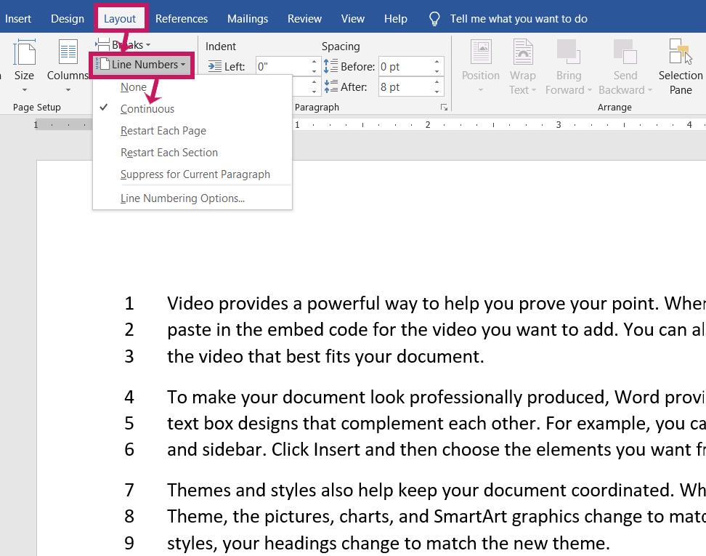
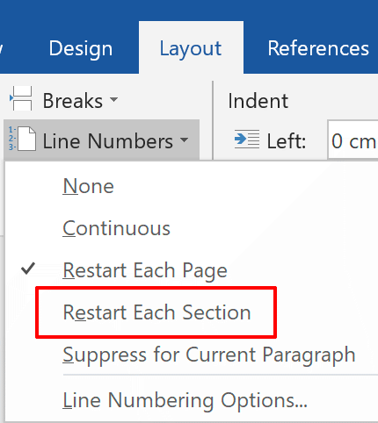
Final steps
When the document is complete, insert line numbering in the left margin for each page—resolution, brief, works cited and action plan.
The line numbering restarts at number one with each section.
Notes:
The left margin line numbering allows easy referencing when the resolutions subcommittee reviews and vets the resolution. Line numbering is particularly helpful in a resolutions dialogue session or during the adoption process. In addition, it aids in easy referencing during group discussions.
Review slide content.

Slide 36
Notes:
On the screen is a comparison of the MLA formatted works cited list and how the list appears with line numbering and meets the criteria for submitting a resolution. Because of the added sequential numbering assigned to the works cited list, the indent for the second line of each citation is not required by the League at the time of submission.

Slide 37
Posting the resolution on the national website
Notes:
Here is an example of a brief of an adopted resolution as it would appear when published on the national website. Note that all numbering is removed for current resolutions throughout, except for the action plan.

Slide 38
Final steps: submission format
Prepare a file of print copies of the resolution, brief, works cited list and action plan, as well as the original source of reference material that corresponds to the order of the works cited list.
Print only the document pages that directly support the citations in the brief (references in parenthesis).
Ensure you have a digital copy of all documents to submit to the next level, along with one printed copy of the complete resolution file.
The resolution, brief, works cited and action plan pages must be in an editable format (not PDF or JPG/image).
Notes:
A print copy provides universal access to the complete resolution file regardless of the technology available and facilitates the review of resources supporting the resolution. A print copy of the adopted resolution is also necessary for the originating council’s records and its archives. The same holds true for the receiving council. Editing the resolution will be required to bridge the resolution from one level of the League to the next. It is also anticipated that other edits may be required. Therefore, PDFs, photographs and scanned image files cannot be accepted.

Slide 39
Final steps: submission format
Ensure all citations, statistics and quotes referenced within the brief are highlighted.
Organize the print copies in a folder or three-ring binder.
A file of all resource material must be organized in the same alphabetical order as in the works cited list. Each index divider tab is numbered to correspond to the works cited list numbering.
Notes:
This is a summary for the finished product.
Refer to slide content and images as actual examples.

Slide 40
The “Checklist for Reviewing Resolutions”
Notes:
The “Checklist for Reviewing Resolutions” has already been introduced as a guide to developing the resolution. It is essential to meet every checklist requirement in the overall resolution review before submitting it for adoption.

Slide 41
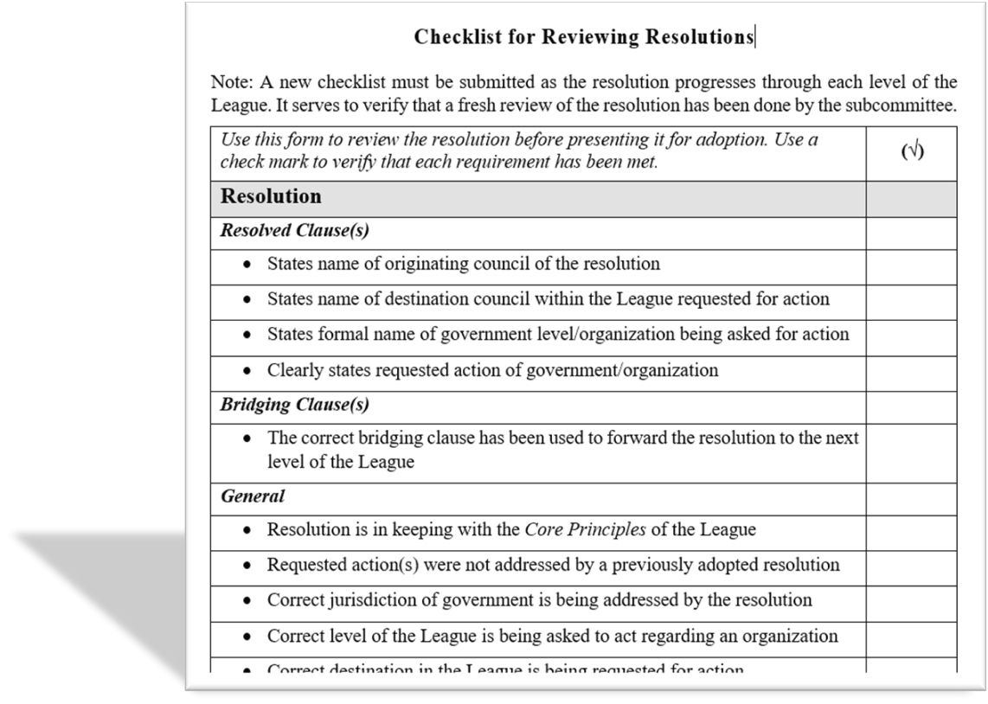
Using the checklist
Ensure the checklist criteria have been satisfied.
Indicate with a check mark that each checklist requirement has been met.
Notes:
The checklist has been revised to reflect the requirements for resolutions according to the Resolutions Handbook. A checkmark in the right margin indicates that you have reviewed that particular requirement and are satisfied that it has been met.
Review the slide content.

Slide 42
Using the checklist
The checklist must accompany the resolution after its adoption.
The checklist is to be used at all levels of the League. It can be printed, or a PDF fillable form is available on the national website.
Failure to meet checklist requirements could result in:
the resolution being returned.
the resolution not being thoroughly reviewed in time for the annual convention/AMM deadline.
the request for additional information by a specified deadline date prior to the annual convention/AMM.
Notes:
The checklist is used to review a resolution before being presented for adoption and must accompany the resolution when it is submitted to the next level of the League. The cover letter and checklist are the first documents the resolutions subcommittee at the next level will look at. A resolution may be returned if there is a failure to submit a completed checklist or if the checklist is submitted where one of the requirements still needs to be met.
Review the slide content.

Slide 43
Using the checklist
Resolutions subcommittees at each level of the League are responsible for reviewing and vetting the resolution to satisfy the elements of the checklist.
The resolutions subcommittee must submit a new checklist as the resolution progresses through each level of the League. This verifies that the committee at each level has done a fresh review of the resolution and that the checklist requirements have been met.
Notes:
Every level of the League is responsible for ensuring that a resolution meets League criteria. Therefore every resolutions subcommittee must complete a new checklist form to verify that its review of the resolution meets the checklist criteria.

Slide 44
Formal Presentation and Adoption of a Resolution
Notes:
There is often a collective sigh of relief and excitement of anticipation when reaching the point of presenting a resolution for adoption. This is the point of the resolution being gifted to the League.
There is the risk, however, to personalize the adoption process by those who have worked in developing the resolution. Be prepared that your work will be critiqued and edited. Subcommittee members may have to answer questions for clarification, defend the resolution’s position, or verify the quality of references. In some circumstances, the resolution may not be adopted. These possibilities can leave a person with feelings of frustration or anger and that they and their work are under attack, not valued or rejected. A member’s disposition of “letting go” and being willing to try again is essential. Developing a resolution presents learning experiences, as does the process of adoption as the resolution moves through the levels of the League.

Slide 45
Formal presentation and adoption of resolutions
Resolutions must be formally presented to councils by motion. A resolution must be moved, seconded and adopted by a majority vote, may be debated and amended and can have secondary motions applied.
Each level of the League must consult the Resolutions Handbook for direction on the formal presentation and adoption of a resolution and the procedures following adoption.
Notes:
A resolution is a motion that is more formal in its structure that introduces new business to the assembly. The rules for presenting a resolution are the same as for other motions. The Resolutions Handbook explains in detail the process for the adoption of a resolution by every level of the League.

Slide 46
Formal presentation and adoption of resolutions
For each level of the League, it is advisable to have a prepared statement to speak in favour of the resolution when the motion for its adoption is opened for debate.
Adopting a resolution initiates its review at the next level of the League.
Notes:
It is essential to be concise and clear when speaking in favour of the resolution when its adoption is open for debate. A rule of thumb is to have a three-minute statement. However, the standing rules of the convention/AMM will specify the amount of time allowed to speak to a motion. Requests for clarification or having to answer questions from the floor do not count in the time limitation.
Refer to the Resolutions Handbook for follow-up actions by each level of the League once a resolution is adopted. As a reminder, members can only act upon a resolution once it is adopted at its final destination.

Slide 47
National Resolutions Subcommittee Review and Disposition
Notes:
The following guidelines direct the review and vetting of resolutions submitted to the national level. Resolutions at all levels should be developed with these guiding principles in mind.

Slide 48
National resolutions subcommittee review and disposition
The national resolutions subcommittee reviews and vets the resolutions submitted by provincial councils.
It is recommended that each level of the League develop guidelines, such as deadlines for submission, for their resolutions subcommittee.
All levels should use the national guidelines to review and vet resolutions.
Notes:
The national resolutions subcommittee meets after all provincial councils have held their convention/AMM to review the provincial resolutions submitted by the deadline date. Refer to the Resolutions Handbook for detailed guidelines used by the national resolutions subcommittee for reviewing and vetting resolutions.
Review slide content.

Slide 49
National resolutions subcommittee review and disposition
The national review and vetting process includes all the national resolutions subcommittee members per League policy.
In addition to the subcommittee members, which includes the national spiritual advisor, the review may include consultation from outside experts on a specific topic (e.g., a medical doctor regarding a health topic, a lawyer regarding a legal matter or an educator regarding a specialized topic).
Following the review, a disposition letter must be sent to the submitting council.
Notes:
In vetting a resolution, subcommittee members avoid personal bias about the subject matter. The resolution is evaluated on the information submitted and the checklist. It must also satisfy the guidelines for reviewing and vetting a resolution and the criteria for acceptance by the national resolutions subcommittee as published in the Resolutions Handbook.
The letter of disposition conveys the outcome of the initial review and states the committee’s decision and recommendations to the submitting council regarding the resolution. This allows councils to consider the recommendations.

Slide 50
National resolutions subcommittee review and disposition
The resolution’s intent must remain consistent as it progresses through the League. However, the resolved clause’s wording may be edited.
As a resolution progresses through each level, resolutions subcommittees are responsible for revising the bridging clause to reflect the next level of the League accountable for the resolution.
Briefs of accepted resolutions may be revised as the subcommittee deems necessary.
Resolutions must go through the adoption process again if the subcommittee determines the intent must be changed, but the resolution has merit.
Notes:
The intent of a resolution through its resolved clause(s) cannot be changed by a subcommittee in its review and vetting process.
If the resolved clause is flawed or there is a discrepancy between the resolved clause’s intent and the purpose conveyed by the brief, the resolution will be returned. If the brief can be revised to correspond with the resolved clause’s intent, the resolutions subcommittee will return the resolution with a specified deadline date for revision and resubmission.
However, if a change to the resolved clause's intent is required, the subcommittee will return the resolution with recommendations that the resolution has merit but requires revision in its entirety. The adoption process would then have to be repeated the following year.

Slide 51
National resolutions subcommittee review and disposition
If the resolved clause’s intent requires change, the resolution is returned. The resolution with a new intent is treated as a new resolution, and the adoption process must be repeated by the provincial council in the following year.
The provincial council is responsible for revising and resubmitting the resolution. It does not return to the council where the resolution originated.
Notes:
Review the slide content. The slide provides summary information that is important to reinforce.

Slide 52
National resolutions subcommittee review and disposition
Just because a resolution may not be presented at a convention/AMM does not mean it is a failed effort.
Other types of dispositions are equally important.
Notes:
A disposition letter is used to convey that a council’s submission is not a lost effort because it would offer recommendations and guidance. The national executive is hopeful suggestions provided in a disposition letter will be received in the spirit it was intended. The national level remains available to provide guidance and assistance to the submitting provincial council regarding the recommendations.

Slide 53
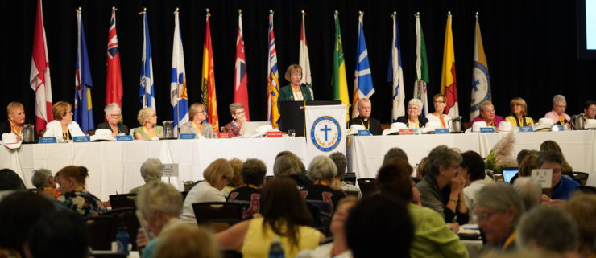
Types of disposition: national level
Recommended for presentation at the national convention/AMM.
The resolution fulfills the established criteria and passes the subcommittee’s review and vetting.
Notes:
Review slide content.
In this instance, the provincial president should become familiar with the resolution’s adoption process at the convention/AMM and arrange for a designate to speak in favour of the resolution when its adoption is opened for debate.

Slide 54
Types of disposition: national level
Recommendation pending discussion in August. The resolution will be considered for the annual national convention/AMM pending:
the receipt of additional information being provided to the subcommittee by a specified deadline date
additional review and vetting by the national resolutions subcommittee in August.
After the subcommittee’s further review in August, the subcommittee issues its recommendation (disposition) regarding the resolution.
The subcommittee members decide to recommend or not recommend the resolution for presentation.
Notes:
The subcommittee stops further review and vetting when it identifies that additional information is required to strengthen the resolution. The disposition letter will advise what is needed with a specified deadline date.
A further review in August will result in the final disposition letter. The resolutions subcommittee will recommend acceptance of the resolution if it now fulfills the criteria.
The reasons for recommending not to accept the resolution will be provided in the disposition letter if the resolution is returned. The reasons may vary, such as not meeting the deadline date or the additional information still does not adequately support the resolved clause’s intent. The national resolutions subcommittee presents its recommendations for each resolution it has received to the national executive, which makes the final decision to accept or return a resolution.

Slide 55
Types of disposition: national level
Recommended to be forwarded to a national chairperson for action.
The resolution has merit and is timely. However, the resolution lacks substantive support at a national level.
The national chairperson is directed to raise awareness of the topic through a communiqué or an article in The Canadian League and to encourage action by members.
Notes:
The integrity and reputation of the League lie in the resolutions put forward for adoption. Each adopted national resolution establishes a League position. The subcommittee tasked with reviewing and vetting resolutions includes appointed members at large, national officers (including the national president) and the national spiritual advisor.
Great care is given to distinguishing between actions requested through the resolved clause(s) and the ability of the national level to act. When a resolution topic is of national interest to members, but the action requested is not feasible at the national level, the subcommittee can recommend that it be forwarded to a national standing committee chairperson for member awareness and action. This ensures the resolution receives national attention and awareness instead of risking the loss of the resolution on the convention floor.
As with all resolutions, the national executive decides whether to accept the recommendations of the resolutions subcommittee.

Slide 56
Types of disposition: national level
Not recommended for presentation at the national convention/AMM:
The resolution has merit and is being returned with recommendations for revision by the provincial council. Before the revised resolution can be submitted to the national level, the provincial council must present its revised resolution for adoption at its convention/AMM the following year.
or
The resolution does not have merit at the national level as determined through the subcommittee review. This may be because the resolution topic is highly controversial or not in keeping with the objects and mission of the League. The resolution is returned to the provincial council.
Notes:
As mentioned previously, the provincial council can consider resubmitting a resolution that has merit after incorporating the recommendations made by the national resolutions subcommittee and repeating the resolutions adoption process.
When it has been determined by the national executive not to accept a resolution, the complete resolution file will be returned to the provincial council, accompanied by a disposition letter explaining the rationale.

Slide 57
Resolutions subcommittee recommendations
All recommendations for dispositions made by the national resolutions subcommittee are presented to the national executive/board at its pre-convention/AMM meeting.
Each recommendation is put forward by motion for acceptance, debated and voted upon.
A two-thirds vote of the national executive is required to overturn the recommendation to accept a resolution.
Notes:
The policy that gives authority to the national executive to overturn the recommendations of a resolutions subcommittee is evidence of how seriously the League approaches the review and vetting process. The resolutions subcommittee must present a rationale for every recommendation.
A simple majority is adequate to accept the recommendations of a subcommittee regarding a resolution. The requirement for a two-thirds majority vote for the national executive to not accept a subcommittee recommendation is indicative of and respects the depth of review given to the resolution and the greater knowledge resolutions subcommittee members have regarding the resolution.

Slide 58
Implementing the Adopted Resolution
Notes:
This section is specific to the action required by the executive of a council to carry forward the resolution’s request to the intended government level or organization. This brings the resolution’s intent to life and is part of the advocacy of resolutions.

Slide 59
Reaching the intended contacts
Each council level should have a policy and procedure for organizing a meeting to present current resolutions to the intended government or organization.
For resolutions directed towards government, this will be flexible with each province and council level (e.g., parish/diocesan – municipal; province – provincial; national – federal).
For resolutions directed to the church, the diocesan council would follow up with the diocesan bishop.
Notes:
When meeting with government officials and, if time allows, resolutions previously presented to government may be revisited by the delegation to inquire about progress made since the last meeting.

Slide 60
Thank you
Resolutions are hard work. Pat yourself on the back for even attempting a resolution.
It can seem like thankless work—it may feel like there is little recognition of the time and energy required to create a resolution.
Do not get discouraged.
Repeated attempts make us understand more and get better at it.
The League is working hard to develop meaningful and effective resources to guide members.
Notes:
It is recognized that resolutions take effort and time to develop. It can be a challenging journey.
However, resolutions are foundational to the League's work. Through them, policy and position papers may be established, programs planned, or concerns and views expressed to governments and organizations.
Developing and gifting resolutions afford opportunities for members to be a part of the direction and work of the organization at all levels and effect change. All efforts by members to develop a resolution are greatly valued and appreciated.
The receiving resolutions subcommittee at each level takes on ownership of a resolution to make it the best it can be before presenting it for adoption. Their efforts are also important and greatly valued.
Review slide content.

Slide 61
At the end of the day, we are doing God’s work…
The Resolutions Handbook reminds us:
Resolutions can be a powerful tool “to infuse a Christian spirit into the temporal order” (Decree on the Apostolate of the Laity).
The League can serve the church’s mission and be a Christian witness through resolutions.
Prayer is essential at every step of the resolutions process.
Notes:
An attitude of humility and service surrounds the development of a resolution. Prayerfully seek the intercession of Mary, our patroness, and she will counsel you along your journey.
Review slide content.

Slide 62
Questions and Thoughts

