Slide 1
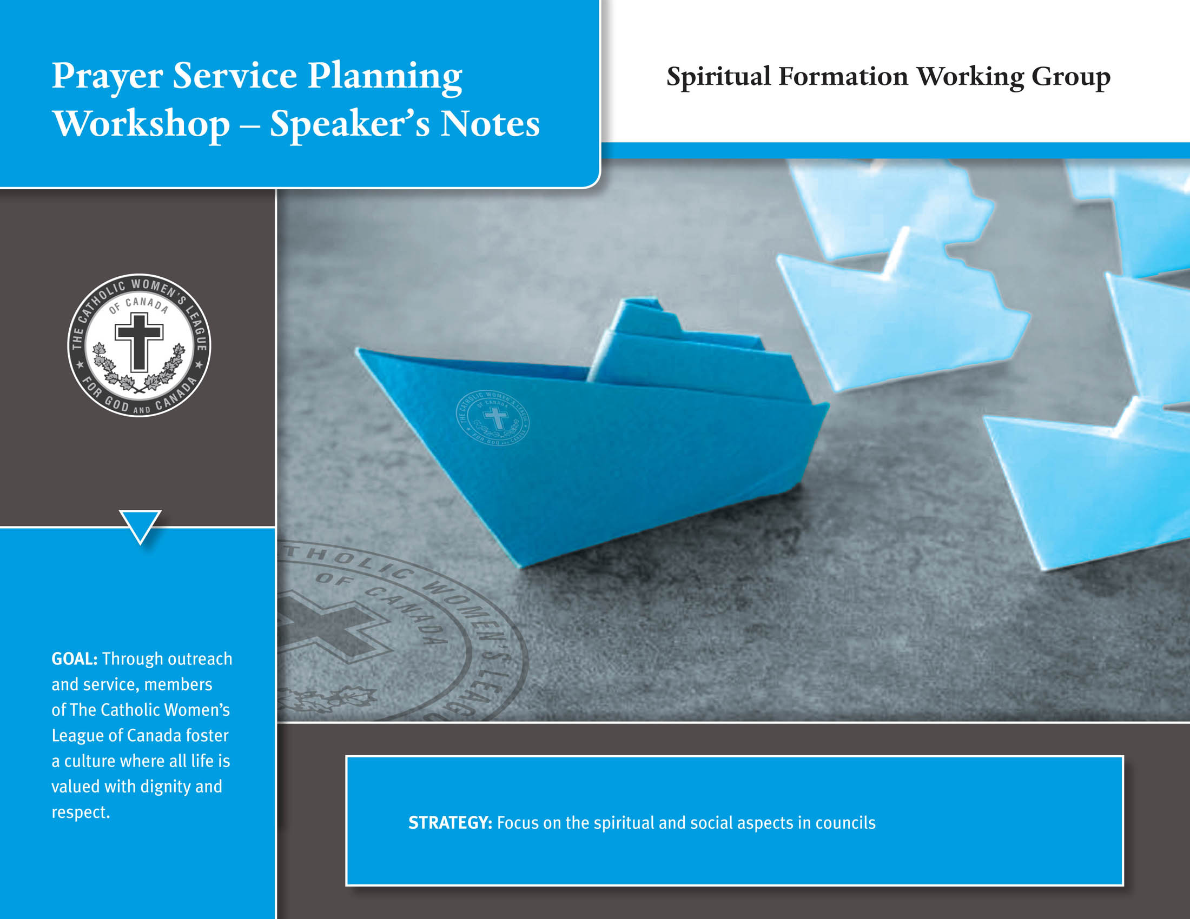

Slide 2


Slide 3
Table of Contents
^{Planning} ²
^{Opening Prayer 4}
^{What is Copyright? 7}
^{Copyright Protects 8}
^{How Long Does it Last? 9}
^{Why Copyright? 10}
Copyright and Prayer Services 11
^{How to Search for Images? 12}
^{Using Search Tools 14}
^{Music 15}
^{Written Text 16}
^{Preparing a Prayer Service 19}
^{Points to Remember 21}
^{Six Forms of Prayer 23}
^{Five Categories of Prayer 24}
Free Flowing / Spontaneous Prayer 25
^{How to Prepare a Prayer 27}
^{The League Prayer 28}
^{Prayer Exemplars 29}
^{Activity Time 30}
^{Prayer 31}
^{Writing Your Prayer Service 32}
^{Peace Prayer Service 33}
^{Gathering Song Exemplars 34}
^{Opening Prayer 35}
^{Scripture Reading 36}
^{Read quietly and reflect 37}
^{Petitions 40}
^{Closing Prayer 41}
^{URLS for images 42}

Slide 4
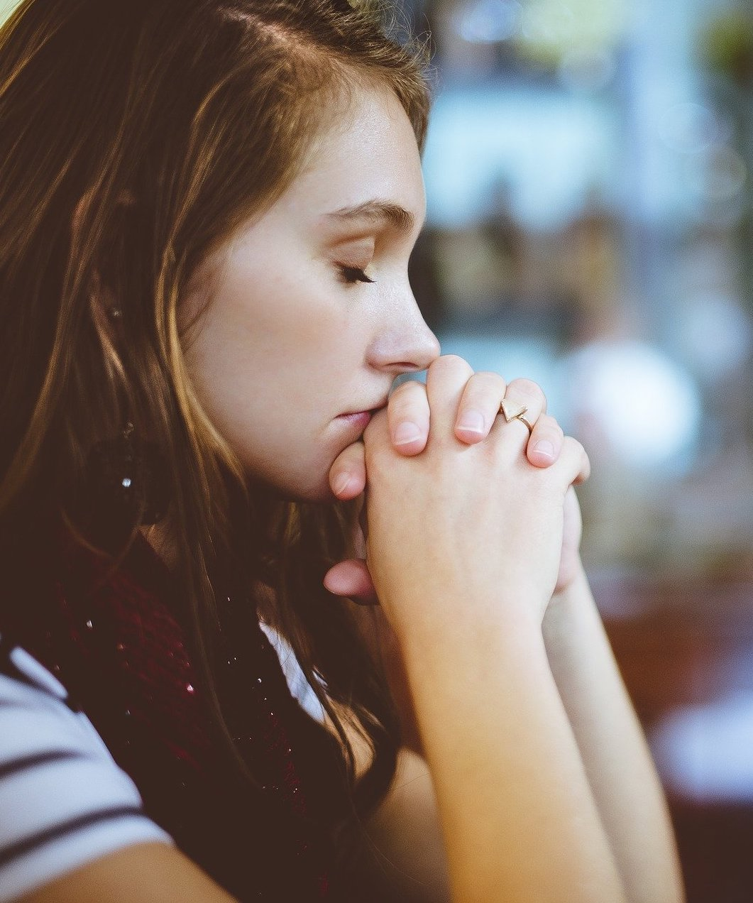
Planning
• Opening prayer
• Copyright
• Types of prayer
• Things to consider
Notes:
The spiritual formation working group was struck in spring 2020 and worked for one year on various projects, including this presentation. The purpose of developing this project was three-fold:
to teach members some basic skills that would enable them to write their own prayers and prayer services so that each meeting would include the elements of spiritual growth and growth in relationship with each other.
to assist members in growing spiritually—to deepen prayer life in councils. What better way to read and develop knowledge of scripture than by writing and sharing prayers and prayer services?
to avoid the serious legal issue of breaking copyright of prayers, prayer services, music, images, etc., produced by other people and organizations.

Slide 5
Opening Prayer
^{Silence}
Listen in silence because if your heart is full of other things you cannot hear the voice of God. But when you have listened to the voice of God in the stillness of your heart, then your heart is filled with God.
To make possible true inner silence, practice: Silence of the eyes, by seeking always the beauty and goodness of God everywhere, and closing them to the faults of others and to all that is sinful and disturbing to the soul.
Silence of the ears, by listening always to the voice of God and to the cry of the poor and the needy, and closing them to all other voices that come from fallen human nature, such as gossip, tale bearing and uncharitable words.
Silence of the tongue, by praising God and speaking the life-giving word of God that is the truth, that enlightens and inspires, brings peace, hope and joy; and by refraining from self-defense and every word that causes darkness, turmoil, pain and death.
Silence of the mind, by opening it to the truth and knowledge of God in prayer and contemplation, like Mary who pondered the marvels of the Lord in her heart, and by closing it to all untruths, distractions, destructive thoughts, rash judgments, false suspicions of others, vengeful thoughts and desires.
Silence of the heart, by loving God with heart, soul, mind and strength; loving one another as God loves; and avoiding all selfishness, hatred, envy, jealousy and greed.May we make total use of Your gift of silence this week as we come together to do your work at this convention. Amen.
^{Adapted from prayers of}
^{St. Mother Teresa of Calcutta}
Notes:
This prayer is an adapted quote from St. Teresa of Calcutta’s In the Heart of the World: Thoughts, Stories and Prayers.
She asks us to listen in silence because if our hearts are full of other things, we cannot hear the voice of God. The humble saint states that “when [we] have listened to the voice of God in the stillness of [our] heart[s], then [our] heart[s] [are] filled with God.” Therefore, to make possible true inner silence, practice:
Silence of the eyes, by seeking always the beauty and goodness of God everywhere, and closing them to the faults of others and to all that is sinful and disturbing to the soul.
Silence of the ears, by listening always to the voice of God and to the cry of the poor and the needy, and closing them to all other voices that come from fallen human nature, such as gossip, tale bearing and uncharitable words.
Silence of the tongue, by praising God and speaking the life-giving word of God that is the truth, that enlightens and inspires, brings peace, hope and joy; and by refraining from self-defense and every word that causes darkness, turmoil, pain and death.
Silence of the mind, by opening it to the truth and knowledge of God in prayer and contemplation, like Mary who pondered the marvels of the Lord in her heart, and by closing it to all untruths, distractions, destructive thoughts, rash judgments, false suspicions of others, vengeful thoughts and desires.
Silence of the heart, by loving God with our heart, soul, mind and strength, loving one another as God loves; and avoiding all selfishness, hatred, envy, jealousy and greed.
Please lead us, our God, to hear Your voice as we learn to practice inner silence. Amen.

Slide 6
Notes:
We have all seen this symbol and usually do not pay much attention to it. It is on nearly every form of medium. What does it mean?

Slide 7
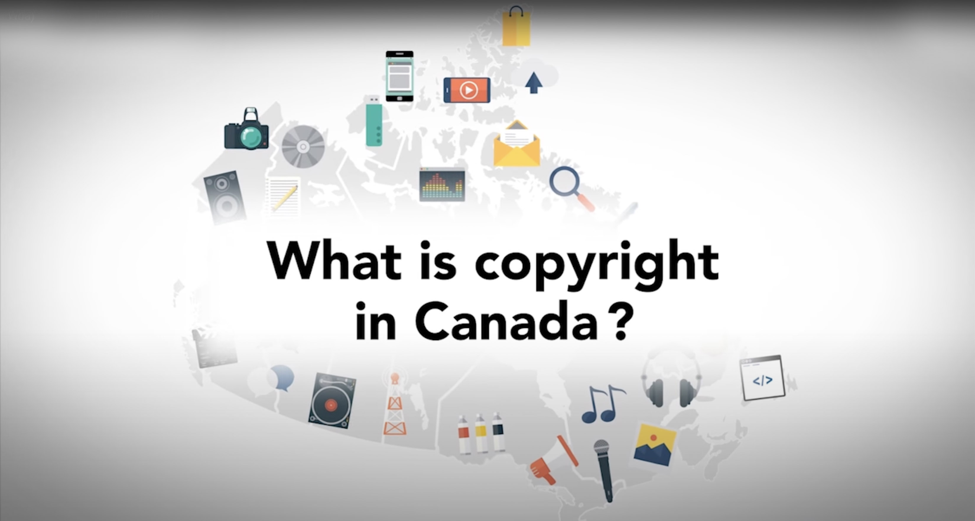
What is Copyright?
Notes:
(What is a copyright? Video: 00:02:44)
youtube.com/watch?v=ljNS5p3cqls&feature=youtu.be

Slide 8
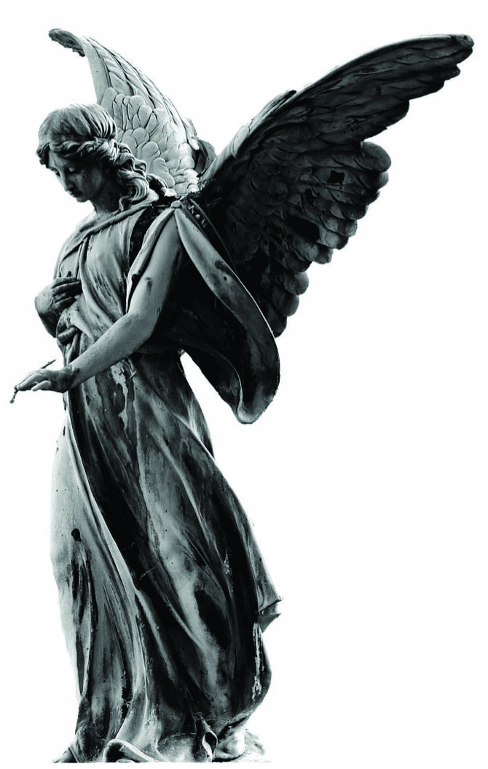
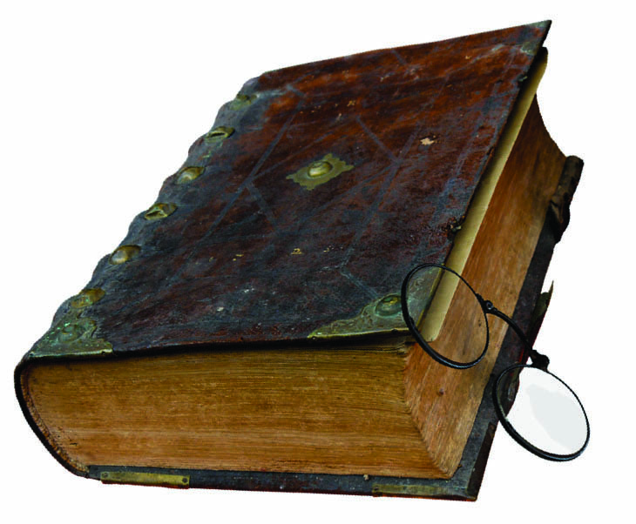
Copyright Protects:
• literary works
• computer programs
• dramatic works
• musical works
• artistic works
• performances, recitation,
sound recordings
Notes:
literary works (books, pamphlets and other works consisting of text)
computer programs
dramatic works (movies, plays, screenplays and scripts)
musical works (with or without words)
artistic works (paintings, drawings, maps, photographs, sculptures and plans)
performances, recitation and sound recordings

Slide 9
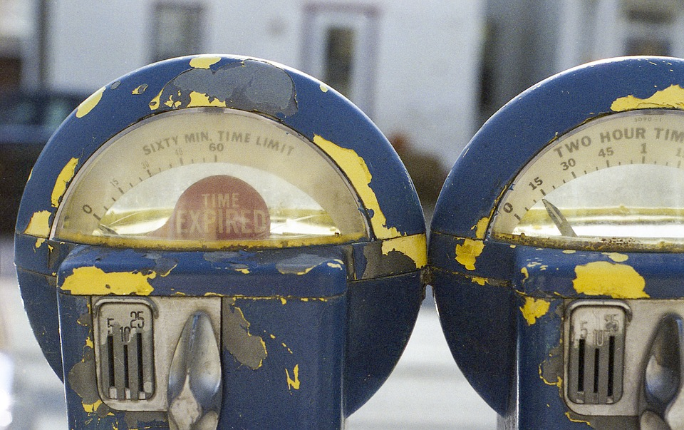
How Long Does it Last?
Notes:
The life of the author, the remainder of the calendar year in which the author dies and for 50 years following the end of that calendar year.
Therefore, copyright protection expires on December 31st of the 50th year after the author dies.

Slide 10


Why Copyright?
Notes:
Creators of the work must be compensated so they can earn a living.
Copyright protects the creators of the work, so they have some control over how their work is used.

Slide 11
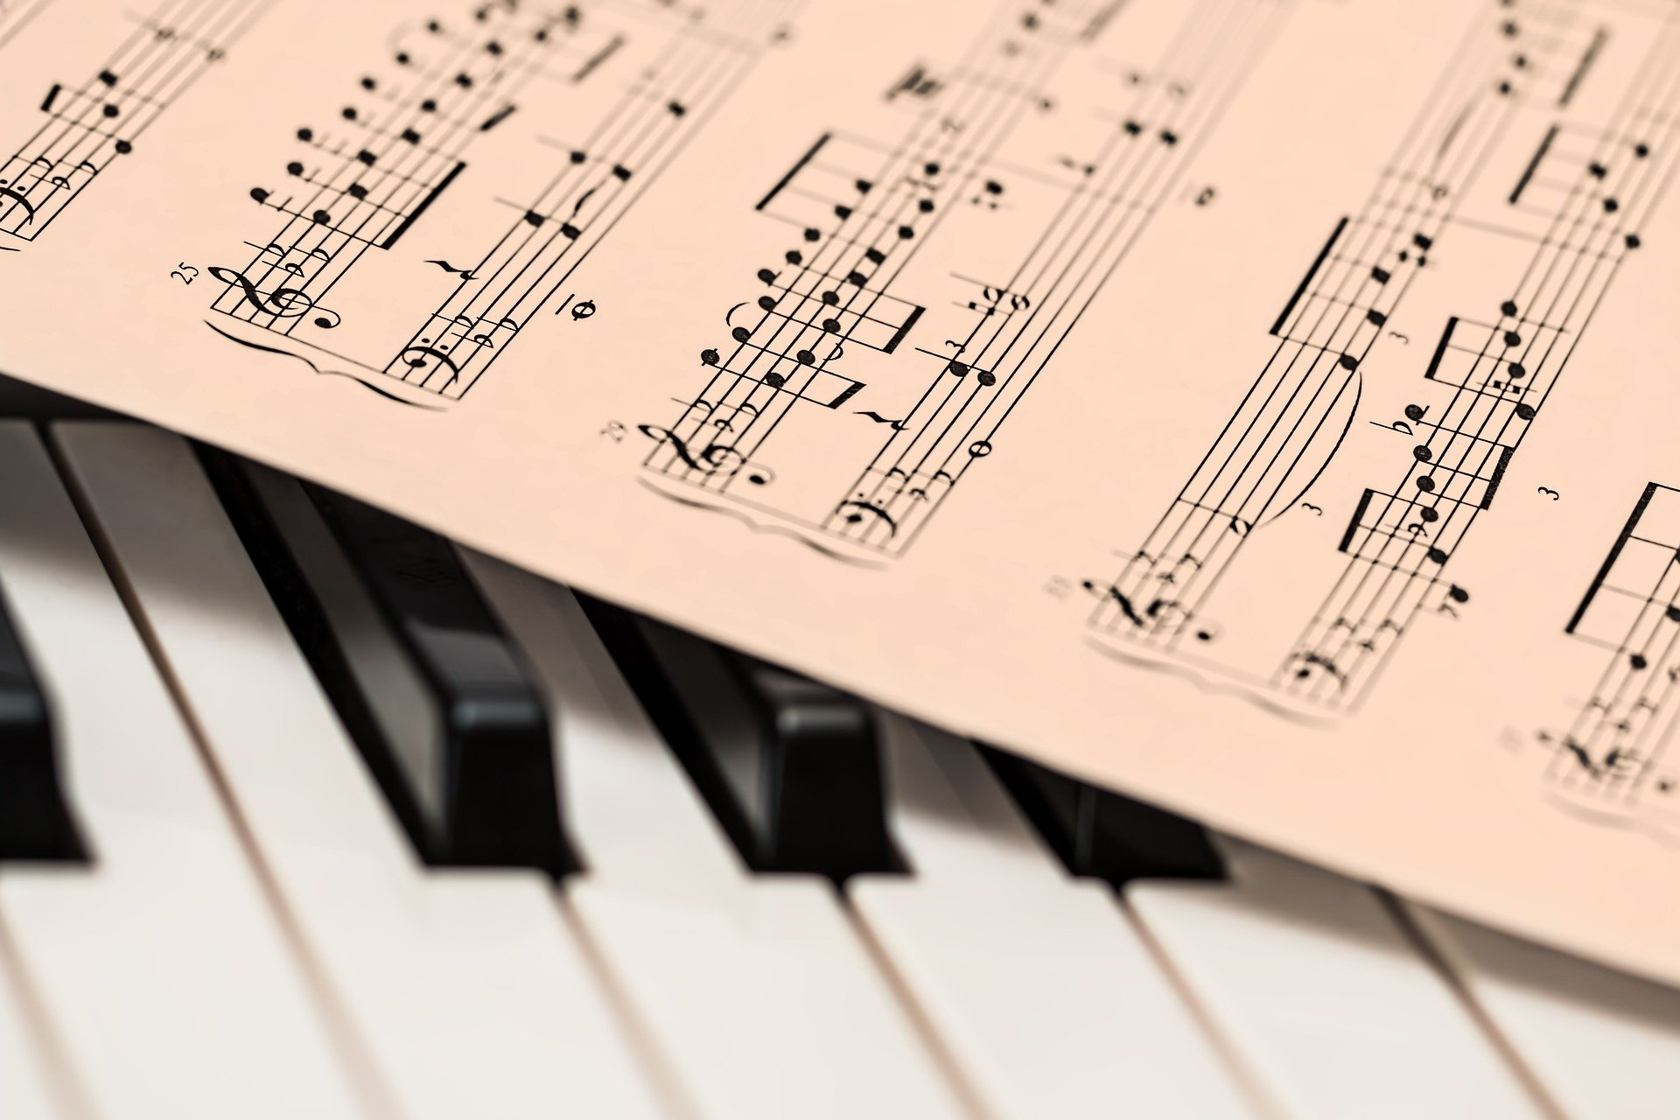

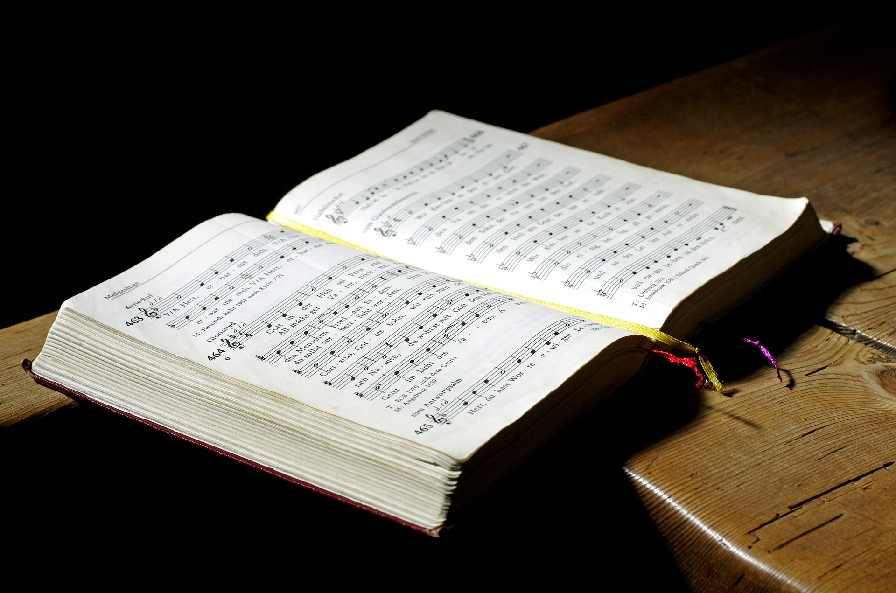
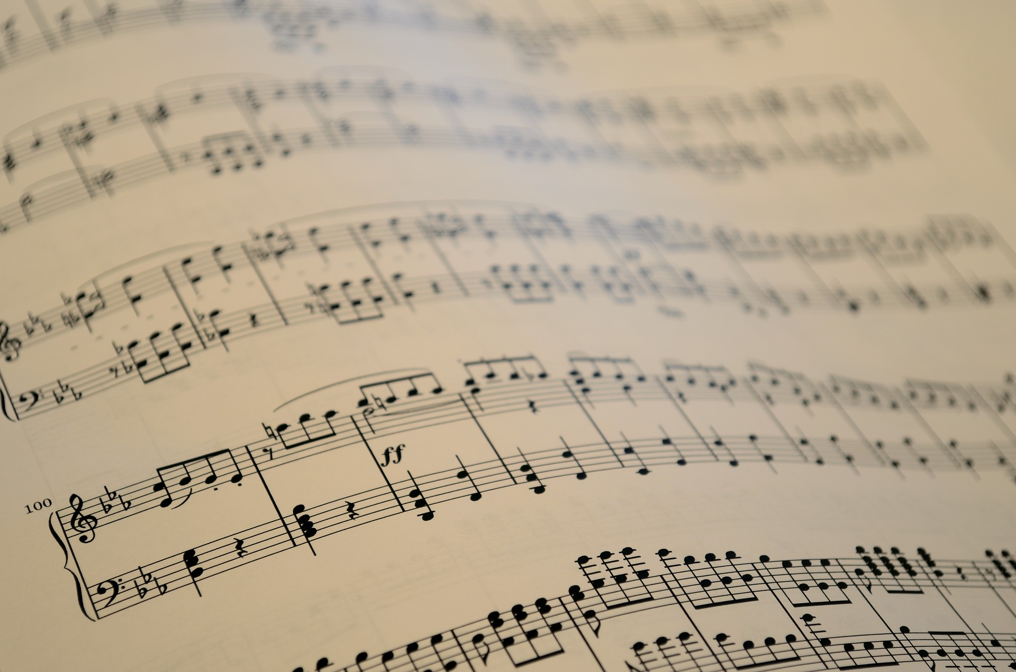
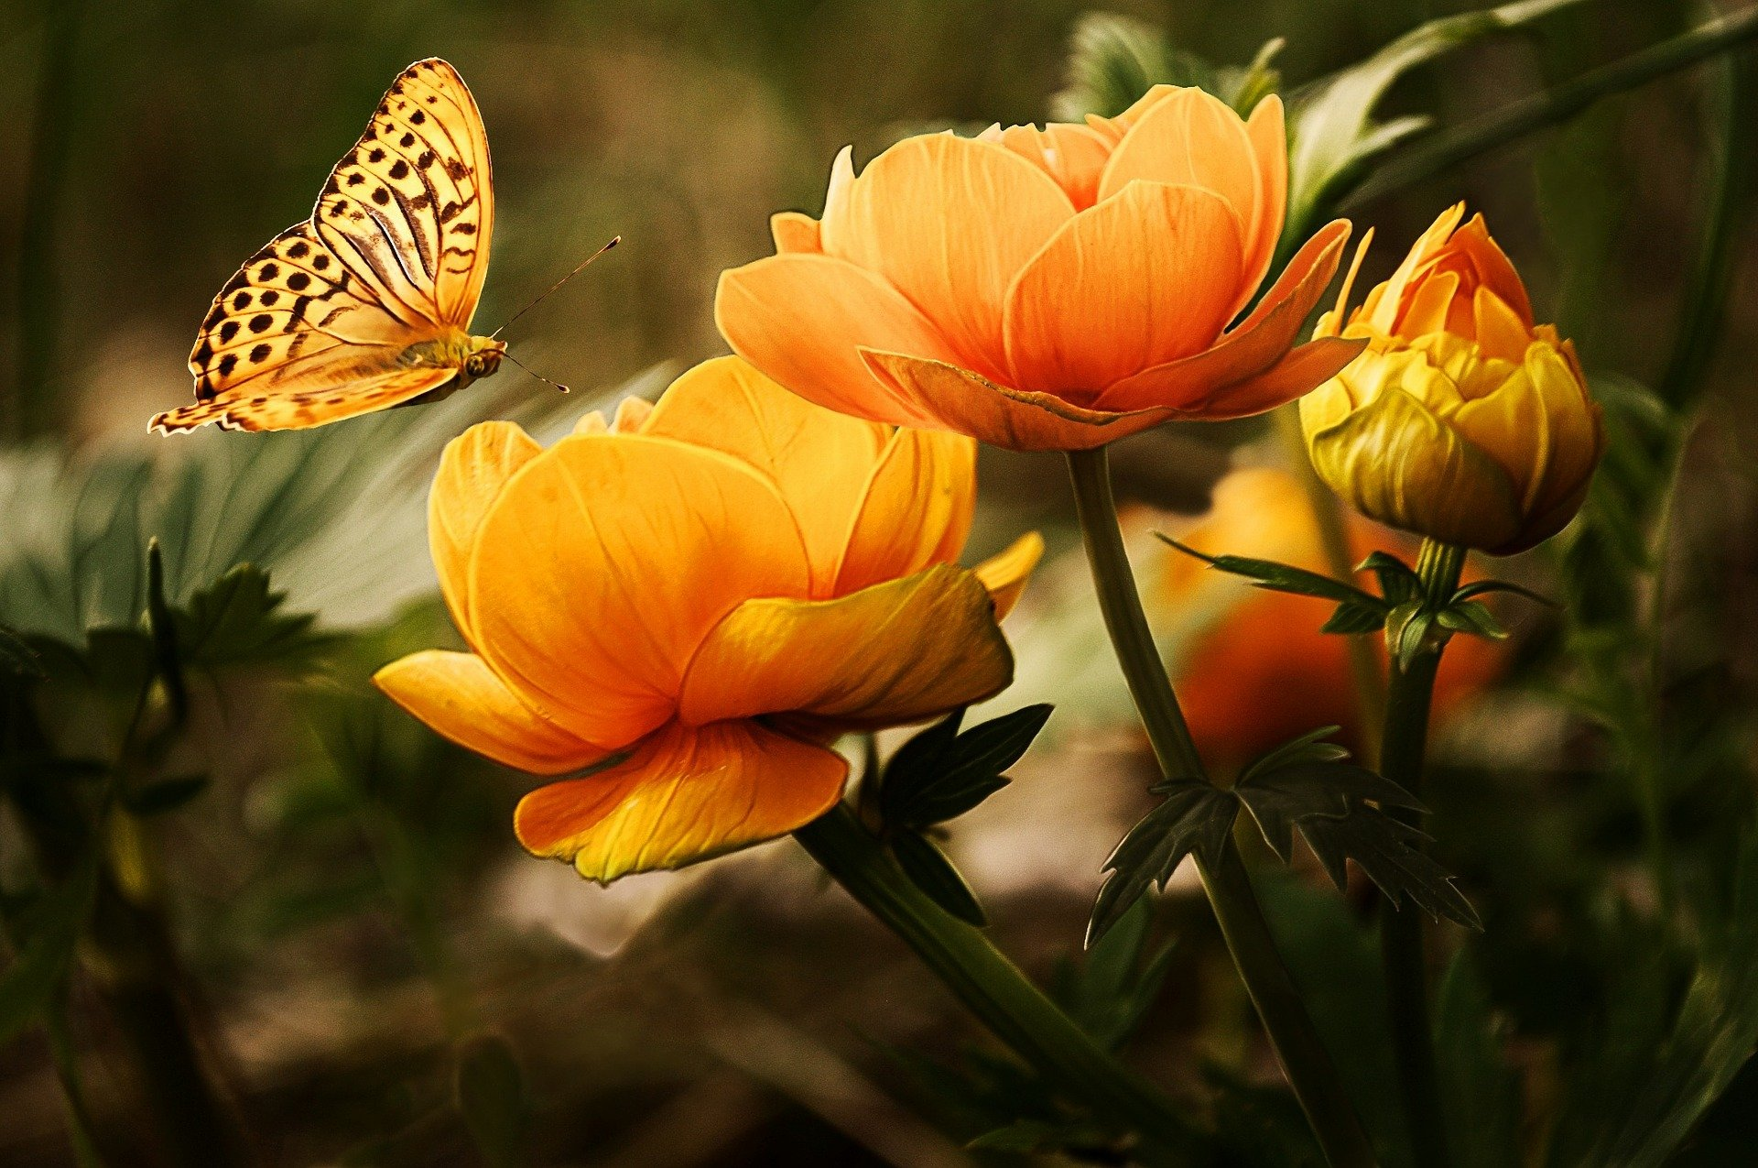
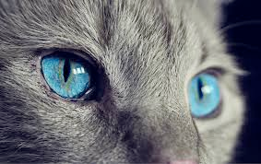


Copyright and Prayer Services
Notes:
Where are we going to encounter copyright in prayer services?
images (stills or video)
text
music (sheet music or recordings)

Slide 12
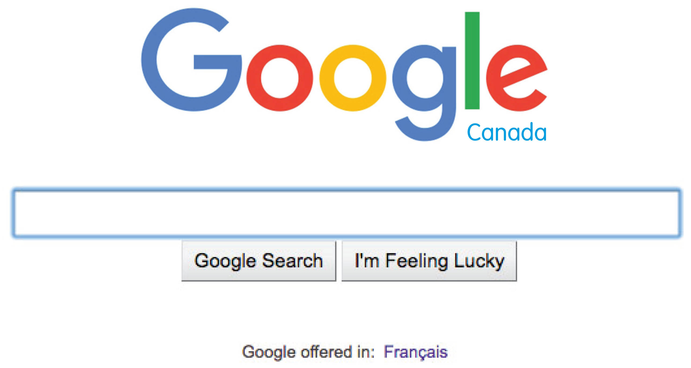
How to Search for Images?
Notes:
The best and sometimes easiest thing to do is to use your own images. This avoids copyright issues and has the benefit of being more personal.

Slide 13
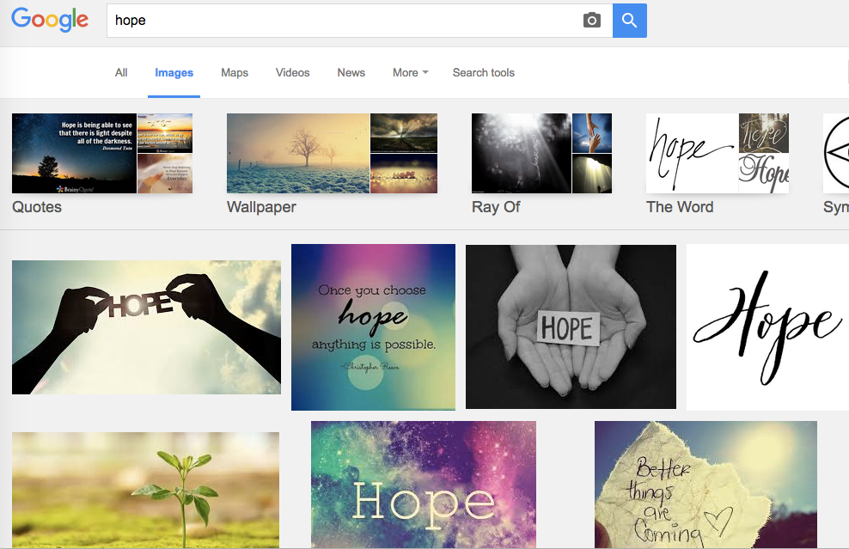
Notes:
Regular search—not worried about copyright!

Slide 14
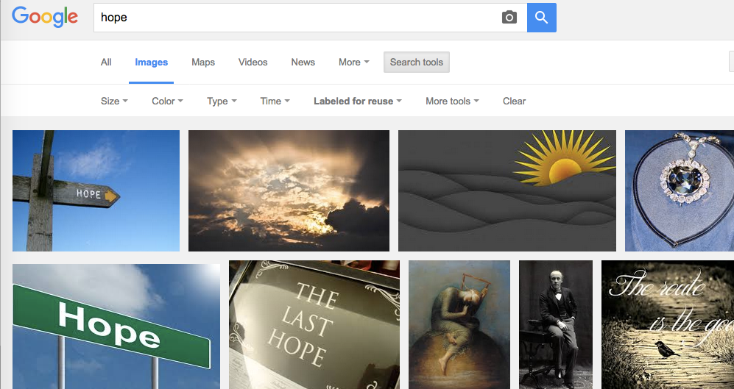
Using Search Tools?
Notes:
Using “Search Tools” or “Tools,” click on “Labeled for reuse” or “Usage Rights,” then select “Creative Commons licenses” from the dropdown menu. According to Google Support, Creative Commons licenses are images that “are usually available at no charge to use, but require credit. They may also have limitations on how, or in what context, you can use them. For example, an image's license might state that you can't modify it or use it for commercial purposes.”

Slide 15


Music
Who owns it?
How can we use it?
Notes:
Music copyright in Canada:
the right to produce or copy the musical work (such as sheet music).
the right to reproduce the musical work, including mechanical rights (such as cassette and digital audio reproductions) and synchronization rights (such as music in films, videos and multimedia productions).
performing rights, which are the rights to perform a work in public (such as a live concert, a recording or any other type of public performance) and the right to communicate to the public by telecommunication (e.g., a broadcast).
Buying a compact disc or other recordings only gives you the right to listen to it in private. The public performance of these musical works is subject to copyright law and therefore requires a Society of Composers, Authors and Music Publishers of Canada (SOCAN) licence.
Many musicians have sold the rights to their music to various companies. You would now need to approach the company for permission to use.

Slide 16

Written Text
Notes:
Need to ask for permission to use or reprint. The easiest thing is to write your own.

Slide 17
Notes:
When this symbol is present, we need to ensure we have permission for use.

Slide 18

Notes:
Use this slide to take a break or change speakers.

Slide 19
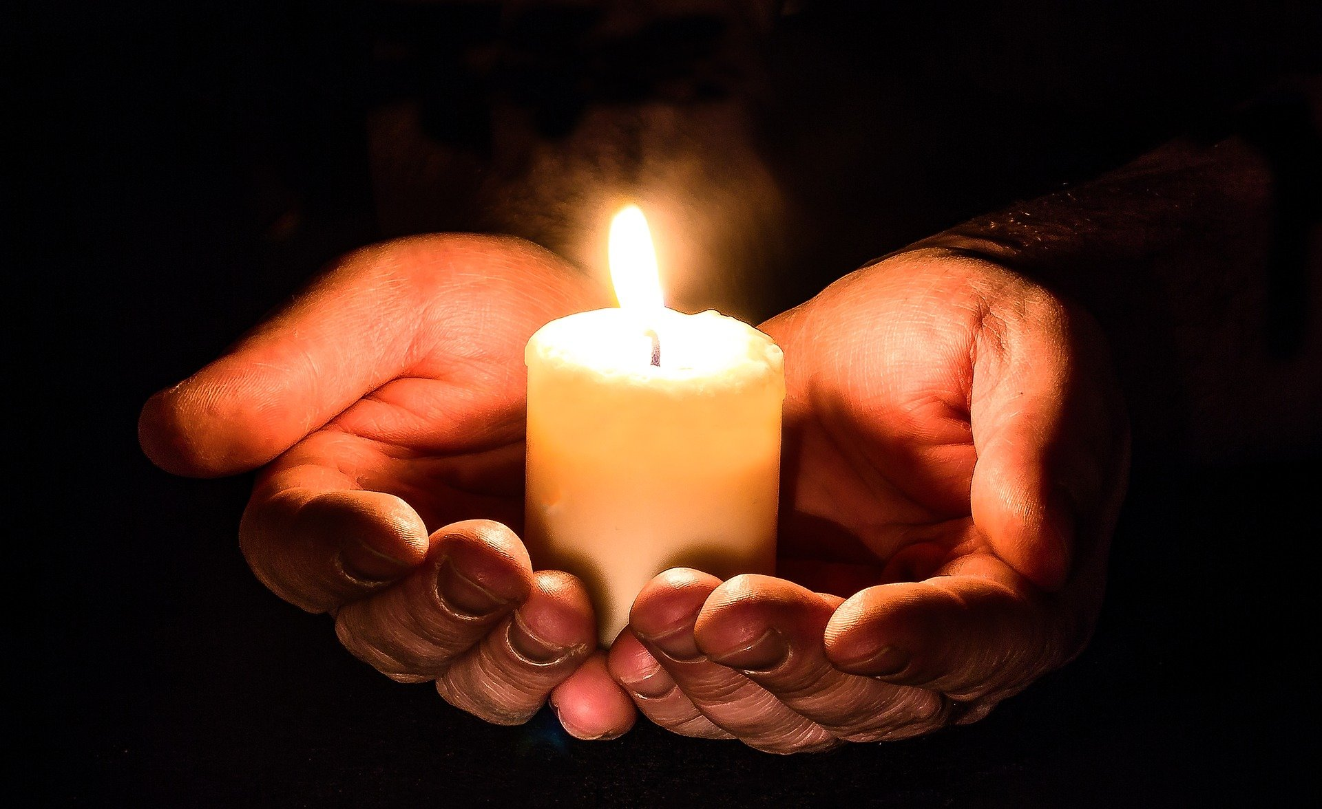
Preparing a Prayer Service
Notes:
First, we will look at prayer—what prayer is, where and when we pray, types of prayer, categories of prayer, and how to write your own prayer.

Slide 20

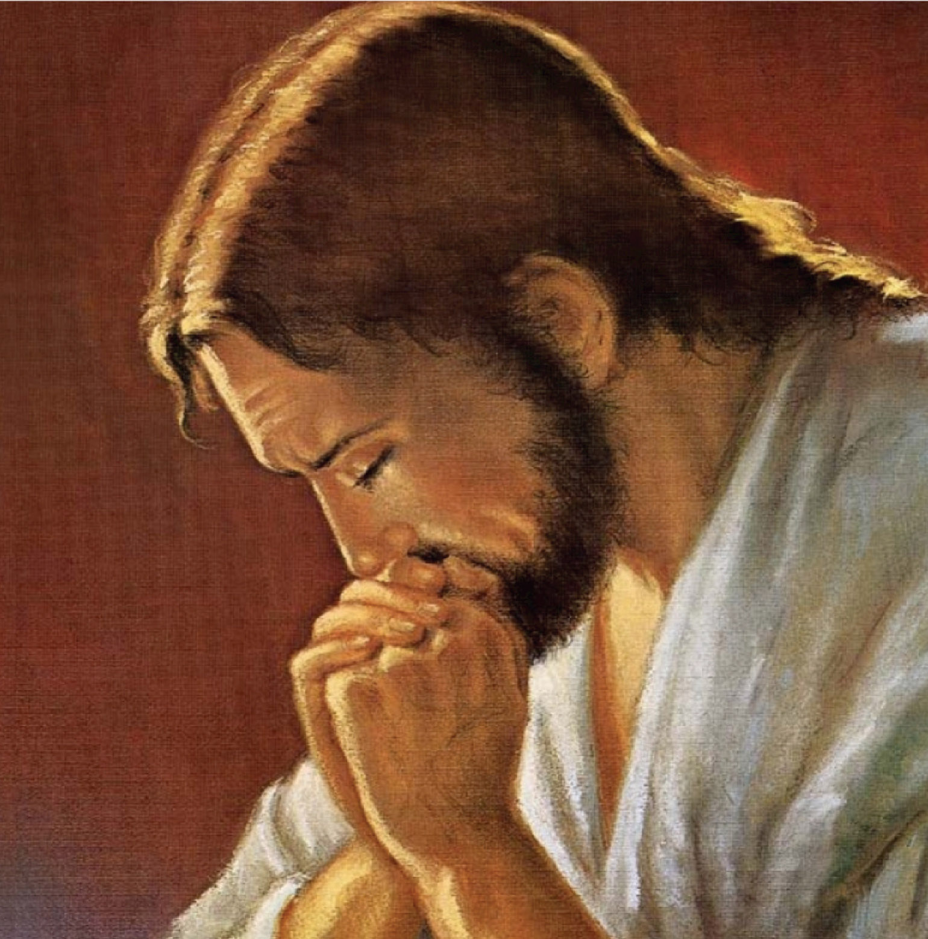
We are a people of prayer…
Jesus is our greatest model of prayer…
Notes:
We are a people of prayer. One of God's greatest gifts is prayer—He allows us an opportunity to develop a relationship with Him, Jesus and the Holy Spirit through prayer. In prayer, we speak to God, who listens and hears us. He speaks to and loves us, and we feel that love in prayer. We can rest and enter into God’s peace in prayer. We can walk with Jesus in prayer. We can enter into salvation history in prayer, and ultimately, we can learn of God's will for our lives in prayer.
Jesus is our greatest model of prayer. Notice in the scriptures how often Jesus prayed—alone and with others.

Slide 21
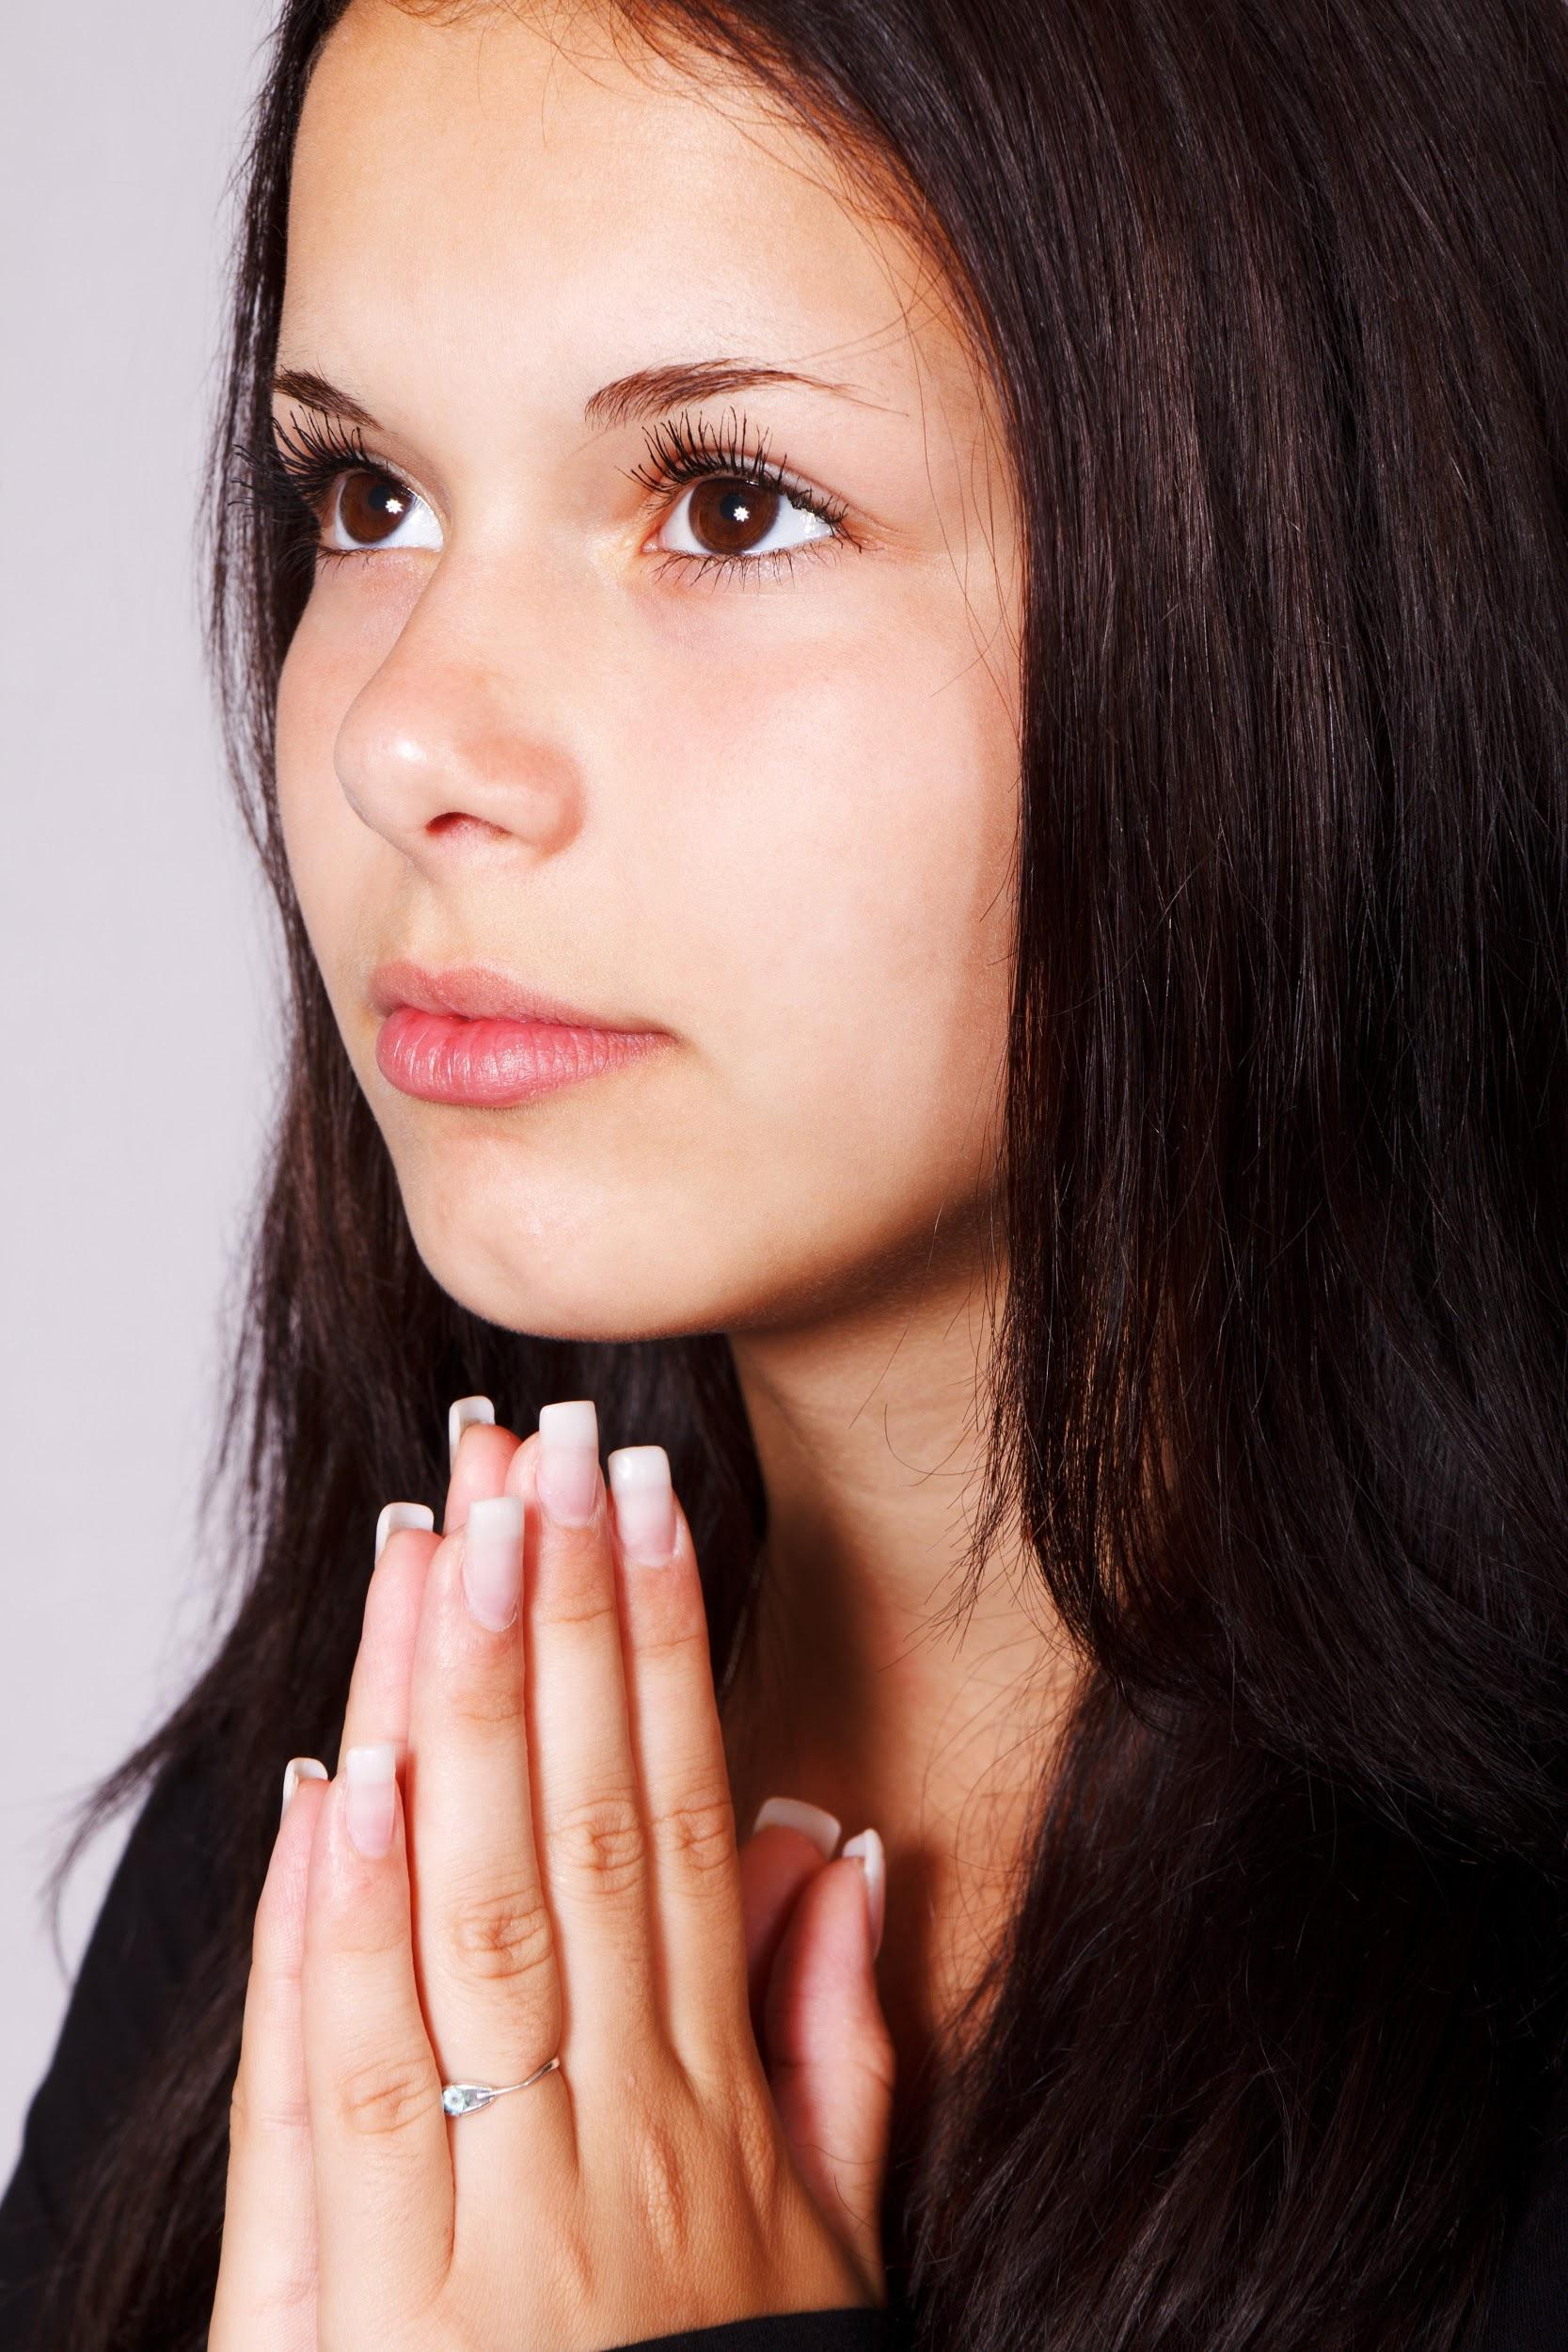
Points to Remember
• Prayer flows from the word of God.
• Prayer is relationship time with
God, Jesus and the Holy Spirit.
• Prayer can be short or long (in personal prayer), simple and sincere.
• Prayer is a response of our whole self to God.
• Prayer is a free response by the Holy Spirit who can teach us to pray.
Notes:
Points to remember:
Prayer flows from the word of God.
Prayer is relationship time with God, Jesus, Holy Spirit.
Prayer can be short or long (in personal prayer), sincere and straightforward.
Prayer is a response of our whole self to God.
Prayer is a free response assisted by the Holy Spirit, who can teach us to pray.

Slide 22
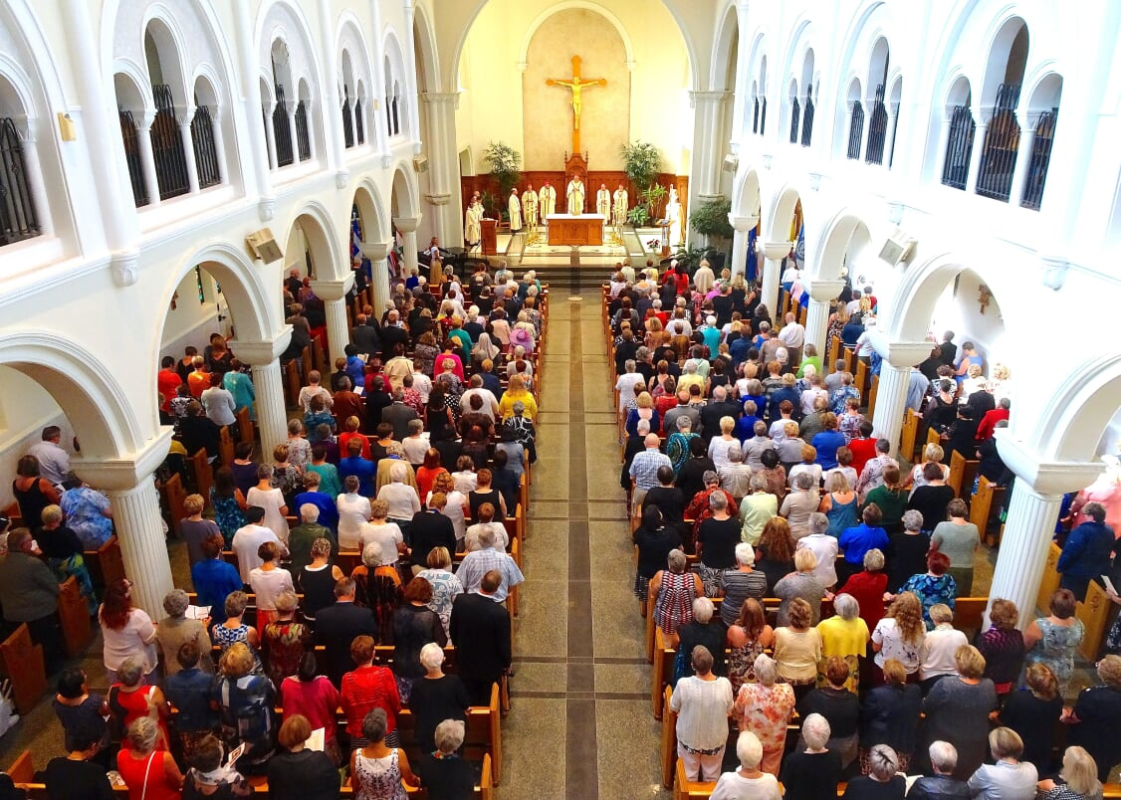
Notes:
Daily Interaction with God: Each of us engages with God every day, either in formal prayer (adoration, rosary, divine mercy, etc.), in mass attendance or through short informal personal prayers.
Mass, Eucharist, Sunday Prayer: The Eucharist is the ultimate form of prayer or worship. It is a fountain of grace. Mass (gathering together as a community) fulfills Jesus’ directive. Here we are commissioned to go and live as Jesus did, to care for our brothers and sisters. Our actions on Sunday and each day of the week are our “prayers.”

Slide 23
Six Forms of Prayer
^{1 Blessing}
^{2 Adoration}
^{3 Thanksgiving}
^{4 Praise}
^{5 Petition}
^{6 Intercession}
Notes:
Blessing: The prayer of blessing has a unique place within our tradition. During a blessing, you may use oil to symbolize strength, healing and comfort. Also, the use of holy water to trace the sign of the cross is an excellent example of a blessing.
Adoration: In this type of prayer, we worship God as He is divine. We regard/adore Him with reverent admiration and devotion.
Thanksgiving: In this type of prayer, we thank God for our blessings and talents and acknowledge our blessings and opportunities.
Praise: Here, we celebrate, affirm and congratulate God as we are in awe of Him. An example is, “Lord, you have always been there for us, leading us and watching over us.”
Petition: We ask for His help and guidance by placing our trust in Him.
Intercession: Here, we ask God for our needs, or we ask Our Lady or the saints to intercede with Him on our behalf.

Slide 24
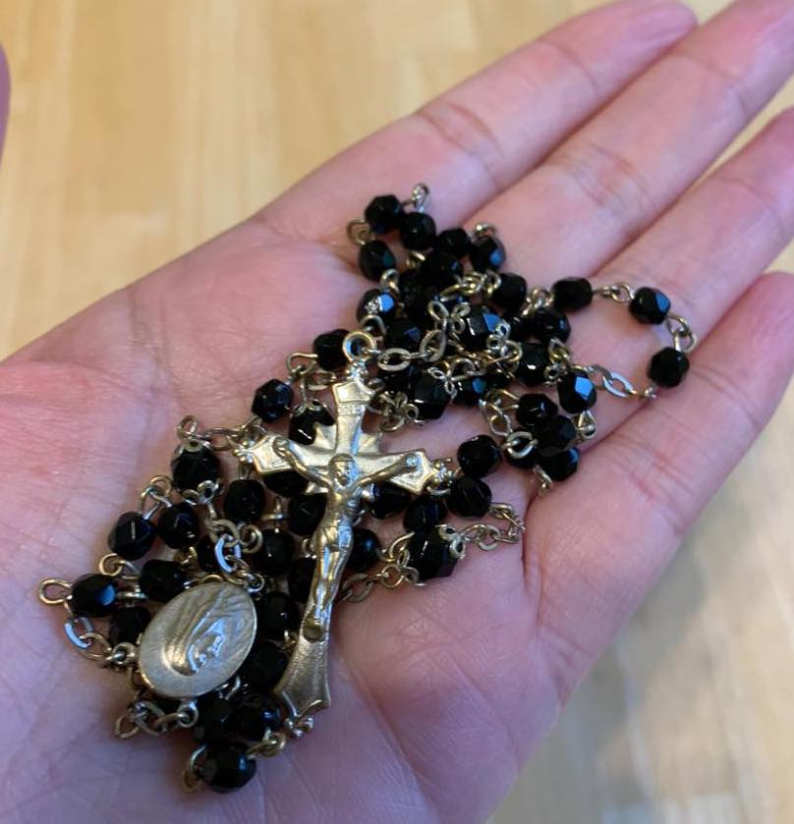
Five Categories of Prayer
• contemplative
• Ignatian exercise
• Lectio Divina
• personal prayer
• free flowing / spontaneous
Notes:
Contemplative Prayer: This is a common form of prayer. In practice, it is usually related to a bible quote or story, and praying that scripture or story. This is almost always done alone, in a quiet place without distractions. It is sometimes referred to as centering prayer. Many books and resources are available.
Ignatian Exercises/Spirituality: This form of prayer is a series of exercises developed by St. Ignatius of Loyola, focusing on meditation, self-discipline and daily self-examination. It is a pathway to more profound prayer, making decisions guided by keen discernment.
Lectio Divina (Latin for divine reading): It is a practice of scriptural reading intended to promote communion with God and increase knowledge of His word. It is a way of praying with scripture that calls one to ponder, listen and pray. Many books and resources are available.
Personal Prayer: These are the prayers learned from childhood. For example, the sign of the cross; The Lord’s Prayer; the Angelus; prayers to your guardian angel; acts of faith, hope and love; acts of contrition; the rosary; Marian prayers; Father, Son and Holy Spirit prayers; saint prayers; divine mercy chaplet; litanies and novenas; and adorations, devotions and benedictions. These prayers can be categorized into four basic types:
A - C - T – S
Adoration: praise and blessings to the Lord.
Confession: reconciliation, seeking mercy and forgiveness.
Thanksgiving: thanking God for all He has done/will do.
Supplication: petition, intercession and asking for help.
Free Flowing Prayer

Slide 25

Free Flowing / Spontaneous Prayer
A formula exists for this type of prayer:
Glory: begin by blessing and praising God
Story: recall, in faith, the great things God has done
Worry: trusting in God, ask for needs
Glory: end by blessing God
Notes:
Free flowing is the last grouping. We pray spontaneously every day… “Lord, give me patience”, “Oh God, how can I be in two places at one time”, and “Please God make this day end!”
Interestingly, there are actual formulas for spontaneous prayer. Here is an example of one:
Glory: begin by blessing and praising God.
Story: recall, in faith, the great things God has done.
Worry: trusting in God, ask for needs (personal, world, church).
Glory: end by blessing God.

Slide 26
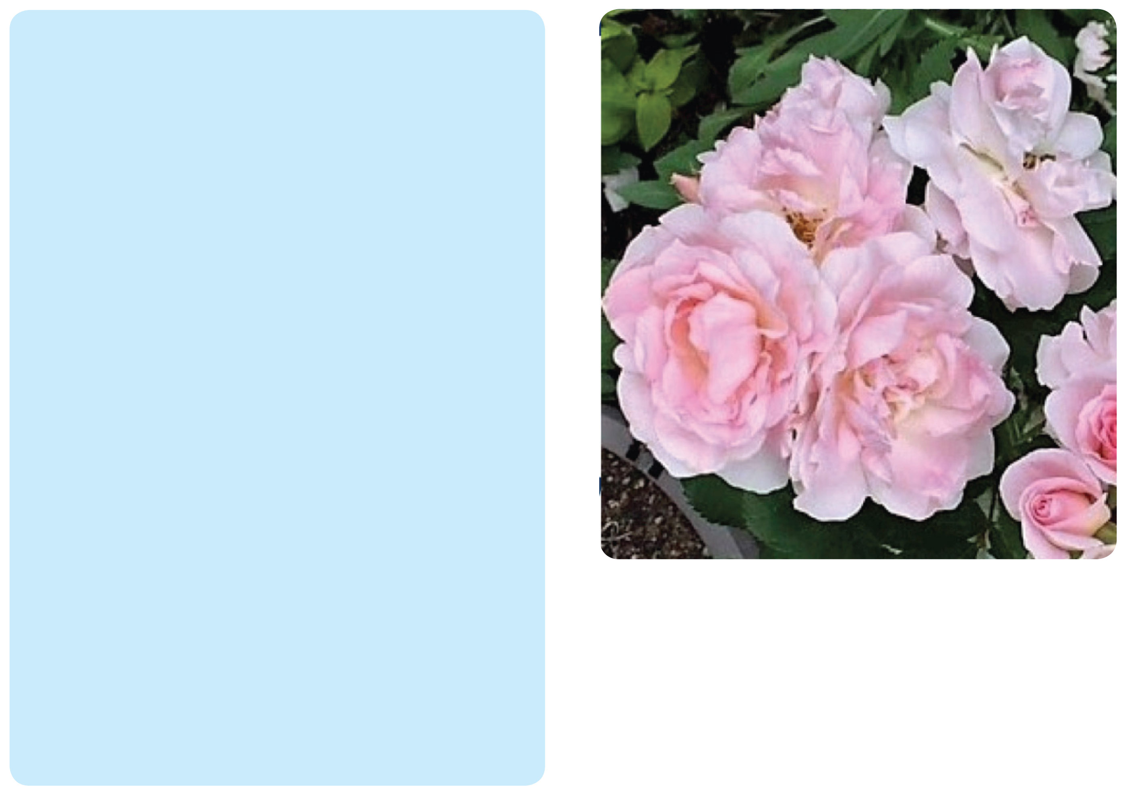
Blessed are You, loving God, creator of all that is
You have given us this day to be closer to You
through our gathering together in this holy place.
Fill each of us here with Your light and peace.
Have mercy on all who are suffering at this moment and bring us to everlasting joy with You.
Father, we bless Your name forever and ever.
Amen.
Notes:
This prayer follows the “glory, story, worry, glory” formula.

Slide 27
How to Prepare a Prayer
1. Sign of the Cross
2. Greeting of praise, adoration, supplication and humility: We humbly pray you, God our Father, bless The Catholic Women’s League of Canada.
3. Petition: Send Your Holy Spirit upon us to give light to our minds and strength to our wills that we may know and fulfill Your great law of charity.
4 Petition: Teach us to share with others at home and abroad
5. Thanksgiving: the good things you have given us.
6. Respect and intercession: This we ask through our Lord Jesus Christ, and the intercession of our patroness, our Lady of Good Counsel.
7. Closing: Amen
8. Sign of the Cross
Notes:
Let’s look at this prayer which is very close to our hearts, the League Prayer.

Slide 28

^{We humbly pray You,}
^{O God our Father, to bless}
The Catholic Women’s League of Canada.
^{Bless our beloved country,}
^{our homes and families.}
^{Send Your Holy Spirit upon us}
^{to give light to our minds}
^{and strength to our wills}
^{that we may know and fulfil}
^{Your great law of charity.}
^{Teach us to share with others}
^{at home and abroad,}
the good things You have given us.
This we ask through our Lord Jesus Christ
and the intercession of our patroness,
Our Lady of Good Counsel. Amen.
The League Prayer

Slide 29

Prayer Exemplars
• Lord’s Prayer is one of the great models of prayer
• The prophet Eli taught Samuel how to pray
(1 Samuel 3:9)
• The priest prays the Collect at the beginning of every
mass
Notes:
Jesus is our greatest model of prayer. The most well-known example is the Our Father. In Matthew, Chapter 6, Jesus gave instructions as to how to pray the Our Father. We address God in worship, that He is holy and ask to do His will. We ask for our needs and for forgiveness as we forgive others. We ask God to keep us from evil. We acknowledge that God is king, all-powerful and glorious, forever.
Another example found in the Old Testament is in 1 Samuel 3:9, where Eli teaches Samuel to listen to God’s voice. “Speak Lord” is an invitation. We listen to God’s voice with an open heart. “For your servant” indicates our humility and readiness to do God’s will. “Is listening” is the response that you will pay attention to the message of God.
The Collect: The priest addresses God at mass on our behalf. He asks for mercy, enlightenment, deeper faith, etc., for us. The Collect uses all the essential parts of prayer.

Slide 30

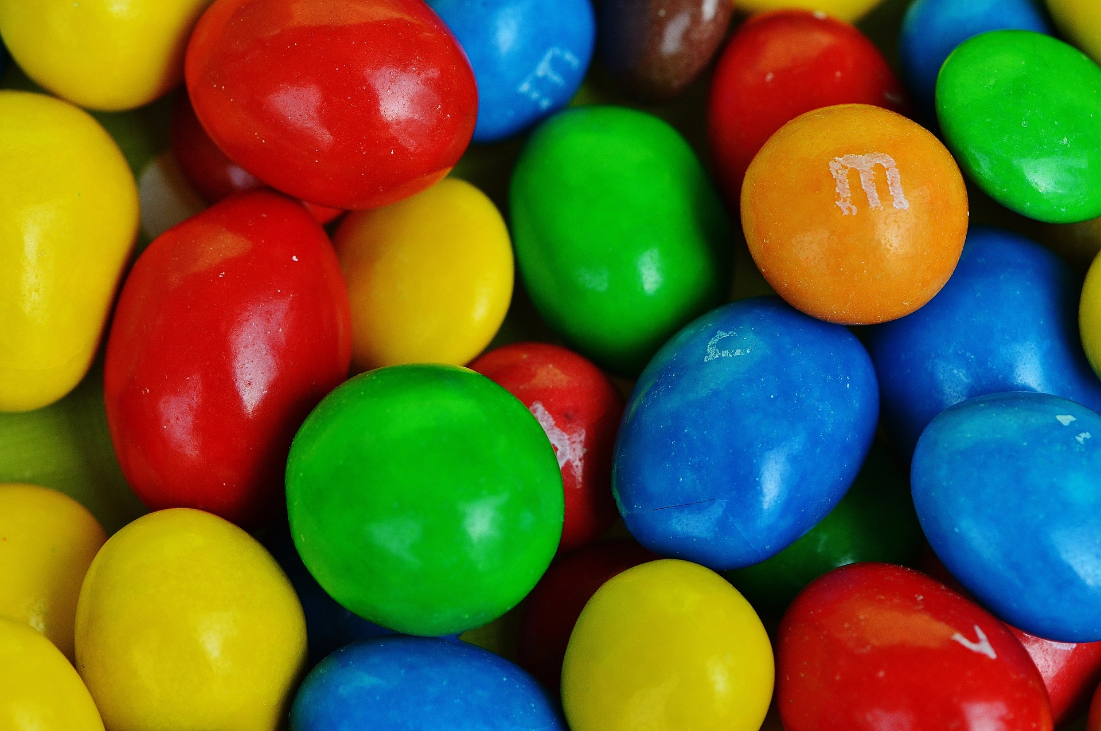
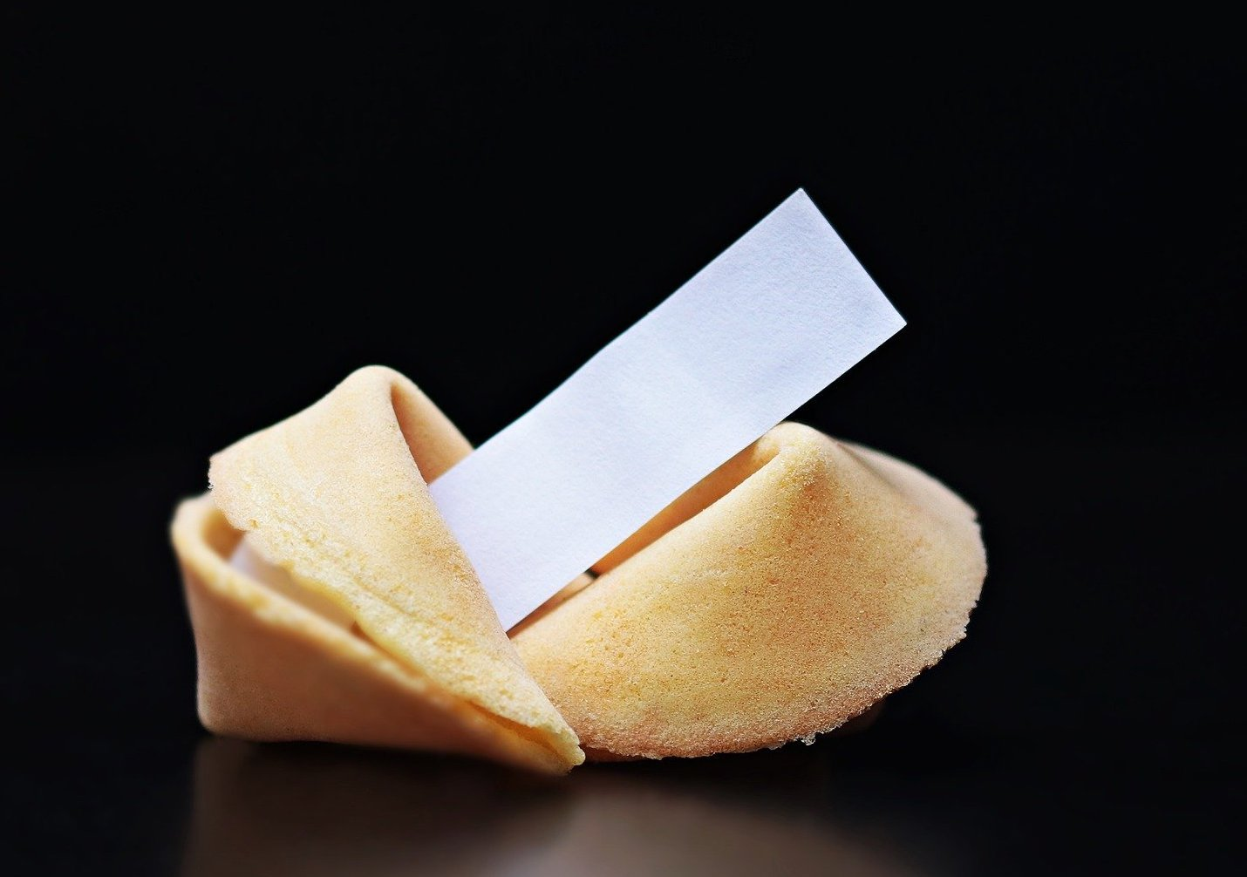
Activity Time
Notes:
Now we are going to write a prayer. Let’s begin by numbering you off (1, 2, 3… 1, 2, 3… etc.) to make some groups.
Allow for group movement.
Instructions:
Group 1 (Someone would have had to look up some resolutions and print them on slips of paper).
Each of the slips contains the topic of recent resolutions adopted at national conventions. Choose one. Using the formula (glory, story, worry, glory) from the prayers above, write a prayer to reflect what needs to happen.
Group 2 (Again, someone would have to buy some M & M candies and have them available).
Each M & M colour has meaning to us. Choose your favourite colour. Write a prayer to reflect on what your chosen colour means to you. Try to use the formula from one of the prayers above.
Group 3 (Someone would have to print up some “fortunes” on slips of paper to get people started).
You have a bowl of fortune cookies. Choose one and read your “fortune.” Then, using what you have just read about the abovementioned prayers, let yourself be inspired and write a prayer.
In your group, feel free to chat a bit about what is being asked before starting. Have fun with this exercise. The goal is for each group to write a prayer. You could use one of the prayers above to model or use the (glory, story, worry, glory) method. Remember that our first attempts might be rough and, as with all new endeavours, we will need some practice. We will give you seven minutes.
Ask a few people to share their prayers with the group.
You can write prayers!

Slide 31

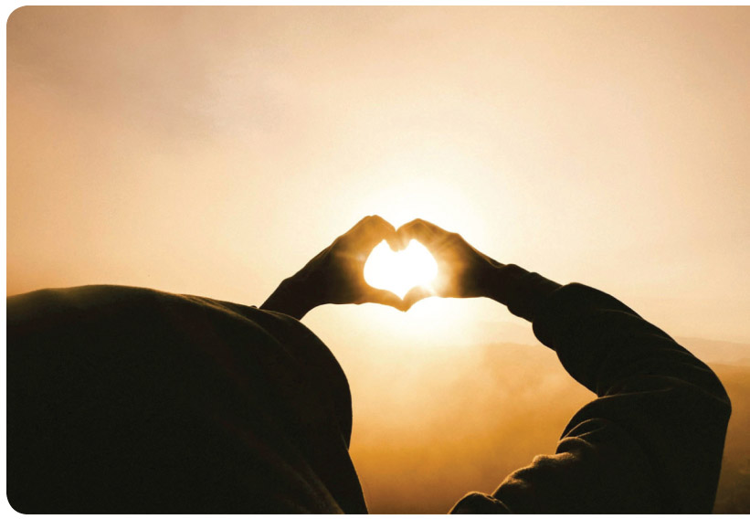
Prayer
Prayer is so simple.
It is like quietly opening a door
And slipping into
The very presence of God.
There, in the stillness,
To listen for His voice,
Perhaps in petition
Or only to listen,
It matters not.
Just to be there,
In His presence,
Is prayer.
~ Anonymous
Notes:
Have the group read the slide together.
Now that we see how simple it is to write a prayer, let’s look at preparing prayer services.

Slide 32
Writing Your Prayer Service
• Theme: Peace
• Time of Year: late October/early November (before Remembrance Day)
• Target Audience: whole church or general
CWL meeting
• Focus Table: cross, candles, bible, Canadian flag, poppies, other symbols of peace
• Pray/Reflect/Act: Ask people to bring a pen and small notebook or have slips of paper available for attendees.

Slide 33
Peace Prayer Service
Introduction:
• Every November 11t^{h}, people pause for a moment to remember a part of history. They stop to think about all those people who gave up their lives for peace. This year, each one of us will celebrate this memory by praying together for peace.
• To make it real, we must help to nurture peace, understanding and love so that it will grow within each of us gathered here. Peace is in our hands. We must share it each and every day in our homes, parish and community.
Notes:
Peace is a concept of “quiet… mental calm; freedom from or the cessation of war… a peace treaty between countries at war; freedom from civil disorder… quarrels or dissension” (Oxford Canadian Dictionary of Current English).
Every November 11th, people pause for a moment to remember a part of history, specifically a time of wars and reconciliation after those wars. People stop to think about and thank all those who gave up their lives to achieve peace on Earth.
This remembrance has been extended in our time to include how each of us can help to nurture peace within our hearts.
Peace is in our hands. We must look deeply into our hearts and root out thoughts and feelings which destroy peace. We must live peace each day in our homes, schools, places of work, parishes, communities and world.
The Dictionary of the Bible states, “Peace is communion with God, and Jesus Himself is our peace ..., since He is the bond of Communion

Slide 34
Gathering Song Exemplars
“Prayer for Peace”
(David Haas)
“Peace is Flowing Like a River”
(Public Domain)
“Let There be Peace on Earth”
( Jill Jackson-Miller and Sy Miller)
*Ensure you have copyright permission*
Notes:
Song.

Slide 35
Opening Prayer
Gracious God, You sent Your Son Jesus as a gift of peace.
We want to be a peaceful people.
Strengthen our efforts to live in harmony, without violence,
only loving one another.
Bless all the peacemakers of the world.
We ask all of this through Jesus our Lord,
Amen.
Notes:
Opening Prayer.

Slide 36

Scripture Reading
Colossians 3:12-16
adapted)
A reading from the letter
of St. Paul to the
Colossians
The Word of the Lord
Notes:
(Scripture – Word of God. Read scripture out loud.)

Slide 37
Read Quietly and Reflect
Martin Luther King Jr. said:
“At the center of non-violence stands the principle of love.
St. Teresa of Calcutta reminded the world that:
“If we have no peace, it is because we have forgotten that we belong to each other.”
Notes:
Please listen prayerfully to each reading; after each, there will be a two-minute pause. Then jot down a word or phrase for each.

Slide 38
Anne Frank, a young teenage girl, wrote:
“How lovely to think that no one need wait a
moment, we can start now, start slowly changing the world!”
The Dalai Lama XIV delivered this message:
“World peace must develop from inner peace.”
Notes:
Here you might decide to ask people (if they feel comfortable) to share a word they have written down with the group.
If you are presenting to a CWL group, you could pair them up and share one of these suggestions.
You might also ask if the words that “spoke” to them might bring to mind an action they might do this week, this month or this year.
You could challenge people to take one action for peace in their family, community, parish, etc., before the end of the year.

Slide 39
On the night before He died, Jesus said:
“Peace I leave with you;
my peace I give to you.
I do not give to you as the world gives.
Do not let your hearts be troubled,
and do not let them be afraid.”
(Jn 15:27)

Slide 40
Petitions
Let us now bring our prayers before our God of Peace:
    That in our homes and workplace we be instruments of peace radiating God’s love, compassion, and justice to all we pray:
R: God of Peace; hear the prayer of Your people.
That we seek forgiveness of God and of each other for those times when we are blind or indifferent to the needs of those around us, or to the pain of those who suffer we pray:
R: God of Peace; hear the prayer of Your people.
Spontaneous Prayer
Invite people to add a prayer / petition keeping in mind
the theme of Peace.
Notes:
Shared Prayer: petitions, traditional prayer, litanies, composed prayers, etc.

Slide 41
Closing Prayer
Lord God, you are a God of Peace. You call us to be people of Peace.
Help us to remember that we need Your help and to call on You.
At times, we have a tendency to be jealous of each other, or we act with disrespect towards our brothers, sisters, neighbours.
When we behave in negative ways, we destroy the peace that should exist, and that we want, with our family, friends and neighbours.
Help us to bring peace to all. Help us to create win-win situations whenever conflict begins. Help us always to remember Your words, “Blessed are the peacemakers; for they shall be called children of God.”
As one body in unity with the Prince of Peace, Your Son, we pray:
Our Father…

Slide 42
URL for Images
Praying hands
https://pixabay.com/photos/blur-close-up-girl-woman-hands-1867402/
Hands with candle
https://pixabay.com/photos/hands-open-candle-candlelight-1926414/
copyright sign
https://pixabay.com/vectors/copyright-icon-license-intellectual-98570/
old book
https://pixabay.com/illustrations/learn-read-book-literature-old-4759967/
computer program
https://pixahive.com/photo/working-on-a-computer-program/
camera
https://pixabay.com/photos/movie-camera-camera-retro-the-flash-4718657/
CD
https://commons.wikimedia.org/wiki/File:CD-ROM.png
masks
https://pixabay.com/vectors/masks-masquerade-masque-faces-40963/
angel-
https://pixabay.com/photos/angel-statue-angel-figure-woman-2636961/
filmstrips
https://pixy.org/184036/
parking meter (same one as before)
https://pxhere.com/en/photo/1154869
control button
https://pixahive.com/photo/laptop-keyboard-focus-on-control-button/
Potato and Calculator (same as before)
https://pixabay.com/photos/coins-calculator-budget-1015125/
flower 1
https://pixabay.com/photos/flower-nature-flora-petal-summer-3140492/
Flower 2
https://pixabay.com/photos/garden-flowers-butterfly-19830/
Cat face (same as before)
https://pixabay.com/photos/cat-cat-s-eyes-blue-eyes-gray-cat-1285634/

Slide 43
Play button
https://pixabay.com/vectors/play-icon-free-wallpaper-vector-1173551/
Audio button
https://pixabay.com/vectors/audio-sound-speaker-button-voice-150191/
Sheet music 1
https://pixabay.com/photos/sheet-music-music-piano-instrument-1229481/
Sheet music 2
https://pixabay.com/photos/piano-sheet-music-music-keyboard-1655558/
sheet music 3
https://pixabay.com/photos/hymnal-book-sing-music-faith-468126/
microphone (same as before)
https://pixabay.com/photos/audio-concert-mic-microphone-music-2941753/
records (instead of cassette tapes)
https://pixabay.com/photos/headphones-music-song-foam-2588235/
pen nib
https://pixabay.com/photos/writing-write-fountain-pen-ink-1209121/
Second part:
woman praying hands with candle(#17)
https://www.pexels.com/photo/person-hands-woman-girl-41192/
black outline woman praying (#18)
https://pixabay.com/illustrations/woman-praying-prayer-woman-of-faith-1935165/
Jesus praying (#18)- include URL for acknowledgement
https://www.flickr.com/photos/136682034@N03/25481514814
woman praying hands (#19)
https://www.pexels.com/photo/person-hands-woman-girl-41192/
hand with rosary (#22)
Jacqueline’s hands- no permission needed
or use this: (rosary on bible) #22
https://unsplash.com/photos/LGnqIPaMj3Q
Hands in sun (#29)
https://www.piqsels.com/en/public-domain-photo-scsrl

Slide 44
bible on table (#34)
https://stocksnap.io/photo/bible-book-C9E7B4U7QY
m and m’s (#28)
https://pixabay.com/photos/m-and-m-sweetness-delicious-m-m-s-1308540/
fortune cookie (#28)
https://pixabay.com/photos/fortune-cookies-sweet-pastries-2503077/
torn paper (#28)
https://pixy.org/6352234/
Closing Mass at St Mary’s Cathedral used with permission from Eva Arsenault (MB CWL Member)
Morden Blush Roses - Con Marks’ photo (MB CWL member).

Slide 45
Notes

Slide 46
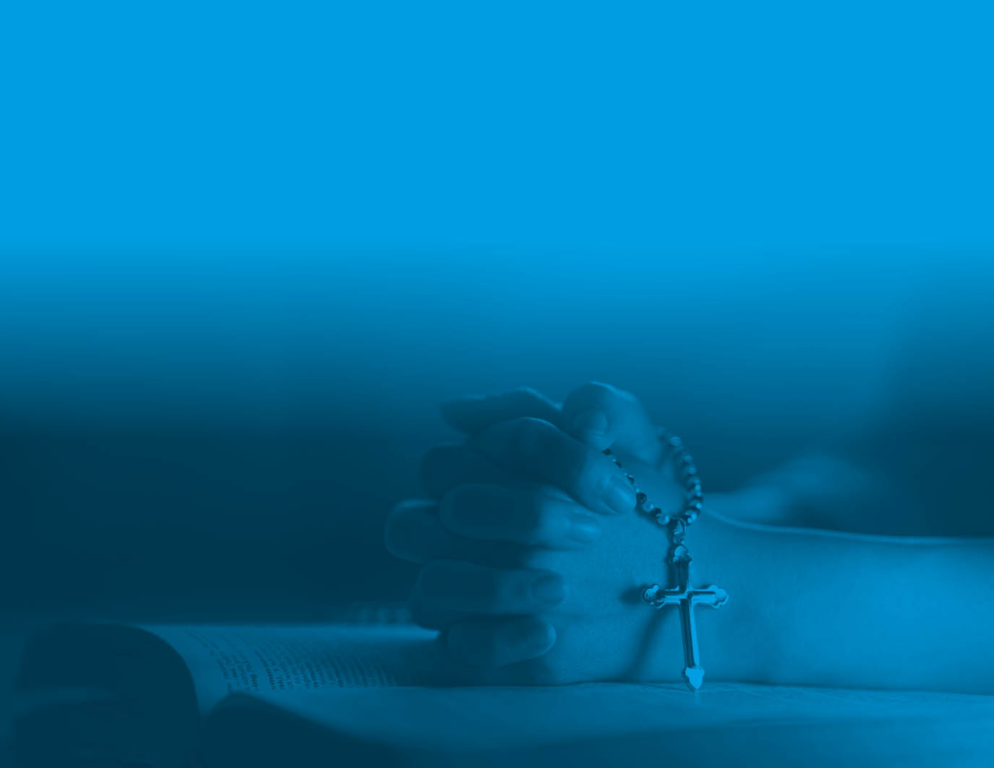

Slide 47

The Catholic Women’s League of Canada
C-702 Scotland Avenue
Winnipeg, MB R3M 1X5
Tel: (204) 927-2310
Website: cwl.ca
E-mail: info@cwl.ca
Inv. #XXX

