Slide 1
1

Slide 2
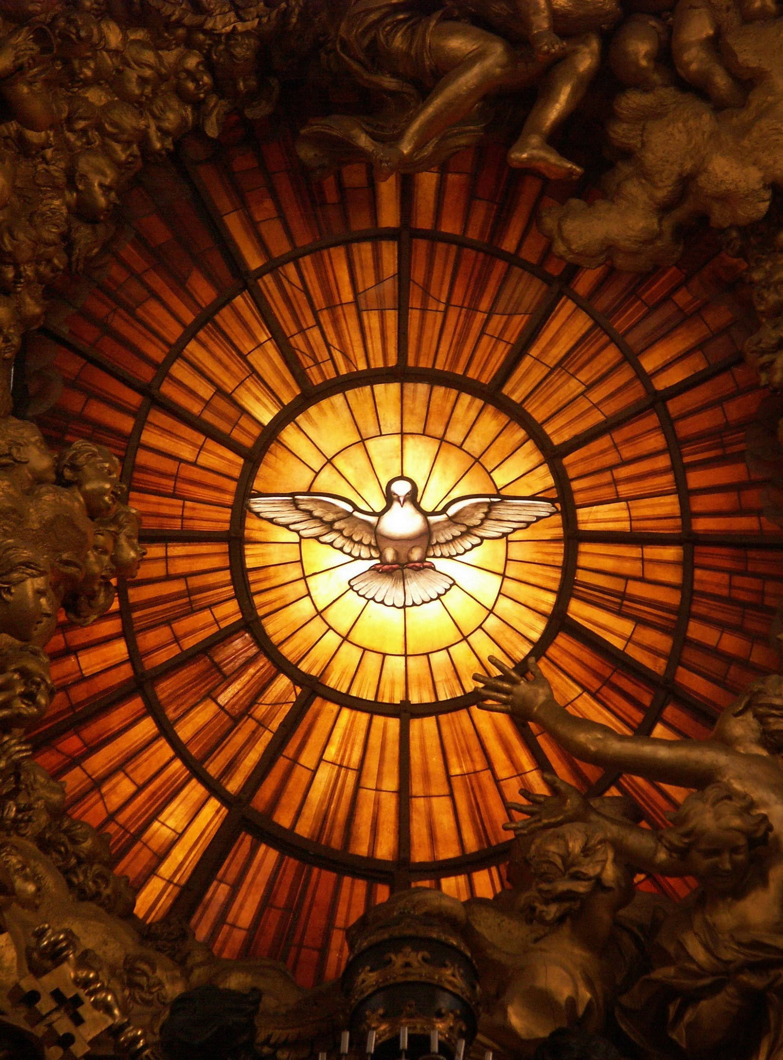
2
FIRE OF THE SPIRIT:
The essential role
of the spiritual advisor

Slide 3
LEAGUE PRAYER
3
We humbly pray You,
O God our Father,
to bless The Catholic Women’s League of Canada.
Bless our beloved country,
our homes and families.
Send Your Holy Spirit upon us
to give light to our minds
and strength to our wills
that we may know and fulfill
Your great law of charity.

Slide 4
4
Teach us to share with others,
at home and abroad,
the good things
You have given us.
This we ask through
our Lord Jesus Christ
and the intercession
of our patroness,
Our Lady of Good Counsel. Amen

Slide 5
5
Inspiration:
“Be who you are meant to be and you will set the world on fire.”
(St. Catherine of Siena)

Slide 6
6
What is The Catholic Women’s League of Canada?
Mission Statement
The Catholic Women’s League of Canada
calls its members to grow in faith,
and to witness to the love of God
through ministry and service.

Slide 7
7
What can the League do for you as a spiritual advisor?
Support your role to evangelize people in the parish
Support for your ministry
Support to ongoing parish initiatives
Notes:
It is not all fundraising and funeral lunches.
Speak about resolutions, The World Union of Catholic Women’s Organisations (WUCWO)
The parish level connects to the diocesan, provincial and national levels of the League.

Slide 8
8
Where do you fit in?

Slide 9
9
The ideal council executive works as a team.
The president and officers, working together with the spiritual advisor, form the executive team that guides the councils members in their work “For God and Canada.”

Slide 10
10
What might surprise you?

Slide 11
11
Not all spiritual advisors are the parish priest. A deacon, sister or trained layperson may take his place if he is unavailable.
Notes:
Quote Constitution & Bylaws, Part IX p. 11 (if time)
(b) (i) (ii) (iii)
It states "(i) The spiritual advisor of the parish council shall be the pastor of the parish. Where this is not possible, the pastor, in consultation with the council executive, shall appoint a spiritual advisor." A deacon, religious or trained layperson may be appointed.

Slide 12
12
The spiritual advisor
represents the official church
helps guide the council’s spiritual programs by working with the president and chairperson of faith

Slide 13
13

Slide 14
14
League Objects
The objects of the League shall be to unite the Catholic women of Canada:
to achieve individual and collective spiritual development
to promote the teachings of the Catholic church
to exemplify the Christian ideal in home and family life
to protect the sanctity of life

Slide 15
15
League Objects (cont’d):
to enhance the role of women in church and society
to recognize the human dignity of all people everywhere
to uphold and defend Christian education and values in the modern world
to contribute to the understanding and growth of religious freedom, social justice, peace and harmony

Slide 16
13

Slide 17
17
What are the different levels?
Parish Council
Diocesan Council
Provincial Council
National Council

Slide 18
18
The basic building block of the League is the parish council.
Parish councils are gathered in the diocese under the diocesan council.
Each diocesan council is represented at the provincial council level.
All members are gathered under the leadership of the national council.
Each level has a different spiritual advisor.

Slide 19
19
When members and spiritual advisors attend a convention or annual meeting of members at the diocesan, provincial or national level, they see that the impact and concerns of the League are much bigger than the council they work with.
At all levels, members agree that the Catholic Women’s League cannot succeed without the support of its priests.

Slide 20
20
Each council has a president, vice-president, secretary, treasurer and past president.
Each council also has standing committees: faith, service and social justice, which focus on different levels of League concerns and activities.

Slide 22
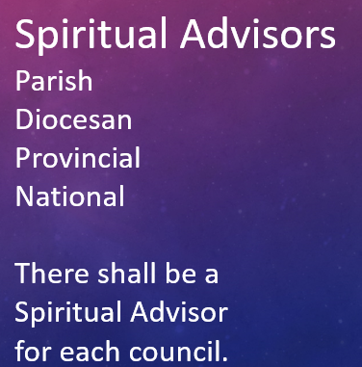

Slide 23
23
Why spiritual advisors?
Spiritual advisors play a vital role in advancing the cause of The Catholic Women’s League of Canada.
With their presence, advice and support, they guide members as they pursue their call to holiness through service to God’s people.

Slide 24
24
By active participation, spiritual advisors demonstrate the value of the League in the life of the parish.
By promoting League membership and activity, spiritual advisors help the council achieve success.

Slide 25
25
By giving their support, spiritual advisors assist in developing communication and fellowship among members and parishioners.
By encouraging League activities, spiritual advisors enable women to develop skills and abilities they will use in serving others in the name of God.

Slide 26
26
What is expected of you as spiritual advisor?
Provide advice and guidance for the spiritual program
Take an interest in the spiritual life of the council and its members

Slide 27
27
Maintain open communication with the president on all League matters, making her aware of your concerns and being updated if you have missed a meeting.
Give a message of encouragement and support at all meetings

Slide 28
28
Promote League membership drives and other projects by speaking frequently and positively to the parish about the League
Assist the League to avoid conflicts in dates with other parish events
Recognize the value of a League representative as a liaison on the parish pastoral council

Slide 29
29
Be familiar with League protocol for a deceased member, including a mass offering, honour guard and prayer service at the funeral home, luncheon, etc.
Serve on the nominations and elections committee

Slide 30
30
Prepare for your role in the installation or reaffirmation of officers and, if possible, conduct these in the context of a Sunday liturgy
Attend meetings and conventions at the next level whenever possible and participate with members

Slide 31
31
Honour the patroness of the League, Our Lady of Good Counsel, by celebrating with the members on her feast day (April 26th)
Use the League motto, “For God and Canada,” when speaking of the League

Slide 32
32
The League is grateful for your commitment, and members appreciate
your celebration of the Eucharist
your presence at meetings
your kind words of encouragement
your support of their work

Slide 33
33
What should you know about the League?

Slide 34
34
Each spiritual advisor is installed in a formal prayer service and renews their commitment to the League each year they serve that council.
You will receive a spiritual advisor’s pin and stole to wear at League functions. The pin is yours to keep. The stole belongs to the council.

Slide 35
35
Members seek to carry out their mission of building up the kingdom of God in a framework of service.
A chairperson (and committee) leads activity in each of these different areas called standing committees.

Slide 36
36
What else should you know about the League?
Being aware that the League goes beyond the parish level will help you understand its potential, the boundaries in decision-making and the scope of the organization.

Slide 37
37
Who will you be working with?
You will meet regularly with the parish council president to discuss the League in general terms.
You will also meet with the parish council chairperson of faith.

Slide 38
38
You may also
Assist the president and the chairperson of faith to develop a long-range plan for the spiritual program of the council.
Work with the president to create a calendar of the events planned for the year.

Slide 39
39
The president may suggest a definite topic to coincide with the theme of the meeting or with some church or League event.

Slide 40
40
The president can provide you with any League materials you may need to assist you in your role as spiritual advisor.

Slide 41
41
So How Does this Work?
Above all…
The key to working successfully with a CWL council is to
COMMUNICATE
COMMUNICATE
COMMUNICATE
And then COMMUNICATE SOME MORE!

Slide 42
42
The Constitution & Bylaws provides the overall policy of the League.
The National Manual of Policy and Procedure and the Handbook for Spiritual Advisors will be helpful to you.

Slide 43
43
Assistance and materials are available to any council, officer or spiritual advisor through the president or spiritual advisor at the next level.

Slide 44
44
Programs and guidelines set out by other levels (diocesan, provincial and national) are often part of the work of the standing committees in the parish council.
Your cooperation with such programs will help the council.

Slide 45
45
Action on social issues or resolutions is often called for by other levels.
The encouragement of spiritual advisors in carrying out these action plans is important.

Slide 46
48
The fiscal year for finances, budgets and membership is January 1st to December 31st for all councils.

Slide 47
49
The Catholic Women’s League was organized in Edmonton in 1912 and nationally in 1920. It was recognized by the Canadian Conference of Catholic Bishops as a national private association of the faithful (2005).

Slide 48
50
The League is a private association of the Christian faithful in the church and as such, Canons 324 and 325 apply.
Notes:
Refer to the (2016 Updated) National Manual of Policy and Procedure.

Slide 49
51
As autonomous of formal church structures, [each council of the League] freely selects its own moderator and officials, freely administers the goods it possesses and freely chooses its own spiritual advisor, who must be confirmed by the local ordinary.

Slide 50
52
Installation of a spiritual advisor
You have been invited to serve the [parish of/diocese of/province of/national church in Canada] as spiritual advisor for the [parish/diocesan/provincial/national] council of The Catholic Women's League of Canada.

Slide 51
53
May you be inspired by the Holy Spirit in offering support, encouragement and guidance to the officers and members of the League. The Catholic Women's League of Canada is an important work in the mission of Christ’s church in Canada. May your collaboration in League activities bring growth and blessing to the members and their communities.

Slide 52
54
Creator God, sustain all CWL spiritual advisors with Your divine grace and grant them peace and joy in serving You. We ask this in the name of Jesus Christ, through the intercession of Our Lady of Good Counsel.
AMEN

Slide 53
55
Thank you for your time and assistance in our mission,
“For God and Canada”

Slide 54
56
Questions? Comments?

