Slide 1

Advocacy Workshop:
Part Four
Advocacy Working Group
Strategy: Develop and Deliver Workshops at All Levels
Notes:
In part four of the Advocacy Workshop, you will be introduced to a more in-depth process for discerning the ‘signs of the times.’ This resource has been developed by Development and Peace—Caritas Canada and has been adapted for this workshop.
The website link for the original, complete version of this PowerPoint and one created for elementary children is included in the “Resources Handout” that accompanies these advocacy workshops.

Slide 2
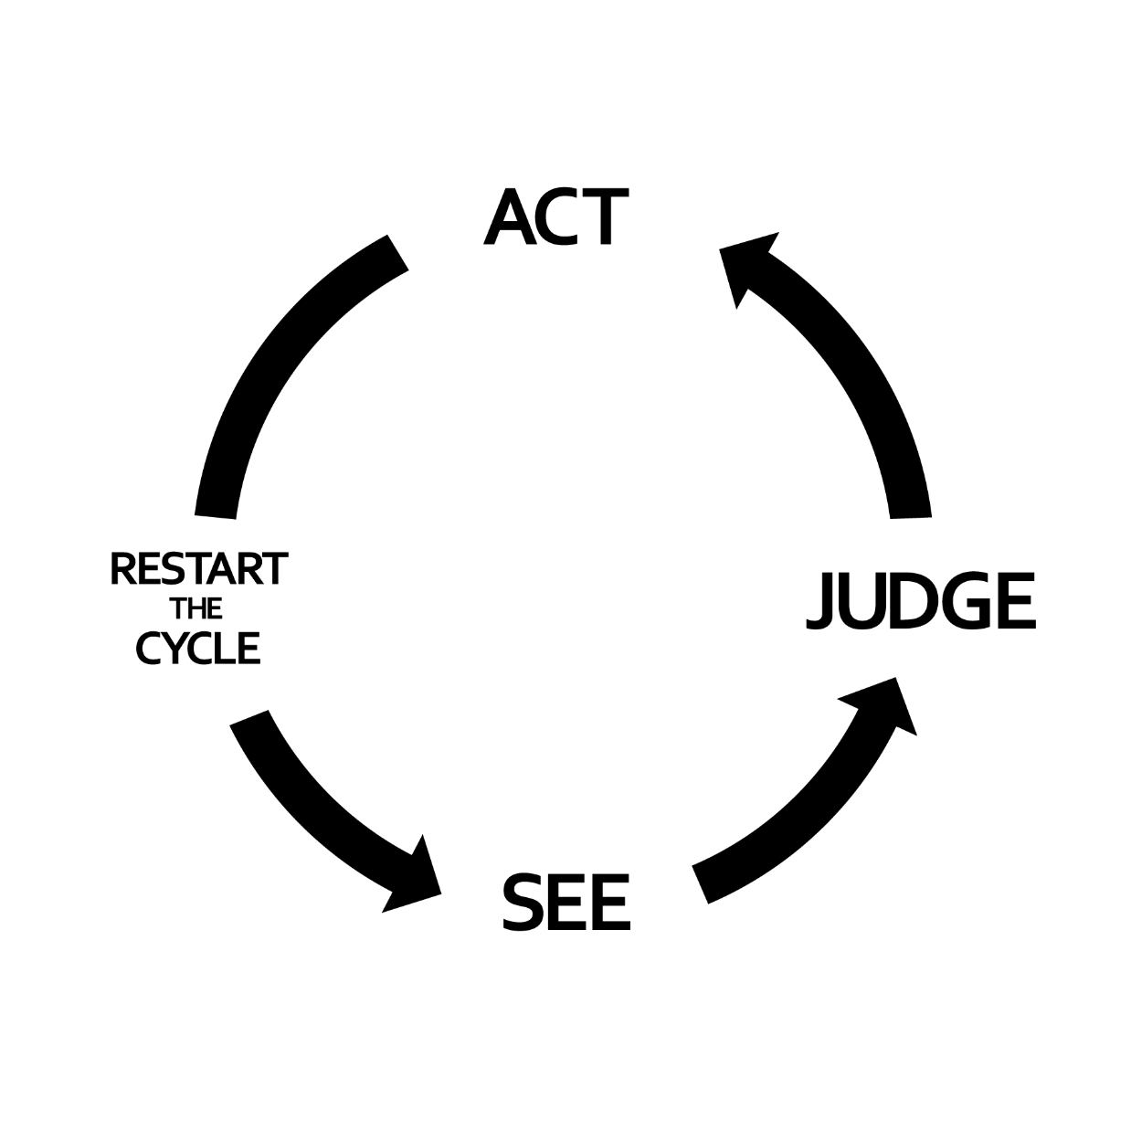


Used with permission.
Notes:
READ:
The first step is reading the “signs of the times.” When we SEE something like a natural disaster or a refugee crisis developing, our faith and capacity for compassion for others call to us. History has taught us that bad things happen when good people do nothing. What can we do to help? A Catholic approach starts with discernment.
Discernment can be understood as the process of listening for and recognizing God’s Spirit on how to respond for the common good in the circumstances we face. This process calls us to gather accurate, truthful information as best we can, to pray and reflect on current events in our lives, communities and world.
The “tree of Catholic social teaching” represents the process of discernment and action on social injustices. The people affected by the injustice must remain central to the whole process, ensuring their dignity and personal involvement.
Stage 1 is to SEE:—recognize and examine key facts, conditions, the impacts of the injustice and where we fit.
Stage 2 is to JUDGE the situation through social analysis and the lens of our faith.
Stage 3 is to ACT by planning and carrying out actions in light of our faith, which will bring a bit of God’s kingdom here on earth and right the injustice.
Stage 4 is to RESTART the CYCLE, returning to the SEE stage to examine our actions’ impact and how best to move forward.

Slide 3
Learn about the situation:
What is happening and where?
Who/what is affected?
What is their experience in the situation?
How are they already responding to the situation?
What has my research revealed about the situation?
SEE
Notes:
READ:
We have to learn as much as possible about the injustice we are examining and how it affects others, be they human or not. As an entry point, some of these questions might guide us.
To better help us in our discernment, we must learn about the situation:
What is happening and where?
Who/what is affected?
What is their experience in the situation?
How are they already responding to the situation?
What has my research revealed about the situation?
Situate yourself concerning the situation:
How do I feel about this situation?
Can I relate to it?
How does it touch me personally?
How am I connected to this?
If I were in this situation, what would I hope?

Slide 4
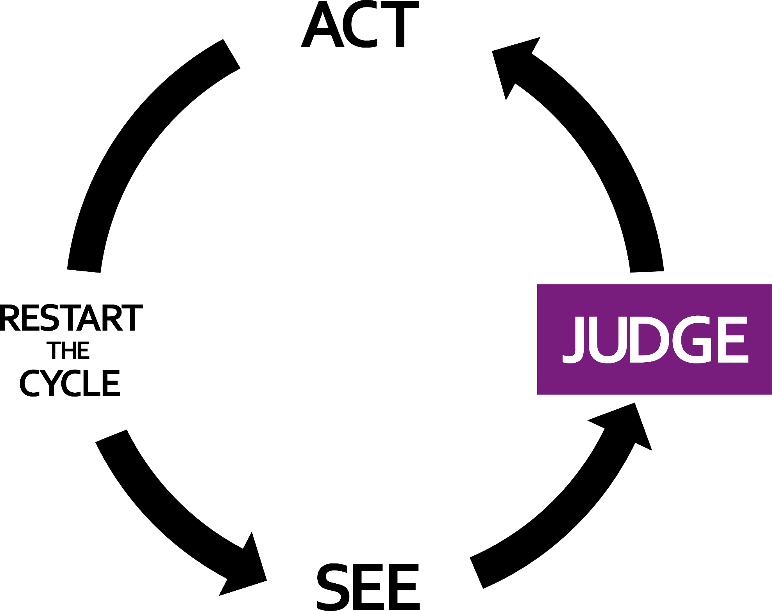

A. Analysis
B. Teachings of our Faith
C. Sacred Scripture
D. Catholic Social Teachings
Notes:
READ:
The second stage is to judge the situation. As baptized Catholics, we draw on our sacred scriptures, papal teachings and Catholic social thought and teachings.
The trunk serves as the filtering site for the tree and represents our examination of the injustice through:
social analysis
reflection on the situation in light of our faith’s teachings so that we can discern the right path to follow.

Slide 5




A. Social Analysis: Guiding Questions
Why does this situation exist?
What are the root causes of the injustice?
Judge
Notes:
READ:
Social analysis broadens the picture of the situation, its causes and some factors that might contribute to it.
In this stage, we attempt to make sense of the reality we saw in step one and ultimately answer these questions:
A. Social Analysis: Guiding Questions
Why does this situation exist?
What might be some of the root causes of the injustice?

Slide 6
A. Social Analysis: Understand the situation
Social Factors | Who is included? Who is excluded? How are they excluded? Why are they included or excluded
Judge
Political Factors
How do decisions get made?
Does everyone have a say in the decisions that concern them?
Whose voices are most influential?
Whose voices are unheard?
Notes:
READ:
Social factors:
Who is included?
Who is excluded?
How are they excluded?
Why are they included or excluded?
Political factors:
How do decisions get made?
Does everyone have a say in the decisions that concern them?
Whose voices are most influential?
Whose voices are unheard?

Slide 7
A. Social Analysis: Understand the Situation
Cultural Factors | What values and beliefs are at play? What practices and institutions are involved? What are the influencing factors in what people believe?
Judge
Historical Factors
What events led to this situation or influence it today?
How do the local people understand the situation and its history?
Environmental Factors
What resources are involved?
What are the environmental considerations?
Who is impacted the most by the environmental factors?
Notes:
READ:
Cultural factors:
What values and beliefs are at play?
What practices and institutions are involved?
What are the influencing factors in what people believe?
Historical factors:
What events led to this situation or influence it today?
How do the local people understand the situation and its history?

Slide 8
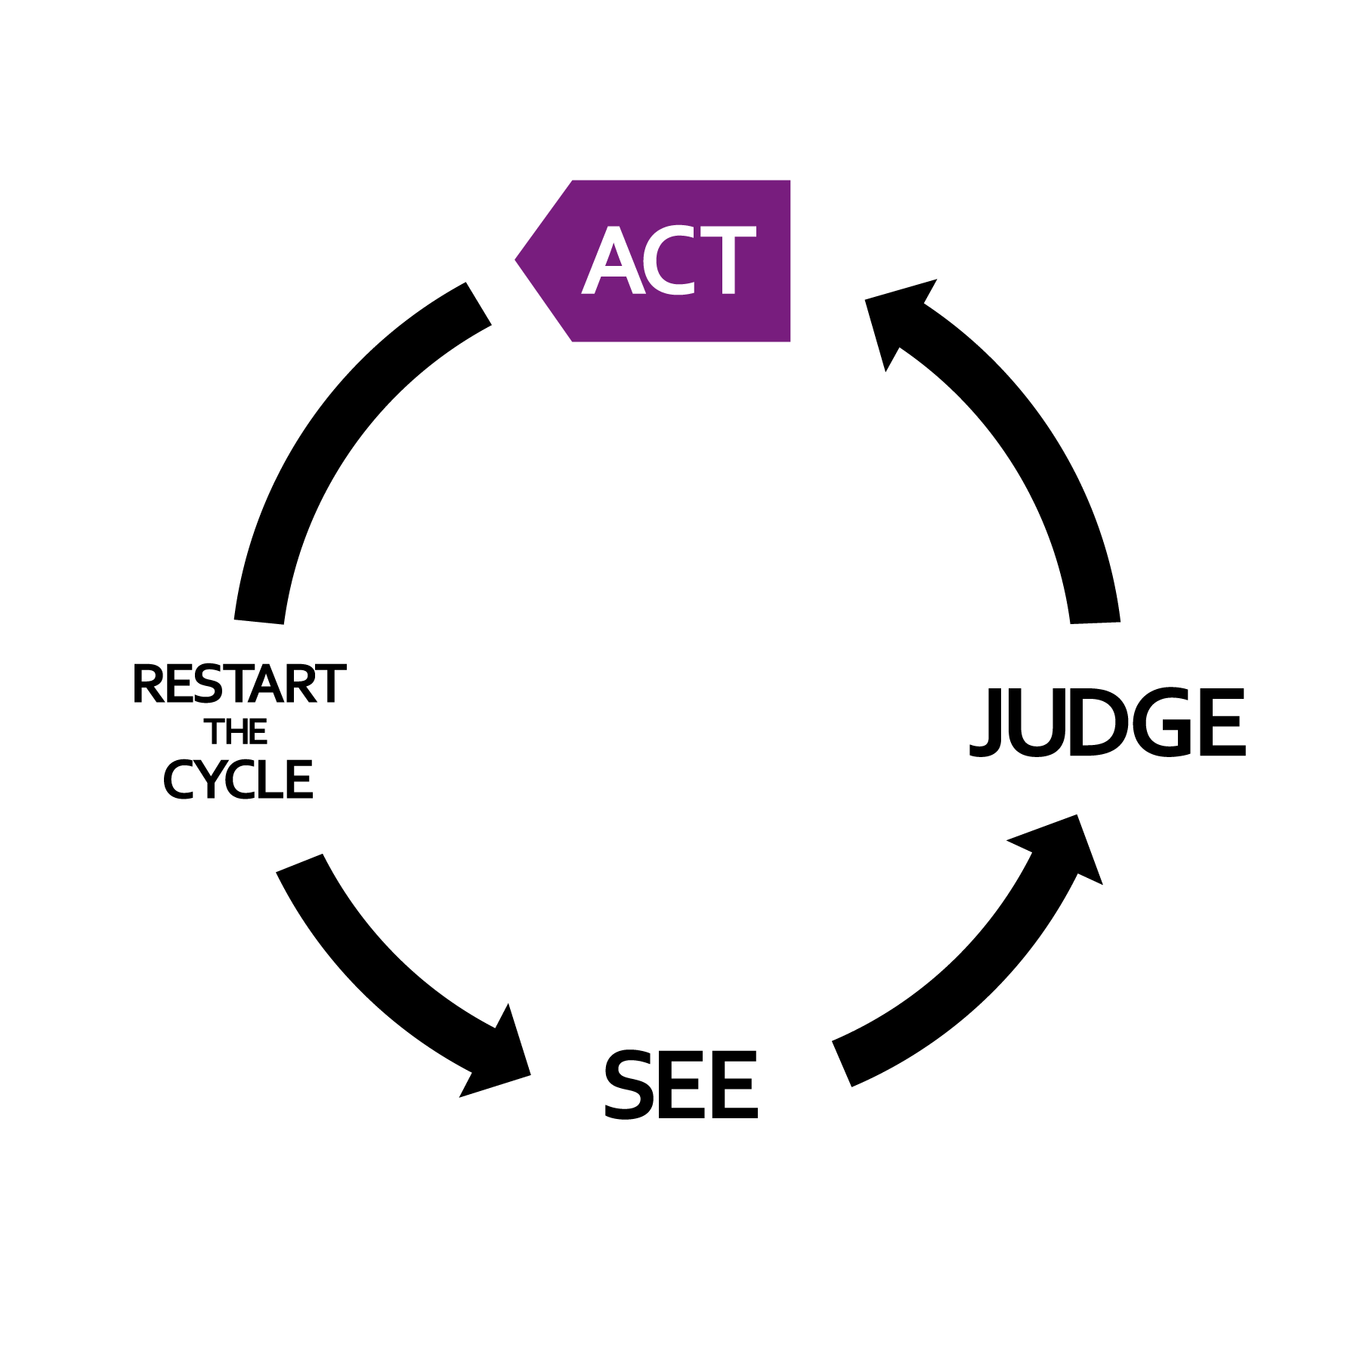
Notes:
READ:
The third step is to ACT by planning and carrying out actions to transform the situation based on the information gathered in the SEE stage and the analysis and reflection done in the JUDGE stage. Through this process, we are better able to discern God’s will.
Sometimes we need to return to an earlier stage to gather more facts, do some more analysis or prayerfully consider new information in the light of our faith before we act.

Slide 9

Questions to Help Plan our Actions:
How will we be a part of the solution?
What resources and allies can be mobilized to support our efforts?
When will we start?
ACt
Notes:
READ:
To plan effectively for our actions, we can ask ourselves the following questions:
How will we be a part of the solution?
What resources and allies can we mobilize to support our efforts?
When will we start?

Slide 10
“ . . . let us love, not in word or speech, but in truth and action . . .”
– 1 John 3:18
ACt
Notes:
READ:
In acting to address injustice, we show our love for God and neighbour. We must act in a way that brings about a more just situation for everyone. Through just action to transform the situation, we reach out like the branches, and our efforts bear fruit.
But first, we must ask:
How do the people negatively impacted by the situation see it?
What are they asking for or proposing as solutions?
What are they already doing and what allies do they have?
Once we have answered these questions, we can ask:
What acts of charity are appropriate in the short term?
What acts of justice are needed for long-term solutions?
Our action should include both aspects of social justice—charity and justice.

Slide 11


Acts of Charity meet immediate needs –such as food, water, shelter, clothing – and reflect the compassion of Christ.
Acts of Justice seek to resolve the root causes of the problem for the long term, so that charity is no longer needed. In this way, we work towards the inclusion of Gospel values in society and bear witness to Jesus’ own heart for justice.
Both are equally important!
Both are crucial to any Response!
ACt
Notes:
READ:
Acts of charity meet immediate needs, such as food, water, shelter and clothing and reflect the compassion of Christ.
Acts of justice seek to resolve the root causes of the problem for the long term so that charity is no longer needed.
In this way, we work towards including gospel values in society and bear witness to Jesus’ heart for justice. Both are equally important, and both are crucial to any response!

Slide 12
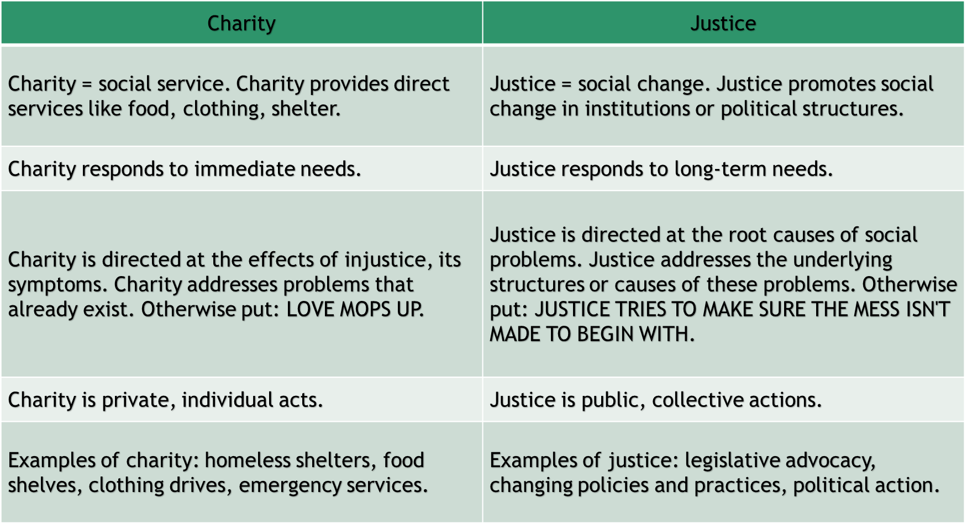
(Source: Office for Social Justice, Archdiocese of St. Paul/Minneapolis.)
Notes:
READ:
Charity = social service.
It provides direct services such as food, clothing and shelter.
It responds to immediate needs.
It is directed at the effects of injustice—its symptoms. Charity addresses problems that already exist. Otherwise put: Love mops up.
It is a private, individual act.
Examples of charity include a homeless shelter, food shelf, clothing drive and emergency service.
Justice = social change.
It promotes social change in institutions or political structures.
It responds to long-term needs.
It is directed at the root causes of social problems. Justice addresses the underlying structures or causes of these problems. Otherwise put: Justice tries to make sure the mess isn’t made to begin with.
It is public, collective actions.
Examples of justice include legislative advocacy, changing policies and practices and political action.
--
Source: http://sites.saintmarys.edu/~incandel/charjust.html

Slide 13
To Evaluate Our Plan:
Are the voices of those we are seeking to help the driving force of the discussion?
Are these actions in line with the other principles and values of our faith?
Are these actions do-able?
What outcomes are expected?
What are our next steps?
How and when will we evaluate both our role and actions?
ACt
Notes:
READ:
We can evaluate the proposed action plan against the principles of Catholic social teaching with these guiding questions:
To evaluate our plan:
Are the voices of those we are seeking to help the driving force of the discussion?
Are these actions in line with the other principles and values of our faith?
Are these actions doable?
What outcomes are expected?
What are our next steps?
How and when will we evaluate both our role and actions?

Slide 14
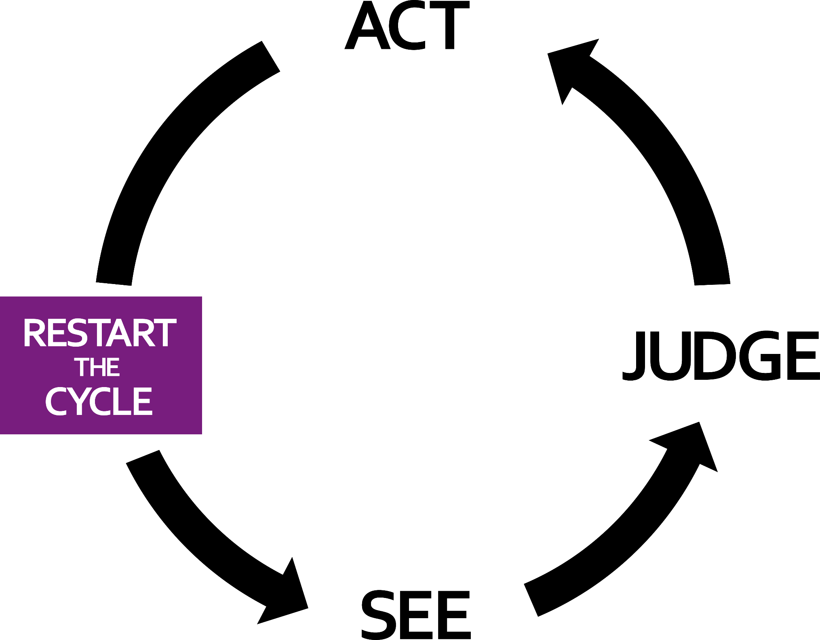
Living in solidarity means we don’t abandon an issue or the people affected after one action. As allies with them, we continue to take the challenge to seek a long- term solutions together.
Notes:
READ:
This is a process that repeats itself until the injustice is resolved. God’s kingdom isn’t built in a day, week or year! We are committed to working to bring it closer to completion though!

Slide 15


Our actions bear Fruit
To Evaluate our Role & Actions:
What impact did we have?
How were we changed and challenged through the process?
Was/ is the principle of subsidiarity put into practice throughout the process?
- How or how not?
Notes:
READ:
We can do this by asking these questions:
To evaluate our role and actions:
What impact did we have?
How were we changed and challenged through the process?
Was/ is the principle of subsidiarity put into practice throughout the process?
How or how not?

Slide 16
Acknowledgements
A special thanks to the Hamilton Catholic School Board for requesting the creation of this resource and particularly to Paul Beaudette and Andy Burns for revision and suggestions.
References
“Catholic Social Teaching Series - Reading the Signs of the Times.” Australian Catholic Social Justice Council. 2016,
http://www.socialjustice.catholic.org.au/social-teaching/10-social-teaching/94-catholic-social-teaching-series-reading-the-signs-of-the-times
Doran, Thomas G. “Dare to Dream: Essential Steps to Discerning God’s Will.” Catholics United for the Faith. 2012,
http://www.cuf.org/2012/03/dare-to-dream-essential-steps-to-discerning-gods-will/

