Slide 1

Advocacy Workshop:
Part Two
Advocacy Working Group
Strategy: Develop and Deliver Workshops at All Levels

Slide 2
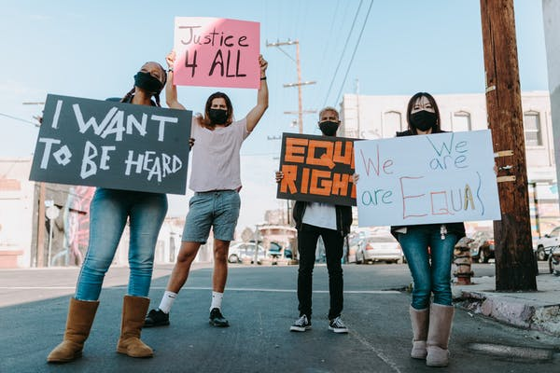
Advocacy Workshop: Part Two
For What Do We Advocate?
Image source: pexels.com/search/protest/
Notes:
READ:
Welcome! It is a pleasure to have you here for part two of the Advocacy Workshop. Your presence here speaks to the importance you give to learning more about advocating for issues dear to your heart that bind us together as League sisters and disciples of Christ.
Let us begin our time together with prayer.

Slide 3
Gathering Prayer
We want our eyes opened to the reality of other people,
to hear what they are not able to articulate…
We want to see justice run like a river,
bringing healing and peace to the nations…
We want the eyes of our hearts to see the grace of God that is present in every child, woman and man we meet.
We want to be able
to see differently,
to think differently,
to live kindly,
to walk humbly,
to serve graciously and gratefully.
Come Lord Jesus!
(Romeo L. del Rosario, Malaysia)
Notes:
READ TOGETHER:
Gathering Prayer
We want our eyes opened to the reality of other people, to hear what they are not able to articulate…
We want to see justice run like a river, bringing healing and peace to the nations…
We want the eyes of our hearts to see the grace of God that is present in every child, woman and man we meet.
We want to be able to see differently, to think differently, to live kindly, to walk humbly, to serve graciously and gratefully.
Come Lord Jesus! (Romeo L. del Rosario, Malaysia)

Slide 4


Welcome One and All
Image source: pexels.com/search/welcome%20meeting/
Notes:
Consider providing some time for participants to introduce themselves and learn a bit about each other. (3–5 minutes)

Slide 5
Key Points from the Advocacy Workshop: Part One
Why Advocacy?
Our actions are based on sacred scripture
We have been called through our baptism
Live the church’s Catholic social teachings
The documents of the Second Vatican Council call us to holiness and to read the “signs of the times”
We have been called to build God’s kingdom here on earth
We walk with two feet—charity AND social justice
How do we distinguish between advocacy and collaboration
Notes:
Each time you click, another point will appear on the screen.
READ:
Key Points from the Advocacy Workshop: Part One:
We reviewed the constant call in our sacred scripture to do justice and be in the right relationship with God, neighbour and creation.
We examined how our baptism calls us to be in the world as followers of Jesus, who opened his public ministry with these words:
“The Spirit of the Lord is upon me, because he has anointed me to bring good news to the poor.
He has sent me to proclaim release to the captives and recovery of sight to the blind, to let the oppressed go free,
to proclaim the year of the Lord’s favour” (Lk 4:18-19).
We briefly presented some of the documents of the Second Vatican Council through which we are called to holiness and to read the “signs of the times.”
When you combine these elements, you can easily see how we have been called to build God’s kingdom here on earth and to walk with the two feet of charity AND social justice.
Lastly, we examined the distinction between advocacy and collaboration.
We also introduced some of the church’s Catholic social teachings, often called “the best-kept secret of the Catholic church.”

Slide 6
Advocacy Workshop: Part Two Topics
Exactly what do we mean by “Catholic social teaching” (CST)?
What are the seven key principles of CST, and how do we “read the signs of the times” using these principles?
What exactly do we mean by advocacy? How do we live this daily as faithful disciples of Jesus and as League women of faith?
What are some specific guidelines to follow as we advocate as members?
What is the connection between advocacy and national resolutions?
Notes:
Each time you click, another point will appear on the screen.
READ:
Advocacy Workshop: Part Two Topics:
In part two of the Advocacy Workshop, we will learn about the following:
Exactly what do we mean by “Catholic social teaching”?
What are the seven key principles of Catholic social teaching, and how do we “read the signs of the times” using these principles?
What exactly do we mean by advocacy? How do we live this daily as faithful disciples of Jesus and as League women of faith?
What are some specific guidelines to follow as we advocate as members?
What is the connection between advocacy and national resolutions?

Slide 7

What is Catholic Social Teaching?
Wait Three Minutes and You Will Know!
Notes:
Before clicking on the video, ask the participants to think about the following questions to help focus them on the content.
READ:
What did you learn that you did not already know about Catholic social teaching? Be as specific as you can.
How far back does Catholic social teaching go in our tradition?
What are the three examples of Catholic social teaching shown in this video?
Dignity
Option for the poor
Show the video, then invite discussion on the questions (see slide 9).
---
Video Source: https://www.youtube.com/watch?v=ELyLdMlFdzA (Trocaire.org)

Slide 8

For our discussions today, I remind you of the following guidelines:
Confidentiality
Respect
Notes:
READ:
For our discussions today, I remind you of the following guidelines:
Confidentiality: To ensure comfort in sharing, we dedicate ourselves to the confidentiality of what is shared. Please do not presume that it is acceptable to tell a friend what was shared in your group. Please do not use a person’s name if you share a personal story. Instead, to protect confidentiality, say something like “Someone I know…“
Respect: Ensure everyone has a chance to speak—time is limited, and we want everyone to have the opportunity to share their ideas.

Slide 9

Discussion Time on the Video
What did you learn that you did not already know about CST? Be as specific as you can.
How far back does CST go in our tradition?
What are the three examples of CST shown in this video?
3 – 5 minutes
Notes:
Invite responses from the participants on these questions. (3–5 minutes)
READ:
What did you learn that you did not already know about Catholic social teaching? Be as specific as you can.
How far back does Catholic social teaching go in our tradition?
What are the three examples of Catholic social teaching shown in this video?

Slide 10
Key Principles of Catholic Social Teaching
Life and Dignity of the Human Person
The Call to Family, Community, and Participation
Rights and Responsibilities
Options for the Poor and Vulnerable
Dignity of Work and the Rights of Workers
Solidarity – Community and the Common Good
Care for God’s Creation
Notes:
Each time you click, another key principle will appear on the screen.
READ:
The key principles of Catholic social teaching are:
1. Life and Dignity of the Human Person
2. The Call to Family, Community, and Participation
3. Rights and Responsibilities
4. Options for the Poor and Vulnerable
5. Dignity of Work and the Rights of Workers
6. Solidarity – Community and the Common Good
7. Care for God’s Creation

Slide 11
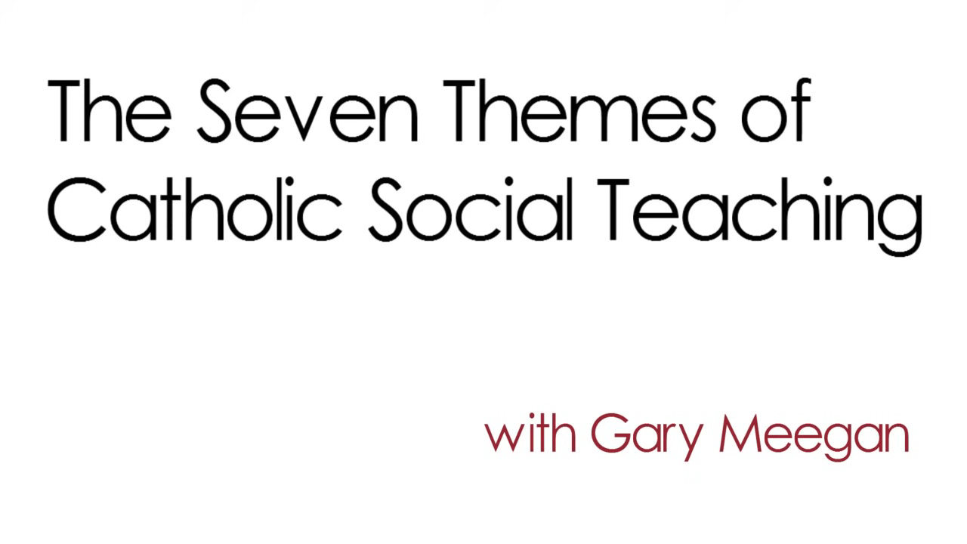
https://www.youtube.com/watch?v=GqSkkeUeV0I
Notes:
Before showing the video ask the women to consider the following questions:
READ
Which of the key principles speaks most strongly to you? Can you explain why?
Why are these key principles only the first step on our journey to social justice?
After showing the video, allow some time for discussion about their answers. (5 minutes)
Move your cursor over the bottom left of the image and click on the “PLAY” arrow.
(5 minutes)
---
Video Source: youtube.com/watch?v=GqSkkeUeV0I

Slide 12
Life and Dignity of the Human Person
The foundation of all CST is that each human person has an inherent dignity because they were created in God’s image and likeness.
The church calls us to be concerned with the well-being of all.
We are called to value and respect each person’s life and dignity regarding economic, political, social, ecological and spiritual needs.
Notes:
Each time you click, another bullet will appear on the screen.
READ:
The following slides will briefly explain each of the seven key principles of Catholic social teaching found in a document provided through Development and Peace—Caritas Canada. The link is included below if you want to view the entire document.
The Life and Dignity of the Human Person:
The foundation of all Catholic social teaching is that each human person has an inherent dignity because they were created in God’s image and likeness.
The church calls us to be concerned with the well-being of all.
We are called to value and respect each person’s life and dignity regarding economic, political, social, ecological and spiritual needs.
Every human person is created in the image and likeness of God. Therefore, every person’s life and dignity must be respected and supported from conception through natural death. We believe that the measure of every institution is whether it threatens or enhances the life and dignity of the human person.
Source: stmikes.utoronto.ca/wp-content/uploads/2020/07/180-Catholic-Teaching-v2.pdf

Slide 13
Family, Community, Subsidiarity and Participation
We are called to:
be family—families which are schools of generosity, patience and dialogue.
be community—contributing to the cultural, economic, political and social life while showing respect for the needs of others.
subsidiarity—we are entitled to have a voice in decisions affecting our lives.
participation and how we interact affects the dignity of individuals and the progress of society.
Notes:
Each time you click, another bullet will appear on the screen.
READ:
The Call to Family, Community, Subsidiarity and Participation:
We are called to be family—families which are schools of generosity, patience and dialogue.
We are called to be community—contributing to the cultural, economic, political and social life while showing respect for the needs of others.
We are called to subsidiarity—we are entitled to have a voice in decisions affecting our lives.
We are called to participation, and how we interact affects the dignity of individuals and the progress of society.
The human person is not only sacred but social. How we organize our society—socially, economically, legally and politically—directly affects human dignity and the ability of every human person to grow in community. Marriage and family, the foundations for social life, should be strengthened and supported. Every person has a right to participate in society and a corresponding duty to work to advance the common good and the well-being of all.
Source: stmikes.utoronto.ca/wp-content/uploads/2020/07/180-Catholic-Teaching-v2.pdf

Slide 14
Rights and Responsibilities
Each person has the right to live as God intended, but this right is linked with the rights of others.
We have a responsibility not to take more at another’s expense.
Human society requires that we contribute to a civic order with rights and responsibilities for all.
Notes:
Each time you click, another bullet will appear on the screen.
READ:
Rights and Responsibilities:
Each person has the right to live as God intended, but this right is linked with the rights of others.
We have a responsibility not to take more at another’s expense.
Human society requires that we contribute to a civic order with rights and responsibilities for all.
Every person has a fundamental right to life, which makes all other rights possible. Each person also has a right to the conditions for living a decent life—food, health care, housing, education and employment. We have a duty to secure and respect these rights for others and fulfill our responsibilities to our families, each other and our larger society.
Source: stmikes.utoronto.ca/wp-content/uploads/2020/07/180-Catholic-Teaching-v2.pdf

Slide 15
Options for the Poor and Vulnerable
God’s love is universal. He calls us to be in solidarity with the vulnerable.
The needs of the poor come before the wants of the rich.
The rights of workers come before profit.
The preservation of the earth comes before uncontrolled industrialization.
Production for the basic needs of people comes before production for military purposes.
Notes:
Each time you click, another bullet will appear on the screen.
READ:
Options for the Poor and Vulnerable:
God’s love is universal. He calls us to be in solidarity with the vulnerable.
The needs of the poor come before the wants of the rich.
The rights of workers come before profit.
The preservation of the earth comes before uncontrolled industrialization.
Production for the basic needs of people comes before production for military purposes.
Scripture teaches that God has a special concern for the poor and vulnerable. The church calls on all of us to put the needs of the poor and vulnerable first. This preferential option for the poor and vulnerable should be reflected in our daily lives and public policies. A fundamental measure of our society is how we care for and stand with our poor and vulnerable brothers and sisters.
Source: stmikes.utoronto.ca/wp-content/uploads/2020/07/180-Catholic-Teaching-v2.pdf

Slide 16
Dignity of Work and the Rights of Workers
The economy serves people, not vice-versa.
Workers are called to participate in God’s creation.
The dignity of work and workers must be respected.
Workers have the right to productive work, fair wages, and to organize and belong to unions.
Workers have the right to a safe workplace and to rest as needed.
Workers have the right to own property and to make economic initiatives.
Notes:
Each time you click, another bullet will appear on the screen.
READ:
Dignity of Work and the Rights of Workers:
The economy serves people, not vice-versa.
Workers are called to participate in God’s creation.
The dignity of work and workers must be respected.
Workers have the right to productive work, a fair wage, and to organize and belong to unions.
Workers have the right to a safe workplace and to rest as needed.
Workers have the right to own property and to make economic initiatives.
The economy must serve people, not the other way around. Work is more than a way to make a living; it is a form of continuing participation in God’s creation. To uphold the dignity of work, the basic rights of workers must be respected—the right to productive work, fair and livable wages, and to organize and join a union.
Source: stmikes.utoronto.ca/wp-content/uploads/2020/07/180-Catholic-Teaching-v2.pdf

Slide 17
Solidarity - Community and the
Common Good
We must all consider the good of the whole human family in organizing our society—economically, politically and legally.
We must love one another and prioritize the good of the human family over commercial interests.
God intended the earth and everything on it to be available to all people.
With justice and charity, there should be enough for all.
(Gaudium et Spes)
Notes:
Each time you click, another bullet will appear on the screen.
READ:
Solidarity – Community and the Common Good:
We must all consider the good of the whole human family in organizing our society—economically, politically and legally.
We must love one another and prioritize the good of the human family over commercial interests.
God intended the earth and everything on it to be available to all people.
With justice and charity, there should be enough for all. (Gaudium et Spes)
We are one human family. We are our brothers’ and sisters’ keepers, wherever they may be. Loving our neighbour has global dimensions. At the core of the virtue of solidarity is the pursuit of justice and peace. Our love for all of our brothers and sisters calls us to seek a peaceful and just society where goods are distributed fairly, opportunity is promoted equally, and the dignity of all is respected.
Source: stmikes.utoronto.ca/wp-content/uploads/2020/07/180-Catholic-Teaching-v2.pdf

Slide 18
Care for God’s Creation
God created the earth, and it is sacred.
Earth is ecologically diverse, beautiful and life-sustaining and worth preserving.
We have a duty to protect and cherish it for the good of all and our descendants.
As the human family, God calls us and inspires us to be creative and responsible for creation.
Notes:
Each time you click, another bullet will appear on the screen.
READ:
Care for God’s Creation:
God created the earth, and it is sacred.
Earth is ecologically diverse, beautiful and life-sustaining and worth preserving.
We have a duty to protect and cherish it for the good of all and our descendants.
As the human family, God calls us and inspires us to be creative and responsible for creation.
The world that God created has been entrusted to all of us. Our stewardship of the earth is a form of participation in God’s act of creating and sustaining the world. In our use of creation, we must be guided by a concern for generations to come. We show our respect for the Creator through our care for creation.
Source: stmikes.utoronto.ca/wp-content/uploads/2020/07/180-Catholic-Teaching-v2.pdf

Slide 19
Key Principles of Catholic Social Teaching
Life and Dignity of the Human Person
The Call to Family, Community, and Participation
Rights and Responsibilities
Options for the Poor and Vulnerable
Dignity of Work and the Rights of Workers
Solidarity – Community and the Common Good
Care for God’s Creation
5 minutes
Notes:
READ:
In a small group (no more than four women), select two of these key principles and brainstorm one way in which you, individually or with others, could advocate to bring about a change that would reflect the principle. (5 minutes)
An example for #1 might be that as a parish council, you support a local organization working to ensure victims of family violence have a safe place to go when they are in danger.
An example for #5 might be that you individually approach a local business that is not giving its staff appropriate break times. Then, you work with the owner/manager to educate them about this requirement.
An example for #7 might be that you coordinate with some friends or family members to do a spring cleanup of a local area and remove litter and garbage.
Leave the slide on the screen so that participants can refer to it during their discussions. After five minutes, invite group sharing. (5 minutes)

Slide 20

Why Should We Follow in the Footsteps of Jesus?
Christ has no body but yours,
No hands, no feet on earth but yours,
Yours are the eyes with which He looks
Compassion on this world,
Yours are the feet with which He walks to do good,
Yours are the hands, with which He blesses all the world.
Yours are the hands, yours are the feet,
Yours are the eyes, you are His body.
Christ has no body now but yours,
No hands, no feet on earth but yours,
Yours are the eyes with which he looks
compassion on this world.
Christ has no body now on earth but yours.
(Attributed to St. Teresa of Ávila)
Image source: thumbs.dreamstime.com/b/can-volunteer-together-male-hand-cupped-female-hand-making-v-surrounded-word-cloud-rustic-dark-colored-89699016.jpg.
Notes:
READ:
Why should we follow in the footsteps of Jesus?
As we identify, research and apply the seven principles of Catholic social teaching, we become the hands and feet of Jesus. We are called to do both charity and justice. Our advocacy, our small actions, one step at a time, are steps along this pathway to holiness.
“Christ has no body but yours,
No hands, no feet on earth but yours,
Yours are the eyes with which He looks
Compassion on this world,
Yours are the feet with which He walks to do good,
Yours are the hands, with which He blesses all the world.
Yours are the hands, yours are the feet,
Yours are the eyes, you are His body.
Christ has no body now but yours,
No hands, no feet on earth but yours,
Yours are the eyes with which he looks
compassion on this world.
Christ has no body now on earth but yours.“
(Attributed to St. Teresa of Ávila)

Slide 21

Speaking Out, Speaking Up
All are invited to speak with courage and in freedom, truth and charity.
“What enables or hinders speaking up courageously, candidly and responsibly in our local church and in society?
When and how do we manage to say what is important to us?
How does the relationship with the local media work (not only Catholic media)?
Who speaks on behalf of the Christian community, and how are they chosen?"
(For a Synodal Church: Communion, Participation, and Mission Vademecum for the Synod on Synodality)
5 minutes
Notes:
Each time you click, another bullet will appear on the screen.
READ:
Speaking Out, Speaking Up
All are invited to speak with courage and in freedom, truth and charity.
Speaking up means to speak louder and advocating.
When you speak up, you communicate publicly, assertively and honestly for the rights and needs of yourself and others.
Speaking out means to advocate both for and against something.
Speaking out may lead to social change, including within organizations.
Invite participants to discuss these questions in groups of two or three (3 – 5 minutes).
Discuss the following question from the Synod on Synodality:
“What enables or hinders speaking up courageously, candidly, and responsibly in our local Church and in society?
When and how do we manage to say what is important to us?
How does the relationship with the local media work (not only Catholic media)?
Who speaks on behalf of the Christian community, and how are they chosen?”
After group discussion, invite sharing. (3 – 5 minutes)

Slide 22

What Exactly is Advocacy?
Notes:
READ:
What is advocacy? It is a way of promoting public support for an idea, plan or way of doing something. It may be an initiative, or it may be a change to an existing process or law.
League advocacy reflects our baptismal call to use our voices to speak for the poor and marginalized. It adheres to the seven principles of Catholic social teaching, such as the common good and care for the environment. It includes the education and mobilization of members, so that they can be informed about issues, take action and become involved in developing and promoting solutions for causes about which they care. It calls members to identify and be part of changes that address the symptoms and the underlying causes of injustice.

Slide 23
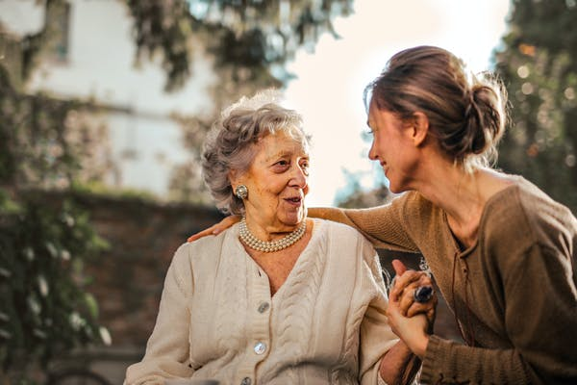
What is Faithful Advocacy?
It is when our actions and efforts seek to create a more socially just, ecologically sustainable and spiritually fulfilling society.
It is part and parcel of living our lives as if the gospel, our faith tradition, our neighbours (especially the poor and oppressed) and the earth really matter!
It is putting flesh onto our call to be faithful disciples of Jesus.
Image source: pexels.com/search/caring/
Notes:
Each time you click, another bullet will appear on the screen.
READ:
What is faithful advocacy?
Faithful advocacy is when our actions and efforts seek to create a more socially just, ecologically sustainable and spiritually fulfilling society.
Faithful advocacy is part and parcel of living our lives as if the gospel, our faith tradition, our neighbours (especially the poor and oppressed) and the earth really matter!
Faithful advocacy is putting flesh onto our call to be faithful disciples of Jesus.

Slide 24
What is CWL Advocacy
League Advocacy:
reflects our baptismal call to be a voice for the poor and marginalized.
adheres to the principles of Catholic Social Teaching such as the key principle of Care for God’s creation.
has always included the education and mobilization of its members so that our members can be informed about issues, take action and become involved in developing and promoting solutions for causes they care about.
Notes:
READ:
How is advocacy linked to the League?
League advocacy reflects our baptismal call to be a voice for the poor and marginalized.
League advocacy adheres to the principles of Catholic social teaching, such as the key principle of Care for God’s Creation.
League advocacy has always included the education and mobilization of members so that they can be informed about issues, take action and become involved in developing and promoting solutions for causes they care about.

Slide 25
Guidelines to Parish Council Advocacy Work
Ensure that the concern or issue aligns with Catholic social teachings and reflects one or more of the League’s Core Values (faith, service, social justice).
Investigate if the League has addressed the topic in past or current resolutions. If yes, study action plans from the resolution.
Communicate with parish and diocesan council president your concern/issue and intent to advocate/collaborate with government official (include what level).
Remain non-partisan in your collaboration/advocacy activity.
Clarify when writing a letter with a personal concern that you are not acting as a representative of the League—do not use League letterhead or speak for anyone else.
Notes:
Each time you click, another bullet will appear on the screen.
READ:
The following are some guidelines for League advocacy work at the parish council level:
Ensure that the concern or issue aligns with Catholic social teachings and reflects one or more of the League’s Core Values (faith, service, social justice).
Investigate if the League has addressed the topic in past or current resolutions. If yes, study action plans from the resolution.
Communicate with the parish and diocesan council president your concern/issue and intent to advocate/collaborate with government officials (include what level).
Remain non-partisan in your collaboration/advocacy activity.
Clarify when writing a letter with a personal concern that you are not acting as a representative of the League—do not use League letterhead or speak for anyone else.

Slide 26
Writing Letters
Follow the suggestions in the Personal Letter Writing Guide (#173) from the League website.
A letter on behalf of the council should be previously authorized by motion and/or resolution.
Personal letters are encouraged but not signed to represent as a League member, officer or council. You are speaking on your own behalf, not someone else’s.
Action plan letters should be delayed until the resolution has been approved at its final destination, e.g., provincial or national.
Notes:
Each time you click, another bullet will appear on the screen.
READ:
Follow the suggestions in the Personal Letter Writing Guide from the League website.
A letter on behalf of the council should be previously authorized by motion and/or resolution.
Personal letters are encouraged but not signed to represent a League member, officer or council. You are speaking on your own behalf, not someone else’s.
Action plan letters should be delayed until the resolution has been approved at its final destination, e.g., provincial or national.
Consider having a letter-writing session at one of your council meetings. It’s good to feel that you are not alone!

Slide 27

Resolutions and the League
Notes:
READ:
We conclude part two of the Advocacy Workshop with this inspiring and historical video that speaks to the long-standing tradition within the League of advocating on topics that cover the seven key principles of Catholic social teaching. The passion driving this advocacy is rooted in our scriptures and baptism and the League’s core purpose, values, mission statement and envisioned future.
Part three of the workshop will further develop these themes and present the following topics:
Fourteen steps to successful advocacy
How to apply these steps to a specific topic/issue
The process of “See, Judge, Act” to guide our advocating

Slide 28
Closing Prayer
  Left: Our God who is in heaven, And all of us here on earth:
  The hungry, the oppressed, the excluded. Holy is Your name.
Right: May Your reign come and Your will be done:
In our choice to struggle with the complexities of this world,
And to confront greed and the desire for power
In ourselves, in our nation, and in the global community.
  Left: Give us this day our daily bread:
  Bread that we are called to share,
  Bread that You have given us abundantly
  And that we must distribute fairly, ensuring security for all.
Right: Forgive us our trespasses:
Times we have turned away from the struggles of other people and countries,
Times when we have thought only of our own security.
Notes:
READ:
We will recite our closing prayer in “choirs” as if we are speaking to one another.
We will alternate paragraphs as left and right.
Left: Our God who is in heaven, And all of us here on earth:
The hungry, the oppressed, the excluded. Holy is Your name.
Right: May Your reign come and Your will be done:
In our choice to struggle with the complexities of this world,
And to confront greed and the desire for power
In ourselves, in our nation, and in the global community.
Left: Give us this day our daily bread:
Bread that we are called to share,
Bread that You have given us abundantly
And that we must distribute fairly, ensuring security for all
Right: Forgive us our trespasses:
Times we have turned away from the struggles of other people and countries,
Times when we have thought only of our own security.

Slide 29
  Left: Lead us not into temptation:
  The temptation to close our minds, ears, and eyes
  To the unfair global systems that create larger and larger gaps between the rich and the poor,
  The temptation to think it is too difficult
  To bring about more just alternatives.
Right: Deliver us from evil:
The evil of a world where violence happens in Your name,
Where wealth for a few is more important
Than economic rights for all,
Where gates and barriers between people
Are so hard to bring down.
ALL: MAY YOUR REIGN COME, FOR YOURS IS THE KINGDOM, THE POWER AND THE GLORY FOREVER AND EVER. AMEN.
(Source: The Lord’s Prayer: An Adaptation, taken from Center of Concern/Education for Justice. Used with permission)
Notes:
Left: Lead us not into temptation:
The temptation to close our minds, ears, and eyes
To the unfair global systems that create
Larger and larger gaps between the rich and the poor,
The temptation to think it is too difficult
To bring about more just alternatives.
Right: Deliver us from evil:
The evil of a world where violence happens in Your name,
Where wealth for a few is more important
Than economic rights for all,
Where gates and barriers between people
Are so hard to bring down
All: May Your reign come, for Yours is the kingdom, the power and the glory forever and ever. Amen.
---
Source: The Lord’s Prayer: An Adaptation, taken from Center of Concern/Education for Justice

