Slide 1
Workshop
Betty Colaneri
National Chairperson of Legislation (2018-2021)

Slide 2
WHAT IS LEGISLATION?
To answer this very important question,
CWL Special Agent T.A.G., code name “The Seeker,” was brought in from a covert operation in the field.
Over to you, Seeker!

Slide 3
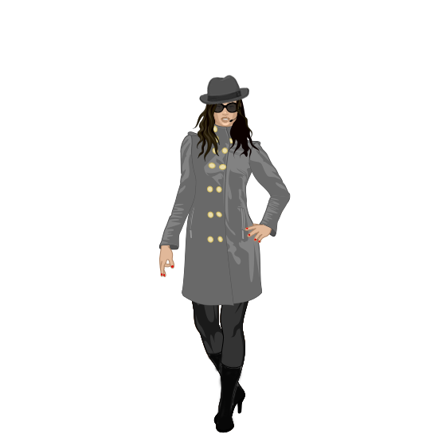
C.W.L. Special Agent T.A.G.
Welcome to the mission!
W
C
L
T – Tracking
A – Actions of
G -Government
T
G
A

Slide 4
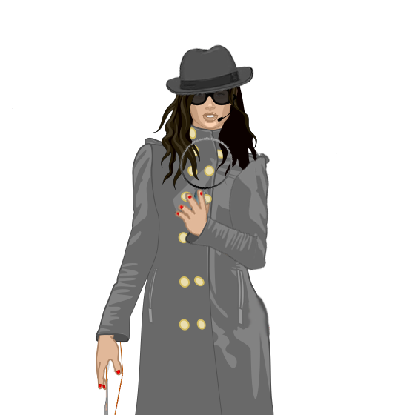
I began my investigation at canada.ca where I found the answer.
According to the Government of Canada website,
“Legislation refers to
written laws, often referred to as Acts or statutes, which are enacted by Parliament, the legislative arm of government.”
Laws affect nearly every aspect of the daily lives of citizens.
Lawmakers work hard to put many laws in place as a way to help ensure a safe and peaceful society.

Slide 5
WHY IS LEGISLATION SO IMPORTANT?
It gives the opportunity to:
make a difference
be advocates for change
be a voice for those that have no voice
affect change to better Canada
defend Christian values
How can members affect legislation?
study legislation on important issues
be informed and keep a finger on the pulse of society
monitor Hansard
monitor newspapers and other social media
write letters to members of parliament and provincial government leaders
spread the word to members
pray
monitor government publications, websites

Slide 6
THE LEGISLATIVE PROCESS
Involves three parts that work together to create new laws:
House of Commons (elected, lower chamber-338 seats)
Senate (appointed, upper chamber-105 seats)
Monarch (head of state, represented by the governor general in Canada)
Draft legislation is introduced to parliament in the form of a bill to:
provide the basis to amend or cancel existing laws
implement new laws
provide rules of conduct

Slide 7
Hi!
I’m Bill!
Intel sent word that an issue was being brought to parliament.
Let’s take a closer look. Strictly for investigative purposes of course!
Code name: BILL

Slide 8
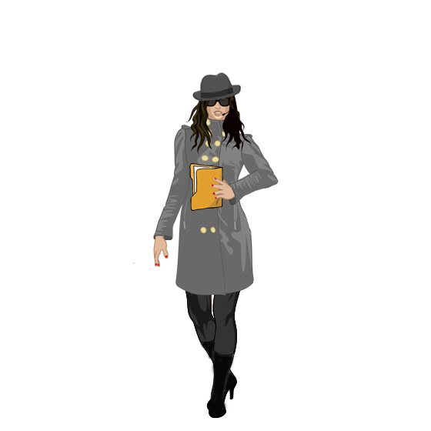
IMPORTANT STAGES IN THE LIFE OF BILL
Introduced by a member
First reading
Second reading
Committee stage
Report stage
Third reading
Passage by the senate
Royal assent and proclamation
Third Reading

Slide 9
INTRODUCTION AND FIRST READING
Any cabinet minister, parliamentary secretary or individual parliamentarian (private member) introduces Bill.
The member must give 48 hours written notice to the clerk of the house to do so.
The title for Bill is put on the notice paper.
The day it appears on the notice paper, the title for Bill is put on the order paper.
It will remain there until the minister decides to introduce it.
Once Bill has been introduced, the speaker proposes the motion for Bill to be introduced, the motion is deemed carried.
The Speaker asks, “When shall Bill be read a second time?” And he answers with “at the next sitting of the house.”
This formality allows Bill to be placed on the order paper for the second reading.
This is the stage that a specific number is assigned to Bill.
In the House of Commons numbers are assigned C-1 – C-200.
Private members are assigned
C-201 – C-1000.

Slide 10
I hope my welcome is warmer than the weather.
Bill has been followed to the parliament buildings. Sources confirm it is his first visit.

Slide 11
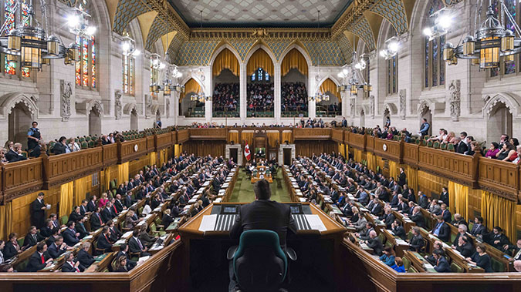
I’ve got eyes on Bill!
Bill
Surveillance cameras on the inside have picked up Bill in the House of Commons. He is being introduced and read for the first time.

Slide 12
SECOND READING OF BILL
The MPs from all parties have an opportunity to debate the strength and weaknesses of Bill ending with a vote on the principle of Bill.
If the vote is in favour of Bill, “passing second reading,” he is sent to a parliamentary committee. The committee examines Bill in great detail. Changes can be made here.
Public hearings or special meetings are held. Different people inside and outside government can comment, hear views or suggest changes to be made to Bill.
The committee can ask for government officials, experts or witnesses, to come and answer questions.
Reflections by the committee may include:
Is what Bill represents good?
Does what Bill propose meet the needs of the people?
If the chamber votes for Bill and he passes this stage, he goes to a committee.

Slide 13
How are you doing? Still with me?
REPORT STAGE
Once a committee has finished its study, it can suggest changes or amendments to Bill before giving its report to the chamber.
Parliamentarians, or individual members of parliament (MPs), can also make amendments to the bill.
Another debate will take place to discuss those amendments.
It is the role of the chairperson of the committee to report about Bill to the House of Commons along with any amendments they may have made.
This stage concludes when the debate ends.

Slide 14
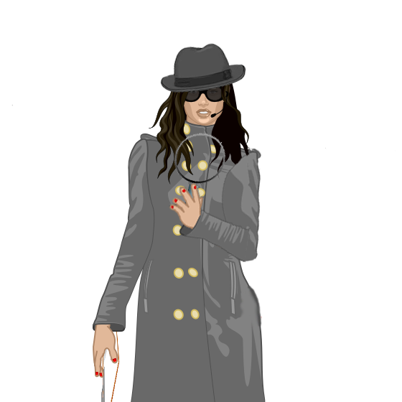
I’ve
picked up on a possible threat!
Bill may not
make it!!
THIRD READING
At this stage, the MPs debate on Bill in his final form and vote to decide whether or not the House should pass him.
Sometimes they can change their minds about Bill. They might vote for him at Second Reading but not at Third Reading if they do not like the changes that were made to Bill.
After Bill passes the Third Reading he is considered passed by the House.
Bill finally leaves the House hails a taxi and makes his way to the Senate.

Slide 15
Bill made it! He is in the Senate to be introduced to this group of senators.
He’s still not in the clear!
He must go through the same process as he did in the House of Commons.

Slide 16
Important Final Steps
When Bill is passed by the Senate, if any amendments were made, the other chamber must agree to those amendments.
Messages may go back and forth until an agreement is reached.
Once the House of Commons and the Senate agree to pass Bill in exactly the same way, he has a date with the governor general or a representative of the governor general for approval.
Be sure to include this in your file.

Slide 17
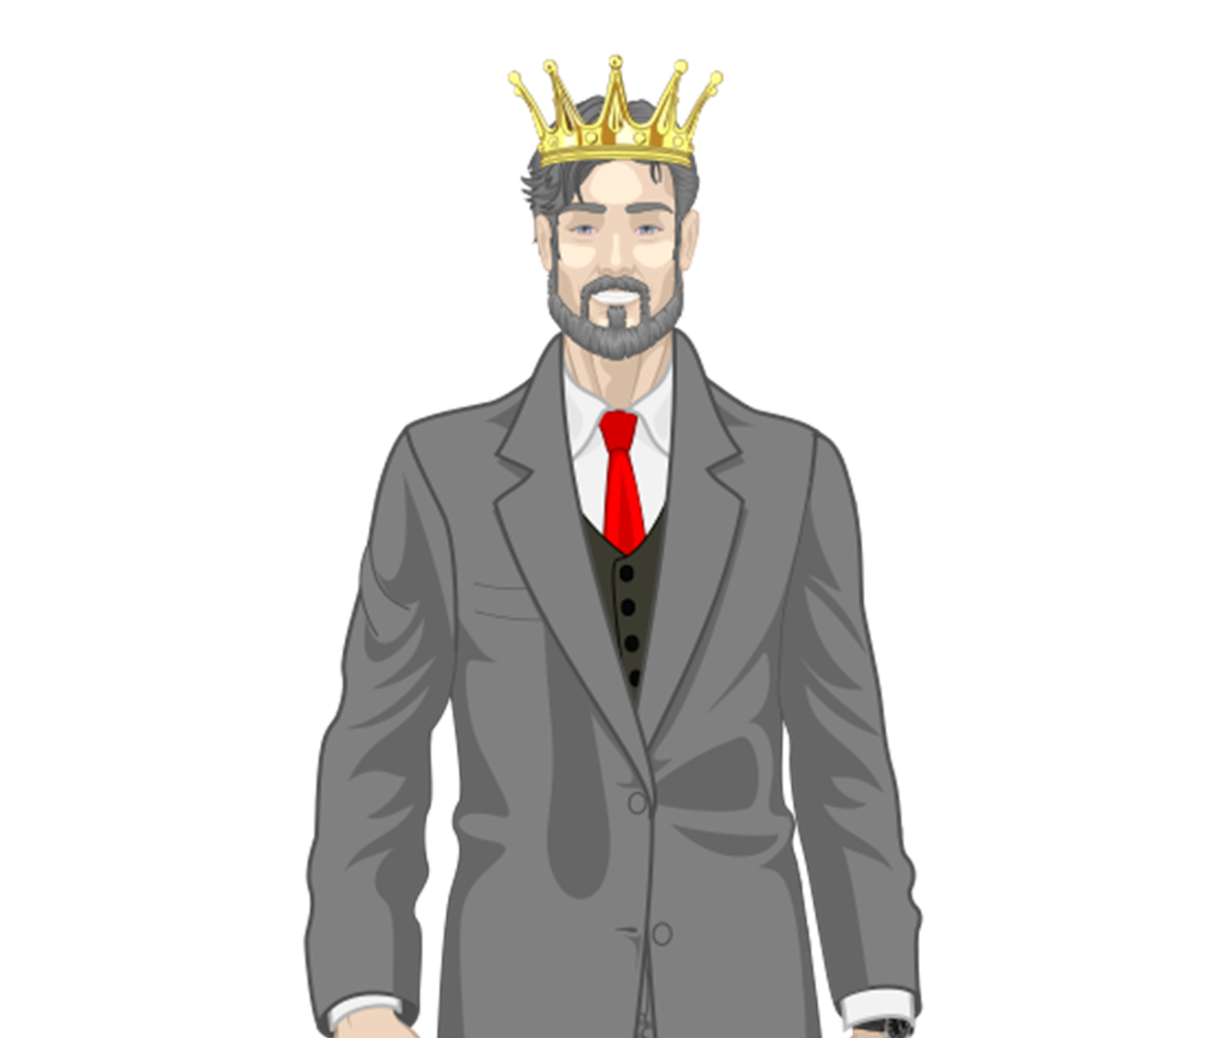
The name is Law…
Bill Law
Just got word from my informant. Bill received his final approval by the governor general or the appointed representative and was granted royal assent. It has been quite a journey!
The grey hair and crown suit him, don’t you think?
New status, new Bill, Code Name: Law!
Welcome Bill Law! You’ve just made history!

Slide 18
Laws come into force in the following ways:
when royal assent is received,
on the day or days set by the governor in council (the governor general, on the advice of the federal cabinet).
on the day or days specified in the Act,

Slide 19
What is legislation?
For CWL members it is
Faith in Action!

Slide 20
The file in this case is
very large. I have pulled some items out for you to become familiar with.
Investigate and research on your own with the resources I have provided for you.
Remember this is NOT
for your eyes only!
Spread the word.
Knowledge is…
Power!

Slide 21
As members of the League, your mission, should you choose to accept it…
Read, Research,
React!
All it takes is the power of one to get things rolling!
Yes,
Special Agent T.A.G. …
You’re it!!

Slide 22
Canadian Parliament
Steeped in
History and Traditions
Intel has provided more background information to help with the mission.
The following can be used as a resource. Be sure to also use sources in the field for assistance.
This information will not
self-destruct.
Good luck Special Agent T.A.G.!

Slide 23
IMPORTANT RESOURCES
LEGISinfo
LEGISinfo is an essential research tool for finding information on legislation before parliament and provides electronic access to a wide range of information.
Details about each bill:
passage of the bill through the Senate and House of Commons
the text of the bill as introduced at first reading and its most recent version if it is amended during the legislative process
votes
major speeches at second reading
when the bill takes effect
summaries from the Parliamentary Information and Research Service of the Library of Parliament
government press releases and backgrounders for bills
a combined effort of the House of Commons, Senate and the Library of Parliament.
Hansard
Hansard is the official report of parliamentary debates.
Provides:
a transcription of everything said on the floor of parliament
reports on speeches made to parliament by MPs either in favour or against a current bill
records of votes
a daily publication covering the preceding day followed by a bound final version.

Slide 24
DID YOU KNOW?
If a bill originates in the House of Commons, it is identified with the letter C and given a number.
E.g. Bill C-7.
In the Senate, the bill is identified with the letter S and given a number. E.g. Bill S-4.
The Senate is decorated in red, which is traditionally identified as a royal colour, because this is where the Queen or her representative, the governor general, addresses parliament.
WHAT IS THE DIFFERENCE BETWEEN PROROGUED AND DISSOLUTION?
PROROGUED
Occurs in parliament when the business of a session is finished in both the House of Commons and the Senate and must resume within one year.
Parliament is prorogued by the governor general on the advice of the prime minister.
DISSOLUTION
Terminates a parliament.
It must be followed by a general election.
Parliament is dissolved by the governor general on the advice of the prime minister.

Slide 25
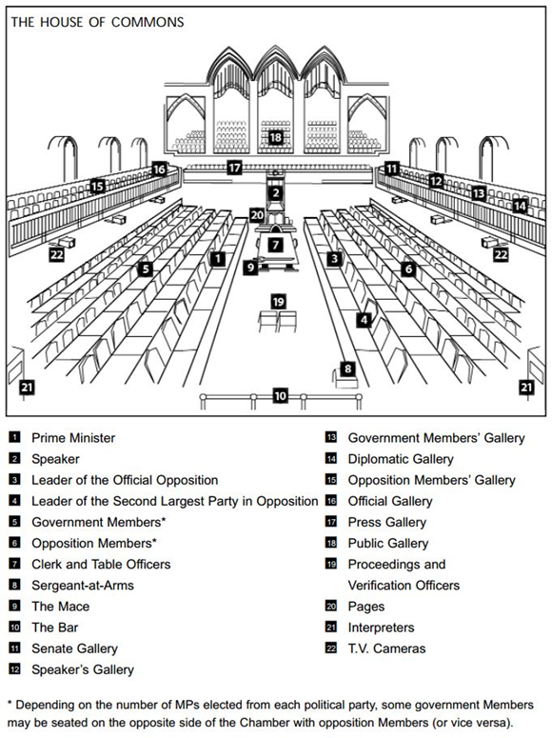
Floor Plan of
The House of Commons
The House of Commons is decorated in green. One of the more popular theories suggests that the colour green is used to represent the commoners.

Slide 26
THE PRIME MINISTER
Leader of the party with the largest number of seats in the House of Commons.
Head of the executive with various duties and responsibilities.
Selects all members of cabinet.
Advises the governor general when to dissolve parliament and call a general election.
As leader of the government has considerable influence over the activities and agenda of parliament.
Faces the leader of the official opposition across the centre isle about a third of the way down the chamber.
First act in the House in each session of parliament is to present a “dummy bill” (pro forma bill) representing the administration of the Oath of Office. This gives the House the right to discuss important matters before responding to the Speech from the Throne, instead of having to make that response the first order of business. Since it is the first bill of the parliament and originates in the House of Commons it is always Bill C-1.

Slide 27
LEADER
OF THE OPPOSITION
Is generally the leader of the political party with the second largest number of seats in the House of Commons.
Primary spokesperson of the official opposition, whose role is to assess government policies and programs, to hold government to account or draw attention to government inaction and to offer constructive criticism and alternatives.
Faces the prime minister across the centre isle about a third of the way down the chamber.
Rallies opposition members in debating the actions and policies of the government with the assistance of a deputy leader.

Slide 28
THE MACE
The mace is a massive, heavy and ornate sceptre that was made in 1917. It is one of the most important symbols inherited from the British parliamentary tradition and continues to be used today. This mace is used in the House of Commons and is almost an exact replica of the one in the British House. The slight variation displays the Canadian decorative elements. It symbolizes the authority of the speaker and the right conferred on the commons by the crown to meet and pass laws. The mace is kept in the custody of the sergeant-at-arms.
The head is in the shape of the Tudor crown with four panels-the Arms of Canada, the Rose of England, the Harp of Ireland and the Thistle of Scotland. The initials ER (for Elizabeth Regina) are carved on each side of the panel. Roses shamrocks, thistles, fleurs-de-lys and maple leaves are all carved on the staff.
The speaker’s parade begins each sitting day of the House of Commons with parade. Officials solemnly walk in procession with the speaker of the House of Commons from the speaker’s offices to the House of Commons.
The sergeant-at-arms places the mace on the clerk’s table.

Slide 29
Made of painted wood and metal, the mace was used until March 28, 1917.
Since the 1980s, the temporary mace has been used when the House sits on February 3rd to commemorate the mace that was destroyed in the block fire of 1916 .
THE TEMPORARY MACE, 1916

Slide 30
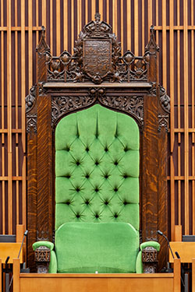
The newly elected speaker, by tradition, pretends to resist as he or she is “dragged” to the chair. This has been done dating back to when British speakers risked execution if the news they reported to the king was not favourable.
In keeping with parliamentary traditions, debate is guided by the speaker.
It is the speaker’s job to assist the House of Commons in moving through its daily agenda and to rule on disputes about proper parliamentary practices or procedures.
The chair remains a strong symbol, a concrete reminder of the authority of the speaker to regulate debate, to maintain order and to ensure the free expression of all opinions.
SPEAKER’S CHAIR

Slide 31
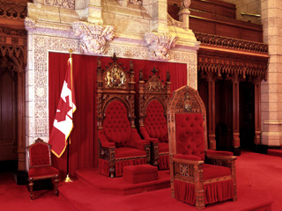
Behind the speaker are two thrones.
The larger is used exclusively by the monarch or governor general.
The other chair is for his or her consort.
CHAIR OF THE SPEAKER OF THE SENATE

Slide 32
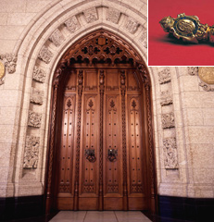
OPENING OF PARLIAMENT
A general election is followed by a new parliament. When all elected members of parliament are sworn in the first session begins.
On the day of the Speech from the Throne, the governor general sends the usher of the black rod to knock on the doors of the House of Commons and to call all members of parliament to the Senate.
Each session begins with a ceremony for the Speech from the Throne.

Slide 33
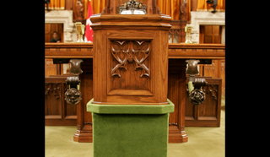
The members of the House of Commons elect a speaker by secret ballot.
Members return to the Senate to announce the elected speaker, asking for confirmation of the rights and privileges of the House.
Ballot box for the election of the Speaker in the House of Commons

Slide 34
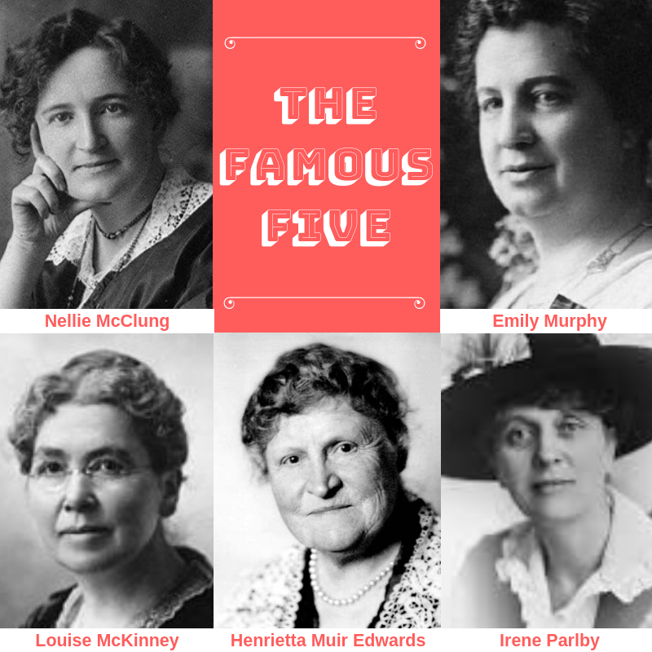
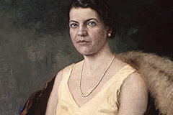
IMPORTANT DATES IN LEGISLATION FOR WOMEN
On October 18, 1929, Lord Chancellor of Great Britain Lord Sankey, delivered the decision of the Judicial Committee of the Privy Council that a woman could be a “qualified person” for appointment to the Senate.
By deciding that a “person” meant both a man and a woman, the committee cleared the way for Cairine Wilson's appointment as the first woman senator four months later.
The case had been spearheaded by five women activists who became known as the Famous Five-Henrietta Edwards, Nellie McClung, Louise McKinney, Emily Murphy and Irene Parlby.

Slide 35
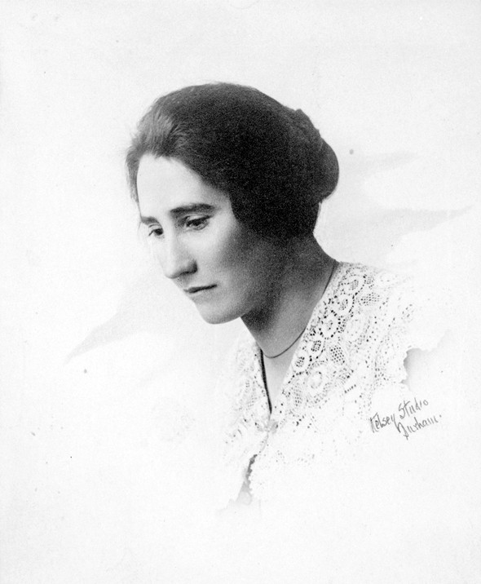
Agnes Macphail, a farmer and teacher, became the first woman member of parliament in 1921.

Slide 36
Bill Status - Parliament of Canada website: parl.ca
Hansard - House of Commons: ourcommons.ca
Government of Canada: canada.ca
Department of Justice: justice.gc.ca
The Catholic Women’ League of Canada website: cwl.ca – Personal Letter Writing Guide
RESOURCES

