Slide 1
OPENING DOORS
SOCIAL JUSTICE and the
COMMUNITY LIFE STANDING COMMITTEE

Slide 2
OPENING PRAYER
Lord, as we gather together here today,
we ask that you bless these women
that they may be instrumental
in helping to bring peace and justice
to our troubled world.
Amen

Slide 3
SCRIPTURE READING
Matthew 25: 31-40

Slide 4
HISTORY OF SOCIAL JUSTICE IN THE CATHOLIC CHURCH
Church has a long history of social justice.
Social justice teachings have their roots in the prophets of the Hebrew Scriptures.
This included prophets such as Isaiah and Micah.
Jesus’ call for justice and compassion for those in need became an essential part of Christianity.
Followers were challenged to live as Jesus did.

Slide 5
Following the Industrial Revolution social conditions changed rapidly.
Popes, bishops and councils wrote documents reflecting the churches social teachings.
Pope Paul VI – Encyclical Letter – Populorum Progressio (On the Development of Peoples) – March 26, 1967
Pope John Paul II wrote three Encyclicals
Laborem Exercens (On Human Work) September 14, 1981
Sollicitudo Rei Socialis (On Social Concerns) December 30, 1987
Centesimus Annus (100th Anniversary of Pope Leo XIIIs Rerum Novarum – On Capital and Labor; On Catholic social teaching) May 1, 1991.

Slide 6
June 2004, the Pontifical Council of Justice and Peace produced the Compendium of the Social Doctrine of the Church.
The Catechism of the Catholic Church – contains official church teachings on social justice.
GOOD NEWS!!!
The good news is that all of these documents have summed up social justice into ten basic principles.
We will look at these ten principles during this workshop and show how they relate to the Community Life Standing Committee.

Slide 7
HISTORY OF SOCIAL JUSTICE
WITHIN THE LEAGUE
The first council founded in Edmonton 1912, was affiliated with The Catholic Women’s League of England. Its main purpose was to address the needs of immigrant women and children.
The Catholic Women’s League of Canada was established in 1920 with a main concern on needs of immigrants.
1966 – League initiated a Social Action Program – The Christian in the Community with the watchwords “Observe, Judge, Act”.
A 1969 resolution was adopted to give 1% of personal and luxury items and 1% of council funds to The Canadian Catholic Organization for Development Peace for projects aimed at empowering women and improving their standard of living.

Slide 8
Over the years we have had letter writing campaigns such as the Argentina Grandmothers and the missing grandchildren.
The League has presented resolutions on many important issues to the federal government.
Our latest initiative is “Women Against Poverty” (WAP)

Slide 9
TEN PRINCIPLES OF SOCIAL JUSTICE AND HOW THEY RELATE TO THE STANDING COMMITTEE OF COMMUNITY LIFE

Slide 10
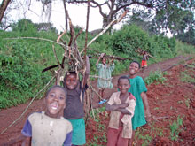
HUMAN DIGNITY
The foundation of all Catholic social teaching is the belief in the inherent dignity of the human person.
Human life is sacred, and each person is precious. The person is made in the image of God. We are called to honour and give priority to the human person.
The dignity of the human person is the starting point for a moral vision for society.

Slide 11
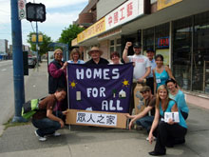
RIGHTS & RESPONSIBILITIES
Human dignity can be protected and a healthy community can be achieved only if human rights are protected and responsibilities are met.
Every person has a fundamental right to life and a right to those things required for human decency, starting with food, shelter, clothing, employment, health care and education.
Corresponding to these rights are duties and responsibilities --- to one another, to our families, and to the larger society.

Slide 12
DIGNITY AND RIGHTS OF PERSONS
It is our responsibility, as Christian women and members of a national organization, to play an active role in opposing discrimination wherever and whatever form it appears.
We should:
Become familiar with the Universal Declaration of Human Rights
Acquire and understanding of minority issues
Become knowledgeable about human trafficking and its prevention
Encourage members to actively denounce social injustice and violation of human rights at home and abroad.

Slide 13
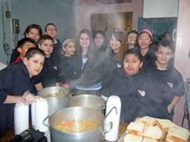
COMMUNITY & THE COMMON GOOD
The person is not only sacred but also social. The obligation to “love our neighbour” requires a broader social commitment.
Everyone has a responsibility to contribute to the good of the whole society, to the common good.
How we organize our society – in economics, politics, law and policy – directly affects human dignity and the capacity of individuals to grow in community.

Slide 14
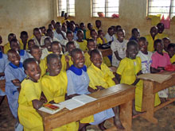
OPTION FOR THE POOR & VULNERABLE
We are called to examine personal decisions, institutional policies, and economic affairs in terms of their effects on the poor.
The obligation to evaluate social and economic activity from the view point of the poor arises from the command to love one’s neighbour as one’s self.
The “option for the poor” is an essential part of society’s effort to achieve the common good. A healthy community can be achieved only if its members give special attention to those with special needs.
A basic moral test of society is how it treats its most vulnerable members.

Slide 15
SOCIAL AND ECONOMIC JUSTICE
We must be active in making sure the most vulnerable members in our society are protected with love and justice.
We should:
Encourage members to participate in the work of organizations caring for those in need
Be familiar with restorative justice programs

Slide 16
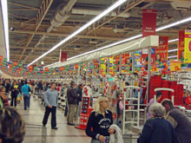
DIGNITY OF WORK
The economy must serve people, not the other way around.
All workers have a right to productive work, to decent and fair wages, and to safe working conditions. They also have a right to organize and join unions.
People have a right to economic initiative and to private property, but it is unjust for some to amass excessive wealth when others lack the basic necessities of life.
Catholic teaching opposes collectivist and statist economic approaches. It also rejects the theory that a free market automatically produces justice.

Slide 17
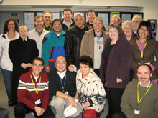
PARTICIPATION
All people have the right to participate in the economic, political and cultural life of society. This is a fundamental demand of justice and a requirement for human dignity.
It is wrong for a person or a group to be excluded unfairly or to be unable to participate in society.

Slide 18
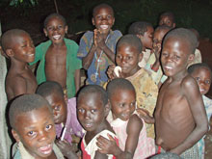
GLOBAL SOLIDARITY
We are one human family, whatever our national, racial, ethnic, economic and ideological differences.
We are our brothers’ and sisters’ keepers, wherever they live. Solidarity means that “loving our neighbour” has global dimensions in an interdependent world.
Pope John Paul II has called solidarity a virtue, by which one demonstrates “a firm and persevering determination to commit oneself to the common good; that is to say, to the good of all and of each individual, because we are all really responsible
for all.”

Slide 19
DEVELOPING COUNTRIES
To help a family become economically independent is to help a community become economically independent.
We should:
Invite guest speakers from developing nations, or other people who have visited or lived in those countries, to meetings.
Become knowledgeable through study about the economic difficulties of developing countries.

Slide 20
We should:
Criticize structures that put profits before people and pressure governments to change these structures.
Become aware of conditions of child labour in developing countries and urge independent study of codes of conduct.
Be aware of the implications of trade laws and practices in the global economy.

Slide 21
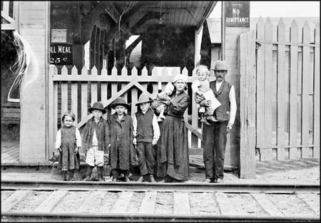
REFUGEES, IMMIGRATION AND CITIZENSHIP
Article 298 Compendium of the Social Doctrine of the Church states the following:
Institutions in host countries must keep careful watch to prevent the spread of the temptation to exploit foreign laborers, denying them the same rights enjoyed by nationals, rights that are to be guaranteed to all without discrimination. Regulating immigrations according to criteria of equity and balance is one of the indispensable conditions for ensuring that immigrants are integrated into society with the guarantees required by recognition of their human dignity. Immigrants are to be received as persons and helped, together with their families, to become a part of societal life. In this context, the right reuniting families should be respected and promoted.

Slide 22
Canada and the League have a long standing tradition of welcoming new citizens. We should:
Become informed about Canada’s official immigration and refugee policies
Become knowledgeable about the needs of immigrants and refugees in the community
Encourage members to volunteer at refugee and immigration centres
Welcome immigrants and refugees into the community
Offer assistance where needed
Support and celebrate the concept of national unity in the community

Slide 23
We should
Assist in English as a Second Language (ESL) programs; if there are no classes available, start one in the community

Slide 24
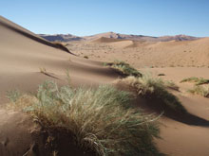
STEWARDSHIP OF CREATION
The goods of the earth are gifts from God, intended for the benefit of all. We are not ultimate owners of these goods, but rather, the temporary stewards and trustees.
We are entrusted with the responsibility of caring for these gifts and preserving them for future generations. We are not merely consumers and users.
How we treat the environment is a measure of our stewardship, a sign of our respect for the Creator.

Slide 25
PROTECTING THE ENVIRONMENT
BECOMING A “GREEN CHURCH”
Encourage members to bring their own coffee mugs to meetings.
Encourage the organizers of parish events to use re-useable dishes, cutlery, etc.
Promote recycling in your community.
If your community does not have a recycling program consider writing a resolution for presentation to the mayor of your community.

Slide 26
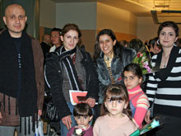
CONSTRUCTIVE ROLE FOR GOVERNMENT
The government has a positive moral function. It is an instrument to promote human dignity, protect human rights, and build the common good.
In our large society, we cannot always carry out our responsibilities to others on a one-to-one basis, so a key function of government is to assist us in fulfilling these responsibilities and promoting the common good.
According to the principle of subsidiarity, what needs to be done should be carried out as close as possible to where the need occurs.

Slide 27
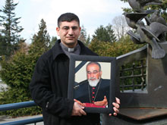
PROMOTION OF PEACE
Catholic teaching promotes peace as a positive, action oriented concept. Peace is the fruit of justice and is dependent upon right order among human beings.
There is a close relationship in Catholic teaching between peace and justice.
As Pope John Paul II has stated: “Peace is not just the absence of war. It involved mutual respect and confidence between peoples and nations. It involves collaboration and binding agreements”.

Slide 28
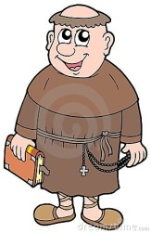
CLOSING PRAYER
A FRANCISCAN BLESSING

