Slide 1
Marian Devotions Prayers, Images and Apparitions

Slide 2
Marian Devotions - Litanies
Approved for official use:
litanies of all saints
litanies of the names of Jesus
litanies of the Sacred Heart of Jesus
litanies in honour of Saint Joseph
litanies of the Precious Blood
litanies of Loreto
Advocation: the act of pleading or advocating
Invocation: petition for help

Slide 3
Marian Devotions - Litanies
Litany of Our Lady of Good Counsel
Mary’s holiness
Mary, the Mother
symbols of Mary
Mary, the Counsellor
invocations
Litany of Loreto
Mary the Helper
Mary the Queen

Slide 4
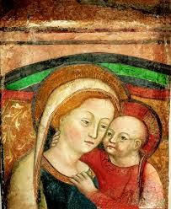
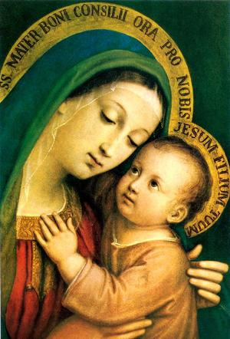
Marian Devotions - Images
Our Lady of Good Counsel
Genazzanno, Italy
15th century
Scutari, Albania
Augustinian Order
Devotions
pilgrimage
prayer
Patroness of Albania
April 26th

Slide 5
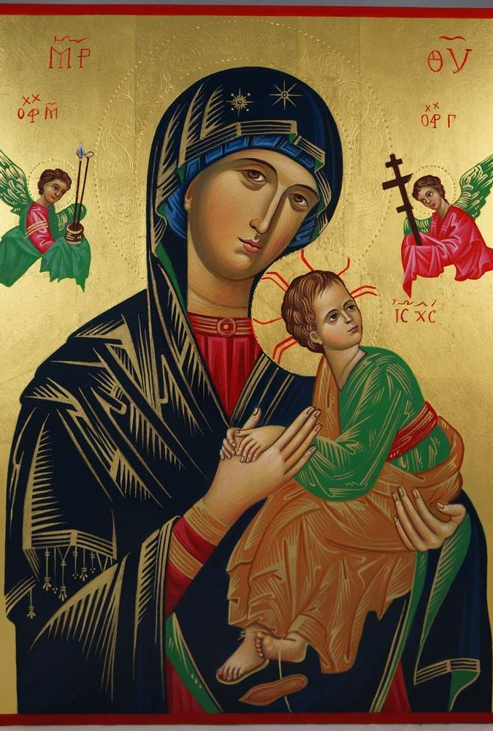
Marian Devotions - Images
Our Lady of Perpetual Help
Church of St. Matthew, Rome
Church of St. Alphonsus, Rome
15th century
Augustinian order
Congregation of the Most Holy Redeemer (the Redemptorists)
Devotions
prayers
pilgrimage
June 27th

Slide 6
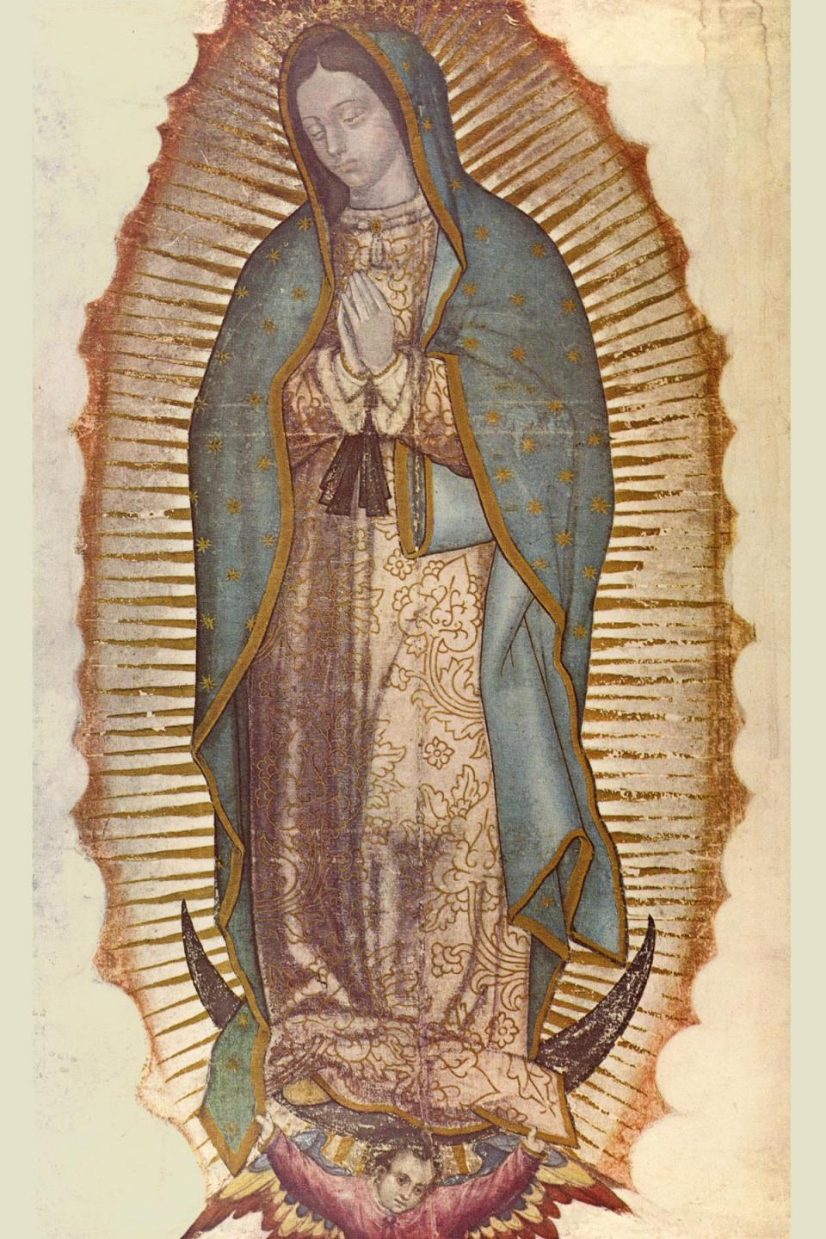
Marian Devotions - Images
Our Lady of Guadalupe
16th century
Our Lady of Guadalupe Basilica, Mexico City
defies scientific explanation
Aztec and Christian symbols
Devotions
pilgrimage
Patroness of the Americas and of Mexico
December 12th

Slide 7
Marian Devotions - Apparitions
Private revelations; a special grace given by Heaven
Approved as “worthy of belief,” but belief is not required of Catholics
Sixteen are Vatican-approved, including:
Our Lady of Guadalupe
Our Lady of Knock
Our Lady of Lourdes
Our Lady of the Miraculous Medal
Our Lady of Hope
Our Lady of Fatima

Slide 8
Marian Devotions - Apparitions
Our Lady of Guadalupe
Location: Teyapac/Mexico City, Mexico
Witness: Juan Diego [Cuauhtlatoatzin] (five times): December 9 (twice) – 12, 1531
Sign of authenticity: tilma full of roses
Message: I am Mother of God; build a chapel on Teyapac Hill (former site of a pagan temple)
Result: Six million converts in seven years

Slide 9
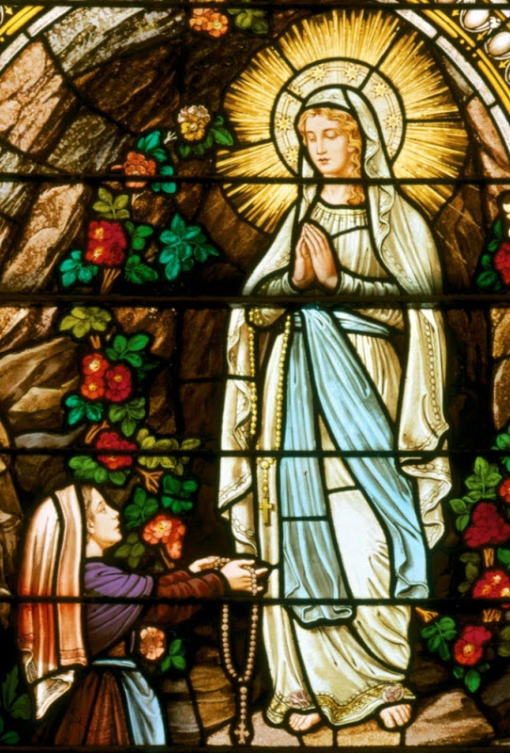
Marian Devotions - Apparitions
Our Lady of Lourdes
Location: Lourdes, France
Witness: Bernadette Soubirous (18 times) – February to April, 1858
Sign of authenticity: revelation of a (hidden) stream/spring/fountain
Message: I am the Immaculate Conception; dedicate prayer and penance for the conversion of sinners; build a chapel and have people come in procession
Result: A place of pilgrimage and many healings

Slide 10
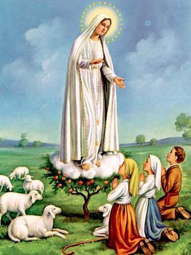
Marian Devotions - Apparitions
Our Lady of Fatima
Location: Fatima, Portugal
Witness: Lucia dos Santos, Jacinta Marto, Francisco Marto (six times) – May to October 1917
Sign of authenticity: miracle of the “Dancing of the Sun”
Message: I am Our Lady of the Rosary; pray the rosary frequently for the conversion of sinners; consecration of Russia to her Immaculate Heart
Result: conversions

