Slide 1
Our Common Home – a Crash Course
Notes:
I invite you to relax and listen. This presentation and its talking points will be shared, so there is no need to take notes.

Slide 2
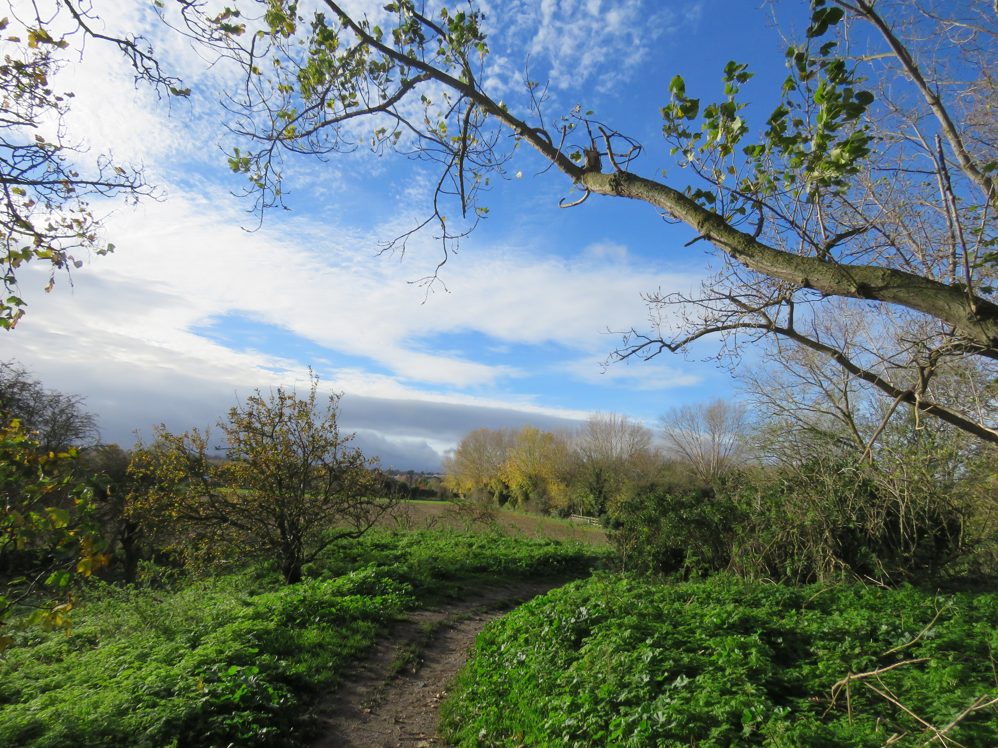
Notes:
All people are all on a path—the same path of life from birth. They live, breathe, eat and grow old. They raise their children in this common home called Earth. It does not matter where one lives in the world—there is one path for living and one common home.

Slide 3
Notes:
A century and a half ago, there was a footpath, then a path for the horse or mule-drawn cart. Then, the Industrial Age came along, and people built railroads. They did not have to walk anymore and soon traded horses for cars and train tickets.
Life became easier as people no longer had to hunt and gather. Stores popped up everywhere with everything that was needed and more. The train became faster.
People traded hunting and gathering the necessities for themselves and their families, for a new, shiny consumer lifestyle. But, they did not realize at the time that they were trading these new modes of convenience—this shiny life—for the future security of their children and clean air and essential resources for their grandchildren.

Slide 4
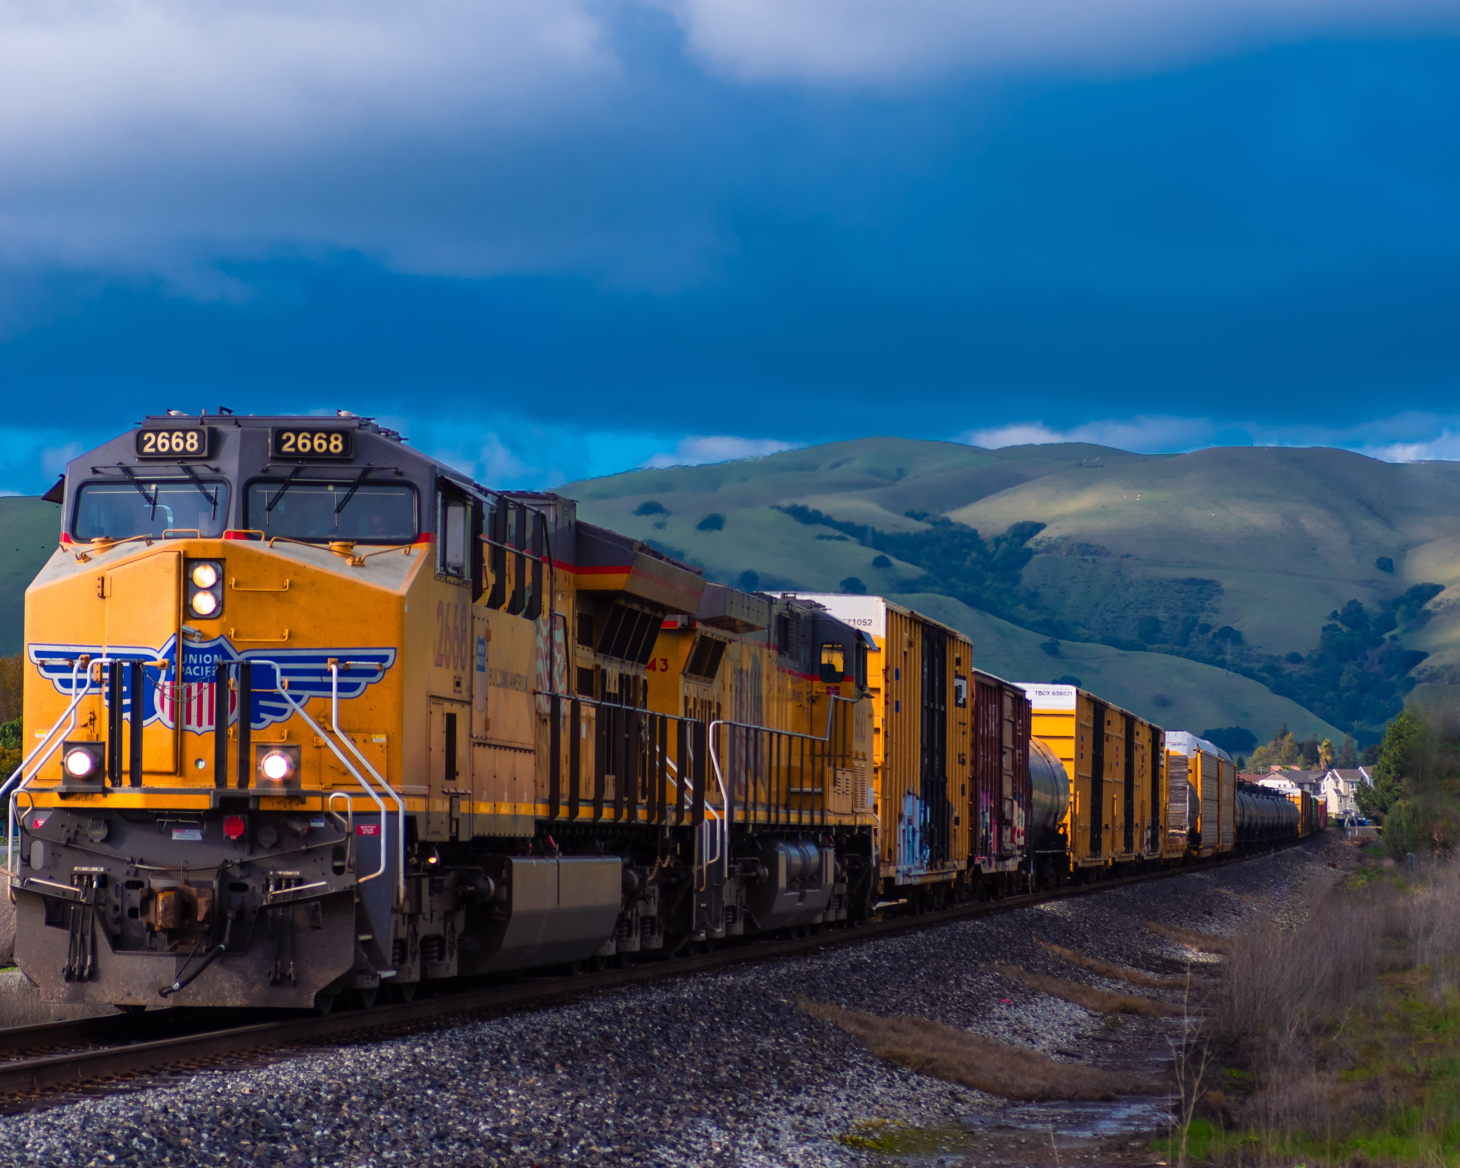
Notes:
Fast food, vacuum cleaners and moving pictures arrived—and the atomic bomb. Chemicals were developed for use in concentration camps. Albert Einstein tried to warn people, but the train only sped up.
The chemicals worked so well that they were converted to pesticides, fungicides and herbicides while other chemicals and fertilizers were developed. Big agriculture and industry boarded the train. Rachel Carson tried to warn everyone, but the train continued to speed up.
Now there is a need to find a way to slow this train down, reduce speed—build better, more sustainable tracks. The train is moving quickly. Everyone is on it, and no one can jump off—it is still their only common home. There are some passenger cars, supply cars and even engineers aboard that know it needs to be slowed down, but not everyone on board knows or understands—and they need to.

Slide 5
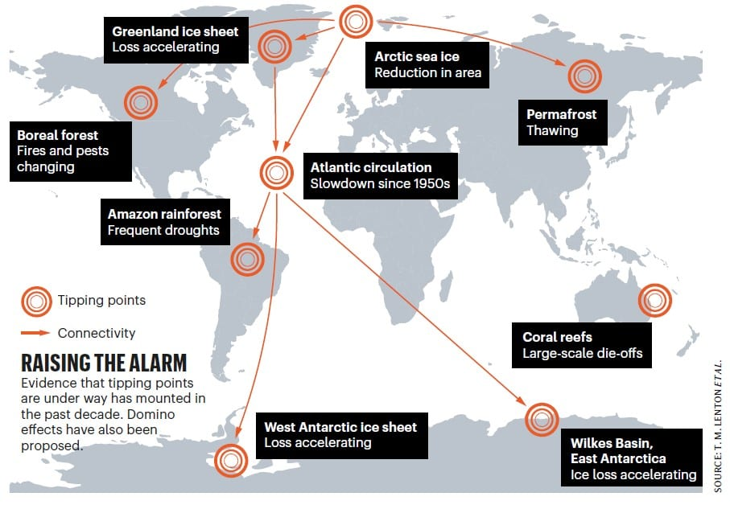
Notes:
*Scientists note there are 15 major signs of health on this planet that are being monitored, including:
Arctic summer sea ice
Greenland ice sheet
West Antarctic ice sheet
Atlantic thermohaline circulation
El Nino–Southern Oscillation (ENSO)
Indian summer monsoon
Sahara/Sahel and West African monsoon
Amazon rain-forest
Boreal forest
Antarctic Bottom Water
Tundra
Permafrost
Marine methane hydrates
Ocean anoxia
Arctic ozone
These are called tipping points. Nine of these tipping points are blinking like indicators on a dashboard. The Greenland ice sheet, West Antarctic ice sheet, Wilkes Basin and East Antarctic ice losses are accelerating. The permafrost is thawing and boreal forests are facing pests and longer fire seasons. The Atlantic thermohaline circulation has been slowing since the 1950s and more. These are pretty startling tipping points!

Slide 6
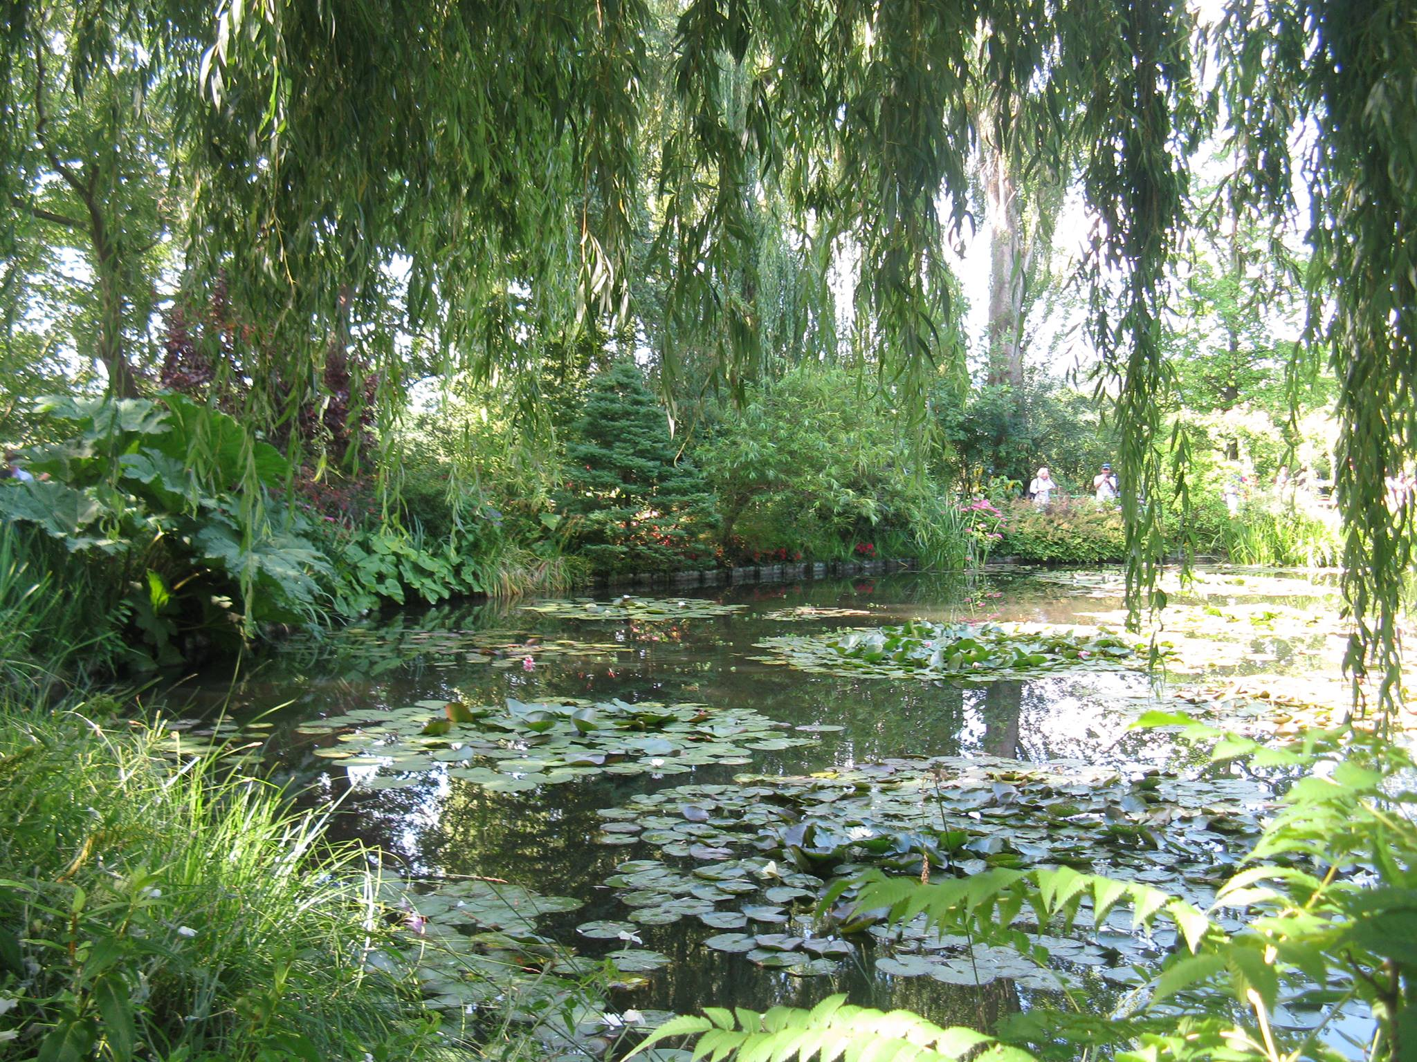
Preparing for the Laudato Si’ Seven-Year Action Plan
Claude Monet Gardens, Giverny, France © Bette Hemstalk, 2016
Notes:
The problems seem so vast and way beyond anyone’s personal control. So, what can members do?
In early 2020, the global COVID-19 pandemic began and made the whole world pause. Aside from the worry of contracting the virus, the tragic loss of lives and the toll on the economy and health care system, there may be a bit of a silver lining in this cloud.
During this period of isolation, people learned to cocoon at home again—like many members did before the world became plugged in—first to television, then to cable, and the Internet with a 24-hour news cycle and 24-hour shopping. They found new ways to work from home, began to make homemade bread and cook from scratch again. In the spring, people went back to gardening and home and yard improvements. Many found they could live well at a far slower pace than they had been living. The video on this next slide is the core message in this presentation.

Slide 7
Notes:
(Laudato Si’ The Theology of Creation, Friars for Future, by Sandesh Manual. A seven-minute video found at youtube.com/watch?v=oXjdcumi-wA.)

Slide 8
The Call to Ecological Conversion
The comprehensive solution the pope calls for is no less than the call to conversion—and no one said conversion would be easy.
Dialogue is our method.
That is where Pope Francis’ encyclical Laudato Si’ and the seven-year action plan come in. People need to continue to find ways to live, work, and consume at a slower, planet-sustaining pace, or they will push those tipping points beyond the ability of the planet to recover. The Earth will become a hotter, more inhospitable climate for all. Or, everyone has to learn a new way to live.
Notes:
“Pope Francis’ concerns [and themes in Laudato Si’] belong to a tradition of Catholic Social Thought that reaches back to the dawn of the Industrial Age with Pope Leo XIII’s groundbreaking encyclical Rerum novarum (1891). Since then, the church has repeatedly called for a more just society in which people can strive for holiness in peace and harmony.” (Most Rev. Thomas Wenski (Miami), 2016)
For those who have not yet read it, Laudato Si’ is a beautiful letter written in 2015 to all people of goodwill. The seven-year action plan based on Laudato Si’ is an invitation to answer the call for a more just ecology and society.
The seven-year action plan is in the process of being rolled out.

Slide 9
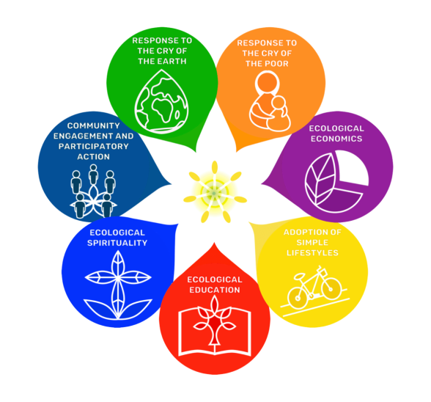
The Seven Goals of Laudato Si’
- Response to the Cry of the Earth
- Response to the Cry of the Poor
- Ecological Economics
- Adoption of Simple Lifestyles
- Ecological Education
- Ecological Spirituality
- Community Engagement
and Participatory Action
© Laudatosi.org
Notes:
These seven goals are the themes addressed in Laudato Si’ and the seven-year action plan. All of these goals are interconnected and cannot be solved on their own. Nor can any one individual, or even nation, solve them independently. As Catholics prepare for the launch of the seven-year action plan, there is so much to learn and so much to do.
What is the response to Laudato Si’? The responses may be different from one region to another, but everyone must respond.

Slide 10
Days for Action
World Water Day
Earth Day
World Oceans Day
World Day of Prayer for the Care of Creation and start of the Season of Creation
Feast of St. Francis of Assisi and close of Season of Creation
World Food Day
March 22:
April 22:
June 8:
September 1:
October 4:
October 16:
Notes:
These are some of the days for action members are invited to consider. The task, yours and mine, is to experience an ecological conversion, develop an ecological spirituality and live this new existence with passion because the planet is crying for justice. People in the global south, Africa, India, and so many other places are crying for justice. Members are called to bring about awareness of the need to respond in love and compassion to the cries of the earth and the cries of the poor today and every day.
The federal government signed and agreed to the 2015 Paris Agreement on climate change, but its response since then seems to be slow and anemic. People cannot sit idly in their seats while the debate lumbers along about targets. Members, you and I, must become the gong clanging in the courtyard.

Slide 11
Resources and Training
Care for God’s Creation Report of Resources (cwl.ca)
Take the Laudato Si’ Pledge (livelaudatosi.org/)
Free Laudato Si’ Animators Program (laudatosianimators.org/)
Laudato Si’ encyclical: (vatican.va/content/francesco/en/encyclicals/documents/papa-francesco_20150524_enciclica-laudato-si.html)
Sacred People, Sacred Earth Action Platform: (actionnetwork.org/forms/sacred-people-sacred-earth)
Notes:
Start today. Take the Laudato Si’ pledge. Sign up for the Laudato Si’ Movement’s Laudato Si’ Animator course. Together, we can do this. Together, we will be the Laudato Si’ revolution if we commit to dialogue as Pope Francis asks.
Thank you.

Slide 12
Thank you to Linda Maddaford for her work on this presentation.

