Slide 1
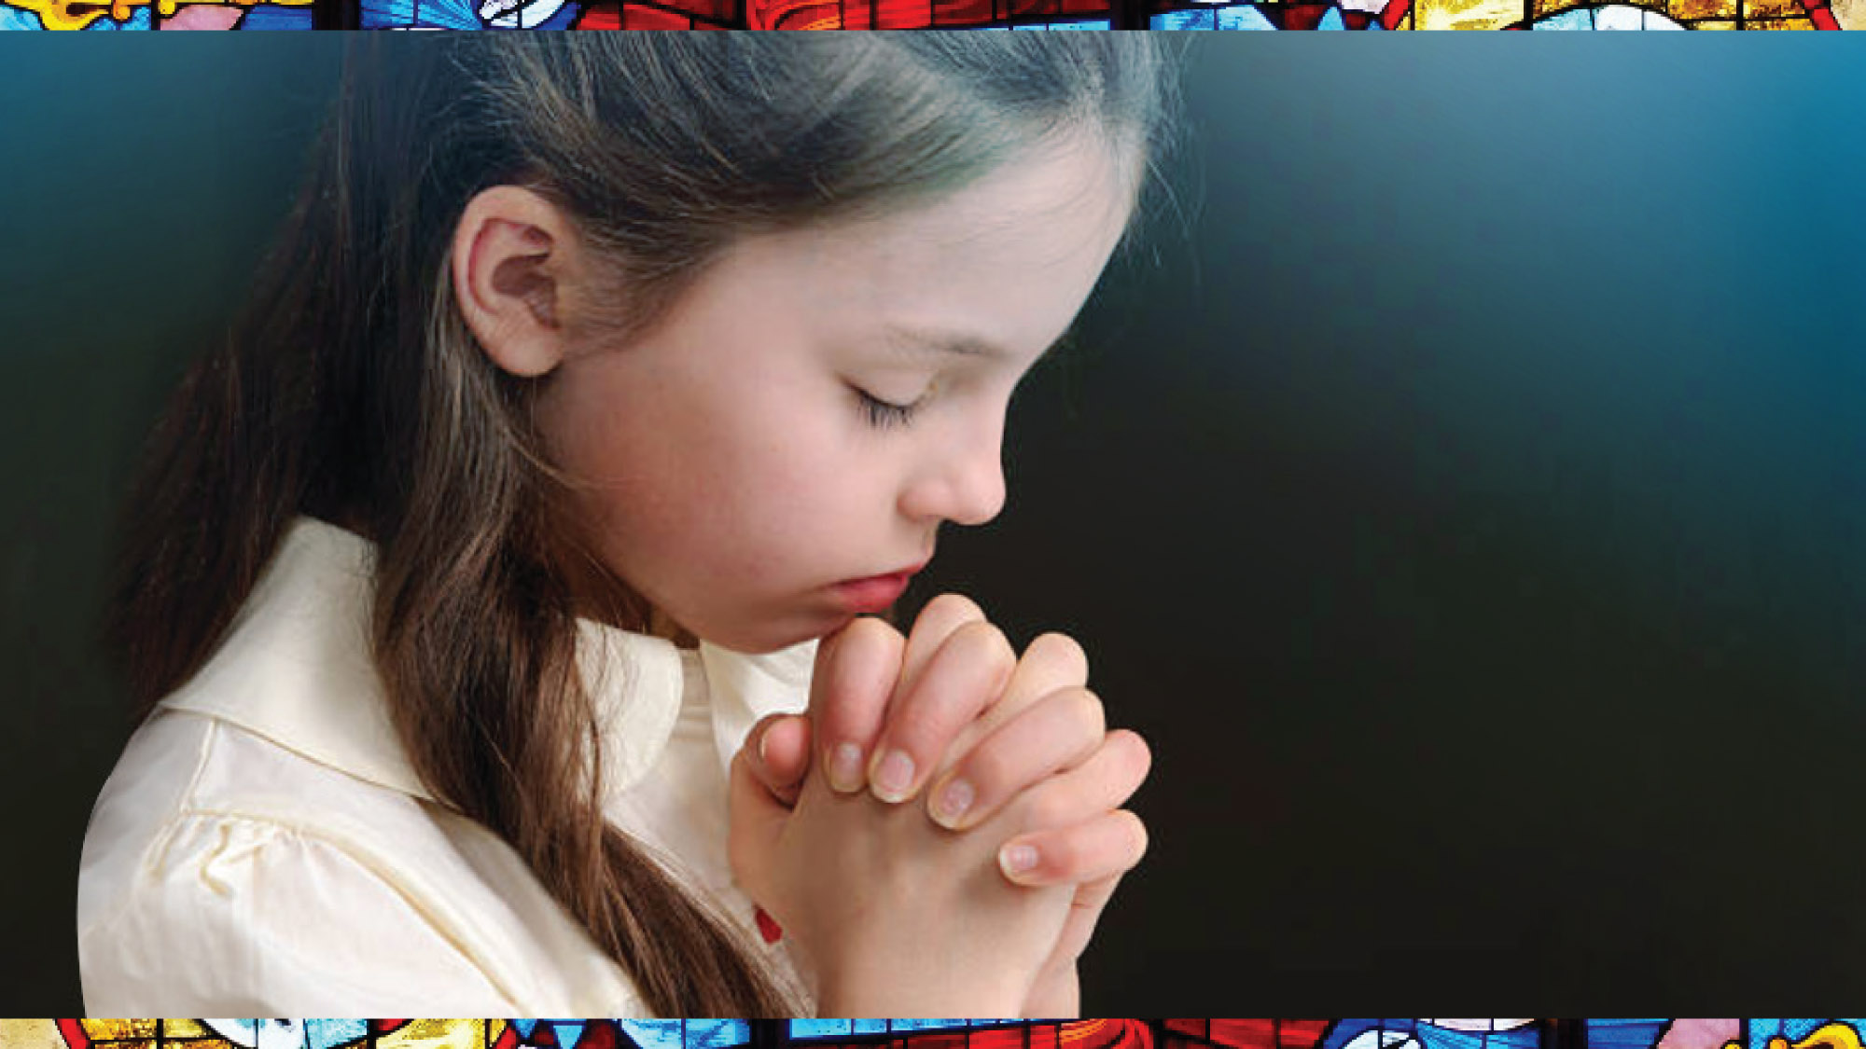
Notes:
Speakers notes:
One of our first outward signs of our faith was when our parent or loved one took our tiny hands and taught us how to cross ourselves. Then came the words: “In the name of the Father, and of the Son and of the Holy Spirt. Amen”
Speakers notes: Fran crosses herself.
We say these words when we begin and end our prayers; the words are automatic because we learned them as babes in arms. Crossing myself on hearing those words is the second automatic action. For me these words and actions are a beautiful symbol of our Catholic faith.

Slide 2
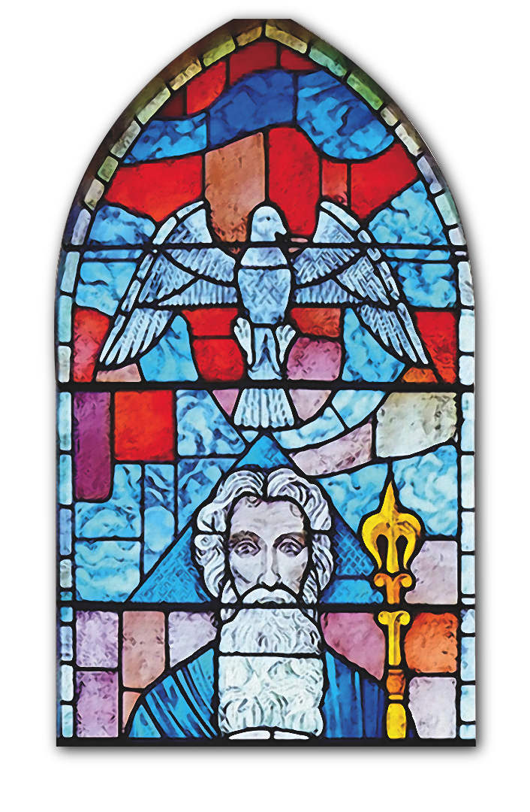
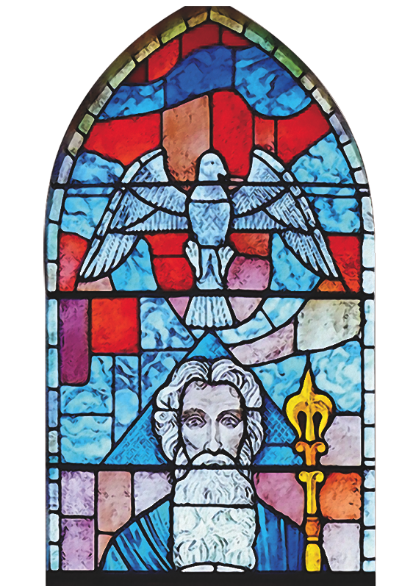
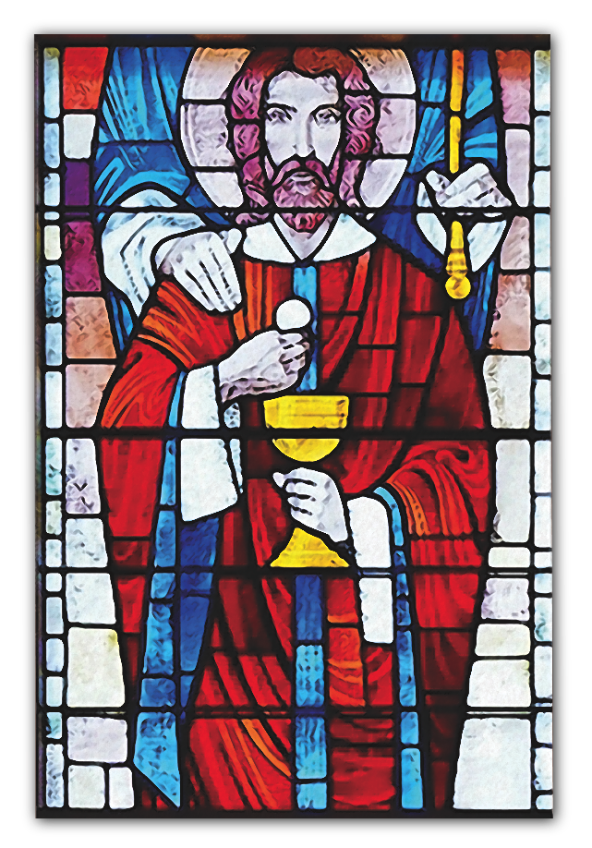
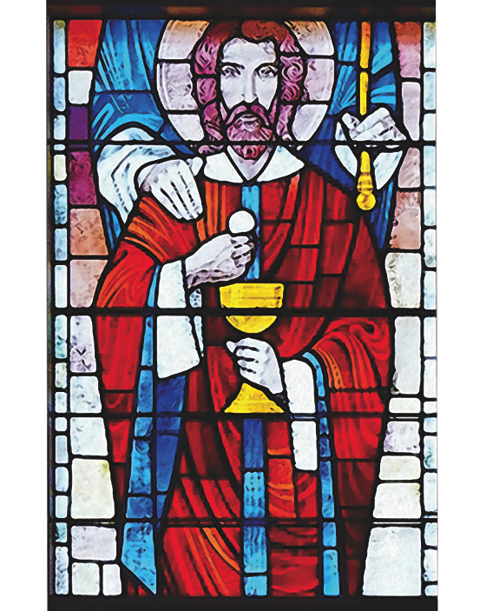
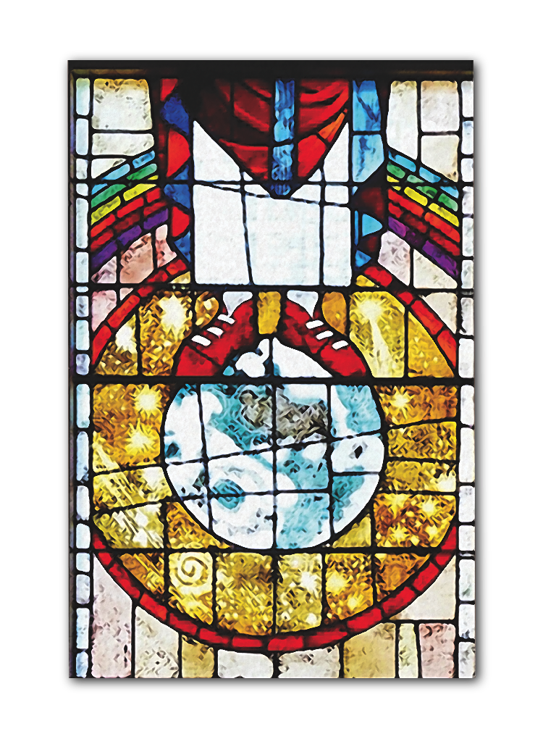
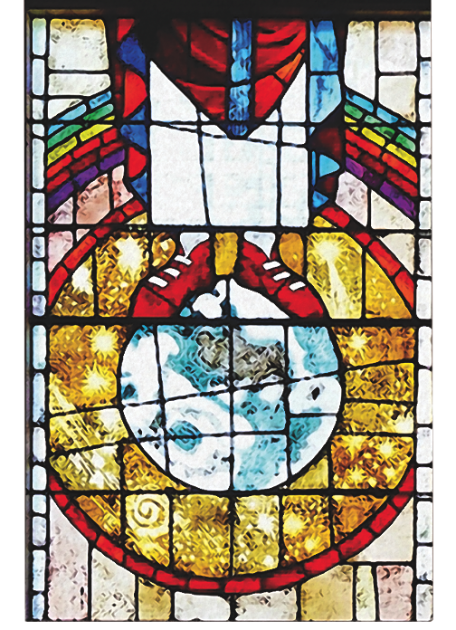
Notes:
Speakers notes:
The Father, Son and Holy Spirit are beautifully depicted in a stained-glass window at my parish, St. Joseph’s Basilica in Edmonton.
Over the past 3 years I have called on the Holy Spirit many, many, many times, especially when I was deliberating on the theme. For me the Trinitarian image comes to mind each time I call on the Holy Spirit. The image of 3 in 1 – Christ the Son holding the Eucharist, the hands of God the Father on his shoulders, and the Holy Spirit above them became the perfect partner for my theme prayer.
I was blessed to have Deacon John Lindsay, from my parish, collaborate with me in creating the prayer once I decided on what the theme for the next 2 years would involve. And Bishop Jensen performed the final critique.

Slide 3
Notes:
Speakers notes:
The theme is Catholic and Living It!
My vision is that relationships in any circumstance – be it family, councils, organizations, etc. are made stronger; that new relationships are forged and made strong; and that the Holy Spirt will be with us in all instances giving us the strength needed.

Slide 4
Strengthen the faith and good works of our members,
Through the intercession of Our Lady of Good Counsel,
building-up life in the world by being Catholic and Living It!
may we be joyful
and responsive to our Christian calling,
May we imitate you with works of mercy,
by truly being Catholic and Living It!
Loving Father, open our hearts to your infinite love for all people,
welcoming the forgotten,
suffering or vulnerable wherever we encounter them.
We make this prayer through Jesus, our Teacher and Messiah,
and to your presence with us wherever we go in your name.
Holy Spirit, strengthen us to live our faith,
who lives and reigns with the Father and the Holy Spirit,
Lord Jesus, deepen the spiritual life of the Catholic Women’s League.
witnessing to life, peace and social justice daily wherever we are in Canada.
forever and ever.
Amen.
Notes:
Speaker notes:
This is the prayer to accompany and guide the theme.

Slide 5
Remember that the Christian life is one of action, not of speech and daydream. Let there be few words and many deeds, and let them be done well.
– St. Vincent
Notes:
There were several quotes that spoke to me as I was discerning the theme. I share these two with you:

Slide 6
Pope Francis in meeting members of American Jewish Committee on #WD2019 says:
“Women make the world beautiful; they protect it and keep it alive. They bring the grace of renewal, the embrace of inclusion, and the courage to give of oneself.”
Notes:
Speaker’s notes:
Taking the messages above, and likely others into consideration, the executive will meet in the fall and deliberate on the specific actions to come from the theme then all will be shared in time for use beginning January 2022.
I ask for your prayers for this theme to be meaningful to all members. And may it be a vehicle for us to truly reveal that WE are ‘CATHOLIC AND LIVING IT!.
Thank you.

