Slide 1
THE CATHOLIC WOMEN’S LEAGUE OF CANADA
EXECUTIVE ORIENTATION
Notes:
Just before we begin this module, please remember the others available to you and your members.

Slide 2
EXECUTIVE ORIENTATION
Modules:
History of the League (15 minutes)
Structure of the League and The Promise of the League (25 minutes)
Core Principles; Constitution & Bylaws; Policy and Procedure; Executive Handbook (20 minutes)
Duties of Officers (20 minutes)
Life Membership and Honorary Life Membership (20 minutes)
Strategic Plan Summary (30 minutes)
Communication (45 minutes)
Budgets (15 minutes)
Member Recognition (10 minutes)
Public Presence and Member Development (30 minutes)
Notes:
They are:
History of the League (15 minutes)
Structure of the League and The Promise of the League (25 minutes)
Core Principles; Constitution & Bylaws; Policy and Procedure; Executive Handbook (25 minutes)
Duties of Officers (20 minutes)
Life Membership and Honorary Life Membership (20 minutes)
Strategic Plan Summary (30 minutes)
Communication (45 minutes)
Budgets (15 minutes)
Member Recognition (10 minutes)
Public Presence and Membership Development (30 minutes)

Slide 3
THE CATHOLIC WOMEN’S LEAGUE OF CANADA
PUBLIC PRESENCE
AND
MEMBER DEVELOPMENT
Gifted to National by Alice Noble (QC), Linda Squarzolo (ON)
Notes:
In this module the Executive Orientation Program called Public Presence and Member development, we will talk about the many ways you as leaders represent the League, how to do so and how to prepare others to take on leadership positions.
As a member of a CWL executive, you may be called on to chair a meeting, give a report, introduce or thank a guest speaker and other forms of public speaking.
Sometimes you may know ahead of time and can prepare what you will say, but other times, you may be called on to speak spontaneously.
Either way, it is important to be effective and confident.
As the leaders of today you have the responsibility to prepare the leadership of tomorrow.

Slide 4
PUBLIC PRESENCE
AGENDA
Personal Presentation
Public Speaking
Hosting Guests
Meeting with Government
CWL Member Development
Question Period
Notes:
During this time together, we will discuss your role as a spokesperson for the League:
look at how to present yourself as a public speaker when representing the CWL
review the basics of public speaking
touch on different expectations when hosting guests
your responsibilities when meeting with government and
The importance of member development

Slide 5
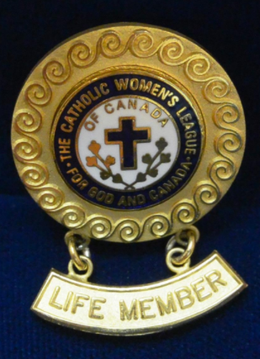
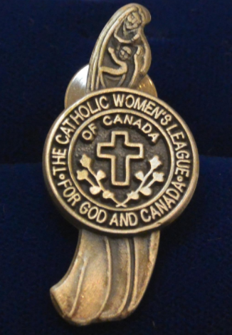
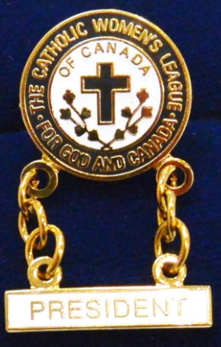
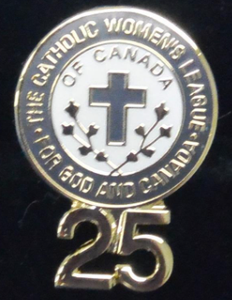
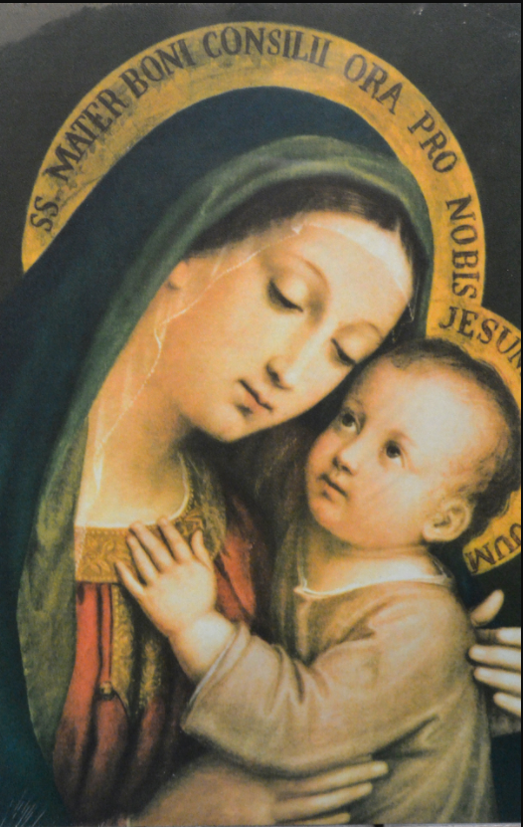
PUBLIC PRESENCE
PERSONAL PRESENTATION
Notes:
Personal Presentation:
Whenever appearing in public in an official capacity as a member, remember you are representing all levels and every member of The Catholic Women’s League of Canada.
Your appearance is important:
Ensure you are well groomed and avoid strong scented soaps and perfumes.
Be appropriately dressed.
Avoid clothing with busy patterns or sparkly clothing.
Avoid bangles which “clang,” and overly sparkly accessories.
At general parish council meetings, casual wear is probably fine unless expecting a special visitor.
At conventions, semi-casual wear is more appropriate.
If you will have a public moment because you are presenting a report, introducing/thanking a guest speaker, or hosting a workshop for example, more formal attire may be appropriate.
When you meet with government officials or other public figures, business attire should be worn.
At CWL banquets and parties, dress with joy and be ready to party!
Wear your appropriate CWL pin, be it your honorary life member, life member, or member pin, to all CWL events and every time you represent the League in public.
Wear your scarf when appropriate.
If you are chairing a meeting or giving a presentation, why not bring your CWL mug?
Show you are a member and honour the League by presenting yourself well.
At meetings and conventions, don’t forget to display your council’s banner and, of course, have a place for the picture of the League’s patroness, Our Lady of Good Counsel.

Slide 6
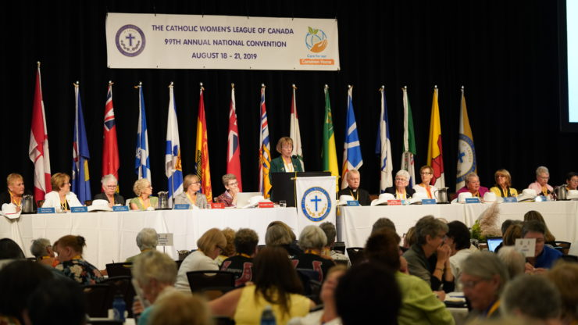
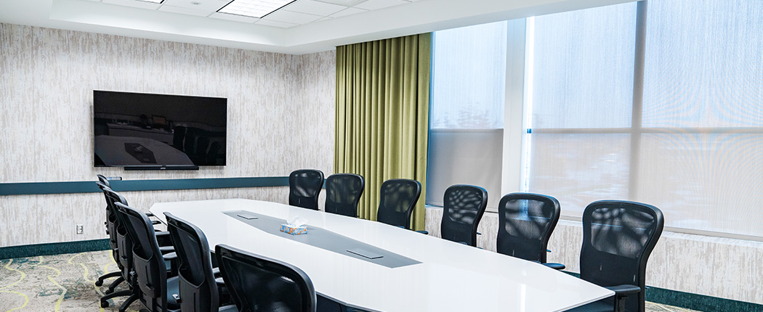
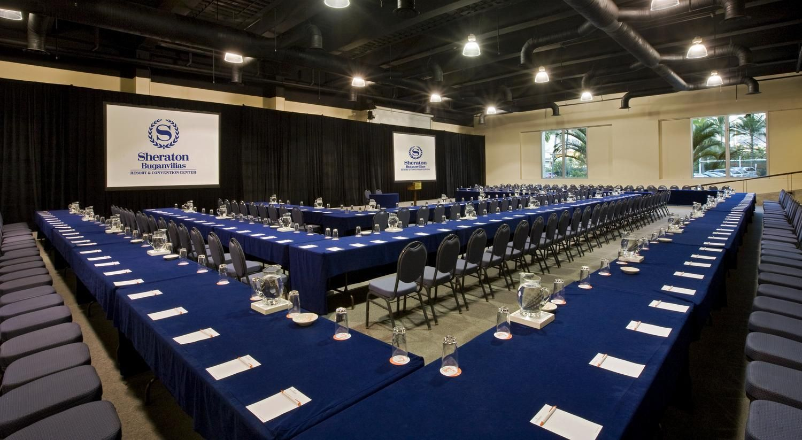
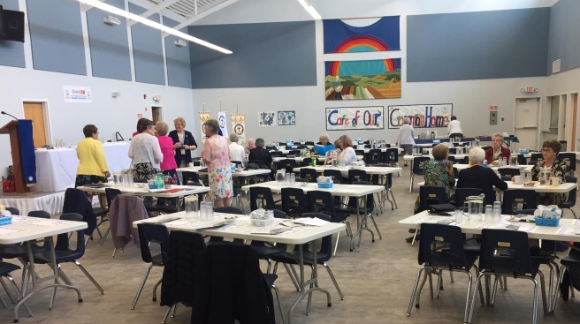
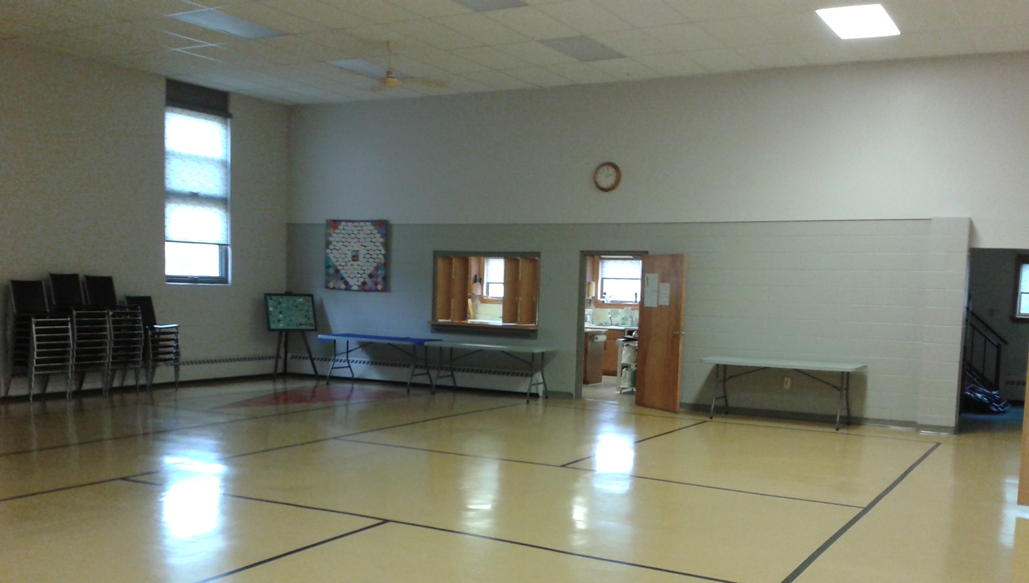
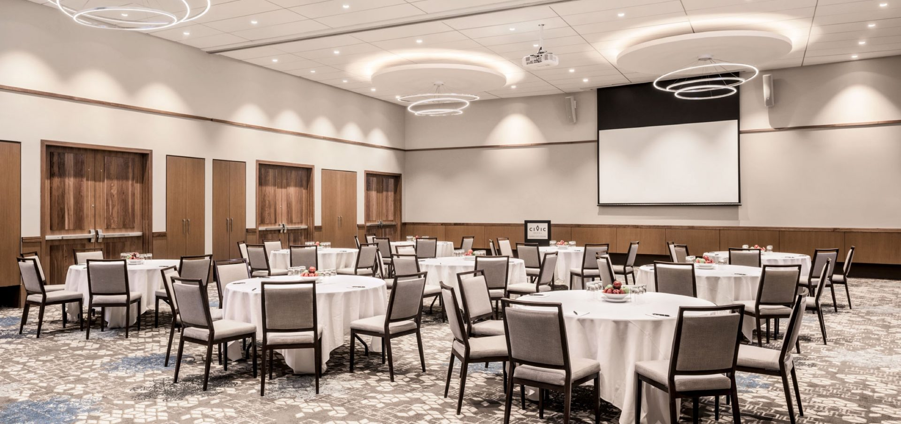
PUBLIC PRESENCE
PUBLIC SPEAKING
SETTING
THE ROOM
Notes:
The Setting:
It is very important to know where you will be giving your presentation or speaking in public.
The Room: Ask questions before you plan your presentation:
Is the room big or small; formal like a convention room or small like a church basement?
Will there be a podium to put your materials on?
Are there screens to project your PowerPoint on?
Do you need to bring your own computer, USB key, surge protector power bar, extension cord, projector?
Will a microphone be provided, or will there be none?
How will the room be set up, i.e., just chairs, tables, round or rectangular tables, one or two screens…?
Can you think of other questions that can be asked?
Feel free to make requests: You can ask that the room be prepared to meet your needs. Ask your host:
Can a projection screen, microphone, podium, extension cord and so on be provided?
What time the room will be open for you to set up.
How many participants will there be, and will you need to bring any handouts or will the organizers print and distribute materials on your behalf?
If you are animating a workshop and props are required, will you need to bring them or will they be provided?
Ask your host to please ensure you have a glass of water.
Can you think of other things you should request?

Slide 7
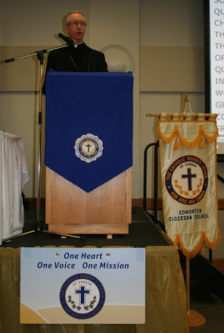
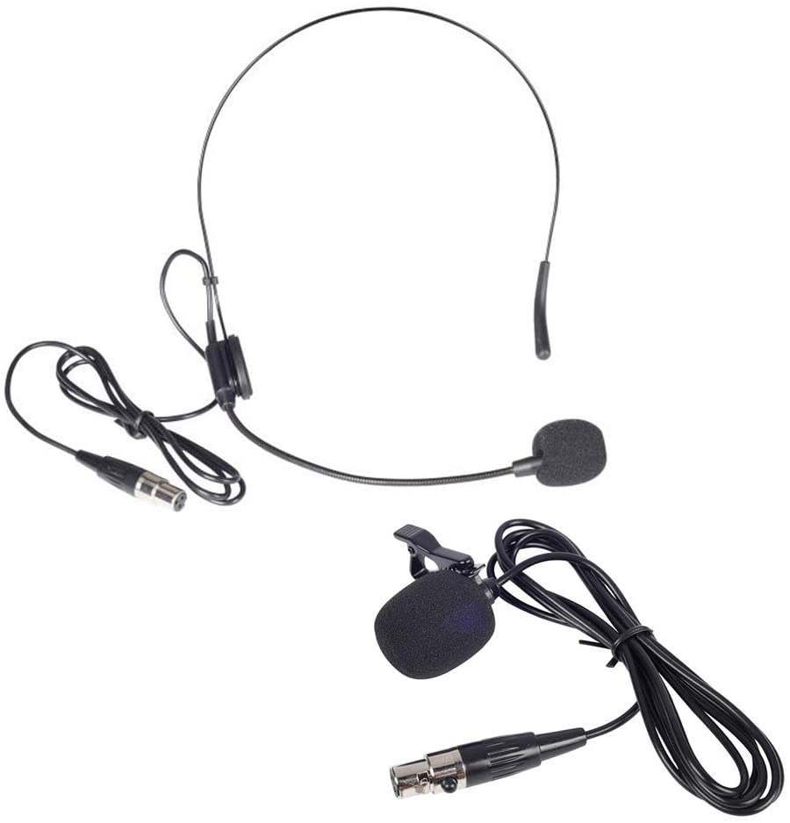
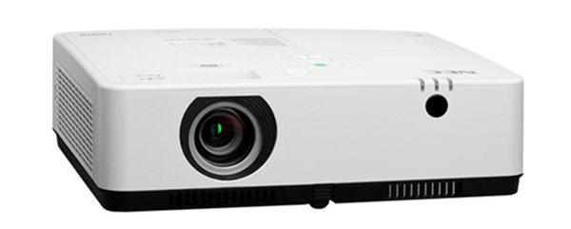
PUBLIC PRESENCE
PUBLIC SPEAKING:
SPEAKING TOOLS
Notes:
Speaking Tools: It is vital to know what tools you will be working with. This requires an in-depth conversation with the organizer/host of the event at which you will be presenting/public speaking.
Where will you be standing: At a podium or front of the room or corner of the room or from your table?
What type of microphone will you be using: Stand-up, hand-held, hands-free? (Note that if it is hands free, find out if you will be clipping on a mini microphone or wearing a headset. This may influence the clothing or hair accessories you choose to wear!)
What type of technology will you be using: Your own portable or theirs? (If theirs, you will need to bring a USB ). Do they have a projector, or do you need to bring your own? (Remember, if you are bringing your own equipment, you need to be sure you have all the accessories – surge-protector cord, extension cord, proper wires and so on).
What type of projector will you be using: Regular screen or television projector? Today, many meeting rooms have projector televisions, meaning you put in your USB and use a mouse to navigate your presentation.
What type of pointer will you be using: If electronic, be sure to understand how it works!
Can you think of other tools public speakers should be aware of?

Slide 8
PUBLIC PRESENCE
PUBLIC SPEAKING:
USING A MICROPHONE OR NOT
Notes:
Speaking In Front of a Group With or Without a Microphone:
With a Microphone:
If you can, practice with the microphone in the room before people enter. Every microphone is different. You may have to speak louder than you think and project into the microphone.
Make sure the microphone is at the right height for you. Just before you start, you can tap it lightly to ensure it is on. Be aware of the right distance to have between your mouth and the microphone.
The microphone should be pointing up at you or be straight ahead if it is on a stand (not pointing down and hiding your face).
Once the microphone is on and at the right height, avoid touching it or fidgeting with it. During your presentation, be sure to always keep your face facing the microphone!
If you cannot test the microphone before people arrive, do not be shy to test before you begin by asking people if they can hear you. Always look at the last row. You may have to talk louder to be heard as women’s voices are softer and more high-pitched than men. People with hearing loss lose high-pitched sounds first!
Also, it is important to keep your volume steady.
Enunciate and pronounce your words clearly.
Speak a little more slowly than you think you are. Nervousness often accelerates our speech.
Be sure to look up and out at the audience.
Without a Microphone:
Before you begin, test the loudness/volume you will need to be heard all the way at the back of the room. Ask the audience if they can hear you and again, pay special attention to the back row.
Ask someone in the back to give you a hand signal if your volume has dropped.
Be sure to stand straight and hold your head up so that your voice carries.
Speak slowly.
Be aware and conscientiously moderate your speed.
Enunciate and pronounce your words clearly.
Breathe!
The most important thing is that the audience can hear you, otherwise your message will be lost.

Slide 9
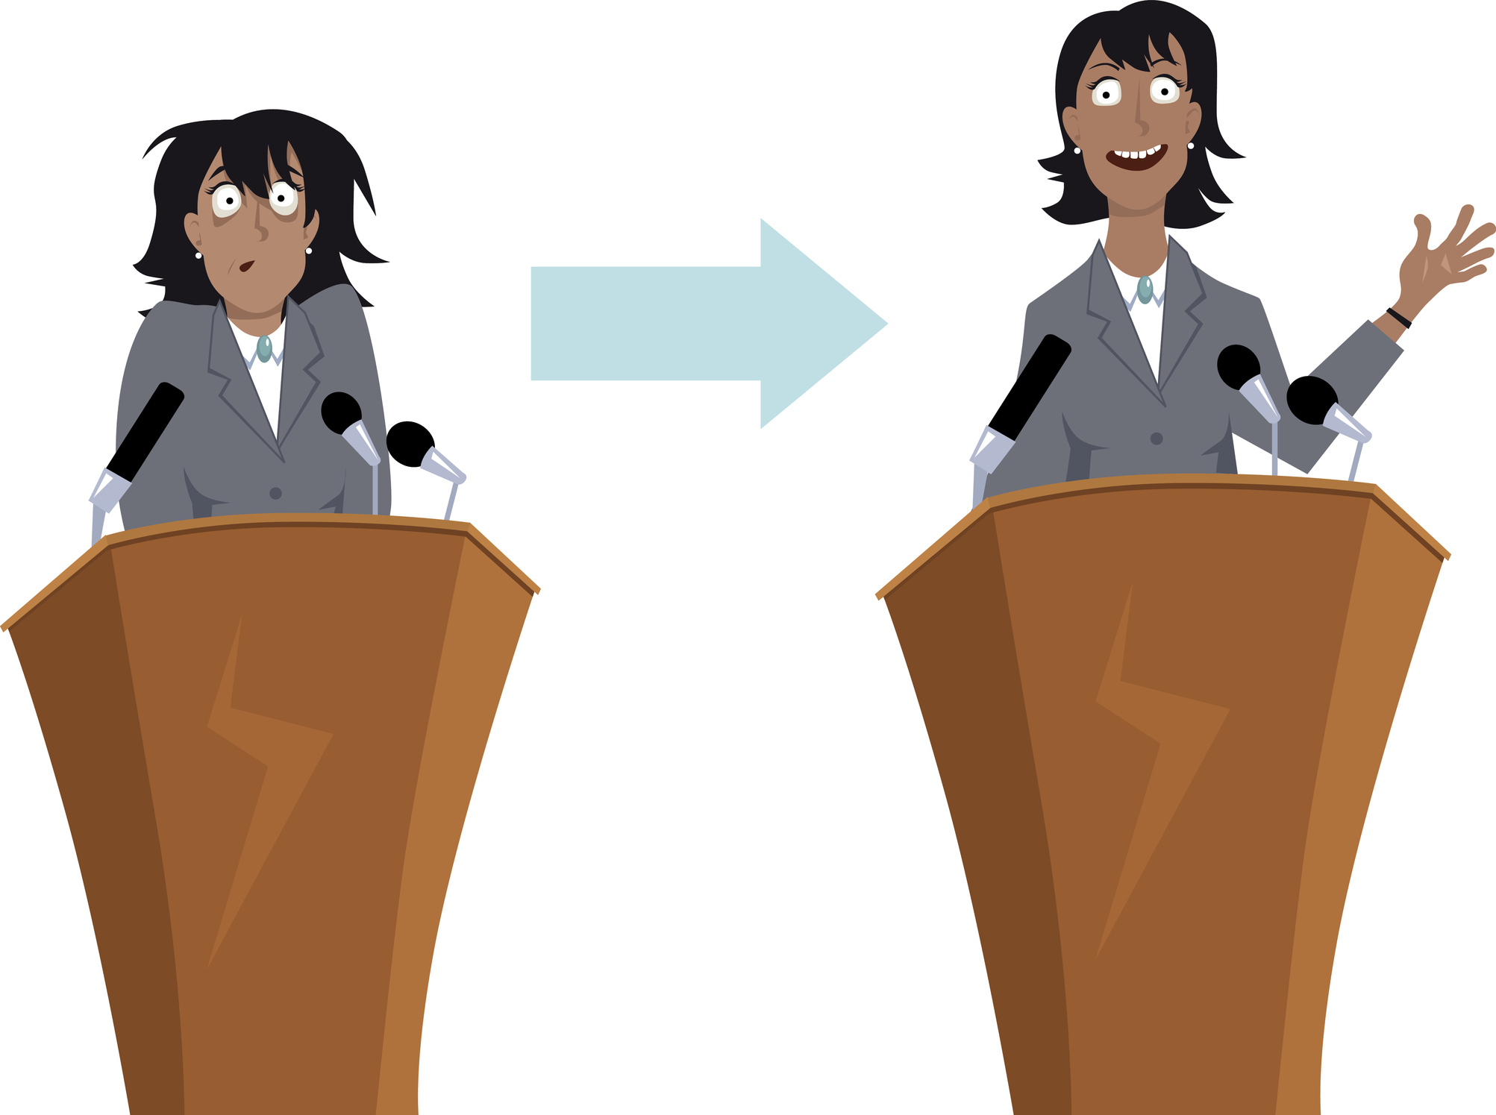
PUBLIC PRESENCE
PUBLIC SPEAKING:
STAGE PRESENCE
Notes:
No matter the tools you are using, stage presence is essential:
be confident
look at the audience
smile, be friendly and open
It all starts right at the beginning with your posture and approach
Rise from your seat smoothly. Do not scrape your chair!
Walk to the podium briskly, back straight.
Turn to face the audience.
Do not appear to be nervous.
Remember you know your presentation. If you get lost or skip something, the audience probably will not notice. Besides, you can always circle back.
If you lose your place, become confused, or go blank, pause, take a sip of water, look up at your slide or down at your notes, gather your thoughts, take a breath and resume.
Hands
Let your hands relax and only use for natural gestures.
Try not to grip the podium.
If you are reading, look up, but use your finger to point where you left off.
If you are wearing a microphone, be aware of movements that could interfere with the reception – no chest banging near the mic!
Breathing
Take breathing breaks.
Deep breaths bring calmness.
Do you have any other ideas to share on stage presence?

Slide 10
PUBLIC PRESENCE
PUBLIC SPEAKING:
PRACTICE
USING A MICROPHONE
PREPARATION
SPEAKING WITHOUT A MICROPHONE
ORGANIZATION
MAKING A PRESENTATION
INTRODUCING AND THANKING GUESTS
CWL GUIDELINES
LEADING A PRAYER
BRINGING GREETINGS
EVALUATION
Notes:
In the following slides, we will review many types of public speaking situations and guidelines to follow.

Slide 11
PUBLIC PRESENCE
PUBLIC SPEAKING:
PREPARATION
Notes:
No matter what you are presenting, no matter where or to whom, preparation is key:
Know when during the event you will be presenting.
Know how much time you will be given to make your presentation.
Get all your materials and presentation organized.
Know what and who you must address during your presentation: the 5W’S: who, what, where, when, why; and of course, you can include how.
Take time to think about your approach.
Do your research and prepare your presentation.
Be confident in your fabulous, prepared self and have fun making your presentation.
It is very helpful to write out your presentation ahead of time. Remember to:
stick to important points.
catch the interest of the audience by asking questions, telling personal anecdotes and/or using humour.
know your topic so you can speak with confidence and authority.
Present the material at the knowledge level of the audience, not above.
emphasize the message appropriately; e.g., “Let’s eat, Grandma” not “Let’s eat Grandma.”
keep the presentation within the specified time.
Rehearsing:
Practise reading out loud.
Once you know your presentation, say it out loud several times.
Say it in front of a mirror or in front of another person. Ask for feedback.
Practise making eye contact and looking to various parts of the room.
A few notes on using PowerPoint:
PowerPoint can be useful to guide and highlight important messages and to capture the audience’s attention.
Each slide should present one main topic and/or idea.
Try to use no more than six bullet points.
Try to keep words to approximately six per bullet the (1 x 6 x 6 rule = one idea x six lines x six words per line).
It is important to not bombard the audience with too much text on a slide.
Use of pictures, pictograms, photographs and animation greatly help to catch the audience’s eye and attention!
Make sure you have an evaluation form prepared for the audience to fill in at the end of your presentation.

Slide 12
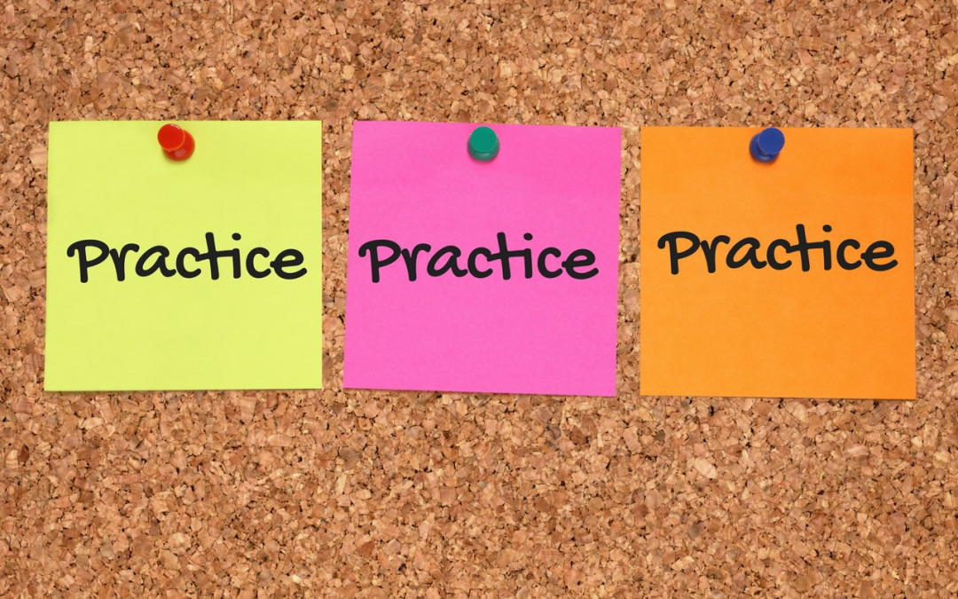
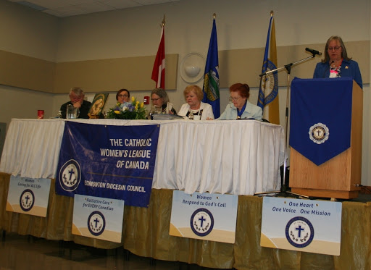
PUBLIC PRESENCE
REPORTS:
ORAL REPORTS
MEETINGS
CONVENTIONS
Summarize your written report.
Be informative.
Stick to the facts.
Only report on new developments since the last meeting.
Present resolutions for discussion and approval to move to the next level.
Provide a hand-out in exceptional cases.
Summarize your written report.
Be informative.
Stick to the facts.
Only report on events since the beginning of the year.
Present resolutions vetted by the resolutions committee for presentation to the assembly for approval.
Provide a hand-out in exceptional cases.
TIME: 2-3 minutes maximum
Notes:
For Example:
Oral Reports: Practice, practice, practice!
When delivering an oral report, you should know it so well that you can look up at the audience to help make a connection.
The National Manual of Policy and Procedure (page 83) reminds us to stand and speak loudly and clearly in order to be heard.
Only address the meeting chairperson/president when you begin your oral report. All members delivering an oral report should use the same address (e.g., “Madam president, sisters in the League, ladies and gentlemen.” (P&P, page 85)
When finished say, “This concludes my report” (Do not use “Respectfully submitted,” this phrasing has been eliminated by national).
Be explicit in the vocabulary you use; e.g., choose “the committee” instead of “it” or “the members” instead of “they.” (P&P, page 85)
Bring dignity to the work of the League through the message. This is not a time for grandstanding, singing, silly jokes, poems or prayers. (P&P, page 85).
This is not the time for a “thank you.” Chairpersons, executive or others may be thanked privately. (P&P, page 85)
At General Meetings:
An oral report should be a summary of your written report.
It should only reflect news/events/initiatives since the last meeting.
It should be informative and factual – aim for brevity, accuracy and clarity. (P&P, page 85)
It should not be about you, but rather CWL information.
The report should take two to three minutes to deliver. This is important because it allows members to practice and hone this habit and skill needed for presenting at conventions.
After you have presented your 2 – 3 minute an oral report: (Not included in the two to three minutes, but the president must know this will take place).
question period, if time allows
distribute any relevant handouts/pamphlets/postcards
It is at this time that you may present a resolution for consideration (the executive must have approved this before it is presented to the assembly).
At Conventions, your oral report should be no different from a parish meeting oral report, with a few exceptions.
The requirements have been put side by side with those of oral reports for meetings for you to see that they are very similar, thus the importance of understanding what is needed in an oral report and mastering the time element as a parish executive member and up.
At conventions or annual meetings, only report on activities/events/initiatives of relevance since the beginning of the year. Your annual report for the previous year will have been published in the annual report book and distributed to every member of the assembly.
The president can also ask chairpersons to present on a particular theme or question, but still only report on the current year.
Address the assembly as follows, “Madam president, sisters in the League, ladies and gentlemen,” or whatever the address that has been identified at the pre-convention meeting for all presenters to use.
End your report with “This concludes my report.”
Once again, after you have presented the oral report: (Not included in the two to three minutes, but the president must know this will take place).
Distribute any relevant hand-outs/pamphlets/postcards.
Present a resolution for consideration. The diocesan, provincial or national executive and/or resolutions committee must have approved this before it is presented to the assembly.

Slide 13
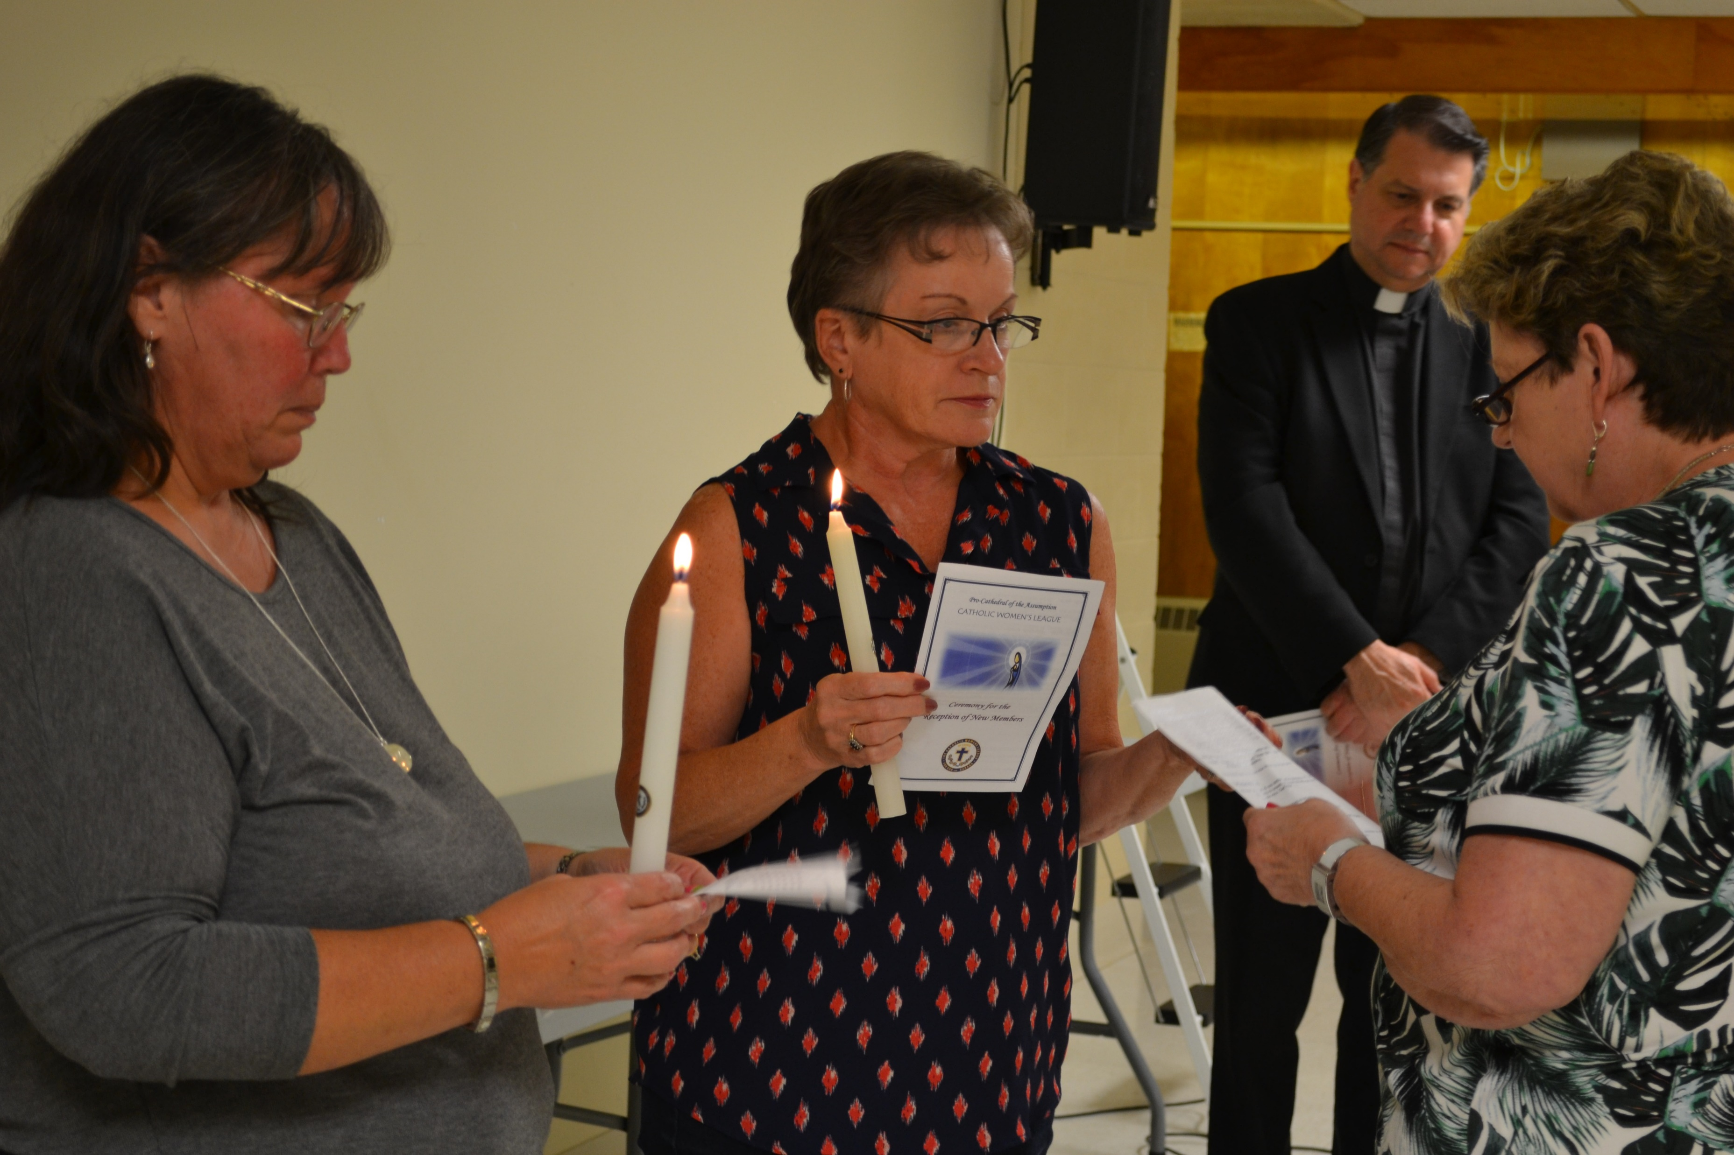
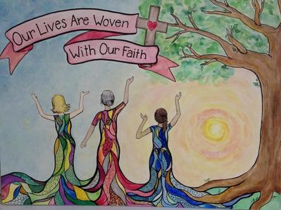
PUBLIC PRESENCE
PUBLIC SPEAKING:
LEADING PRAYER
Notes:
Leading Prayer:
As you all know well:
Prayer is the open practice of our faith.
Prayer is at the core of our values and practices.
Prayer unites us.
Prayer is our way of speaking to God.
To Lead Prayer:
Inform all those present that a moment of prayer will commence in a minute.
Ask people to settle down and to become silent.
Start the music, light candles and be near your sacred space.
Explain to those present any special themes or actions you would like them to take during the prayer or spiritual reflection moment. Let the audience know if they will be participating and if so, how.
Always start and end with: In the Name of the Father, the Son and the Holy Spirit.
Regardless of the setting, prayer, whether a simple prayer or a moment of spiritual reflection, is a moment of reverence and should be treated as such.

Slide 14
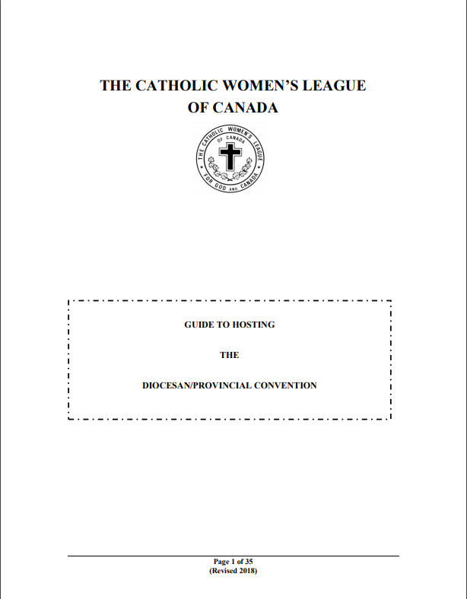
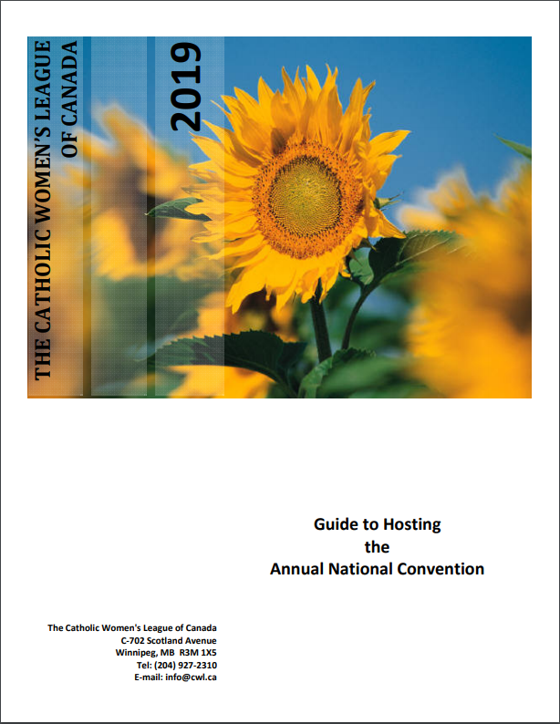
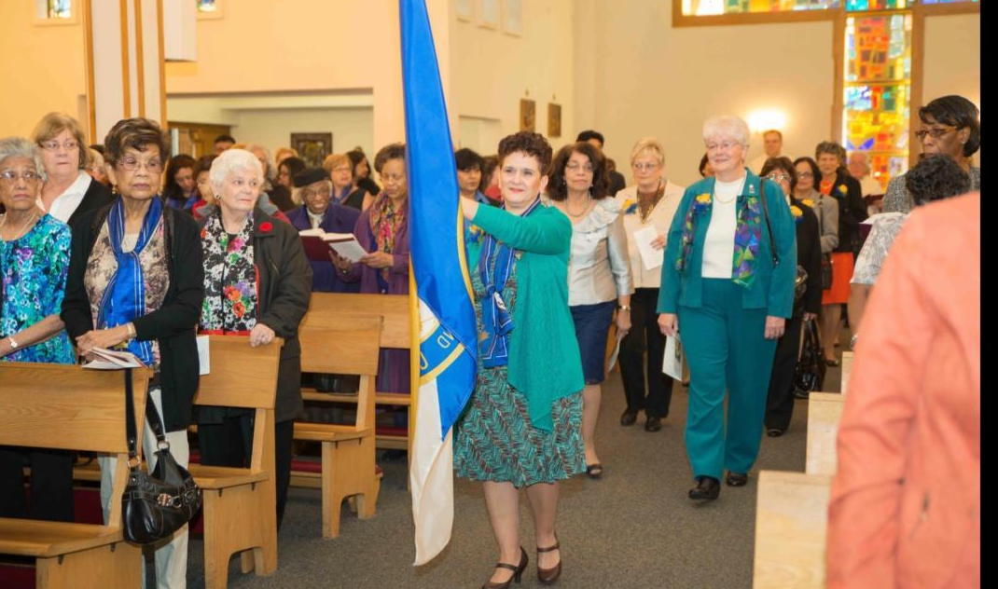
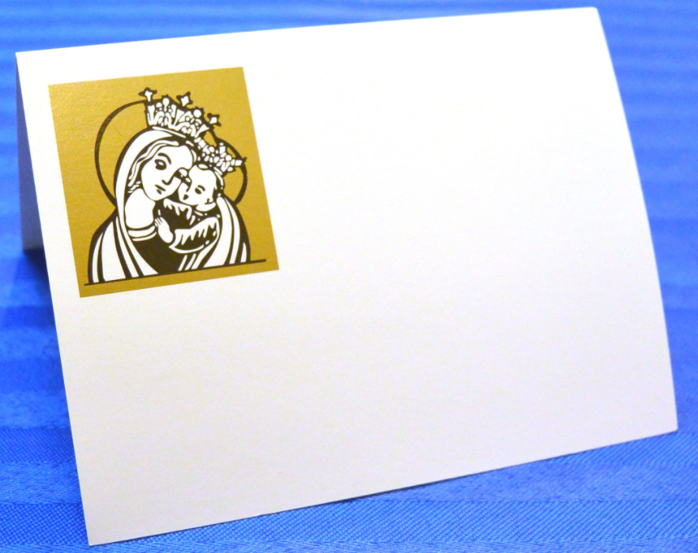
PUBLIC PRESENCE
HOSTING GUESTS:
Notes:
Hosting Guests:
The two most important documents to consult are:
The Guide to Hosting the Diocesan/Provincial Convention
The Guide to Hosting the Annual National Convention
These two guides provide all kinds of information on how to host guests.
The main ideas include:
The importance of sending formal invitations to potential guests/presenters.
The need to set up airport/train/bus pick-ups and drop-offs for guests and dignitaries.
Be sure to always be welcoming.
The importance of assigning each dignitary/guest someone to accompany them throughout their stay.
Remember, hotel, meal and event tickets are paid for by either the inviting council or the national treasury (see the appropriate guide).
Certain guests and dignitaries should receive a welcome gift in their rooms (see the appropriate guide).
There are protocols in place for processions, church seating, meeting room seating and banquet seating.
If you have the national president, provincial president or her delegate as a guest, she must be given time to share with all members present. She is usually invited to give a workshop (she is not there just to observe).
As always, be sure to introduce and thank all guests and dignitaries in the appropriate way.

Slide 15
PUBLIC PRESENCE
PUBLIC SPEAKING:
INTRODUCING AND THANKING GUESTS
Notes:
Introducing and Thanking Guests: The key is to be prepared
1. Know when you are to introduce or thank a speaker or special guest so that you are in position and ready when the time comes.
2. Know who you are introducing and/or thanking:
Ask the guest to provide you with a brief biography of themselves.
Ask the person who invited the guest, why they did so.
Know the link between the guest and the League: are they touching on a resolution, national theme, council concern…
Do some research on social media.
3. Prepare:
Prepare what you are going to say: Write it down! Introduce and thank using notes on a lovely piece of paper or use a folder to keep your notes in (not scraps or a napkin!).
Organizers should avoid asking members to introduce someone on the spot. If you are organizing and forgot to give someone time to prepare, do it yourself (you know the person you invited and why).
If you are introducing someone:
Try to keep the introduction to no more than one minute.
Be sure to face the audience not the guest speaker.
A brief summary of the guest’s biography is appropriate:
highlight their family life (married for 25 years, mother of three)
highlight their education
highlight their professional career
highlight their volunteer work
highlight their public image (articles and books published; movies made, …)
highlight their hobbies
Do not forget to highlight why they were invited
To conclude the introduction:
Name their presentation subject/theme.
Thank the guest for sharing their time and expertise.

Slide 16
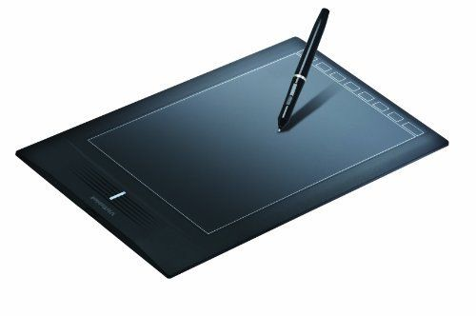
PUBLIC PRESENCE
PUBLIC SPEAKING:
INTRODUCING AND THANKING GUESTS
Notes:
Preparation If You are Thanking Someone:
Be familiar with the guest’s biography.
Ahead of time, prepare notes from the biography that may directly touch the subject or reason for the invitation to present to the assembly.
Have a few notes prepared about the importance of the subject matter to the CWL. For example, remind members of any resolutions that touch the subject directly or the national theme.
During the presentation, take notes of ideas you can use in your thank you. Listen carefully. Note moments that caused a positive audience reaction and perhaps refer back to them.
During question period, formalize your thoughts.
Five minutes before the end of the time allocated to the guest, approach the front of the room. The guest should be advised ahead of time that you will be approaching so they can draw their time to a close.
Make sure your thank you is warm and meaningful.
Have your thank you token (card/gift) with you or already at the front of the room.
Have the person who invited the guest, the chairperson of the meeting and the introducer be ready to quickly come to the front for a photograph. Assign a photographer for this moment. Photographs are an important part of our visual history. However, even though members love photographs, do not allow more than a few seconds for this moment - the speaker is tired. Digital photographs allow members to request copies later at no cost (announce this if you need to).
In your thank you, do not:
make a long summary of the talk or disagree with the speaker’s position on the topic
introduce yourself
allow a speaker to sit down without acknowledging their presentation
Remember, one short moment for a photograph by an assigned photographers. Of course, some guests may be willing to pose for pictures after the meeting and this can be announced.
Summary of steps to your thank you:
Start with “Thank you.”
Comment about the speaker’s presentation and especially the content.
Link the presentation to the CWL, be it with a resolution or to the national theme (if possible).
Thank again.
Give card and/or card gift.
Shake hands or hug.
Pose for a quick picture.

Slide 17
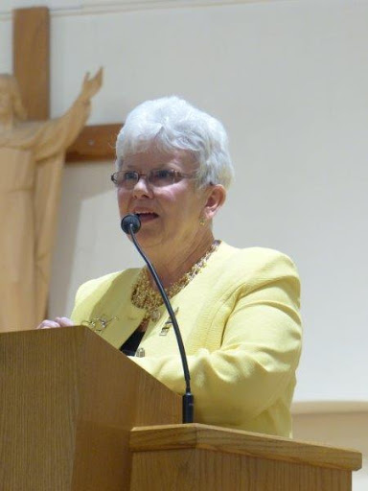
PUBLIC PRESENCE
HOSTING GUESTS:
BRINGING GREETINGS
Notes:
Bringing greetings is an official element of conventions.
Consult either:
The Guide to Hosting the Diocesan/Provincial Convention (p.7)
The Guide to Hosting the Annual National Convention (pages 6, 8.19, 23-24)
Greetings are brief official messages, usually of welcome and acknowledgement given at the opening of a convention.
In the convention guides, you will find lists of those who are traditionally invited to send greetings:
host spiritual advisor
provincial president (if she is not the host – e.g. at diocesan convention)
national president (if she is not the host – e.g. at diocesan or provincial conventions)
national spiritual advisor
municipal, provincial and/or federal government representatives
state deputy of the Knights of Columbus
Greetings will be delivered by the person from whom they are coming.
If the person invited to send greetings cannot be present, they may send them to the organizing committee of the convention. These will be read by the secretary, president or chairperson of the convention organizing committee.
If someone invited to send greetings does not send any, do not invent any, just omit them from the list.
If you are delivering greetings on your behalf or on behalf of someone else:
Prepare the greetings ahead of time and have them in an official-looking document holder.
If you are reading someone else’s greetings, be prepared and have the document in an official document holder.

Slide 18
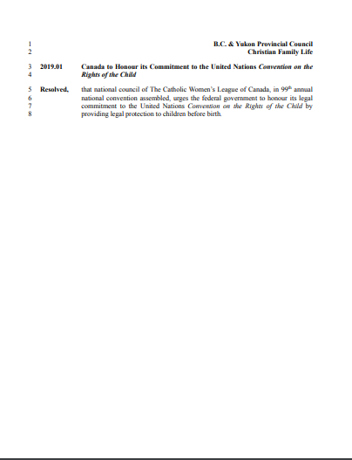
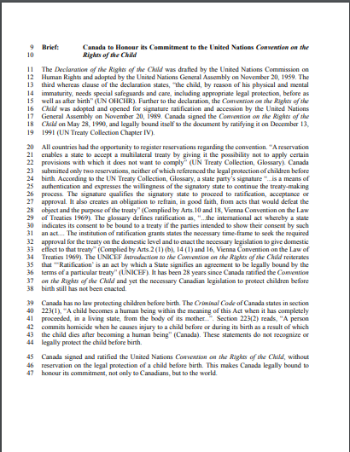
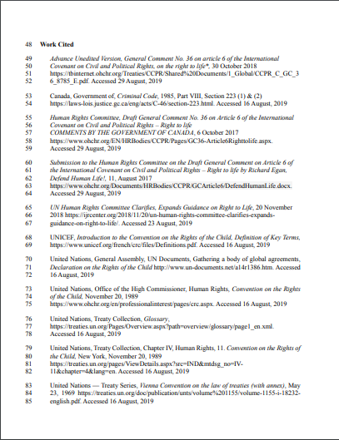
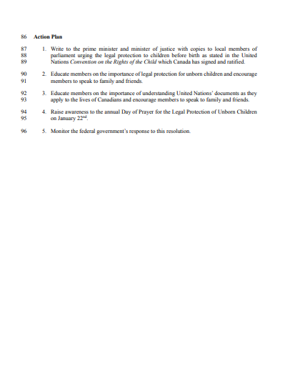
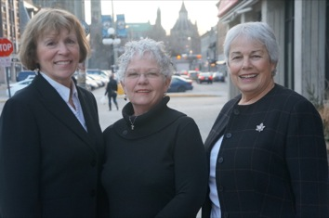
PUBLIC PRESENCE
MEETING WITH GOVERNMENT:
PRINCIPAL MINISTRY
“…to represent Catholic women and their views on topics of national interest and importance, and to communicate those views to church, government and society at large”¹
Notes:
Meeting with Government:
One of the principle ministries of the CWL as written in the National Manual of Policy and Procedure (page 14), is “To represent Catholic women and their views on topics of national interest and importance, and to communicate those views to church, government and society at large.”
How does the CWL do this? Through its adopted resolutions followed by meetings with government officials.
Preparation:
Book meetings with government well ahead of time.
Get a schedule for the time you will be there, including the times of meetings and names of government officials you will be meeting with.
Prepare an agenda for each meeting ahead of time.
Prepare resolution folders to leave with the government officials you meet.
Be thoroughly and totally organized.
Prepare your presentations to each official ahead of time.
Plan how you will present and initiate the resolutions at each meeting and with each official.
Ensure that the whole delegation is aware of every detail of every resolution to be presented, and the way each resolution will be handled.
Ensure you know the resolutions and all their details (brief and more) like the back of your hand.
Different members of the delegation can present different resolutions, but everyone must know them well.
At the Meeting:
Name one spokesperson per resolution and/or meeting.
Have a member of your delegation take notes of the government responses received.
Remember: you are representing the CWL.
Present yourself in an official manner, be properly attired in business wear and wear your CWL pin.
Note: The national president is the official spokesperson for the League and she is thereby the official spokesperson with the press and all media!

Slide 19
PUBLIC PRESENCE
CWL MEMBER DEVELOPMENT:
RESPONSIBILITY
TRAINING
LEADERSHIP
Notes:
As the leaders of your councils, you have many responsibilities including:
the responsibility to ensure your membership continues to increase its knowledge about the League
the responsibility to prepare your members to take on leadership roles
the responsibility to keep motivating your membership to attend all CWL events from meetings and conventions to celebrations and fundraisers and more.
Most important is to recognize that many are afraid to take on leadership roles because of the unknown or lack of self-confidence in their knowledge and skills.
Fear of leadership often comes from a fear of “not being good enough”, “not knowing all the rules”, “not knowing what you can and cannot do,” and more.
To inspire others to become leaders, you must find ways to ensure they have the knowledge and skills to take on leadership roles in the League:
Training is a core tool to help past, current and future leaders.
Training is a way to impart knowledge and skills to our members.
Providing training to our members is a gift from you to your sisters in the League.

Slide 20
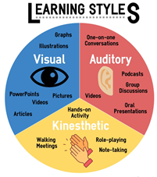
PUBLIC PRESENCE
CWL MEMBER DEVELOPMENT:
SUBJECTS
(What)
RESEARCH & PREPARATION
(5Ws)
HOW TO DELIVER
(How)
WHO WILL DELIVER
(Who)
Notes:
WHAT YOU NEED TO DO TO TRAIN YOUR MEMBERSHIP:
First, find out what skills or knowledge need reinforcement.
We can always improve our knowledge and skills. Here are some examples of subjects that can be addressed:
Team building
Conflict resolution
Computer skills to encourage online activities, including online learning
Mentorship training
Education on current parish, diocesan, provincial and national resolutions
Art of producing a resolution
Art of a good meeting
How to produce annual reports
Education on the national theme
Practice workshop on public speaking
Can you think of any subjects you would like to see?
Second, research how this knowledge or these skills can be taught and prepare time when you will organize this training.
What resources exist?
Does the League have materials available?
Is the topic of concern pertinent to members in your parish, diocese and/or province?
Third, decide on how you will deliver the training.
Know your audience and how best to reach them.
Will this training be offered during a parish, diocesan or provincial meeting or convention?
Will this training be delivered in-person or online or simply by distributing reading materials?
Will this training be given in conjunction with other training exercises?
Fourth, decide who will give the training:
Find an expert in whatever topic you are addressing.

Slide 21
PUBLIC PRESENCE
CWL MEMBER DEVELOPMENT:
EVALUATION
Notes:
Plan and deliver CWL member development events during the year.
A CWL Member Development Events can be the presentation of a short module up to to the hosting of full CWL Development Day or Days.
CWL development events are:
a way to encourage learning and personal development
allow members to improve their skills and deepen their knowledge.
motivate members to continue their personal growth.
The more members know and understand, the less they fear taking on leadership roles.
Examples of short CWL member development events can be a short presentation in person or using multi-media during a regular meeting.
Examples available through national include:
Showing one or more of the Executive Orientation modules
Watching the webinar on annual surveys
Listening to the webinar on online membership registration
Viewing one or all of the 2020 Summer Series webinars
Examples of in person presentations:
Presentation of the national Welcome Kit by your chairperson of organization
Presentation of the national website by your chairperson of communications
Presentation of the role of the spiritual advisor by the spiritual advisor and chairperson of spiritual development
A presentation and/or workshop can be offered during an annual meeting/convention:
Explore the national theme
Educate members on a resolution’s subject
A full Member Development Day can be hosted by your parish, diocesan or provincial council(s).
All members from your region can be invited including local members of the Military Ordinariate.
Have one or two workshops before and another one or two after lunch on various subjects.
Be sure to include some fun time and activities to get everyone involved!
Development events can be simple or multi-faceted.
Their format is up to you but, planning is essential.
Motivating members to attend is key, so ensure the venue in accessible to all.
EVALUATION
At the end of each event be sure to have an evaluation.
Use the responses to improve your next session!

Slide 22
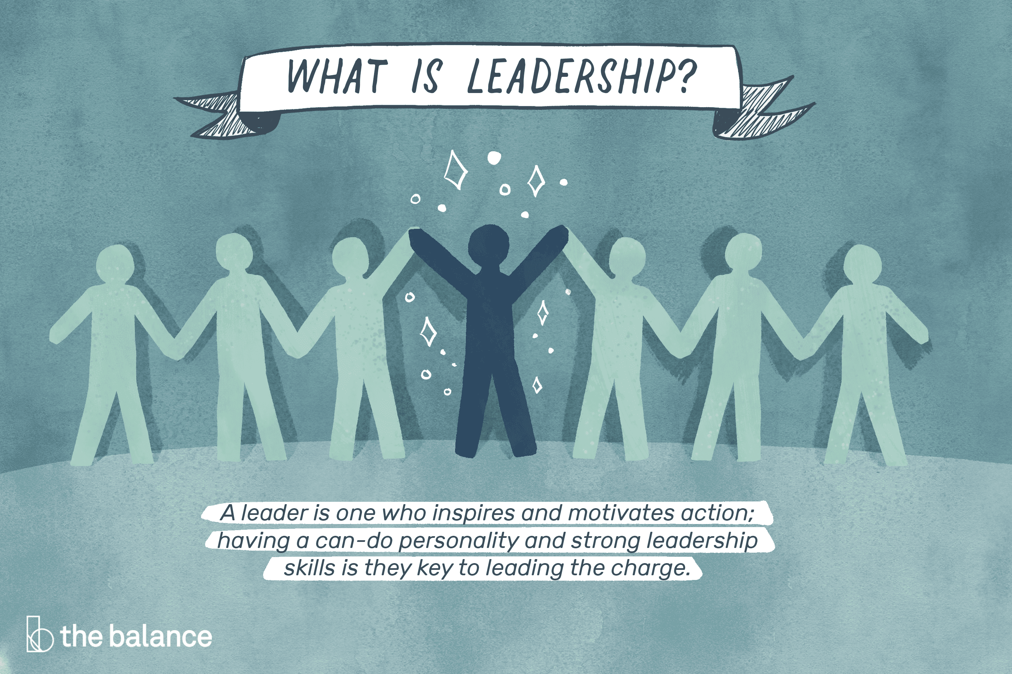
PUBLIC PRESENCE
CWL MEMBER DEVELOPMENT:
EDUCATION is the key to LEARNING.
LEARNING is the key to KNOWLEDGE.
KNOWLEDGE is the key to UNDERSTANDING.
UNDERSTANDING leads to SELF-DEVELOPMENT.
SELF-DEVELOPMENT leads to CONFIDENCE.
CONFIDENCE reduces FEAR.
LACK OF FEAR leads to willingness to take on LEADERSHIP.
Notes:
Make member development a key pillar of your council.
Let’s be the leaders who shape the leaders that follow us!
REMEMBER:
EDUCATION is the key to LEARNING.
LEARNING is the key to KNOWLEDGE.
KNOWLEDGE is the key to UNDERSTANDING.
UNDERSTANDING leads to SELF-DEVELOPMENT.
SELF-DEVELOPMENT leads to CONFIDENCE.
CONFIDENCE reduces FEAR.
LACK OF FEAR leads to willingness to take on LEADERSHIP roles.

Slide 23
PUBLIC PRESENCE
Notes:
IN CONCLUSION:
Whenever and wherever you represent the League, at all levels, in person or in reports, remember you are representing every member of the League. Present yourself accordingly.
Be familiar with the appropriate ways of ensuring your public presence is top notch:
Hone your public speaking skills
Know to whom you are presenting
Know when, where and what tools you will have access to
Know the formal requirements for presentations at CWL events
Know what is expected of you with respect to guests at CWL events
Be prepared when meeting with government officials
It is also important to talk about Member Development and embrace your responsibility as a leader to prepare future leaders:
Understand and integrate the need for member development and training in your annual planning
Know what members should know about
Know what resources are available
Know when and how you will pass on knowledge and tools
Know who the best person is to deliver knowledge needed
Remember as leaders you must pave the way and mentor future leaders to ensure the League continues to grow, thrive and remain vital.

Slide 24
PUBLIC PRESENCE
QUESTION PERIOD
Notes:
Do you have any questions?

Slide 25
PUBLIC PRESENCE
Notes:
Thank you!

Slide 26
EXECUTIVE ORIENTATION
Modules:
History of the League (15 minutes)
Structure of the League and The Promise of the League (25 minutes)
Core Principles; Constitution & Bylaws; Policy and Procedure; Executive Handbook (20 minutes)
Duties of Officers (20 minutes)
Life Membership and Honorary Life Membership (20 minutes)
Strategic Plan Summary (30 minutes)
Communication (45 minutes)
Budgets (15 minutes)
Member Recognition (10 minutes)
Public Presence and Member Development (30 minutes) P
Notes:
Before I leave you, I would like to remind you once again of the other modules available to you and your members to further develop your knowledge of the League and your leadership skills.
They include:
History of the League (15 minutes)
Structure of the League and The Promise of the League (25 minutes)
Core Principles; Constitution & Bylaws; Policy and Procedure; Executive Handbook (25 minutes)
Duties of Officers (20 minutes)
Life Membership and Honorary Life Membership (20 minutes)
Strategic Plan Summary (30 minutes)
Communication (45 minutes)
Budgets (15 minutes)
Member Recognition (10 minutes)
Public Presence and Membership Development (30 minutes)
Thank you.

