Slide 1
THE CATHOLIC WOMEN’S LEAGUE OF CANADA
EXECUTIVE ORIENTATION

Slide 2
EXECUTIVE ORIENTATION
Modules:
History of the League (15 minutes)
Structure of the League and The Promise of the League (25 minutes)
Core Principles; Constitution & Bylaws; Policy and Procedure; Executive Handbook (20 minutes)
Duties of Officers (20 minutes)
Life Membership and Honorary Life Membership (20 minutes)
Strategic Plan Summary (30 minutes)
Communication (45 minutes)
Budgets (15 minutes)
Member Recognition (10 minutes)
Public Presence and Member Development (30 minutes)
Notes:
Executive Orientation
Modules:
History of the League (15 minutes)
Structure of the League and The Promise of the League (25 minutes)
Core Principles; Constitution & Bylaws; Policy and Procedure; Executive Handbook (25 minutes)
Duties of Officers (20 minutes)
Life Membership and Honorary Life Membership (20 minutes)
Strategic Plan Summary (30 minutes)
Communication (45 minutes)
Budgets (15 minutes)
Member Recognition (10 minutes)
Public Presence and Membership Development (30 minutes)

Slide 3
THE CATHOLIC WOMEN’S LEAGUE OF CANADA
CORE PRINCIPLES; CONSTITUTION & BYLAWS;
POLICY AND PROCEDURE; EXECUTIVE HANDBOOK
Gifted to National by Mary Hunt (ABMK)

Slide 4
CORE PRINCIPLES
What core principles are used to guide all planning and decision-making?
1. Core purpose
2. Core values
3. Mission statement
4. Envisioned future
Notes:
Core Principles: [Presenter may choose abbreviate this info]
Core purpose: the reason an organization exists. The League exists to unite Catholic women to grow in faith, and to promote social justice through service to the church, Canada and the world.
Core values: the fundamental beliefs of an organization that determine the behavior of its membership. More on this on the next slide.
Mission statement: The statement captures and identifies the scope of an organization’s operation. The League’s mission statement is, “The Catholic Women's League of Canada calls its members to grow in faith, and to witness to the love of God through ministry and service.”
Envisioned future: A description of what the organization strives to become. Members want the League to be an inclusive and engaged community of Catholic women inspired by Catholic faith.
We are reminded the League is:
a vital participant in the church
a valued partner for social justice
a respected advocate at all government levels
connected to the world
This is the time to share what is important to you for the League to take into the future.

Slide 5
CORE VALUES
What are the core values guiding the League?
1. Faith
2. Service
3. Social Justice
Notes:
Core Values Guiding the League
Faith - Our shared Catholic faith is the reason we choose to belong to the League and guides activities in all that we do.
Service - The League has a long-standing tradition of service in their parishes and the communities in which they live. Members are involved in many church ministries including: Eucharistic ministers, lectors, ushers, members of pastoral councils, liturgy committees, Catholic Girls League, St. Vincent De Paul Society, prayer shawl ministry, soup kitchens and much more.
Social Justice - Every member is asked to share through resolutions and legislation any social injustice in her community, throughout Canada and globally. Many resolutions have resulted in legislation and social change.

Slide 6
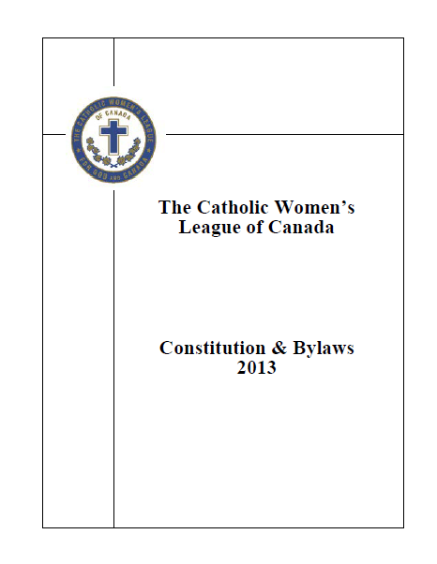
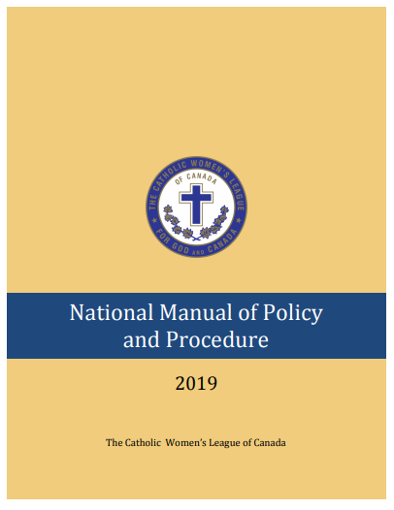
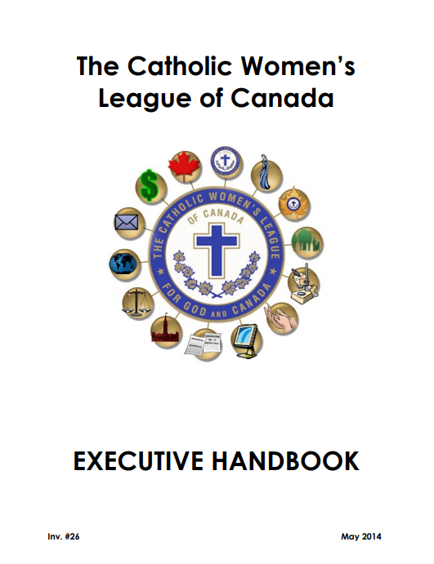
ESSENTIAL REFERENCE MANUALS
Notes:
Executive members at the diocesan, provincial and national levels should already be familiar with these three publications and can attest to the importance of these documents in understanding how the League works; especially new executive members. Seasoned executive members will find this a quick refresher.
Many of you will find these three manuals very informative. For those whose eyes glaze over thinking the manuals will be difficult to understand and cumbersome… think again! They represent very valuable reference resources for you and your council, and will serve to answer many of your questions about the League.

Slide 7
CONSTITUTION & BYLAWS
The Constitution & Bylaws (C&B) determines the League’s structure and activities.
The most recent publication of the C&B was published in 2013.
Proposed amendments have been circulated which will change the C&B effective January 1, 2022.
The proposed amendments are part of the process of modernizing the League’s structure and activities.
Notes:
This slide provides important basic information about the Constitution & Bylaws.

Slide 8
CONSTITUTION & BYLAWS
What information can be found in the C&B?
Part 1: Name
Part 2: Patroness
Part 3: Crest, Corporate Seal and Flag
Part 4: Objects of the League
Part 5: Policy
Part 6: Spiritual Program
Part 7: Membership
Part 8: Organization
Part 9: The League and the Church
Part 10: Directors (at the national level)
Part 11: Officers
Notes:
As an executive member, you will want to know what kind of information is contained in the Constitution and Bylaws. These two slides provide you with the contents of this important document. [It is to the discretion of the presenter what items to talk about. For new members this will serve as an introduction to these topics].
Part I: Name
Part 2: Patroness: Our Lady of Good Counsel. A change in patroness has been circulated as a proposed amendment. The results of the decision will be known in August 2022.
Part 3: Crest, Corporate Seal and Flag The crest, as designed and adopted in 1922, shall be the cross, symbolic of faith, surmount 10 maple leaves, symbolic of the provinces of Canada, with the words “The Catholic Women’s League of Canada for God and Canada” enclosed in an unbroken circle, symbolic of constant service to God and Canada. The colours of the crest shall be blue, chosen for Our Lady, and the papal colours, white and gold.
Part 4: Objects of the League are as follows:
to achieve individual and collective spiritual development
to promote the teachings of the Catholic church
to exemplify the Christian ideal in home and family
to protect the sanctity of human life
to enhance the role of women in church and society
to recognize the human dignity of all people everywhere
to uphold and defend Christian education and values in the modern world
to contribute to the understanding and growth of religious freedom, social justice, peace and harmony
Part 5: Policy
Part 6: Spiritual Program
Part 7: Membership, which includes the four types of membership:
general membership
life membership
honorary life membership
associate membership
Part 8: Organization, which is covered in another module
Part 9: The League and the church covers the appointment and role of a spiritual advisor
Part 10: Directors (at the national level)
Part 11: Officers: describes the composition of the executive of all levels of the League including parish, diocesan, provincial and national. A change in the number of officers at each level has been circulated as a proposed amendment. The results of the decision will be known in August 2022.

Slide 9
CONSTITUTION & BYLAWS
Part 12: Duties of Officers
Part 13: Standing Committees
Part 14: Meetings, Conventions and Quorums
Part 15: Representation at Annual Conventions
Part 16: Eligibility, Nominations and Elections
Part 17: Finance
Part 18 : National Office and Executive Director
Part 19: The Canadian League
Part 20: Amendment of Constitution & Bylaws
Part 21: Parliamentary Procedure
Notes:
Part 12: Duties of Officers. A change in the duties of officers has been circulated as a proposed amendment. The results of the decision will be known in August 2022.
Part 13: Standing Committees. A change in the number of standing committees and their associated duties at each level has been circulated as a proposed amendment. The results of the decision will be known in August 2022.
Part 14: Meetings, Conventions and Quorums. A change in the timing and format of annual meetings (and conventions) has been circulated as a proposed amendment. The results of the decision will be known in August 2022.

Slide 10
NATIONAL MANUAL OF POLICY AND PROCEDURE
FOR EVERY LEVEL OF THE LEAGUE
The go-to reference for League information…
NATIONAL MANUAL OF POLICY AND PROCEDURE
The National Manual of Policy and Procedure is a core resource for every member of every executive at every level of the League to have on hand.
It is available on the CWL website so you do not even need to have a hard copy!
If you want a hard copy, you can print it yourself off the website or order it from national office.
https://cwl.ca/wp-content/uploads/2020/03/615-National-Manual-of-Policy-and-Procedure-2020.pdf
Notes:
The National Manual of Policy and Procedure is a core resource for each member of every executive at all levels to have on hand.
It is available on the League website so you do not even need to have a hard copy!
If you want a hard copy, you can print it yourself off the website or order it from national office.

Slide 11
Preparing a Parish Council Manual of Policy and Procedure
Appoint an ad hoc committee.
Gather the minutes of council general meetings for the past six years and make them available to the committee.
Set a target date for completion of the task.
Present draft manual to the parish executive for review and approval.
Draft manual is presented to members of the council at a general meeting.
Notes:
There is a National Manual of Policy and Procedure, a provincial manual of policy and procedure and a diocesan manual of policy and procedure, and yet, many parish councils do not have their own policy and procedure manual. This slide provides councils with the basics on how to proceed in creating their own policies and procedures..

Slide 12
Preparing a Parish Council Manual of Policy and Procedure
Meetings of the council; both executive and general. Stating the day, time and place.
Policies as established by motions or long-standing traditions which may include the following:
When a member or their immediate family passes away.
Mass intentions (monthly or other).
Presentation of going-away gifts to members.
Remembrances for members who are ill, hospitalized, celebrating wedding anniversaries or other special occasions.
Presentation of maple leaf service pins.
Council responsibilities in the parish.
Paid expenses for members or delegates to attend conventions.
Funeral luncheons.
Preparation and presentation of the council budget.
Notes:
For those of you wondering what the contents of a policy and procedure manual might be, here are some suggestions. A good starting point are the first two suggestions: executive and general meeting dates, place and time. It has been proven that consistency is important. For example, the date for the executive meeting can always be the first Monday of each month. The start time at 7:00 p.m. The location: church boardroom.
It is very important that councils include their own traditions and practices in order to make this a vital reference document for them.

Slide 13
Preparing a Parish Council Manual of Policy and Procedure
Paid expenses for voting/accredited delegates to attend diocesan convention (travel, accommodations and meals).
List of ongoing commitments.
Gifts to pastor/associate pastor/parish staff.
On-going special events sponsored by the council.
Solicitation of gifts/advertising from outside sources.
Petty cash or advances for elected officers.
Travel and/or allowable expenses for other meetings, especially for the council president.
Preparation of annual reports.
Any other items of important relevance to the council.
Notes:
[List of more possible items to include in a policy and procedures manual. Presenter may want to talk about a couple of the examples.]

Slide 14
EXECUTIVE HANDBOOK
Members of executives at any level should be encouraged to look at the Executive Handbook as an important resource.
Includes the Mission Statement.
Provides the Objects of the League.
Outlines information about the duties and responsibilities for all parish executive members.
Includes a list of suggestions and guidelines for written annual reports.
This handbook is available on the national website and can be purchased through national office.
Notes:
The Executive Handbook is an important quick reference document that cross connects with both manuals previously discussed. It is particularly useful for new members of executives.

Slide 15
CORE PRINCIPLES; CONSTITUTION & BYLAWS; POLICY AND PROCEDURE; EXECUTIVE HANDBOOK

Slide 16
EXECUTIVE ORIENTATION
Modules:
History of the League (15 minutes)
Structure of the League and The Promise of the League (25 minutes)
Core Principles; Constitution & Bylaws; Policy and Procedure; Executive Handbook (20 minutes) P
Duties of Officers (20 minutes)
Life Membership and Honorary Life Membership (20 minutes)
Strategic Plan Summary (30 minutes)
Communication (45 minutes)
Budgets (15 minutes)
Member Recognition (10 minutes)
Public Presence and Member Development (30 minutes)
Notes:
Executive Orientation
Modules:
History of the League (15 minutes)
Structure of the League and The Promise of the League (25 minutes)
Core Principles; Constitution & Bylaws; Policy and Procedure; Executive Handbook (25 minutes)
Duties of Officers (20 minutes)
Life Membership and Honorary Life Membership (20 minutes)
Strategic Plan Summary (30 minutes)
Communication (45 minutes)
Budgets (15 minutes)
Member Recognition (10 minutes)
Public Presence and Membership Development (30 minutes)

