Slide 1
THE CATHOLIC WOMEN’S LEAGUE OF CANADA
EXECUTIVE ORIENTATION

Slide 2
EXECUTIVE ORIENTATION
Modules:
History of the League (15 minutes)
Structure of the League and The Promise of the League (25 minutes)
Core Principles; Constitution & Bylaws; Policy and Procedure; Executive Handbook (20 minutes)
Duties of Officers (20 minutes)
Life Membership and Honorary Life Membership (20 minutes)
Strategic Plan Summary (30 minutes)
Communication (45 minutes)
Budgets (15 minutes)
Member Recognition (10 minutes)
Public Presence and Member Development (30 minutes)
Notes:
Executive Orientation
Modules:
History of the League (15 minutes)
Structure of the League and The Promise of the League (25 minutes)
Core Principles; Constitution & Bylaws; Policy and Procedure; Executive Handbook (25 minutes)
Duties of Officers (20 minutes)
Life Membership and Honorary Life Membership (20 minutes)
Strategic Plan Summary (30 minutes)
Communication (45 minutes)
Budgets (15 minutes)
Member Recognition (10 minutes)
Public Presence and Membership Development (30 minutes)

Slide 3
THE CATHOLIC WOMEN’S LEAGUE OF CANADA
STRUCTURE OF THE LEAGUE AND THE PROMISE OF THE LEAGUE
Gifted to National by Allison Klemen (MO), Alice Noble (QC), Gay Garvey (PE)
Notes:
Welcome everyone!
PRESENTER: Introduce yourself
We will share with you this module on the Structure of the League and review The Promise of the League.

Slide 4
STRUCTURE OF THE LEAGUE
AGENDA
The Organogram of the League
Levels of the League
Councils of the League
Council Executives of the League
Officers of the League
The Promise of the League
Notes:
In this module, we will review the organizational structure of the Catholic Women’s League, including:
The Organogram of the League
The Levels of the League
The Councils of the League
The Council Executives of the League
The Officers of the League
And, we will look at the Promise of the League to remind us of its importance and when it is appropriate to use.

Slide 5
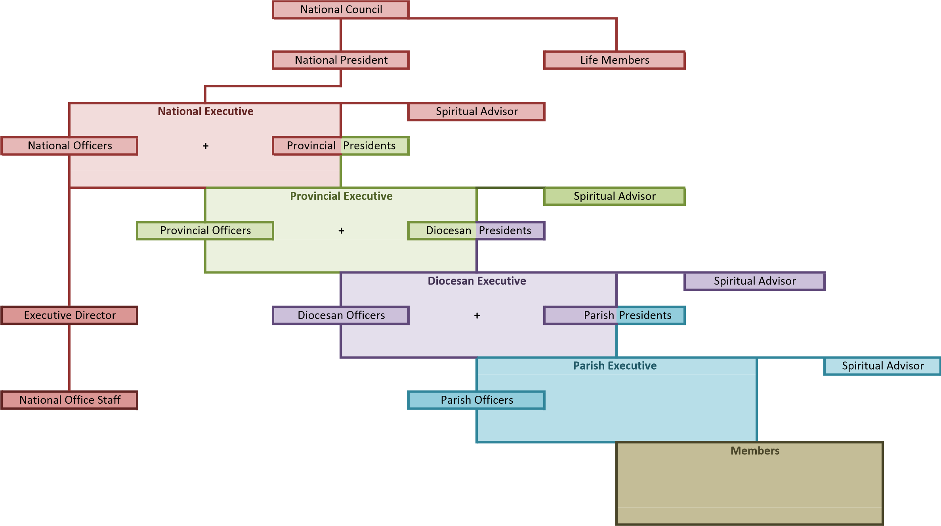
ORGANOGRAM OF THE LEAGUE
Note: Throughout the presentation each level of the League is represented by its own colour: national (red), provincial (green), diocesan (purple), parish (blue)
Notes:
This is the official organogram of the League as it is found in the National Manual of Policy and Procedure.
This is what this presentation will review and explain!
We will also take time to examine the Military Ordinariate Provincial Council and review the use of regional committees and how both of these fit in the structure of the League.
Note that throughout this presentation, each level will be represented using the colours of the organogram to help distinguish them from each other.

Slide 6
LEVELS OF THE LEAGUE
QUIZ
QUIZ ANSWERS
How many LEVELS are there in the League?
4
What are the LEVELS in the League?
National, provincial, diocesan, parish
Who represents each level in the League?
National president
Provincial president
Diocesan president
Parish president
Notes:
Let’s see if you already know the levels of the League!
How many levels are there?
Can you name them?
Who represents these levels in the League? In other words, who speaks for each of these Levels?

Slide 7
LEVELS OF THE LEAGUE
EXCEPTIONS: REGIONAL COMMITTEES
Diocesan councils may, at the request of the majority of their parish councils, establish regional committees and the rules under which these will function.
Provincial councils may vote to establish regional committees and the rules under which these will function, if requested by the majority of diocesan councils within the provincial council.
Regional committees will be made up of a chairperson, the presidents of the parish or diocesan councils concerned. Other members may be appointed as needed.
Diocesan and provincial councils may vote to have regional committee chairpersons as members of their council.
Notes:
Parish, diocesan, provincial and national sound very straightforward, but councils vary across the country. There is an exception to the usual levels that you may hear about called regional committees.
This slide shows the possible regional committees and the procedure to establish them.
Regional committees may be established to function under diocesan or provincial councils, but they are not an added or extra level in the League’s structure.
They usually include an appointed chairperson and the president of the parish council or diocesan council concerned.
Other members such as secretary and members at large may be appointed as needed.
IMPORTANT:
Regional committees are committees of a diocesan or provincial council and are NOT another level in the structure of the League.
They are established by special request.
Regional committees exist in Nova Scotia, Ontario, New Brunswick, Edmonton and Calgary. If you are considering such committees, reach out to their provincial president or chairperson of organization to learn how it is working for them.
For example, in New Brunswick:
The province is divided into two (2) regions, East and West.
Each region has a chairperson who acts as liaison between the parish councils in the region and the provincial council.
Their duties include organizing a fall regional meeting, helping the provincial convention planning committee, liaising with the provincial secretary, ensuring councils’ executive lists are up to date, and forwarding e-mail messages from provincial council to council’ chairpersons.
TO SUMMARIZE:
Regional Committees may be established to function under Diocesan or Provincial councils
They usually include an appointed Chairperson and the President of the Parish or Diocese concerned.
Other members such as secretary and members at large may be appointed as needed.
Regional Committees exist in Nova Scotia , Ontario and New Brunswick so if you are considering using such committees, contact their Provincial President or Organization Chairperson for guidance

Slide 8
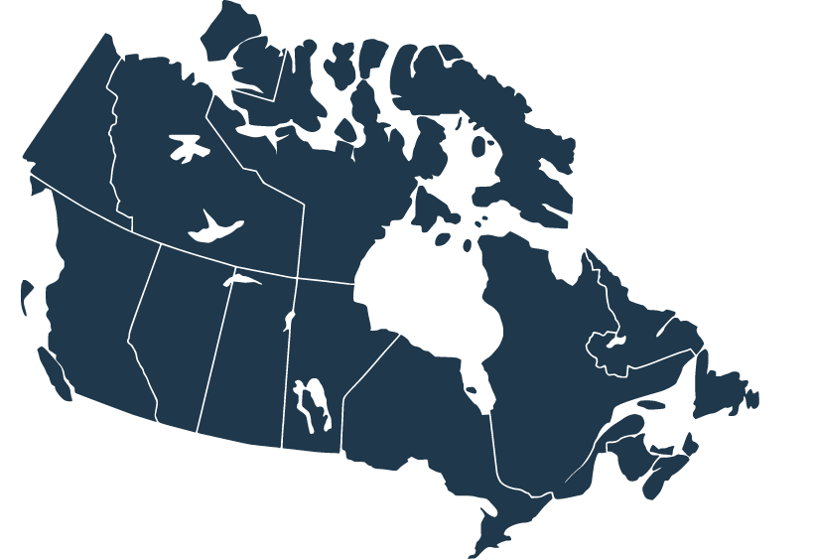
LEVELS OF THE LEAGUE
QUIZ:
Can you name all the PROVINCIAL councils?
Notes:
Now we see how good you all are! Can you name the provincial councils either in alphabetical order or in geographical order, either West to East or East to West!
IN ALPHABETICAL ORDER: IN GEOGRAPHICAL ORDER (West to East)
Alberta Mackenzie Military Ordinariate (across Canada)
B.C. & Yukon B.C. & Yukon
Manitoba Alberta Mackenzie
Military Ordinariate Saskatchewan
New Brunswick Manitoba
Newfoundland and Labrador Ontario
Nova Scotia Quebec
Ontario New Brunswick
Prince Edward Island Prince Edward Island
Quebec Nova Scotia
Saskatchewan Newfoundland and Labrador
Congratulations on remembering the Military Ordinariate… or … It is very important for us all to never to forget the Military Ordinariate Provincial Council as it is present throughout the country!

Slide 9
LEVELS AND COUNCILS OF THE LEAGUE
NATIONAL COUNCIL
B.C. & Yukon
Alberta Mackenzie
Sask.
Man.
Ont.
Que.
NB
NS
PEI
NL & Lab.
Military Ordinariate
6 diocesan councils
126 parish councils
3 diocesan councils
131 parish councils
13 diocesan councils
526 parish councils
0 diocesan councils
37 parish councils
0 diocesan councils 32 parish councils
0 diocesan councils 13 base councils
5 diocesan councils
150 parish councils
3 diocesan councils
46 parish councils
2 diocesan councils
18 parish councils
2 diocesan councils
66 parish councils
0 diocesan councils 17 parish councils
Statistics from December 2020
Notes:
If we look at the levels of the League, the councils of the League across the country map out like this.
Here you get an idea of how many councils, and thereby women, are involved in the League! Do you see where you fit in the bigger picture?
It is all of you that keep the structure stable and working! Thank you!
Now let us take a few minutes to learn about the special council on the far right, the Military Ordinariate Provincial Council.

Slide 10
THE MILITARY ORDINARIATE
The Military Ordinariate (formerly the Military Vicariate) was granted provincial council status by the CWL in 1965.
No geographic bounds.
Chapels that serve military members, their families, retirees and sometimes local civilians.
Part of the Roman Catholic Military Ordinariate of Canada.
The Military Ordinariate provincial president carries the Canadian flag at the opening and closing ceremonies of national conventions.
Notes:
The Military Ordinariate, which used to be called the Military Vicariate, was granted provincial council status by the CWL in 1965.
The Roman Catholic Military Ordinariate of Canada is a pseudo-diocese overseen by a bishop, the Military Ordinary.
It does not have geographic boundaries like most dioceses. It extends anywhere in the world where a military family is stationed or deployed.
Most Canadian Armed Forces bases have chapels that serve local military members, their families, retirees and sometimes, local civilians.
Military Ordinariate base councils belong to these chapels, and the Roman Catholic Military Ordinariate of Canada and their spiritual advisors are actively serving chaplains in the Canadian Armed Forces.
The Military Ordinariate is proud of its unique status as a provincial council.
As a fun fact, the Military Ordinariate provincial president carries the Canadian flag at the opening and closing ceremonies at national conventions.

Slide 11
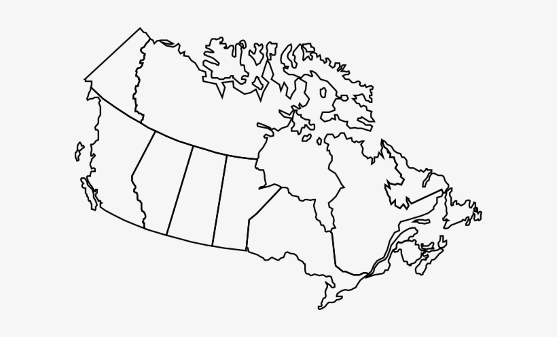
THE MILITARY ORDINARIATE
No diocesan levels
13 base councils
Notes:
This slide shows an updated map of where Military Ordinariate base councils are currently located.
Presently, there are 13 active base councils. Two each in British Columbia, Alberta and Nova Scotia, five in Ontario and one each in Manitoba and New Brunswick.
Is there a Military Ordinariate base council near you? Invite them to join you as guests whenever possible.
One last fun fact about the Military Ordinariate: CWL councils are called base councils and not parish councils, not just because they are technically located on a military base, but also because a military chapel congregation is not called a parish.

Slide 12
COUNCILS OF THE LEAGUE
WHO MAKES UP EACH COUNCIL?
PARISH COUNCIL
ALL WOMEN 16 YEARS OF AGE AND OVER WHO HAVE PAID MEMBERSHIP FEES TO THE PARISH COUNCIL
DIOCESAN COUNCIL
DIOCESAN OFFICERS + PARISH COUNCIL PRESIDENTS + UP TO TWO PARISH ACCREDITED DELEGATES + HONORARY LIFE AND LIFE MEMBERS IN THE DIOCESE
Notes:
Now we will spend a little time talking about the councils of the League, followed by the executive of each council.
It must be noted that councils at all levels must hold one annual general meeting/convention each year.
Activities during an annual general meeting can vary and may include masses, workshops, distribution of that level’s annual report book, guest speakers and more.
Activities must include voting on proposed changes to the Constitution & Bylaws, presentation and voting on resolutions, oral reports delivered by each member of the executive to bring the general membership up to date on activities, initiatives and news, and finally, a time for elections to sit a new executive every two years.
Now, let’s review the composition of each council at each level in the League during regular meetings, and the members with the right to vote, called accredited delegates, at the annual general meeting/convention.
First, there are the parish councils made up of all of its paid-up members.
Most councils meet every month except during the summer holiday season.
During the annual general meeting, every paid member has the right to vote.
The diocesan council is made up of:
its officers (past parish presidents elected to the diocesan council by the parish councils’ executives at the annual diocesan meeting/convention)
all parish council presidents in the diocese
During the annual diocesan meeting/convention, the diocesan council membership also includes up to two voting members chosen by each parish council executive, called accredited delegates.
All honorary life members and life members living in the diocese have the right to vote at the annual general meeting/convention and as such are accredited delegates.
The diocesan council’s executive usually meet semi-annually or quarterly.
Diocesan councils usually hold their annual general meeting/convention during the months of April or May, depending on the council.

Slide 13
COUNCILS OF THE LEAGUE
WHO MAKES UP EACH COUNCIL?
PROVINCIAL COUNCIL
PROVINCIAL OFFICERS + DIOCESAN PRESIDENTS + UP TO TWO DIOCESAN ACCREDITED DELEGATES + UP TO ONE PARISH ACCREDITED DELEGATE + HONORARY LIFE AND LIFE MEMBERS IN THE PROVINCE
NATIONAL COUNCIL
NATIONAL OFFICERS + PROVINCIAL PRESIDENTS + UP TO TWO PROVINCIAL ACCREDITED DELEGATES + UP TO TWO DIOCESAN ACCREDITED DELEGATES + ALL HONORARY LIFE AND LIFE MEMBERS IN CANADA
Notes:
The provincial council is made up of:
its officers (past diocesan presidents, elected by the diocesan executives or parish council executives with no diocesan council)
all diocesan presidents and parish presidents with no diocesan council,
Voting membership on the provincial council is increased during the annual meeting/convention to include up to two voting members chosen by each diocesan council executive and parish councils with no diocesan council, called accredited delegates.
Lastly, all honorary life members and life members living in the province have the right to vote at the annual general meeting/convention and as such are accredited delegates.
The provincial council executive usually meets semi-annually or quarterly.
Provincial councils’ annual general meeting/convention generally takes place during the months of May, June or July depending on the council.
The national council is made up of:
its national officers (past provincial presidents elected by the provincial executives to the national council)
all sitting provincial presidents are also members of the national council
During the annual meeting/convention, voting membership in the national council includes up to two voting members per provincial and diocesan council, called accredited delegates, and all honorary life and life members, also called accredited delegates, as they have the right to vote.
The national executive usually meets three times per year.
National council holds its annual meeting of members in August.

Slide 14
EXECUTIVES OF THE LEAGUE
Who makes up the parish executive?
Members who have been elected by the membership of the parish council.
Who officially represents the parish council?
The parish executive, as elected by the members.
The parish president is the official spokesperson of her parish council.
Notes:
Now we will talk about the executives of the League. The executives are entrusted to direct the affairs of the council, organize programs, represent the membership, and develop policy.
It is important to understand who makes up each executive in the League.
Can you name who makes up the parish executive?
Yes, members who have been elected as officers and committee chairpersons by the membership of the parish council at the parish annual general meeting.
Note: Vacancies may be filled by appointment in accordance with procedures outlined in the National Manual of Policy and Procedures, pg. 72
Each parish executive also has a spiritual advisor
The parish executive usually meet four to six times a year and some meet before each parish council meeting.
And who represents all the members of a parish council?
Yes, the parish executive elected by the members, with the guidance of a spiritual advisor.
The official spokesperson for the parish executive and council is the parish president.

Slide 15
EXECUTIVES OF THE LEAGUE
What members makes up the diocesan executive?
Diocesan officers who were elected to office by parish council presidents in an instructed vote at the annual meeting/convention
Parish council presidents who are representative of their parish councils
Diocesan president is the official spokesperson for her diocesan council.
Notes:
Now, can you name the members that make up the diocesan executive?
Yes, diocesan officers who have been elected by the parish council presidents in an instructed vote at the diocesan annual meeting/convention. Note, women eligible to run for diocesan office have been parish council presidents.
Note: Vacancies may be filled by appointment in accordance with procedures outlined in the National Manual of Policy and Procedure, pg. 72
All sitting parish council presidents in the diocese are also part of the diocesan executive.
Of course, each diocesan executive also benefits from the guidance of a spiritual advisor.
Regional committees may be represented, depending on the diocesan executive but have no vote.
Diocesan council executives should meet at least twice a year, but many meet up to four times a year depending on the diocesan executive.
Diocesan executive presides over the diocesan council annual meeting/convention hosted by one of its parish councils.
It is the diocesan president who is the official spokesperson for her diocesan executive and council.

Slide 16
EXECUTIVES OF THE LEAGUE
What members make up the provincial executive?
Provincial officers who were elected to office by diocesan presidents*
Diocesan presidents who are representative of their diocesan councils*
The provincial president is the official spokesperson for her provincial council
* Newfoundland and Labrador, New Brunswick, Prince Edward Island and Military Ordinariate provincial councils have no diocesan councils. The * positions are replaced with parish council presidents.
Notes:
Great! Now which members make up the provincial executive?
Yes, provincial officers who have been elected by the diocesan presidents in an instructed vote at the provincial annual meeting/convention. The women eligible to run for provincial office have served as diocesan presidents. In the case of the Military Ordinariate, New Brunswick, Newfoundland and Labrador and Prince Edward Island, which do not have diocesan councils, their past parish or base presidents are eligible.
Note: Vacancies may be filled by appointment in accordance with procedures outlined in the National Manual of Policy and Procedure, pg. 72
All sitting diocesan presidents in the province and all sitting parish presidents with no diocesan council are also members of the provincial executive.
Regional committees may be represented, depending on the provincial executive but have no vote.
Each provincial executive also has its own spiritual advisor.
Provincial executives should also meet at least twice a year and some meet up to four times a year, depending on the provincial executive.
The provincial executive presides over the provincial annual meeting/convention hosted by one of its diocesan, parish or base councils.
The provincial president is the official spokeswoman for her provincial executive and council.

Slide 17
EXECUTIVES OF THE LEAGUE
Who makes up the national executive?
National officers who were elected to office by provincial presidents*
Provincial presidents who are representative of their provincial councils*
The national president is the official spokesperson for national council and The Catholic Women’s League of Canada
Notes:
Finally, who makes up the national executive?
National officers who have been elected by provincial presidents in an instructed vote at the annual meeting/convention. Women eligible to run for national office have served as provincial presidents.
Note: Vacancies may be filled by appointment in accordance with procedures outlined in the National Manual of Policy and Procedures, pg. 72.
Current provincial presidents are also members of the national executive.
A spiritual advisor and an executive director provide guidance and assistance to the national executive.
The national executive should meet at least twice a year.
The national executive presides over the annual national meeting of members/convention hosted by a diocesan or provincial council.
The national president is the official spokeswoman for the national executive and council and all the League at all outside activities, with the government and with all media.

Slide 18
OFFICERS OF THE LEAGUE
WHO MAKES UP THE ELECTED OFFICERS FOR EACH COUNCIL?
National Manuel of Policy and Procedure, page 13
Note: List of the officers can be found in the Constitution & Bylaws, Part XI: Officers; Sections 1-3; pgs. 17-18
Duties of the officers can be found in the Constitution & Bylaws, Part XII: Duties of Officers; Sections 1-9; pgs. 19-24
Duties of chairpersons can be found in the Constitution & Bylaws, Part XIII: Standing Committees; Sections 1-11; pgs. 25-29
Notes:
Lastly, at the bottom of the League organogram, found in the National Manual of Policy and Procedure, is an official breakdown of all the elected executive positions called officers and standing committee chairpersons, at every level, as it currently stands. This slide is being presented as part of the pilot program, and will be changed if the 2021 proposed amendments are adopted.
Notes:
First vice-president and second vice-president are not always found at parish and diocesan levels.
The secretary-treasurer position is one person at national level, but is often two people at the provincial, diocesan and parish levels.
Some diocesan and parish councils have two people occupying the positions of corresponding secretary and recording secretary.
Presidents-elect at all levels hold the position of chairperson of organization.
Chairpersons of law and international relations only exist at the national level.
Chairpersons of parish activities only exists at the parish level.
Spiritual advisors at the parish level are usually the parish priest, or someone appointed by the council upon the recommendation of the parish priest in consultation with the parish executive.¹
At the diocesan, provincial and national levels, the spiritual advisor is appointed by the appropriate level of the hierarchy. For example, the spiritual advisor at the national level is appointed by the Canadian Conference of Catholic Bishops (CCCB). ¹
Note: The same person cannot serve as spiritual advisor simultaneously on any two levels above the parish council level. For example, the parish spiritual advisor could also be the provincial spiritual advisor; but, the diocesan spiritual advisor cannot also be the provincial and/or national spiritual advisor). ¹
(Constitution & Bylaws, Part X: The League and the Church Spiritual Advisor, pages 11-12)

Slide 19
ORGANOGRAM OF THE LEAGUE
National Manuel of Policy & Procedure, page 13
Notes:
So now you understand the League organogram!
Do not forget that you can refer to the National Manual of Policy and Procedure at cwl.ca under To Organize - 600 Series: Manuals.
Let’s just review together starting at the bottom left, “members.”

Slide 20
LEVELS OF THE LEAGUE
QUIZ:
ANSWERS:
How many levels are there in the League?
Four levels
Can you name the levels in the League?
Parish, diocesan, provincial, national
Are the levels the same for each province?
No, some do not have diocesan councils, some have regional committees
What document defines the levels in the League?
Constitution & Bylaws
What document outlines the levels in the League?
National Manual of Policy and Procedure
Who determines changes in the levels in the League?
Changes may only be made by a vote of the entire membership, through an amendments process.
Notes:
A little fun challenge: Let’s see how much you have all mastered the League’s organogram.

Slide 21
COUNCILS OF THE LEAGUE
QUIZ:
ANSWERS:
How many parish councils are there?
1,162
How many diocesan councils are there?
34
How many provincial councils are there?
11
How many national councils are there?
One
Statistics from December 2020
Notes:
Now can you guess how many parish councils there are in Canada?
This answer will be available by January 31, 2022, and will be applicable for the 2021 membership year.
How many diocesan councils are there?
The answer is 34.
Now an easy one: How many provincial councils are there?
Correct: There are 11, one for each province and one for the Military Ordinariate.
Last but not least, how many national councils are there?
Of course, there is only one.

Slide 22
THE PROMISE OF THE LEAGUE
WHAT AFFIRMS OUR COMMITMENT TO THE LEAGUE?
THE LEAGUE PROMISE
It reminds members, in all their activities, of their commitment to:
God
God’s people
Our Lady of Good Counsel, our patroness
the League
Elected officers
The bylaws
INFORMATION ON THE LEAGUE PROMISE
Found in the Ceremonies Booklet
Used for the Reception of New Members, Ceremonies Booklet
Notes:
Women across the country belong to parish, diocesan, provincial and national councils and many are members of their executives, participating in thousands of initiatives and activities.
What affirms our commitment to the League? The League’s Mission.
Where is this Mission reflected to help women remember why they participate in the League and all its activities? In…
THE PROMISE OF THE LEAGUE
The League Promise reminds members of their commitment to:
God
God’s people
Our Lady of Good Counsel, the League’s patroness [subject to a vote in August 2022]
the League itself
the elected officers [subject to a vote in August 202]
the bylaws, the rules guiding the League’s actions

Slide 23
THE PROMISE OF THE LEAGUE
For the glory of God and the good of God’s people,
I promise as a Catholic woman to honour, invoke and imitate our patroness, Our Lady of Good Counsel.
I promise to be a loyal member of The Catholic Women’s League of Canada and to promote its interest and growth in every way.
I promise to cooperate with officers in all programs under their direction and
to conform to the best of my ability to the bylaws of the organization in all League activities.
Amen
Notes:
Let us read the “League Promise” together, pausing at the end of each separate statement as indicated by the spacing, in order to reflect on this commitment that we have each taken as members of The Catholic Women’s League of Canada.
NOTES TO FACILITATOR:
Lead the reading of the “League Promise,” pausing between each segment (as seen by the spacing of the prayer), to allow time for reflection.
Feel free to open the floor to a discussion about the “League Promise.”
This promise could be recited at least once a year, perhaps at:
the first general meeting after an election
perhaps in the fall at the first meeting of the resumption of activities after the summer break
perhaps to open meetings on event planning sessions
and certainly, during the welcoming ceremony for new members
I am sure you can think of other occasions when it may be recited.

Slide 24
THE STRUCTURE OF THE LEAGUE AND THE PROMISE OF THE LEAGUE
Notes:
In conclusion:
Please remember to always honour the League’s organizational structure.
Remember your commitment by reciting the “League Promise” on a regular basis.
Thank you for sharing your time with us/me during the presentation of this module of the Executive Orientation.

Slide 25
EXECUTIVE ORIENTATION
Modules:
History of the League (15 minutes)
Structure of the League and The Promise of the League (25 minutes) P
Core Principles; Constitution & Bylaws; Policy and Procedure; Executive Handbook (20 minutes)
Duties of Officers (20 minutes)
Life Membership and Honorary Life Membership (20 minutes)
Strategic Plan Summary (30 minutes)
Communication (45 minutes)
Budgets (15 minutes)
Member Recognition (10 minutes)
Public Presence and Member Development (30 minutes)
Notes:
Executive Orientation
Modules:
History of the League (15 minutes)
Structure of the League and The Promise of the League (25 minutes)
Core Principles; Constitution & Bylaws; Policy and Procedure; Executive Handbook (25 minutes)
Duties of Officers (20 minutes)
Life Membership and Honorary Life Membership (20 minutes)
Strategic Plan Summary (30 minutes)
Communication (45 minutes)
Budgets (15 minutes)
Member Recognition (10 minutes)
Public Presence and Membership Development (30 minutes)

