Slide 1
THE CATHOLIC WOMEN’S LEAGUE OF CANADA
EXECUTIVE ORIENTATION

Slide 2
EXECUTIVE ORIENTATION
Modules:
History of the League (15 minutes)
Structure of the League and The Promise of the League (25 minutes)
Core Principles; Constitution & Bylaws; Policy and Procedure; Executive Handbook (20 minutes)
Duties of Officers (20 minutes)
Life Membership and Honorary Life Membership (20 minutes)
Strategic Plan Summary (30 minutes)
Communication (45 minutes)
Budgets (15 minutes)
Member Recognition (10 minutes)
Public Presence and Member Development (30 minutes)
Notes:
Executive Orientation
Modules:
History of the League (15 minutes)
Structure of the League and The Promise of the League (25 minutes)
Core Principles; Constitution & Bylaws; Policy and Procedure; Executive Handbook (25 minutes)
Duties of Officers (20 minutes)
Life Membership and Honorary Life Membership (20 minutes)
Strategic Plan Summary (30 minutes)
Communication (45 minutes)
Budgets (15 minutes)
Member Recognition (10 minutes)
Public Presence and Membership Development (30 minutes)

Slide 3
THE CATHOLIC WOMEN’S LEAGUE OF CANADA
STRATEGIC PLAN SUMMARY
Gifted to National by Allison Klemen (MO), June Brown (NB), Judy Hodge (NL)
Notes:
Every organization, company, or business needs to understand its purpose, its reason for being, and how its organization and activities support that purpose. The League is no different. While the League’s foundation is strong and its purpose clear, it was determined that how the organization is structured and how the activities are conducted, could be updated to embrace the 21st century and new technologies.
This presentation will summarize the effort of the League to plan strategically, and what has been accomplished to date.
***italicized notes provided for optional further explanation***

Slide 4
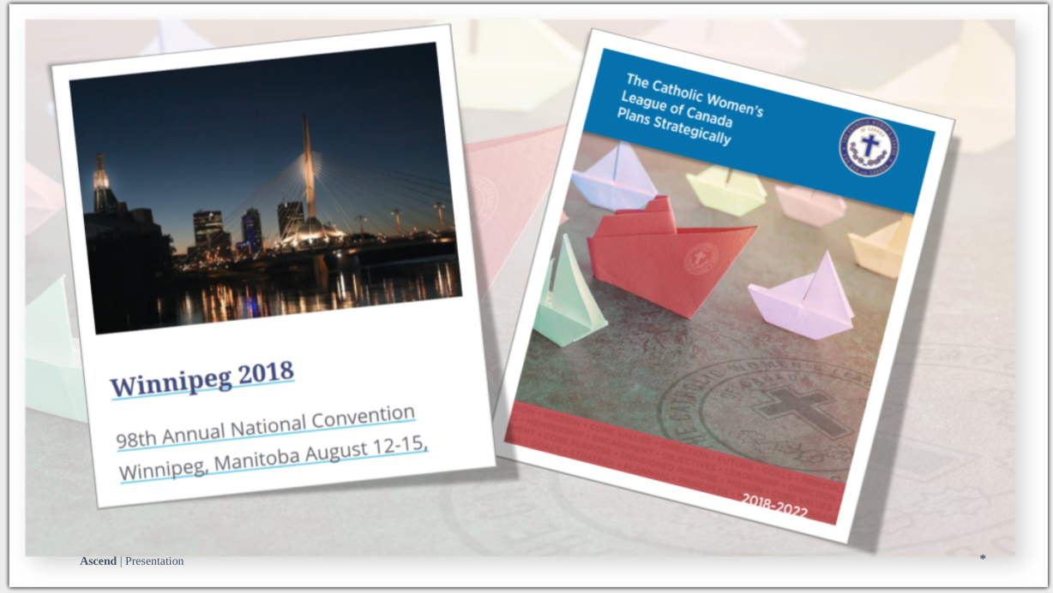
THE CATHOLIC WOMEN’S LEAGUE OF CANADA
PLANS STRATEGICALLY
Notes:
The Catholic Women’s League of Canada Plans Strategically document is a resource members should be familiar with. It was released at the 2018 national convention in Winnipeg. Inside this document is an explanation of the strategic planning process, and the steps taken by the League up to that point. Let’s take a look...

Slide 5
THE STEPS
STEP 1: Get organized (steering committee)
STEP 2: Take stock
Review past studies and history of major changes in the League.
Review feedback from members at the town hall meeting held at the 2017 national convention in Charlottetown.
STEP 3: Set direction
Guiding principles were written and fine-tuned at provincial executive meetings.
Goals, objectives, critical issues and strategies were identified.
STEP 4: Refine and adopt the plan
Notes:
The first step was to set up a steering committee. This group consisted of the National “Presidents Three,” -- at the time, Past President Barbara Dowding, President Margaret-Ann Jacobs and President-Elect Anne-Marie Gorman. Joining them from across Canada were Honorary Life Member Danielle McNeil-Hessian, Ontario Provincial Past President Pauline Krupa, Quebec Provincial Past President Ingrid Lefort, Vancouver Diocesan Past President Roxanne McDonald and Executive Director Kim Scammell.
The second step was to review past studies and changes in the League and gather feedback from a national town hall.
The town hall was held during the 2017 national convention in Charlottetown, and members were able to participate online from across the country! Did you take part?
The third step was to set direction. It was done in two phases. The first phase was to articulate guiding principles, and identify goals and objectives.
Provincial executives had a direct hand in fine-tuning these details and participated in workshops to provide feedback.
The second phase was to come up with strategies that would move the League toward the objectives.
All members in attendance at provincial and diocesan conventions in spring 2018 were invited to participate by identifying which strategies would be the most impactful for them. “Members of the steering committee and other leaders presented the strategies at 44 diocesan and provincial conventions. This activity expanded the consultation pool from the core 26 leaders to 4,060 members serving at all levels of the League.”
The fourth and final step. The plan was presented to the national executive/board to be adopted. The Catholic Women’s League of Canada Plans Strategically booklet was the result.

Slide 6
GUIDING PRINCIPLES
Notes:
One of the most important pages of this document is page 11, where you will find this graphic of the League’s new guiding principles.

Slide 7
CORE PURPOSE
the reason an organization exists
Uniting Catholic women to grow in faith, and to promote social justice through service to the church, Canada and the world.
Notes:
The core purpose is the reason an organization exists.
The core purpose of the League is: uniting Catholic women to grow in faith, and to promote social justice through service to the church, Canada, and the world.

Slide 8
CORE VALUES
the fundamental beliefs of an organization that dictate the behaviour of its membership
FAITH – following Catholic teaching
SERVICE – local, national and international
SOCIAL JUSTICE – actively involved in society
Notes:
The core values are the fundamental beliefs of an organization that dictate the behaviour of its membership.
By now, you will have certainly heard these three: faith, service and social justice.
Faith - following Catholic teaching; service - local, national, and international; social justice - actively involved in society.

Slide 9
MISSION STATEMENT
what an organization does, and how it is accomplished
The Catholic Women’s League of Canada calls its members to grow in faith, and to witness to the love of God through ministry and service.
Notes:
A mission statement reflects what an organization does and how it is accomplished.
"The Catholic Women’s League of Canada calls its members to grow in faith, and to witness to the love of God through ministry and service.”

Slide 10
ENVISIONED FUTURE
what the organization strives to become
The Catholic Women’s League of Canada is an inclusive and engaged community of Catholic women inspired by faith. It is:
- A vital participant in the church;
- A valued partner for social justice;
- A respected advocate at all government levels;
- Connected to the world.
Notes:
The envisioned future is what the organization strives to become: inclusive, engaged, inspired by faith; a vital participant in the church, a valued partner for social justice, a respected advocate at all government levels, and connected to the world.

Slide 11
GOALS, OBJECTIVES AND CRITICAL ISSUES
GOAL Outcome, to be achieved in three to five years
OBJECTIVE Sets direction towards goal
Forms the measurement to determine progress
CRITICAL ISSUES Things that need to be addressed regardless of progress
Notes:
Now that the guiding principles were set, the next big part was to plan the way forward.
three goals were set (the desired outcome).
objectives were determined (in order to measure progress), and
critical issues were identified - these are the big things that need to change, no matter what. They are now called “Goal 4.”

Slide 12
GOAL 1
Members grow in faith by sharing, witnessing and developing leadership skills to create positive change.
Objectives:
increase opportunities for spiritual development
increase membership
remove structural impediments to participation and action by increasing flexibility
increase the capacity and efficiency of leadership
increase the number and readiness of members to hold office
increase effectiveness of communication
Notes:
Goal 1 identifies the attributes of members who belong to the League. The goal is that they become, or are, women who grow in faith by sharing, witnessing and developing leadership skills to create positive change. Please note this is a goal for members, not for the organization.
The objectives of Goal 1 are listed here:
To increase opportunities for spiritual development
to increase membership
to remove structural impediments to participation and action by increasing flexibility
to increase the capacity and efficiency of leadership
to increase the number and readiness of members to hold office, and
to increase effectiveness of communication

Slide 13
GOAL 2
The CWL addresses and supports Catholic social teaching through advocacy.
Objectives:
increase members knowledge of Catholic social teaching
increase number of members trained to lead advocacy efforts
increase collaboration with faith organizations and governments
Notes:
Goal 2 focuses on the League as an organization. The goal is that the League address and support Catholic social teaching through advocacy efforts.
The objectives of Goal 2 are listed here:
to increase members’ knowledge of Catholic social teaching
to increase the number of members trained to lead advocacy efforts, and
to increase collaboration with faith organizations and governments

Slide 14
GOAL 3
Through outreach and service, members of the CWL foster a culture where all life is valued with dignity and respect.
Objectives:
increase participation of diverse cultural and generational groups
increase awareness and opportunities for parish-based projects that protect and respect all human life
increase a sense of belonging and connectedness within the organization
Notes:
Goal 3 is another goal that focuses on the membership, not the organization. It is a goal where the members themselves actively reach out and serve in ways that foster a culture where all lives are honoured with dignity and respect, in community of course, but just as importantly, within the CWL, in a spirit of sisterhood.
The objectives of Goal 3 are listed here:
to increase participation of diverse cultural and generational groups,
to increase awareness and opportunities for parish-based projects that protect and respect all human life, and
to increase a sense of belonging and connectedness within the organization

Slide 15
GOAL 4
Critical issues
provide valid options in structure and meetings
address the lack of participation and engagement, disparity in engagement levels and competition for members’ time
address the perception of the League, its marketing and promotion
address the lack of training and resistance to taking on leadership roles
improve the use of technology, communication methods and tools
Notes:
Goal 4 is to address those issues that parish councils, through the town hall held in 2017, identified as being critical to their current situation and their ability to function successfully. These are the most pressing needs of councils, those that “national” has been asked to prioritize.
They are listed here:
to provide valid options in structure and meetings
to address the lack of participation and engagement, disparity in engagement levels, and competition for members’ and prospective members’ time
to address the perception of the League, its marketing and promotion
to address the lack of training and resistance to taking on leadership roles, and
to improve the use of technology, communication methods, and tools
Fifty strategies were developed for each of the 17 objectives and then prioritized through consultation at conventions.
Of all of the 50 strategies, six were identified as most needed by a majority of councils across the country, that would created the greatest positive impact. These were
Reduce the number of standing committees to three to align with the core values of faith, service and social justice.
Simplify procedures and reporting processes.
Include (leave no member behind) and affirm (make members feel welcomed, needed and wanted).
Increase awareness about the League within the church through marketing.
Market the League as an association that showcases the strength of Catholic women grounded in faith ready and willing to act.
Position the League as an organization for all Catholic women that encourages and supports their role and responsibility in the church and society.
The final plan was adopted in August 2018, and the implementation process began. The next set of slides summarizes a presentation in 2019 that described what occurred in the first year of implementation.

Slide 16
STRATEGIES and FINAL PLAN
50 strategies developed for the 17 objectives and prioritized through consultation at conventions
Six strategies identified as most needed:
Final plan adopted August 2018
reduce standing committees to three
include/affirm members
increase awareness of the League
showcase strength of Catholic women of faith and action
position the League as an organization for all Catholic women
Notes:
Fifty strategies were developed for each of the 17 objectives and then prioritized through consultation at conventions.
Of all of the 50 strategies, six were identified as most needed by a majority of councils across the country that would create the greatest positive impact. These were
Reduce the number of standing committees to three to align with the core values of faith, service and social justice.
Simplify procedures and reporting processes.
Include (leave no member behind) and affirm (make members feel welcomed, needed and wanted).
Increase awareness about the League within the church through marketing.
Market the League as an association that showcases the strength of Catholic women grounded in faith ready and willing to act.
Position the League as an organization for all Catholic women that encourages and supports their role and responsibility in the church and society.
The final plan was adopted in August 2018, and the implementation process began. The next set of slides summarizes a presentation in 2019 that described what occurred in the first year of implementation.

Slide 17
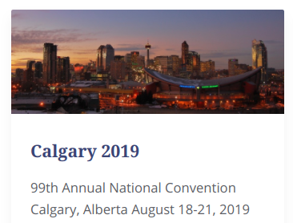
THE LEAGUE OF THE FUTURE – YEAR 1
Notes:
The League of the Future - Year 1, which was presented at the 2019 national convention in Calgary, was the first formal report to the membership on the progress of implementing the strategic plan.
It opened with an awesome Star Wars themed video, which you may remember. It was presented afterwards at provincial and diocesan levels, and presentations across Canada were mapped on the national website.

Slide 18
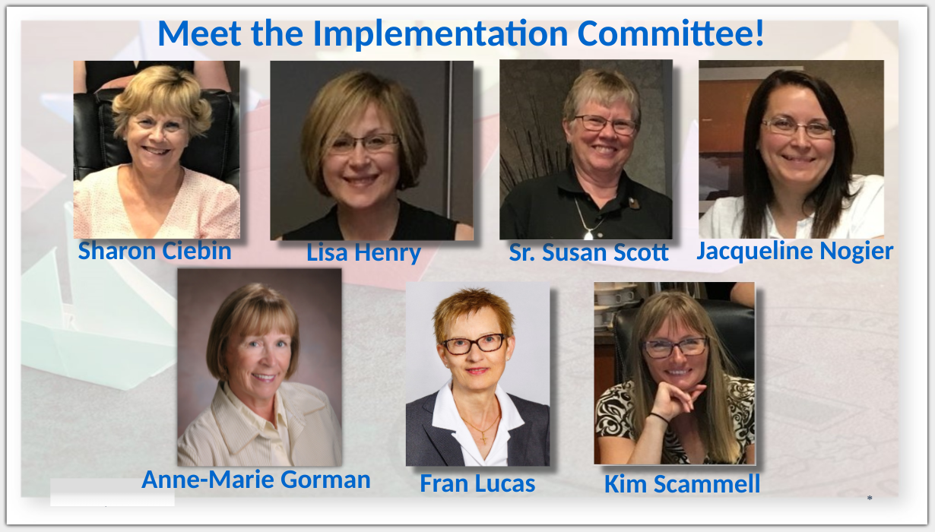
THE LEAGUE OF THE FUTURE – YEAR 1
reviewed the policies in the Constitution & Bylaws that dictate the current structure
reviewed the strategic planning process and how the 2018 document came to be
introduced:
Notes:
This presentation reviewed the League’s current organizational structure and the process that lead to the 2018 document (The Catholic Women’s League Plans Strategically). The Three Pillars activity was included to lead participants in categorizing common CWL activities into the new core values.
The presentation also introduced the implementation committee, seen here. The committee chairperson is Sharon Ciebin from British Columbia. The vice-chairperson is Lisa Henry from Ontario. The secretary is Sr. Susan Scott from Alberta, and the final selected member is Jacqueline Nogier from Manitoba. National President-Elect Fran Lucas is the liaison between the implementation committee and the national executive/board. National President Anne-Marie Gorman and Executive Director Kim Scammell are ex-officios.

Slide 19
THE LEAGUE OF THE FUTURE – YEAR 1
5 year strategy maps for each goal
9-step process for implementing change
first three working groups introduced:
reorganization
marketing
affirmation
Notes:
The presentation continued by revealing five year strategy maps for each of the four goals, and then by describing the nine-step process for implementing change. Finally, the first three working groups were introduced:
reorganization
marketing
affirmation
These three groups were formed to address the six strategies mentioned earlier that were deemed to be most pressing.
The implementation committee and the working groups met often after they were formed: collaborating, brainstorming, researching and developing.

Slide 20
THE LEAGUE OF THE FUTURE – YEAR 2
Notes:
The first year went by quickly, and soon it was time to give the Year 2 update, which was provided online during the Summer Speaker Series in August 2020.
Here you can see National President-Elect and Chairperson of Organization Fran Lucas giving her presentation on the screen…

Slide 21
Notes:
… where she shared news with members of the first deliverable! The Welcome Program was unveiled as the affirmation working group concluded its work.

Slide 22
THE LEAGUE OF THE FUTURE – YEAR 2
Notes:
More updates were provided, and the next seven working groups were introduced.

Slide 23
THE LEAGUE OF THE FUTURE – YEAR 2
SEVEN MORE WORKING GROUPS INTRODUCED:
Catholic social teaching
League misconceptions
encourage diversity
toolkits
spiritual formation
strategic leadership
parish council
Notes:
Each of the seven new working groups was tasked with implementing one or more strategies. By August 2020, each working group had developed an action plan.
The Catholic social teaching working group was planning to empower members by providing educational opportunities to learn more about Catholic Social Teachings.
The League misconceptions working group was planning to do exactly that, address the misconceptions about the League.
The encourage diversity working group was making plans to embrace diverse cultures and ages.
The toolkits working group was tasked with creating ready-made adaptable toolkits for use in parishes.
The spiritual formation working group had four strategies to employ:
- Develop and deliver spiritual programs at all levels.
- Provide opportunities to increase women’s spirituality as a core objective.
- Focus on the spiritual and social aspects in councils.
- Emphasize small Christian community model of “pray, reflect, act”.
The strategic leadership and parish council working groups had complementary strategies:
- Restructure the existing standing committees structure at the parish level to respect the uniqueness of councils.
- Capitalize on members’ willingness to take on short term leadership responsibilities.

Slide 24
UPDATED INFORMATION
National website - www.cwl.ca
National Facebook page
Communiques
The Canadian League magazine
Notes:
As new groups are established and others share updates on their work, the latest information can be found on the national website and Facebook page, in recent communiques, and in The Canadian League.

Slide 25
“In her voyage across the ocean of the world, the Church is like a great ship being pounded by the waves of life’s different stresses. Our duty is not to abandon ship but to keep her on course.”
-Saint Boniface
Will you share in the journey?
Notes:
This quote from St. Boniface is a perfect metaphor for what we are trying to achieve with the strategic plan. (Read quote)
Do not forget to watch for opportunities to participate and contribute.
Will you share in the journey and help keep us on course?

Slide 26
STRATEGIC PLAN SUMMARY

Slide 27
EXECUTIVE ORIENTATION
Modules:
History of the League (15 minutes)
Structure of the League and The Promise of the League (25 minutes)
Core Principles; Constitution & Bylaws; Policy and Procedure; Executive Handbook (20 minutes)
Duties of Officers (20 minutes)
Life Membership and Honorary Life Membership (20 minutes)
Strategic Plan Summary (30 minutes) P
Communication (45 minutes)
Budgets (15 minutes)
Member Recognition (10 minutes)
Public Presence and Member Development (30 minutes)
Notes:
Executive Orientation
Modules:
History of the League (15 minutes)
Structure of the League and The Promise of the League (25 minutes)
Core Principles; Constitution & Bylaws; Policy and Procedure; Executive Handbook (25 minutes)
Duties of Officers (20 minutes)
Life Membership and Honorary Life Membership (20 minutes)
Strategic Plan Summary (30 minutes)
Communication (45 minutes)
Budgets (15 minutes)
Member Recognition (10 minutes)
Public Presence and Membership Development (30 minutes)

