Slide 1
THE CATHOLIC WOMEN’S LEAGUE OF CANADA
EXECUTIVE ORIENTATION

Slide 2
EXECUTIVE ORIENTATION
Modules:
History of the League (15 minutes)
Structure of the League and The Promise of the League (25 minutes)
Core Principles; Constitution & Bylaws; Policy and Procedure; Executive Handbook (20 minutes)
Duties of Officers (20 minutes)
Life Membership and Honorary Life Membership (20 minutes)
Strategic Plan Summary (30 minutes)
Communication (45 minutes)
Budgets (15 minutes)
Member Recognition (10 minutes)
Public Presence and Member Development (30 minutes)
Notes:
Executive Orientation
Modules:
History of the League (15 minutes)
Structure of the League and The Promise of the League (25 minutes)
Core Principles; Constitution & Bylaws; Policy and Procedure; Executive Handbook (25 minutes)
Duties of Officers (20 minutes)
Life Membership and Honorary Life Membership (20 minutes)
Strategic Plan Summary (30 minutes)
Communication (45 minutes)
Budgets (15 minutes)
Member Recognition (10 minutes)
Public Presence and Membership Development (30 minutes)

Slide 3
THE CATHOLIC WOMEN’S LEAGUE OF CANADA
MEMBER RECOGNITION
Ecclesiastes 3:1 For everything there is a season, and a time for every matter under heaven
Gifted to National by Sharon Geiger (BC), Mary Hunt (ABMK)
Notes:
Ecclesiastes reminds us that modesty and humility set aside, there is a place for recognition and awards in the League.

Slide 4
RECOGNITION AND AWARDS
Why present awards and recognition?
What types of awards are available?
What is the best way to present service awards?
Notes:
Recognition and Awards
Women who join the League do not do so in the anticipation or hope of receiving recognition or awards.
It is important that members are recognized for their dedication, good works and service, to express our appreciation for their contributions. These women serve as an inspiration and serve as role models. They energize the membership in their resolve as they continue in their own personal CWL journey.
The League has made available through national office and on the national website a Ceremonies Booklet which includes a ceremony for the Presentation of Service Awards. This is a guideline and your council may wish to add to or change the ceremony suggested to accommodate your needs.

Slide 5
INSIGNIA PIN
Notes:
Insignia Pin
Annually councils are encouraged to welcome new members by hosting a Reception of New Members Ceremony at which new members are presented with an insignia pin to serve as a sign and a reminder to them of their membership in the League sisterhood.
All members will want to wear their pins as often as possible as a way of sharing the good news of the League with others. Often, members are asked what the pin they are wearing symbolizes.

Slide 6
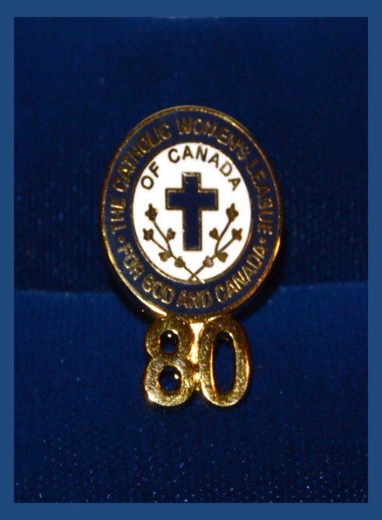
SERVICE PINS
Notes:
Service Pins
Councils are encouraged to annually celebrate the dedicated years of service of their members. Members are presented with service pin awards to mark milestone anniversaries in their personal League membership. It is a privilege to present members with the appropriate years of service pin and it is an honour for members to receive the pins.
Service pins can be presented to members at five year intervals. The pins are available through national office.
Service pin recipients are encouraged to wear their pins as a cherished reminder of their membership in the League.
Councils are encouraged to request anniversary scrolls to recognize their years of service. The scrolls are stamped with the signature of the national president. Requests can be made by contacting national office.

Slide 7
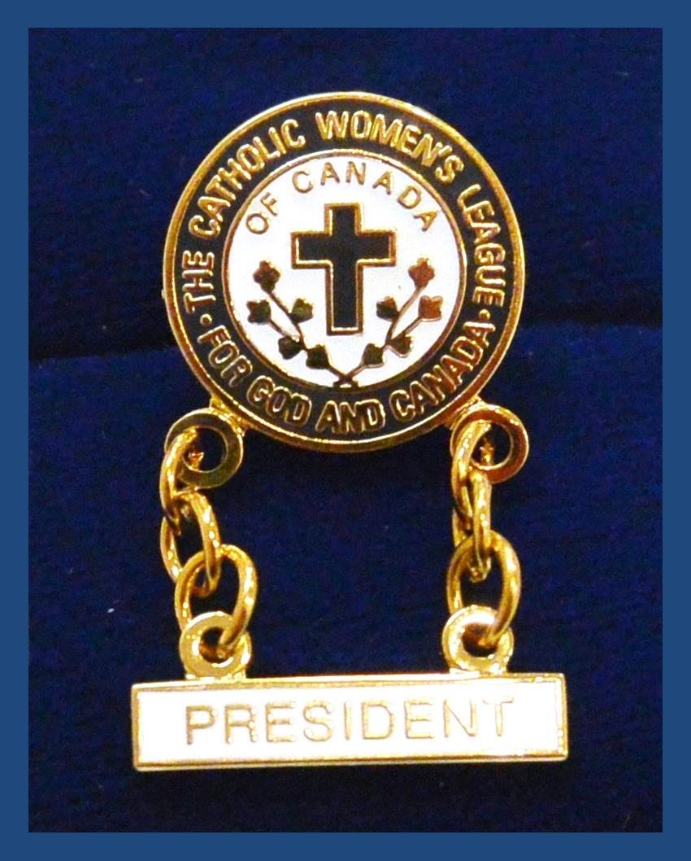
PRESIDENT PIN
Notes:
President’s Pin
The president’s pin consists of an insignia pin with a bar stating “President.” It identifies currently serving presidents. Presidents wear these pins as a cherished reminder of their position and responsibilities within their council.

Slide 8
PAST PRESIDENT PIN
Notes:
Past President’s Pin
The past president’s pin consists of an insignia pin with a bar stating “Past President.” It serves to identify them to others that they are members with leadership experience who are available to answer questions and mentor.

Slide 9
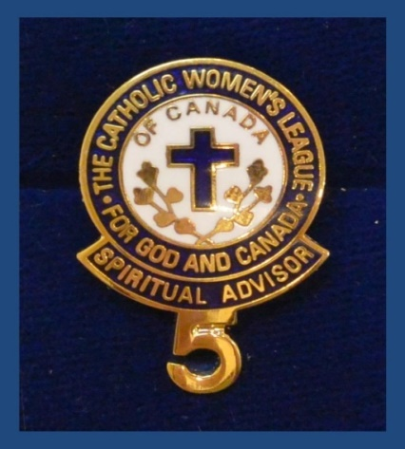
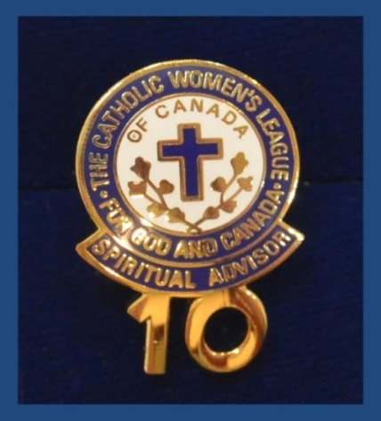
SPIRITUAL ADVISOR
Notes:
Spiritual Advisor Pins
Presented to the spiritual advisor of a council at all levels, who has taken an active interest in the spiritual life of the members and communicated the teachings of the church. The pin should be presented by individual councils as a milestone award at five year intervals.

Slide 10
MAPLE LEAF SERVICE PIN
Notes:
Maple Leaf Service Pin
Pins are awarded to members who have served the League in an exceptional or meritorious manner.
Eligibility criteria is determined by the presenting council.
This pin must be ordered by a council as a presentation item through national office.
Recipients wearing this beautiful pin are often asked where a pin can be purchased.

Slide 11
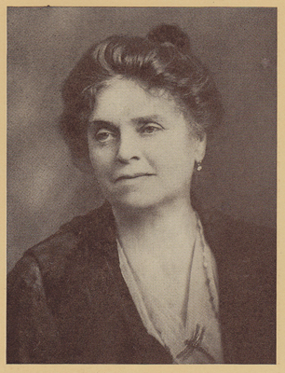
BELLELLE GUERIN PIN
Members who have a vision and a dream…
Notes:
The Bellelle Guerin Pin
• The Bellelle Guerin pin can be awarded to members who have kept the vision and dream of Bellelle Guerin alive.
• Recipients of this award have dedicated themselves to the work of the League in the parish, diocese and/or province and are not or will not eligible for life membership. Recipients waive their right to be considered for life membership at a future date when accepting this pin.
• Nomination information is available through the national office website.

Slide 12
LIFE MEMBER PIN
Nominations for life membership must be completed and forwarded by both a diocesan council and a provincial council. Guidelines are found in another module.
Notes:
Life Members
With more than 300 life members, these gifted members have been cited as ”one of the best resources available to the League membership.”
Many have served a parliamentarians, speakers, mentors, resolution and letter-writing leaders, event organizers and because of necessity, some have filled roles for parish level executives, and even as spiritual advisors.
Nomination information is available through national office and on the national website. It should be noted that the nomination must be co-signed by a diocesan council and/or a provincial council president.
Provincial life member liaisons stay in contact with life members – a service very much needed and appreciated. Through e-mails and newsletters, they keep life members informed on results of provincial meetings, of ailing and deceased members, and so much more.

Slide 13
HONORARY LIFE MEMBER PIN
Awarded to the women who have served as national president of The Catholic Women’s League of Canada.
Notes:
Honorary Life Members
This very special award is presented to women who have served as national president of The Catholic Women’s League of Canada.
This beautifully crafted pin is awarded in recognition for the recipients exemplary service to the League during their time as national president.
These women keep this special honour for the remainder of their lives.
Honorary life members serve as wonderful mentors and are an inspiration to all. When in attendance, they are introduced at meetings and conventions.

Slide 14
CERTIFICATES AND SCROLLS
National office has various certificates, scrolls and presentation holders available for purchase, including:
certificate of merit
council anniversary certificate
increase in membership certificate
leadership certificate
membership scroll and bursary certificates
Available in addition:
certificate holder
presentation folder
Notes:
Certificates and Scrolls
There are a selection of scrolls and certificates available through national office designed for your use. Take the time to look at them to see what suits your council’s needs.
The certificate of merit is available to present to members in “grateful recognition and appreciation of faithful and exceptional service.” Possible reasons for presenting this certificate would include: leadership in a soup kitchen ministry for the poor and homeless, leadership and/or participation in a prayer shawl ministry, etc.
Council anniversary certificates are presented at the diocesan and provincial levels.
Increase in membership certificates are primarily gifted by the provincial level but would also be appropriate at the diocesan level.
Membership scrolls are available for presentation to members who have served the League of a total of 25 years or more. National office will provide the scrolls, complete with the League’s seal, and the stamped signatures of the national president and national secretary-treasurer. Awarded by national council, these scrolls can be pre-ordered. The presenting council would then complete the lettering.
Bursary certificates: Many councils have established annual bursaries/scholarships that they annually present. These certificates may be used.

Slide 15
GIFT CERTIFICATE
Perfect for gift giving and inviting
other women in the parish to join the League.
Notes:
Membership Gift Certificates
We would all like to see the League grow and flourish. If every member were to invite one woman to join and mentor this person through her first year of membership, the League would have the potential to double its membership in one year… wouldn’t that be wonderful?
Your council may want to use these certificates to present to women whose membership is covered by your council such as members living in long term care facilities.

Slide 16
A TIME TO CELEBRATE
Notes:
Councils are encouraged to celebrate the wonderful work being done in councils by so many talented, dedicated Catholic women. They speak volumes about why other women should consider joining.

Slide 17
EXECUTIVE ORIENTATION
Modules:
History of the League (15 minutes)
Structure of the League and The Promise of the League (25 minutes)
Core Principles; Constitution & Bylaws; Policy and Procedure; Executive Handbook (20 minutes)
Duties of Officers (20 minutes)
Life Membership and Honorary Life Membership (20 minutes)
Strategic Plan Summary (30 minutes)
Communication (45 minutes)
Budgets (15 minutes)
Member Recognition (10 minutes) P
Public Presence and Member Development (30 minutes)
Notes:
Executive Orientation
Modules:
History of the League (15 minutes)
Structure of the League and The Promise of the League (25 minutes)
Core Principles; Constitution & Bylaws; Policy and Procedure; Executive Handbook (25 minutes)
Duties of Officers (20 minutes)
Life Membership and Honorary Life Membership (20 minutes)
Strategic Plan Summary (30 minutes)
Communication (45 minutes)
Budgets (15 minutes)
Member Recognition (10 minutes)
Public Presence and Membership Development (30 minutes)

