Slide 1
THE CATHOLIC WOMEN’S LEAGUE OF CANADA
EXECUTIVE ORIENTATION

Slide 2
EXECUTIVE ORIENTATION
Modules:
History of the League (15 minutes)
Structure of the League and The Promise of the League (25 minutes)
Core Principles; Constitution & Bylaws; Policy and Procedure; Executive Handbook (20 minutes)
Duties of Officers (20 minutes)
Life Membership and Honorary Life Membership (20 minutes)
Strategic Plan Summary (30 minutes)
Communication (45 minutes)
Budgets (15 minutes)
Member Recognition (10 minutes)
Public Presence and Member Development (30 minutes)
Notes:
Executive Orientation
Modules:
History of the League (15 minutes)
Structure of the League and The Promise of the League (25 minutes)
Core Principles; Constitution & Bylaws; Policy and Procedure; Executive Handbook (25 minutes)
Duties of Officers (20 minutes)
Life Membership and Honorary Life Membership (20 minutes)
Strategic Plan Summary (30 minutes)
Communication (45 minutes)
Budgets (15 minutes)
Member Recognition (10 minutes)
Public Presence and Membership Development (30 minutes)

Slide 3
THE CATHOLIC WOMEN’S LEAGUE OF CANADA
LIFE MEMBERSHIP AND
HONORARY LIFE MEMBERSHIP
Gifted to National by Alice Noble (QC)

Slide 4
LIFE MEMBERSHIP AND HONORARY LIFE MEMBERSHIP
Notes:
Today I have the pleasure of talking to you about life memberships and honorary life memberships.
It should be noted, it was announced in National President-Elect and Chairperson of Organization Fran Lucas’ communiqué #16, that as of March 2021, a moratorium on new life membership nominations was adopted by the national executive. This means following the 2021 annual national meeting of members, no life memberships will be granted until a full review of the designation is concluded (national winter mid-term meeting 2021).
National executive instituted this moratorium upon the recommendation of an ad hoc committee in order to review “the accountability of life members and an over-representation at annual meetings of members.” (Communiqué #16, Fran Lucas, March 15, 2021)
None the less, today we will rejoice in the life members and honorary life members we have and will explore all that these designations mean as these women are vital to the League. They are the heart of the League, its living history, our mentors and so much more.
NOTE TO PRESENTER: You may omit slides 14-17 until the moratorium of Life Membership nominations is over.

Slide 5
LIFE MEMBERSHIP AND HONORARY LIFE MEMBERSHIP
AGENDA
Definition of Life Membership
Privileges & Responsibilities of Life Membership
Responsibilities of National to Life Members
Nominating Councils & Criteria for Life Membership
Steps for Nomination of Life Membership
Honorary Life Membership Criteria
Life Membership & Honorary Life Membership Pins
Gifts of Life Members to the League
Question Period
Notes:
Today we will look at:
What life membership is and is not.
What the privileges and responsibilities are of life members.
What are the responsibilities national council has towards life and honorary life members?
We will review who can nominate candidates for life membership and the criteria for life membership. You will see how these women have dedicated themselves to the League well before they became life members.
We will look at the steps for nomination and even describe them in detail. NOTE: you can skip over the detailed explanation of the steps for nomination until the moratorium on nominations is over.
We will look at the criteria for honorary life membership the highest distinction in the League and have a look at the pins given to life members and honorary life members to wear.
We will conclude with an acknowledgement of why life and honorary life members are gifts to the League.

Slide 6
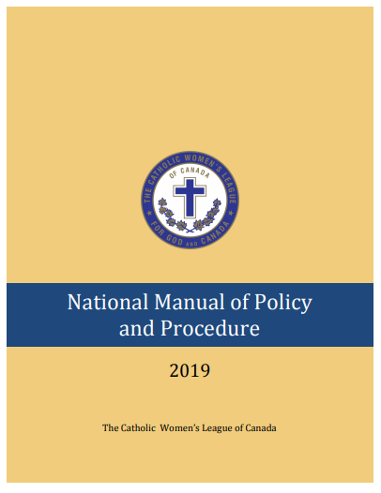
LIFE MEMBERSHIP
QUIZ & ANSWERS:
Where do you find information on life membership?
NATIONAL MANUAL OF POLICY AND PROCEDURE
Definition, criteria, application, approval pages 32-34
Conferring of life membership pin, page 37
Comparison to other awards & pins, pages 37-39
League magazine, page 132
National database, page 173
Link to document
Notes:
The National Manual of Policy and Procedure is a core resource for each member of every executive at all levels to have on hand.
It is available on the League website so you do not even need to have a hard copy!
If you want a hard copy, you can print it yourself off the website, or order it from national office.
Note to Presenter: The National Manual of Policy and Procedure will be undergoing a comprehensive revision in 2021, and the page numbers listed on this slide may not correspond beyond September 2021.

Slide 7
LIFE MEMBERSHIP
WHAT IS LIFE MEMBERSHIP?
“In The Catholic Women’s League of Canada, life membership… (is an) honour…”
Life membership is a “privilege” that “entails responsibility”.
Life membership is a promise and a call to active service and support to councils at all levels.
Notes:
Life membership is a unique and important category of membership in the League.
While it is NOT an award, it is a recognition for a member’s experience through her service at all levels in the League, her dedication to the League and her sisters, and her deep knowledge and love of the League and all members.
It is a commitment to continue to serve the League by its recipient, whenever called upon. Life member nominees are asked if they are ready and want to accept a life membership. Always in the service to God and God’s people, inspired by our patroness and the Holy Spirit.
It is very important to remember that life membership is a call to service. When thinking of nominating someone, diocesan and provincial executives should be sure this is an appropriate bestowment of privilege for a member.
If the fit is not quite right, there are other forms of recognition that may be appropriate such as the Bellelle Guerin pin, the maple leaf service pin or a certificate of merit. Each is a way of recognizing outstanding contributions made to a council and the League, but only a life membership is a promise to keep doing more.

Slide 8
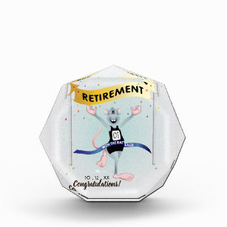
LIFE MEMBERSHIP
WHAT IS NOT PART LIFE MEMBERSHIP?
Life membership is not a reward for years of service.
Life membership is not a retirement gift.
Life members do not attend parish, diocesan or provincial executive meetings unless invited or appointed to a position.
Notes:
Not everyone should be nominated for life membership:
It is not a reward for long-term membership and service - it is an award asking for more service!
It is not a retirement gift - it’s an invitation to keep right on working for the League
Life members do not get to automatically attend parish, diocesan and provincial executive meetings - they get to mentor or sit on committees if invited to do so.
Life membership does not mean permanent positions on council executives – it is an invitation to get others to take on roles with their support and guidance.

Slide 9
LIFE MEMBERSHIP
WHAT ARE THE PRIVILEGES OF LIFE MEMBERSHIP?
Life members are permanent members of national council.
Life members can be appointed to committees of national council.
Life members receive notice of the annual meetings of members, copies of the minutes and all relevant mailings, upon request.
They have voting rights as accredited delegates at national conventions, at all levels.
Notes:
Life membership comes with privileges, duties and responsibilities by the League towards the recipient and by the life member to the League.
Let’s look at what the privileges of life membership are:

Slide 10
LIFE MEMBERSHIP WHAT ARE THE PRIVILEGES OF LIFE MEMBERSHIP?
In the provincial council in which they have membership, they have accredited delegate voting privileges at diocesan and provincial conventions.
New life members are officially recognized by national council at the annual national convention, in the national annual report and will appear in the Fall issue of The Canadian League.
In the event of the death of… an honorary life member, an obituary and picture will be published; for life members, an obituary notice will be published.

Slide 11
LIFE MEMBERSHIP
WHAT ARE THE RESPONSIBILITIES OF LIFE MEMBERSHIP?
Life members promise to support national council.
They promise to be active and take on requests as made by national council.
Life members promise to support their parish, diocesan and provincial councils in committee work and as mentors.
They are responsible for registering themselves for diocesan, provincial and national conventions and for all the costs associated with attending these conventions.
Life members are expected to pay their own annual membership fees through their parish council.
Notes:
So, What are the responsibilities of a life member?
To support the national council
To be active and work for the national council
To support their parish, diocesan and provincial councils in committee work and as mentors
For conventions, they are responsible for their own registration and costs.
To pay their own annual membership fees.

Slide 12
LIFE MEMBERSHIP
WHAT ARE THE RESPONSIBILITIES AND TRADITIONS OF THE NATIONAL EXECUTIVE TO LIFE MEMBERS?
to ensure nominees meet the criteria
to keep life members informed about national council activities: conventions, committees, …
to invite life members to participate in national initiatives
to publicly recognize honorary life members and officiate the new life member ceremony at national convention
to recognize new life members in The Canadian League
to publish notice of death of an honorary life member or life member
Notes:
The national executive also has responsibilities towards its life members as they are considered permanent members of the national council.
Ensure nominees meet the criteria.
Inform life members on national council activities.
Invite life members to participate in national initiatives.
Recognize its honorary life members at national conventions.
Inform the membership of new life members by publishing a short biography in the fall issue of The Canadian League magazine.
To inform the membership of the death of honorary life members and life members in the appropriate manner as outlined in the National Manual of Policy and Procedure.

Slide 13
LIFE MEMBERSHIP
WHO CAN NOMINATE A MEMBER FOR LIFE MEMBERSHIP?
At an executive meeting, only diocesan and provincial executives may nominate a member to become a life member with a motion and a majority vote in favour.
Diocesan and provincial executives must ensure that a candidate meets all the criteria as defined in the National Manual of Policy and Procedure
Notes:
As it stands now in the National Manual of Policy and Procedure, should the moratorium on life membership nominations be lifted,
Only diocesan and provincial council executives may nominate a member for life membership.
They must do so responsibly by making sure the potential nominee meets the criteria for life membership.
They must NOT nominate someone just because “it is time” or traditional to do so after a certain time as a member of the diocesan and provincial councils.

Slide 14
LIFE MEMBERSHIP
CRITERIA FOR LIFE MEMBERSHIP
The nominee must have been a member of the League in good standing for at least 10 years.
All nominees must have been a diocesan or provincial president.
The nominee must have held executive positions at diocesan level for a minimum of four years.
The nominee must have held executive positions at provincial level for a minimum of four years, not to include term served as diocesan president, at the time she is presented with her life membership.
The nominee must have demonstrated her love of the League, her encouragement of others and her ability to participate in study, research, presentations, workshops, etc.
Notes:
Here is a copy of the criteria as dictated in the National Manual of Policy and Procedure, under Life Membership, page 33. [The page number is subject to change with any P&P revision.]
As you see as we review the criteria, candidates will have demonstrated long service and dedication to the League as seen in criteria 1-4. Their participation in diocesan and provincial levels also demonstrates their deep knowledge of the League and its workings and works. Note: The four years of service at provincial level must be completed at the time the life membership is given.
Criteria 5 means the candidate must have also participated in special projects and activities for the League over and above her service on executives. For example, giving workshops, acting as a mentor to new members, sitting on annual meeting/convention committees, sitting on diocesan, provincial and national committees and more. These are women who have shared their gifts often and in many ways.

Slide 15
LIFE MEMBERSHIP
CRITERIA FOR LIFE MEMBERSHIP
The nominee must be available and willing to continue to serve the League at national level on committees, preparing briefs, researching reports and resolutions, facilitating workshops and attending conferences at the request of the national president.
SPECIAL NORMS
In Ontario, with 13 diocesan councils, criterion #4 may be waived, providing the nominee has served in executive positions at diocesan level for a minimum of eight years. In this situation, years served at diocesan level must include two years as diocesan past president at the time of the anticipated date of presentation.
In provinces with no diocesan councils, Military Ordinariate, New Brunswick, Newfoundland and Labrador, and Prince Edward Island, criterion #3 may be waived, providing the nominee has served in executive positions at provincial level for a minimum of eight years.
Notes:
Criteria 6 is very important because once nominated, the candidate must reflect and accept the responsibilities of life membership including the commitment to continue to actively serve the League.
There are special norms for provincial councils with special circumstances.
For example:
Provincial councils with vast membership and thus many diocesan councils, like in Ontario.
Provincial councils where the regular organizational structure of the League is slightly different.
All this to remind you that life membership is not given lightly and is both an acknowledgment of past service, dedication and knowledge of the League and love and commitment to continued service to the League.

Slide 16
STEPS FOR NOMINATION
Nomination for Life Membership
Life Member Nominee Questionnaire
Life Membership Checklist
Notice of Nomination
to national office
September 15
Life Membership Package
to nominating council
Complete Nomination for Life Membership
Motion to approve
Motion to nominate
to national office
Life Membership Checklist by
Provincial President
National office
verifies
Criteria 1-4 met
Life Member Nominee Questionnaire and nominee
Signatures of both levels
December 15
$200, date
for presentation
to national office
to national chairperson of organization
National chairperson of organization reviews criteria
and prepares list of all nominees
National executive accepts life members by motion
(Winter meeting)
Notification to parish, diocesan, provincial
Pin & scroll sent to nominating council
February 1
National, Provincial, Diocesan, Parish, Diocesan or Provincial, Diocesan & Provincial
Notes:
The process from nomination to acceptance can seem daunting and with many steps.
This is a flow chart outlining each step which demonstrates that several levels of the League are involved in the process.
Each arrow has a colour to represent the responsibilities of the following councils:
national (red)
provincial (green)
diocesan (purple)
parish (blue)
diocesan or provincial nominating executive (light green)
diocesan and provincial (pink)
When there is a time sensitive step, a small clock appears.
Pictograms represent the different forms in question as found in the National Manual of Policy and Procedure (we will see them later).
The next seven slides relate to the nomination steps of for life membership. You may only want to use this part of the module once the moratorium on nominating candidates for life membership is lifted.

Slide 17
STEPS FOR NOMINATION
Nomination for Life Membership
Life Member Nominee Questionnaire
Life Membership Checklist
Notice of Nomination
to national office September 15
Life Membership Package
to nominating council
Complete Nomination
for
Life Membership
Motion to approve
Motion to nominate
National, Provincial, Diocesan, Parish, Diocesan or Provincial, Diocesan & Provincial
Notes:
First Row (Left to Right)
A diocesan or provincial executive agrees through a motion and majority vote in favour to nominate a candidate.
Notice of Nomination for Life Membership form is
completed by nominating diocesan or provincial executive
signed by the secretary and president (if you are nominating the provincial president, the provincial past president should sign instead)
submitted to national office by September 15th
National forwards to the nominating executive the Life Membership Package: (Also found on the website under “To Organize”, “500 Series: Forms”).
Criteria for Life Membership
Nomination Form for Life Membership
Life Member Nominee Questionnaire
Life Member Checklist
The Nomination for Life Membership form is completed by the nominating diocesan or provincial executive and is sent to the provincial executive.
The provincial executive approves the Nomination for Life Membership by motion majority vote.

Slide 18
STEPS FOR NOMINATION
Nomination for Life Membership
Life Member Nominee Questionnaire
Life Membership Checklist
To national office
Life Membership Checklist by
Provincial President
National office
verifies
Criteria 1-4 met
Life Member Nominee Questionnaire
& nominee
Signatures of
both levels
December 15
National, Provincial, Diocesan, Parish, Diocesan or Provincial, Diocesan & Provincial
Notes:
Second row (right to left)
The Nomination for Life Membership form is then signed by the nominating council secretary and by both the diocesan and provincial presidents. (If you are nominating one of these presidents, the past president should sign instead).
The nominating executive completes the contact information on the Life Member Nominee Questionnaire which is then completed by the nominee.
National office verifies the nominee meets the criteria for life membership (#1-4) and confirms this to the nominating executive.
The provincial president (or provincial past president if nominating the provincial president) verifies all the forms are complete and uses the Life Membership Checklist to ensure eligibility.
The nominating executive sends the completed Nomination for Life Membership, Life Member Nominee Questionnaire* and the Life Membership Checklist (signed by the provincial secretary thus confirming provincial council executive support) to national office by December 15th. *Note: The nominee herself completes the Life Member Nominee Questionnaire and sends copies to the nominating council, the provincial president and national office by December 15th.

Slide 19
STEPS FOR NOMINATION
Nomination for Life Membership
Life Member Nominee Questionnaire
Life Membership Checklist
$200, date for
presentation
to national
to national chairperson of organization
National executive approves life
members by motion
(Winter meeting)
Notification to
parish, diocesan, provincial
Pin and scroll sent to nominating council
National chairperson of organization
prepares list of all nominees
February 1
National, Provincial, Diocesan, Parish, Diocesan or Provincial, Diocesan & Provincial
Notes:
Third row (left to right)
The nominating diocesan or provincial executive must submit the Life Member Checklist for the Provincial Council, a cheque for $200.00 and the date on which the life membership will be presented to national office by February 1st.
National office sends the Nomination for Life Membership and the Life Member Nominee Questionnaire forms to the national chairperson of organization for confirmation that the nominee meets all the criteria for eligibility.
The national chairperson of organization prepares a list of all those who have met the criteria for life membership for the national executive/board.
The board accepts nominees on the basis of the provincial executive’s recommendation (#9, previous slide) to receive a life membership by motion and majority vote at the Winter meeting.
Once the board has approved a life membership, the recipient’s parish, diocesan and provincial executives are notified; a pin and scroll are sent to the nominating diocesan or provincial executive prior to the anticipated date of presentation.

Slide 20
STEPS FOR NOMINATION
Nomination for Life Membership
Life Member Nominee Questionnaire
Life Membership Checklist
Notice of Nomination
to national office
September 15
Life Membership Package
to nominating council
Complete Nomination for Life Membership
Motion to approve
Motion to nominate
to national office
Life Membership Checklist by
Provincial President
National office
verifies
Criteria 1-4 met
Life Member Nominee Questionnaire & nominee
Signature of both levels
December 15
$200, date
for presentation
to national office
to national chairperson of organization
National chairperson of organization
prepares list of all nominees
National executive accepts life members by motion
(Winter meeting)
Notification to parish, diocesan, provincial
Pin and scroll sent to nominating council
February 1
National, Provincial, Diocesan, Parish, Diocesan or Provincial, Diocesan & Provincial
Notes:
Now that we have reviewed the complete process, are there any questions?

Slide 21
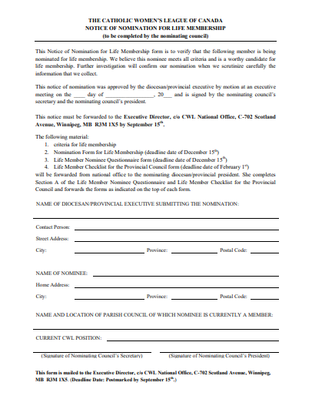
LIFE MEMBERSHIP
NOTICE OF NOMINATION
Link to Manual of Policy & Procedure
Notes:
The Life Membership Application Package can be found on the national website under “To Organize”, “500 Series: Forms.”
Here is the Notice of Nomination For Life Membership Form.
This form starts the whole process and is used to advise national office of a diocesan or provincial executive’s intent to nominate a member.
It is this form that national will use to verify that the nominee meets criteria 1-4.

Slide 22
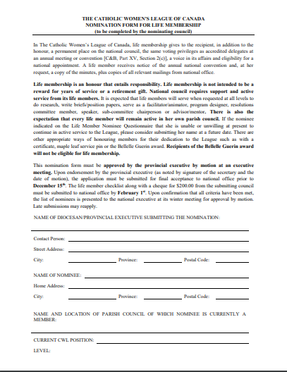
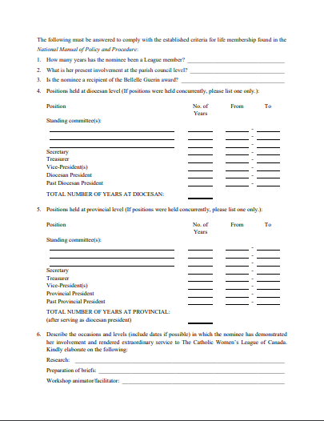
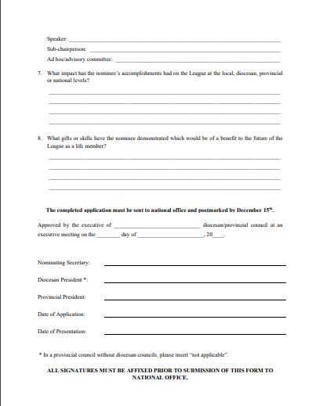
LIFE MEMBERSHIP
NOMINATION FORM
Link to Manual of Policy & Procedure
Notes:
Here is the Nomination for Life Membership form to be completed by the nominating diocesan or provincial executive and submitted to national office. National office then confirms that criteria 1-4 are met, before supplying the next set of forms.

Slide 23
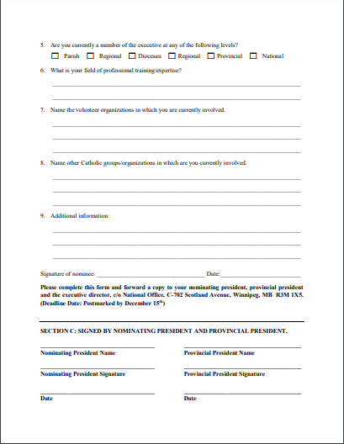
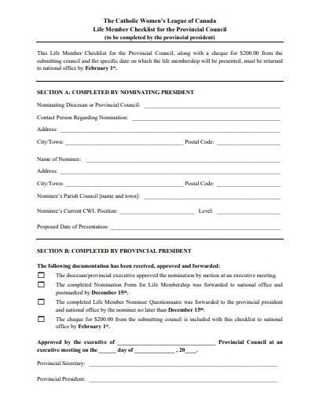
LIFE MEMBERSHIP
QUESTIONNAIRE
CHECKLIST
Link to Manual of Policy & Procedure
Notes:
Here is the Life Member Nominee Questionnaire that the member nominated completes herself.
The member being nominated completes this form as she often knows best all the activities she has been involved with over the years!
This is also a moment for the nominee to reflect on her past experience, her love of the League and her willingness to continue to contribute and serve.
It is also the moment at which a nominee must evaluate if she is able to fulfill all the responsibilities of being a life member as outlined earlier. There is no harm in asking to delay a nomination or in respectfully declining a nomination because of a lack of time, illness, or whatever.
If a nominee declines an offer to become a life member, look at other forms of recognition the council may consider offering her. The council would not have nominated her if she did not have special gifts to be thanked for and to offer.

Slide 24
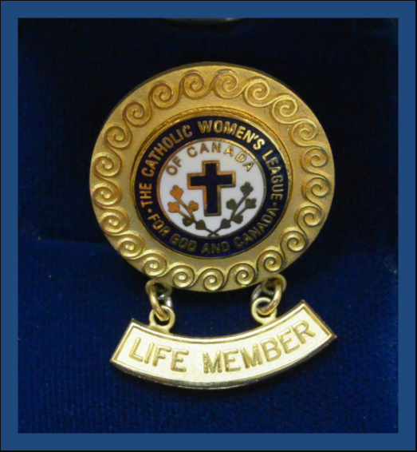
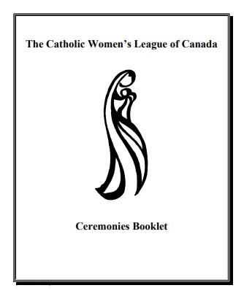
LIFE MEMBERSHIP
PRESENTATION OF LIFE MEMBERSHIP
Notes:
Once the diocesan or provincial executive’s candidate for life membership has been approved by the national executive/board, it is time to present the life membership pin and scroll.
Do you know when and how this should be presented?
The life membership pin and scroll should be presented at the annual convention of the nominating executive, thus, the annual diocesan or provincial convention.
All new recipients who have received their life membership pin and scroll at the diocesan convention, should also be acknowledged at the provincial convention. (Either named, or some councils have a short recognition ceremony – it is up to the provincial council).
All new recipients who attend the national convention will be recognized during the convention.
The how:
Usually, the life membership pin and scroll are presented either during the convention or at the closing mass of the convention, with the spiritual advisor of the submitting council presiding (diocesan or provincial convention).
Should a recipient not be able to attend the convention, the life membership pin and scroll may be presented at the next council meeting during mass. COVID-19 meant that some ceremonies were held in parks, driveways and near-empty churches, but were always presented with reverence and joy.
Councils should use the Ceremony for the Presentation of Service Awards found in the Ceremonies Booklet (cwl.ca; To Organize: Series 600: Manuals: 603 - Ceremonies Booklet).

Slide 25
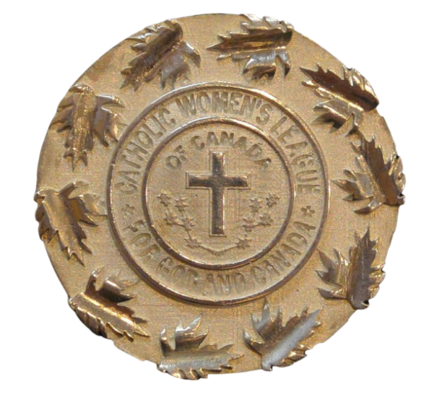
HONORARY LIFE MEMBERSHIP
CRITERIA FOR HONORARY LIFE MEMBERSHIP
Only past national presidents are honorary life members.
Honorary life membership is awarded to the national president upon completion of her term of office.
Notes:
Honorary Life Membership:
This is the highest honour in the League and is an exclusive one only awarded to past national presidents.
It is an automatic award given immediately at the end of a national president’s mandate.
It is an immense gift these women have given to the League. The League and all its members acknowledge that gift with the honorary life membership status.
You will recognize these ladies who sit at a table together each summer at the annual national convention.
Take the time to go up to these members and thank them for their years and years of service. Ask them questions as they are a fountain of knowledge!

Slide 26
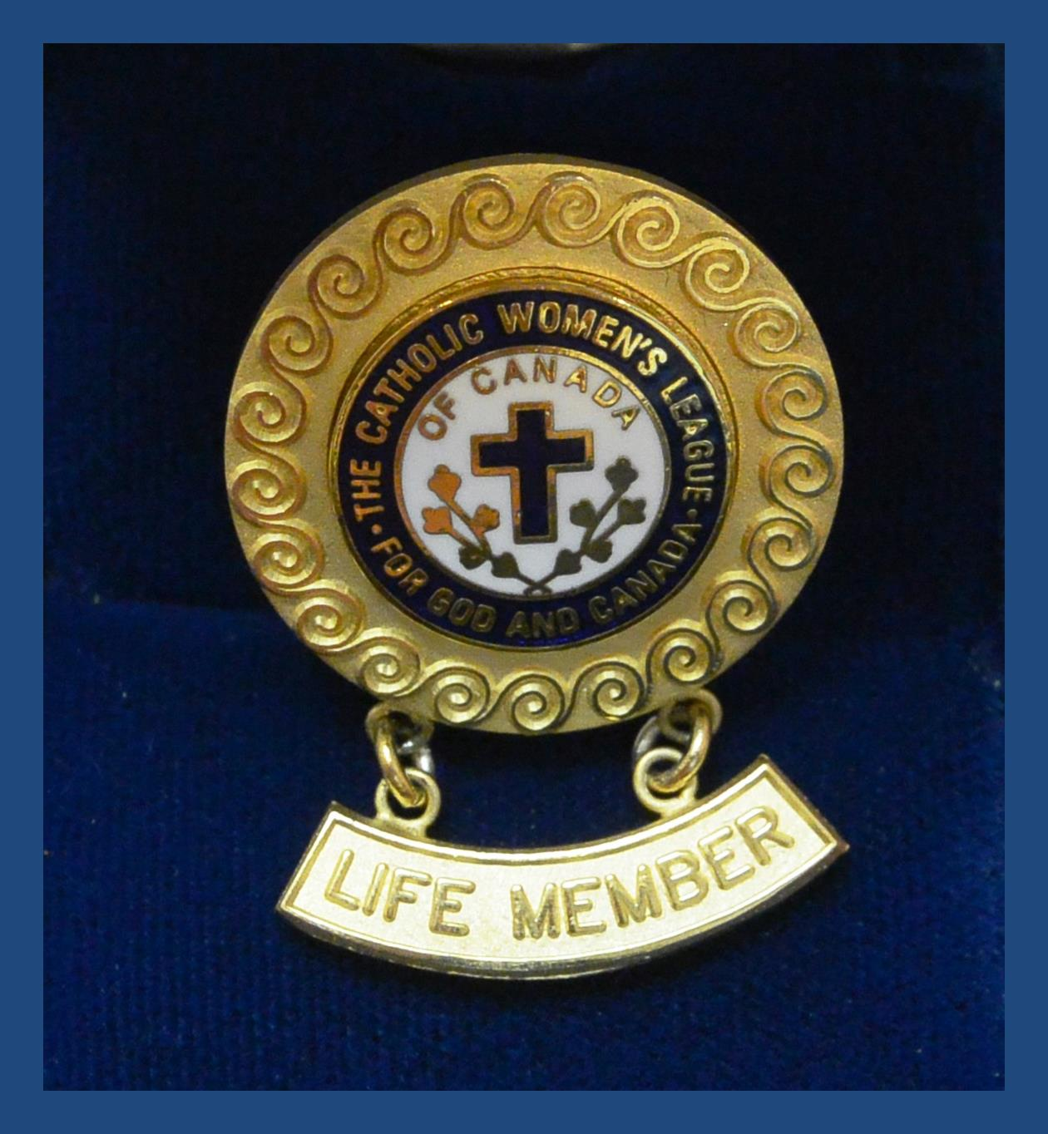
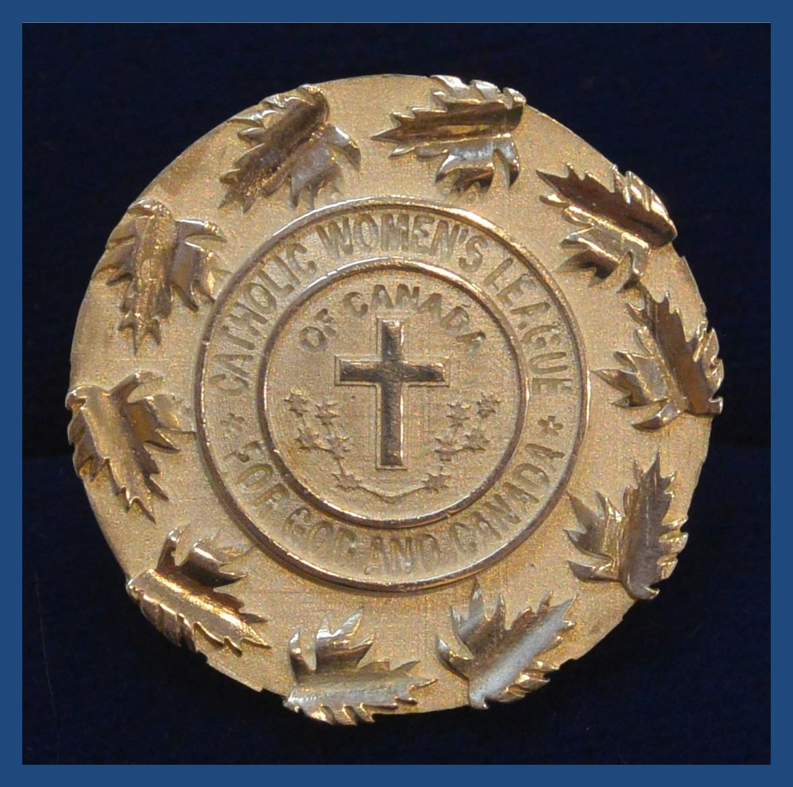
HONORARY LIFE AND LIFE MEMBERSHIP
LIFE MEMBER PIN
is presented to members awarded life membership
takes precedence over all other League pins, except the national president pin and honorary life member pin
should be worn on all official occasions
HONORARY LIFE MEMBER PIN
is awarded to each retiring national president at the termination of her term of office
takes precedence over all other League pins
should be worn on all official occasions
Notes:
So, as you see it is not easy to receive a life membership and it requires exceptional time and service to receive the honorary life membership.
Life membership and honorary life memberships are so special and so valued by the League, special pins have been designed and are given to each recipient.
These pins hold a special place and are therefore worn alone by these women at all official CWL functions as they take precedence over all other League pins.

Slide 27
HONORARY LIFE AND LIFE MEMBERSHIP
THE GIFT OF LIFE MEMBERS
Honorary and life members are the living history of the League.
They are important resources for all councils.
Honorary and life members are resources for all members and especially members of executives.
They are mentors to all members.
Honorary and life members are gifts to every member of the League.
Notes:
Why are these women so important to the League and to each member of the League? Because they are gifts to us all.
Be sure to invite your life members and honorary life members to mentor up-an-coming leaders, give workshops, share anecdotes about the past and support you when you need help or advice.
Please remember to honour and publicly identify and name these ladies at meetings, conventions and all events.
Honorary life members should be identified separately from other life members.
Above all, we thank honorary life members and life members for their love of the League and continued service to members.
We also give thanks to God for blessing us with them.

Slide 28
LIFE MEMBERSHIP AND HONORARY LIFE MEMBERSHIP
Notes:
THANK YOU!

Slide 29
EXECUTIVE ORIENTATION
Modules:
History of the League (15 minutes)
Structure of the League and The Promise of the League (25 minutes)
Core Principles; Constitution & Bylaws; Policy and Procedure; Executive Handbook (20 minutes)
Duties of Officers (20 minutes)
Life Membership and Honorary Life Membership (20 minutes) P
Strategic Plan Summary (30 minutes)
Communication (45 minutes)
Budgets (15 minutes)
Member Recognition (10 minutes)
Public Presence and Member Development (30 minutes)
Notes:
Executive Orientation
Modules:
History of the League (15 minutes)
Structure of the League and The Promise of the League (25 minutes)
Core Principles; Constitution & Bylaws; Policy and Procedure; Executive Handbook (25 minutes)
Duties of Officers (20 minutes)
Life Membership and Honorary Life Membership (20 minutes)
Strategic Plan Summary (30 minutes)
Communication (45 minutes)
Budgets (15 minutes)
Member Recognition (10 minutes)
Public Presence and Membership Development (30 minutes)

