Slide 1
THE CATHOLIC WOMEN’S LEAGUE OF CANADA
EXECUTIVE ORIENTATION

Slide 2
EXECUTIVE ORIENTATION
Modules:
History of the League (15 minutes)
Structure of the League and The Promise of the League (25 minutes)
Core Principles; Constitution & Bylaws; Policy and Procedure; Executive Handbook (20 minutes)
Duties of Officers (20 minutes)
Life Membership and Honorary Life Membership (20 minutes)
Strategic Plan Summary (30 minutes)
Communication (45 minutes)
Budgets (15 minutes)
Member Recognition (10 minutes)
Public Presence and Member Development (30 minutes)
Notes:
Executive Orientation
Modules:
History of the League (15 minutes)
Structure of the League and The Promise of the League (25 minutes)
Core Principles; Constitution & Bylaws; Policy and Procedure; Executive Handbook (25 minutes)
Duties of Officers (20 minutes)
Life Membership and Honorary Life Membership (20 minutes)
Strategic Plan Summary (30 minutes)
Communication (45 minutes)
Budgets (15 minutes)
Member Recognition (10 minutes)
Public Presence and Membership Development (30 minutes)

Slide 3
THE CATHOLIC WOMEN’S LEAGUE OF CANADA
HISTORY OF THE LEAGUE
Gifted to National by Joline Belliveau (NS); Gay Garvey (PE); Crystal Reiter (MB)

Slide 4
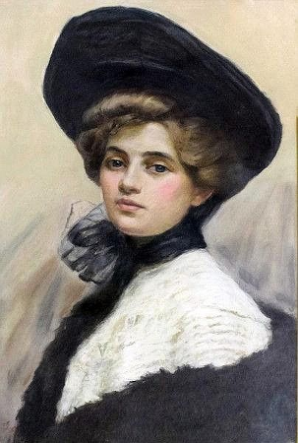
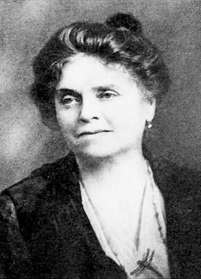
HISTORY OF THE LEAGUE
1891
1912
1921
.1
..1
- Rerum Novarum “participation of laity in the apostolate of the hierarchy”
- Origin of the name Catholic Women’s League in England
- Katherine Hughes organizes CWL in Canada
- Affiliation with WUCWO, still enjoyed today
- 1st annual national convention in Toronto
1906
1920
- Margaret Fletcher, founder of national organization for Catholic women in England
- First National President Bellelle Guerin elected
www.free-powerpoint-templates-design.com
Notes:
Animation 1: The history of The Catholic Women’s League of Canada began with the papal encyclical Rerum Novarum by Pope Leo XIII, May 18, 1891. This set the church on a dramatic path into the 20th century, calling for workers to have rights to dignity, to form unions, to just wages and to fair working conditions. Later, Pope Pius XI called for Catholic lay action designated as “the participation of the laity in the apostolate of the hierarchy.”
Animation 2: In 1906, this call was heard in England by Margaret Fletcher. She founded a national organization for Catholic women, a non-political organization for the formation of religious and intellectual interests, as a response to the call for Catholic lay action and to address the severe socio-economic needs of the working classes in Britain.
Animation 3: The name “Catholic Women’s League” originated in England in 1912. Word spread across the Atlantic, and in 1910, the call for lay action was brought to the Eucharistic Congress in Montreal by Cardinal Bourne of Westminster. He called for all English-speaking women of Canada to create one union and affiliate with similar groups forming in England and other European countries. About the same time, Katherine Hughes of Edmonton became aware of the Catholic Women’s League in England while travelling overseas and brought the message home to her bishop. Many young immigrant women were finding their way to western cities. Bishop Legal recognized the need for organized assistance for these women and called upon Katherine Hughes and Abbe Casgrain to organize a meeting held on November 7, 1912. The group that formed was called the Catholic Women’s League, after the English group, with objectives to provide protection and support to women and girls, especially immigrants seeking work in Edmonton.
Animation 4: Catholic women’s groups in Canada were forming in the major cities of Montreal (1917), Toronto (1918) and Halifax (1919), with each group functioning in its own territory, whether in a parish or diocese. In 1918, all nationally organized groups were called to Ottawa to share their opinions with the federal government about the settling of immigrants flocking to Canada. However, there was no national organization of Catholic women represented. Loretta Kneil, sister of Katherine Hughes, contacted Bellelle Guerin, president of the Catholic Women’s Club of Montreal, who subsequently met with the federal minister and was inspired to push for such a national organization. Invitations were sent to cities where the League was established locally and to other centres with societies of Catholic women in Hamilton, St. Catharines and Saint John. The first conference was held in Montreal, and on June 17, 1920, The Catholic Women’s League of Canada was founded and placed under the patronage of the Canadian hierarchy, with Bellelle Guerin of Montreal elected first national president. Present at the organizational meeting were representatives from the future subdivisions of Edmonton, Halifax, Hamilton, Montreal, Ottawa, Regina, Saint John, Sherbrooke and Toronto.
More than one hundred “sub-divisions” (councils) were organized within the first year by women travelling across the vast country by train, visiting small and large centres in every diocese, inspired by the motto “For God and Canada.”
Animation 5: In 1921, the League affiliated with the International Union of the Catholic Women, now known as the World Union of the Catholic Women’s Organisations (WUCWO), an affiliation still enjoyed today. Also in 1921, the first annual national convention of The Catholic Women’s League of Canada was held in Toronto. At the convention, delegates produced a constitution, a set of by-laws and the beginnings of a publication, The Canadian League.

Slide 5
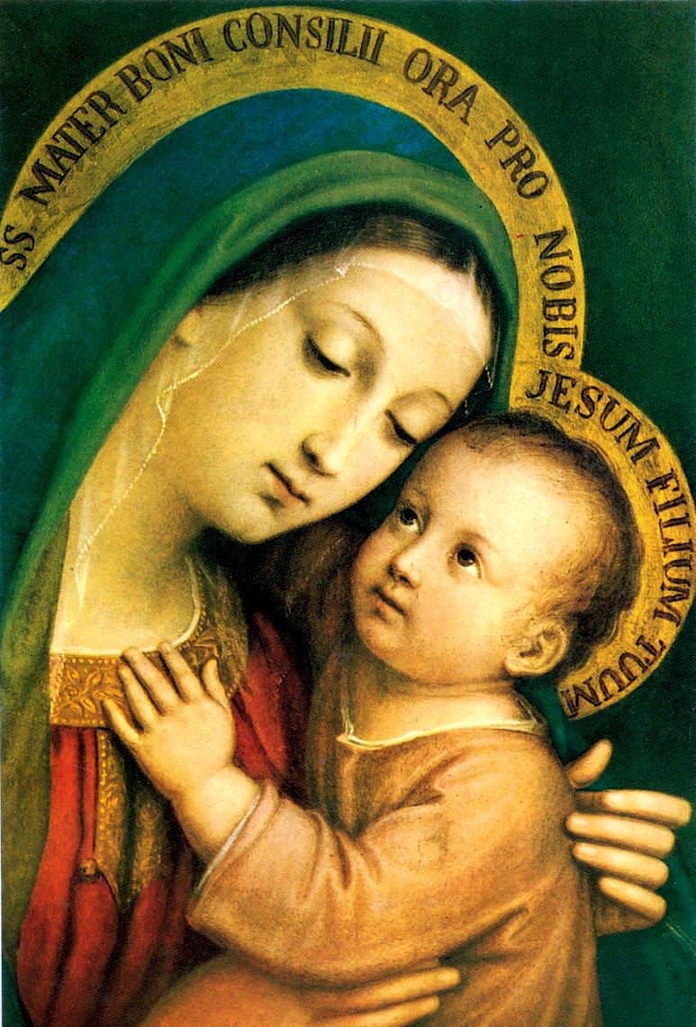
HISTORY OF THE LEAGUE
1922
1927
1947
- League crest and seal
- Objects of the League
- Fund founded to financially support women
- Provincial councils were organized
1923
1938
-Incorporated federally
-Adoption of Patroness Our Lady of Good Counsel
- Business and professional women organized CWL councils in major cities
Notes:
Animation 1: In 1922, the League crest and seal—the cross surmounting the maple leaves with the words “The Catholic Women’s League of Canada - For God and Canada” in the surrounding circle was designed by Mrs. Emmett Mullally. The Objects of the League became the cornerstone for all League activity.
Animation 2: In 1923, the League incorporated federally. At the 1923 national convention in Halifax, a resolution was made to adopt Our Lady of Good Counsel as the League’s patroness, feast day April 26th. Pope Pius XII granted the privilege of celebrating the Feast of Our Lady of Good Counsel on April 26, 1955. Then after Vatican ll, this feast and many others were deleted from the liturgical calendar and Saturdays were set aside for votive masses in honour of the Blessed Mother. Still CWL councils and members are encouraged to celebrate the Feast of Our Lady of Good Counsel on or around April 26th every year. The picture in the slide is the version approved by the board of directors. The patroness may only be approved by a vote of the membership, which is occurring in 2022.
Animation 3: In 1927, a national scholarship fund was established to assist Catholic female students, and for many years, this was given for graduate studies in social work.
Animation 4: The year 1938 saw the organization of Business & Professional Women’s CWL councils in some major cities across Canada.
Animation 5: In 1947 and 1948, the organization of the first provincial councils of the League occurred, allowing for coordinated action on matters of provincial jurisdiction.
In 1948, the League was mandated by the Canadian Catholic Conference of the Hierarchy (now the Canadian Conference of Catholic Bishops (CCCB)) and under the patronage of His Eminence James C. Cardinal McGuigan DD, until his death in 1975.

Slide 6
HISTORY OF THE LEAGUE
1965
1970
1988
- The Military Vicariate Council formed
- Leadership courses
- National officers met with federal government
- Name changed to Military Ordinariate Provincial Council
1969
- 1% commitment to Development & Peace
-fund donated to Coady International
1980
- Newfoundland joined the CWL
Notes:
Animation 1: In 1965 the Military Vicariate Council was formed to coordinate the councils established on military bases and was given provincial council status.
Animation 2: In 1969, following Canada’s leadership, the countries of the Organization for Economic Cooperation and Development (OECD) pledged to assign 0.7% of their Gross National Income (GNI) to development assistance. The CCCB established the Canadian Catholic Organization for Development and Peace (CCODP) in response. The League adopted by motion a 1% commitment to the CCODP. Councils were invited to contribute 1% of their budgets, and members 1% of all monies spent on luxury items.
Animation 3: During the 1970s, leadership courses were formulated. National officers presented resolutions adopted by the national council to members of parliament on Parliament Hill.
Animation 4: In 1980, Newfoundland joined the League as a provincial council.
Animation 5: In 1988, the name of the Military Vicariate Council was changed to Military Ordinariate Provincial Council.

Slide 7
HISTORY OF THE LEAGUE
1992
2007
2017
ç
ç
- League Mission Statement
- Catholic Girls League
(ages 10-15)
- Strategic Planning Steering Committee
2005
- Recognized by CCCB as an association of the faithful
2014
- Catholic Women’s Leadership Foundation incorporated
Notes:
Animation 1: In 1992, the League adopted its first Mission Statement. In 2020, the Mission Statement was simplified as part of the five-year strategic plan.
Animation 2: Since its inception, the League has many times sought the guidance of Canadian Catholic bishops and priests. Since 1976, the League has been privileged to be under the patronage of the CCCB. In 2005, the League was canonically recognized by the CCCB as a national private association of the faithful.
Animation 3: In 2007, the Catholic Girls League was created as a parish-based program for girls between the ages of 10 and 15.
Animation 4: In 2014, in partnership with the Sisters of Service, the League incorporated and funded the Catholic Women’s Leadership Foundation
Animation 5: As membership has slowly declined and society has gradually become more secular, it was determined a change and a review of the entire League were needed, hence the adoption of the strategic plan in August 2018. This process begin with a town hall in 2017 at the national convention in Charlottetown, Prince Edward Island, and the selection of a steering committee took place.

Slide 8
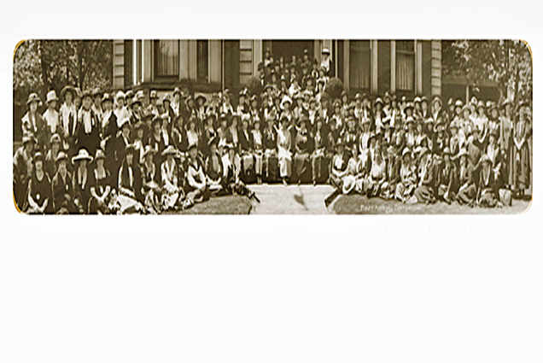
HISTORY OF THE LEAGUE
2018
Implementation committee formed and a 5-year plan was developed
The Catholic Women’s League of Canada Convention (1921), Toronto, Ontario
Notes:
Animation 1: In 2018, after a 24 month period of developing a strategic plan, the plan was adopted and implementation over a five year period began.
Summary Comments:
Diocesan, provincial and national levels are financed through per capita fees paid by the membership. Parish councils fundraise to fund activities and projects.
The spiritual growth of members both individually and collectively has always been a primary focus of the League. In addition to the spiritual growth of members, the League's activities since its original purpose of aiding immigrants have broadened. In recent years emphasis has been on issues concerning human dignity, social justice, the sanctity of life from conception to natural death and the preservation of Christian family life.

Slide 9
HISTORY OF THE LEAGUE
Notes:
This ends the PowerPoint presentation on the History of the League. Thank you so much for your time and attention today.
Any questions?

Slide 10
EXECUTIVE ORIENTATION
Modules:
History of the League (15 minutes) P
Structure of the League and The Promise of the League (25 minutes)
Core Principles; Constitution & Bylaws; Policy and Procedure; Executive Handbook (20 minutes)
Duties of Officers (20 minutes)
Life Membership and Honorary Life Membership (20 minutes)
Strategic Plan Summary (30 minutes)
Communication (45 minutes)
Budgets (15 minutes)
Member Recognition (10 minutes)
Public Presence and Member Development (30 minutes)
Notes:
Executive Orientation
Modules:
History of the League (15 minutes)
Structure of the League and The Promise of the League (25 minutes)
Core Principles; Constitution & Bylaws; Policy and Procedure; Executive Handbook (25 minutes)
Duties of Officers (20 minutes)
Life Membership and Honorary Life Membership (20 minutes)
Strategic Plan Summary (30 minutes)
Communication (45 minutes)
Budgets (15 minutes)
Member Recognition (10 minutes)
Public Presence and Membership Development (30 minutes)

