Slide 1
THE CATHOLIC WOMEN’S LEAGUE OF CANADA
EXECUTIVE ORIENTATION

Slide 2
EXECUTIVE ORIENTATION
Modules:
History of the League (15 minutes)
Structure of the League and The Promise of the League (25 minutes)
Core Principles; Constitution & Bylaws; Policy and Procedure; Executive Handbook (20 minutes)
Duties of Officers (20 minutes)
Life Membership and Honorary Life Membership (20 minutes)
Strategic Plan Summary (30 minutes)
Communication (45 minutes)
Budgets (15 minutes)
Member Recognition (10 minutes)
Public Presence and Member Development (30 minutes)
Notes:
Executive Orientation
Modules:
History of the League (15 minutes)
Structure of the League and The Promise of the League (25 minutes)
Core Principles; Constitution & Bylaws; Policy and Procedure; Executive Handbook (25 minutes)
Duties of Officers (20 minutes)
Life Membership and Honorary Life Membership (20 minutes)
Strategic Plan Summary (30 minutes)
Communication (45 minutes)
Budgets (15 minutes)
Member Recognition (10 minutes)
Public Presence and Membership Development (30 minutes)

Slide 3
THE CATHOLIC WOMEN’S LEAGUE OF CANADA
COMMUNICATION
Gifted to National by Connie Crichton (SK), Joline Belliveau (NS)

Slide 4
A PRAYER FOR JOURNALISTS
St. Francis de Sales, Patron Saint of writers and journalists
Almighty God, Strengthen and direct, we pray, the will of all whose work it is to write what many read, and to speak where many listen.
May we be bold to confront evil and injustice: Understanding and compassionate of human weakness; Rejecting alike the half-truth which deceives, And the slanted word which corrupts.
May the power, which is ours, for good or ill, Always be used with honesty and courage, With respect and integrity, So that when all here has been written, said and done, We may, unashamed, meet Thee face to face. Amen May Our Lady of Good Counsel guide us always, as together we work
“For God and Canada.” https://www.marquette.edu/faith/prayer-for-journalists.php
Notes:
This is a prayer that National Second Vice-President and Chairperson of Communications Chairperson Doreen Gowns included in her September 4, 2020 communique.
Prayer is always a good place to start, whether it be to start a new day, begin a meeting, before a meal, or to give thanks for all we have been blessed with.
Make it a practice to say a quick prayer before writing a message or reading a communication you have received.

Slide 5
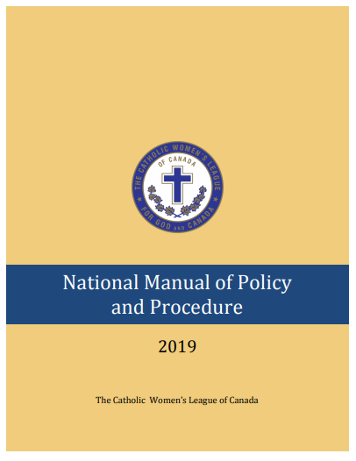
RESOURCES
QUIZ & ANSWERS:
Where do you find information on MEDIA?
NATIONAL MANUAL OF POLICY AND PROCEDURE
Section 10: MEDIA
The Canadian League magazine
On the Spot submissions
Style Guide for Publications
Advertising
Websites
Council Facebook Guidelines
Notes:
The National Manual of Policy and Procedure is a core resource for each member of every executive at all levels to have on hand.
It is available on the national website, so you do not even need to have a hard copy!
If you want a hard copy, you can print it yourself from the website or order it from national office.
It provides information on guidelines for submission to The Canadian League magazine and On the Spot.
It provides guidelines for publications and advertising as well as the dos and don’ts for websites and Facebook pages.

Slide 6
COMMUNICATION
WHAT IS THE DEFINITION OF COMMUNICATION?
Communication is simply the act of transferring information from one place, person or group to another.
Every communication involves (at least) one sender, a message and a recipient.
Feedback – Has the message been received and understood?
Notes:
How is communication defined?
Communication is simply the act of transferring information from one place, person or group to another.
Every communication involves (at least) one sender, a message and a recipient.
Communication can be written or oral and can be nonverbal or visual.
Asking for feedback may be optional but some form of feedback may be required to ensure the message was received and understood.
I am sure there is not an organization around that would not identify increasing the effectiveness of communication as one of its objectives in improving how the organization performs. The League is no exception.

Slide 7
STRATEGIC PLAN
YEAR THREE STRATEGY:
Goal #1: To grow in faith by sharing, witnessing, and developing leadership skills to create positive change.
Objective #5 – Increase effectiveness of communication
Strategy – Improve, streamline and expedite internal and external communications.
Notes:
A Year 3 strategy:
Goal#1 of the strategic plan: To grow in faith by sharing, witnessing, and developing leadership skills to create positive change.
Objective #5 – Increase effectiveness of communication
Strategy – Improve, streamline and expedite internal and external communications.
This does not mean we have to wait for a new plan to work on this improvement now.

Slide 8
THE SENDER
What information am I responsible for conveying?
Who needs to receive the message?
How do I convey the message?
National
Provincial
Diocesan
Parish Council
Provincial
Diocesan
Parish Council
National
Notes:
When taking on a new position, understanding your role is very important. By reviewing your duties in the Executive Handbook, you should be able to identify the specific areas of information you will want to identify with and convey.
Information that you receive from a higher level (i.e., provincial from national), should be passed on to the next level.
Issues that are brought to you from a lower level may require information that only a higher level can provide.
Information may be sent both up or down through the levels or across through the council.
It is important not to bypass levels when dealing with specific questions or issues. This helps executives at all levels to remedy situations as quickly as possible and not overtax the national officers.
The national president is the official spokesperson for The Catholic Women’s League of Canada.
The council president (at her level) represents the council at any events.

Slide 9
THE SENDER
NATIONAL OFFICE AND OTHER COUNCILS
Changes to provincial and diocesan executive members and/or their contact information:
Diocesan should also advise the provincial council.
Changes to parish council contacts:
Online membership system.
E-mail if not online.
Also advise diocesan council (and regional if applicable)
Notes:
It is important that national office be kept up to date with changes to executive positions at all levels.
National office requires a complete list of names for all provincial and diocesan executive members and their contact information.
For parish councils, a list of the president, treasurer, spiritual advisor and membership chairperson, including their contact information, should be provided. This may be done through e-mail to info@cwl.ca, regular mail or, for parish councils, through the online membership process.
When a new executive is elected or when the contact information changes, national office should be advised as soon as possible. The president should ensure this is done to ensure she receives all parish mailings. The diocesan council for the parish should also be advised so that councils receive information from them in a timely manner.

Slide 10
THE SENDER
PARISH COUNCILS AND THEIR MEMBERS
general meetings
e-mails and/or telephone trees
newsletters and/or parish bulletins
training and leadership development
Notes:
Parish council executives should be keeping members informed through general meetings, e-mails, newsletters and telephone trees.
Each executive, whether parish, regional, diocesan or provincial, should establish the best communication mode for messages. The ability of members to use a computer may still be a key factor in reaching members. To reduce costs, media such as e-mail and websites should be used as much as possible but remember, leave no one behind and find ways to reach all members.
Opportunities for training and leadership development should be taken whenever possible. Members who are well informed about the purpose and objects of the League will be more likely to feel engaged and be able to promote the League to others.

Slide 11
THE MESSAGE
WHAT MESSAGES DO WE SEND OR RECEIVE?
communiqués and memos
parish council mailings
convention information
meeting notices
reports and other materials
special events
Notes:
What messages do we send?
communiques and memos
parish council mailings
convention information
meeting notices
reports and other materials
special events

Slide 12
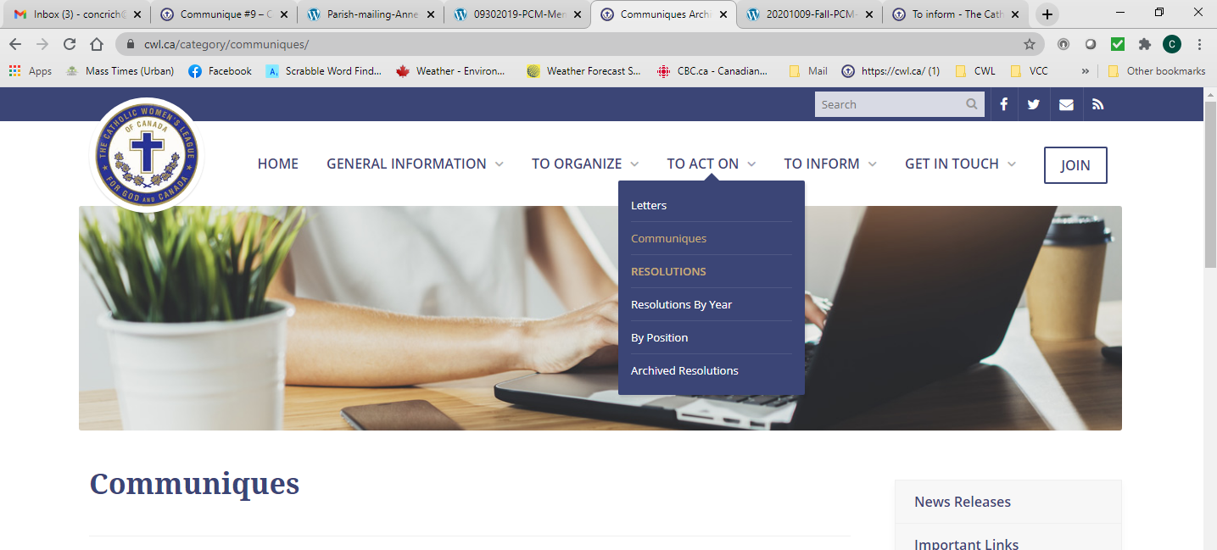
THE MESSAGE
COMMUNIQUES
Notes:
Communiques:
At the national, provincial or diocesan level, you will be responsible for producing a communique. The frequencies and forms of producing these communiques is decided on by the individual executives. Some councils may have websites where these communiques are also posted.
Communiques are an important way to keep chairpersons at all levels informed.
National communiques are sent to provincial chairpersons and members of the national executive (for their information).
Provincial chairpersons review these national communiques for their position. In their own communiques, they may choose to incorporate the general message and expand on it to bring attention to events or initiatives that may be happening, or actions that could be taken, relevant to their provincial council. The national communique should not be duplicated; rather any reference to it should provide a link to the communique on the national website.
Diocesan chairpersons will review the provincial communiques for their position and produce their own communication that will be sent to the chairperson of their parish councils. In this communication, they will focus on diocesan initiatives or actions and provide some of their own personal reflection on relevant issues. They too should avoid reproducing the text of other communiques and instead, reference links to these communiques.
Communiques should include useful resources for members to access.
They can provide food for thought (reference to an article, a passage from the bible, a spiritual reflection…)
They can be a call to action.
Communications should NOT contain personal information on oneself or others. It is an official communication and not a letter to members.
It should not be longer than one or two pages.
A communique is an official statement or announcement. Accurate, factual, credible and unified! This is the goal for the 14,400 women in the League entrusted to communicate on the its behalf! With research, respect and due diligence, it is possible to speak with one unified voice!
It may be a best practice of the council president to have all communications and reports sent to her for approval before being distributed or posted to websites. This may avoid having to deal with fall out from any contentious content that may be contained in the document.
By providing links to national, provincial and diocesan websites in communiques, you are educating the audience as to resources they can use in future. National communiqués can be found on the national website under “To Act On.”
Every executive member should make time weekly to go to the national website and read through all new content. If you have a provincial or diocesan website, take time to do the same on these websites.
Parish council executives could have a meeting devoted just to making its members familiar with what is on the national website and others if applicable. This could even be the event for a general meeting.

Slide 13
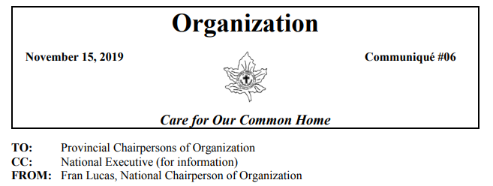
THE MESSAGE
Communiqués
Memos
Notes:
While no two communiques will look alike, and will vary based on the personality of the writer, communiques have basic guidelines for content. These include:
Promoting actions addressing adopted resolutions.
Informing the membership about approved League projects.
Promoting programs or initiatives of other organizations that fall within the scope of the standing committee and that are vetted by the screening policy found in the National Manual of Policy and Procedure.
Providing the names and sites of reliable resources that chairpersons may use when educating themselves and the members to which they report.
Raising awareness of key positions taken by the League with respect to current affairs in the church and society.
Encouraging spirituality, ministry, social justice, lifelong learning and advocacy, inspiring confidence among the membership, and advancing communications throughout the League.
When writing a communique, the chairperson must be cognizant that she is representing the League in her communications. Every written and published document, regardless of level, can and will enhance or minimize the League’s credibility. It is necessary, therefore, to ensure that:
Facts are independently verified by credible sources.
Personal opinions are not expressed.
Strong or inflammatory language is avoided.
Quoted material is provided with complete referencing in order to credit the source.
Material is not plagiarized, particularly from websites.
Appeals are not circulated unless they have been previously approved by the executive to which the chairperson is accountable.
Information provided aligns with the official teachings of the church.
Information provided does not contradict the formal position or decision of any of the more senior levels of the League.
Communique Presentation:
Communiqués should be presented in roughly the same way to distinguish them from annual reports or memos.
The heading should include:
the title of the committee, the communiqué (or memo) from whom the document is coming from
the date and the number of the communiqué
the committee logo can also be included
the current national theme should appear in one form or another (logo and/or slogan)
Under the heading, the following should appear:
committees or persons to whom the communiqué is directed
the other members who have been sent the document for reference purposes
the name of the author (and contact information, if desired)
You may also choose to send a similar message in the form of a memo. These often come with the parish mailings or may come on their own.
MEMOS:
much shorter document than a communiqué
should only address one subject
can be used to remind members of an upcoming deadline or event
can be used for an urgent, time-sensitive call to action
should not be about the author, but only the topic being presented
no more than one page long (added information can be attached. E.g., access codes for annual report survey)

Slide 14
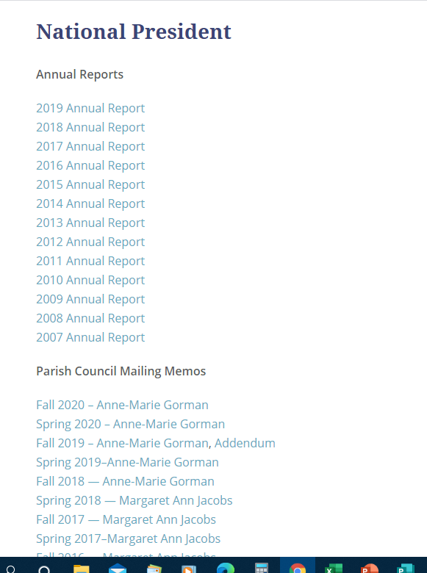
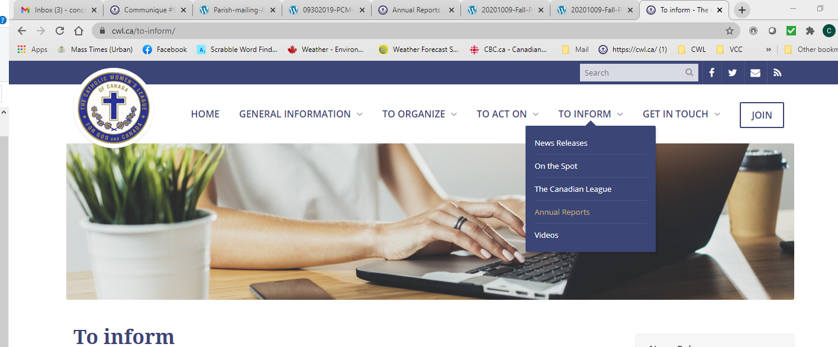
THE MESSAGE
PARISH COUNCIL MAILINGS FROM NATIONAL
Under Annual Reports
Notes:
Parish Council Mailings:
National office sends out a parish mailing twice a year to the parish president.
Those who are on the online system will receive the “package” by e-mail. Those that use the manual system will receive a hard copy package in the mail.
It is important that parish contact information be kept up to date so that the right person gets the information in a timely manner. If it is received by a past president, this information should be forwarded as soon as possible to the current president and she should ensure contact information is updated with national office for future mailings.
The information in these mailings should be distributed to all executive members. If received by e-mail and all executive members have e-mail, the complete package could be forwarded in this manner. If packages are in hard copy, the president could choose to only pass on the memos relevant to the position.
Fall mailings (October) generally focus on some happenings from the national convention and resulting actions that can be taken in relations to resolutions, faith programs and service projects. The package will also include information concerning preparation of annual reports.
Spring mailings (March) generally focus on upcoming events and activities, recap of initiatives and reporting that have gone on since the last reporting, new or revised policies and procedures, insurance information, and the Book of Life.
Parish mailings can be found on the website under To Inform - Annual Reports.
Some items sent in this package are not posted to the website. One item is the access codes to the annual report survey for security reasons.

Slide 15
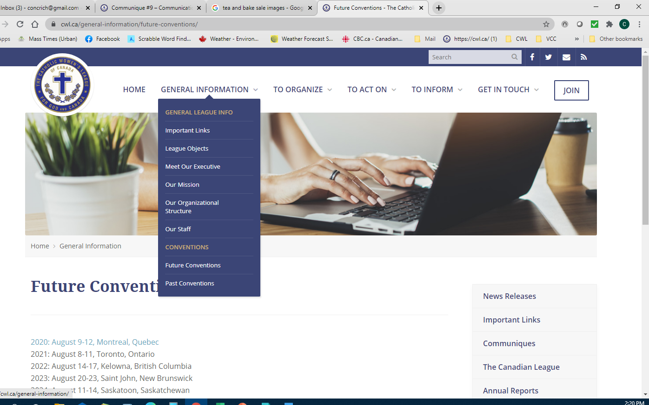
THE MESSAGE
CONVENTION INFORMATION
Notes:
Convention Information:
Information concerning the upcoming national conventions can be found on the national website.
Information concerning diocesan conventions may be found on provincial or diocesan websites.
Information concerning annual conventions should go out early and often in various forms. While convention committees are responsible for distributing much of the information concerning conventions, each council should promote attendance for conventions at all levels. Parish councils should thoughtfully consider supporting attendance at conventions with as many of their members as possible. Realizing the location and need to travel can be an impediment for some, consideration should be given to sponsoring at least the president’s attendance at diocesan, provincial and where it is possible, national conventions.

Slide 16
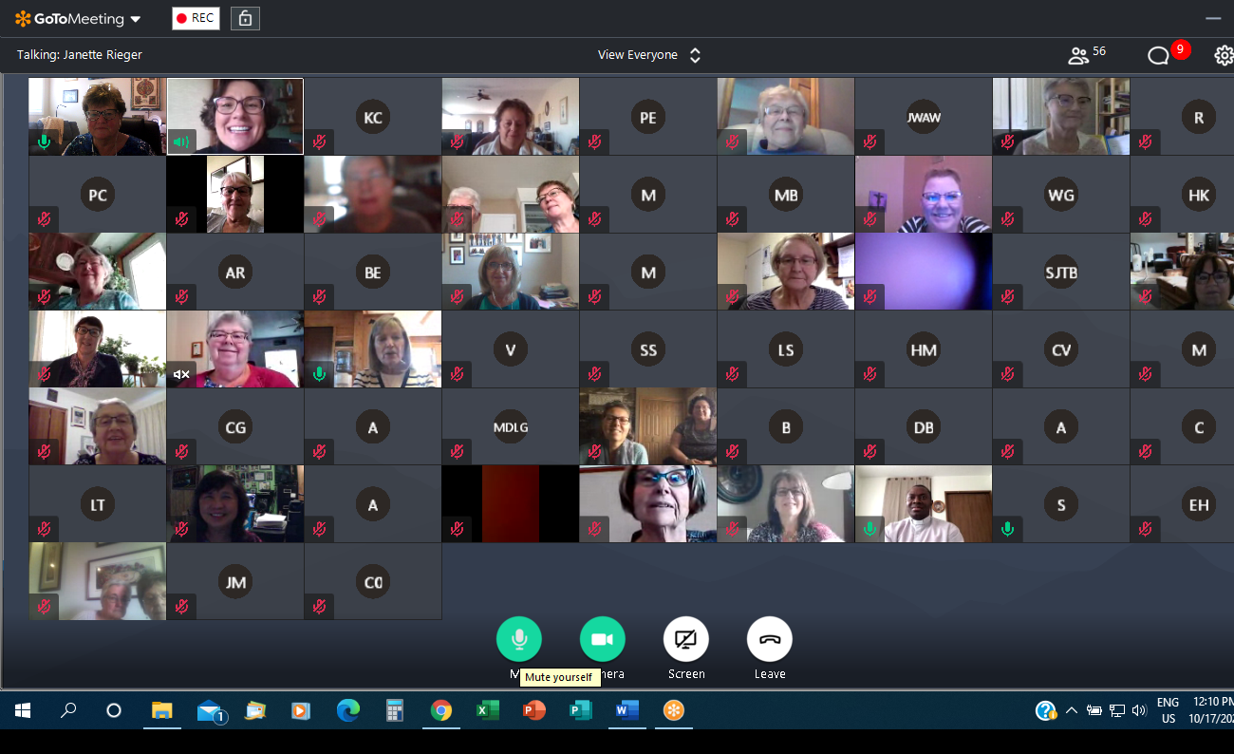
THE MESSAGE
MEETING NOTICES
Meetings: in person only
Virtual platforms for other events - is training required?
Notes:
Meeting notices:
In person:
At the parish level, general meetings should be well advertised in parish bulletins, through e-mail and/or a telephone tree. Create excitement to attend by keying in on something special that will be occurring at this meeting. Nothing exciting happening? Find something exciting to happen! If the meeting includes guest speakers that are open to the public, make sure this is publicized well in advance.
At regional, diocesan and provincial levels, strive to set the next meeting dates at the current meeting. This will allow for executive members to keep these dates open and plan their busy lives around them.
Make sure everyone knows the date, time and place. Follow up with a reminder that includes an agenda, so members have time to think about the issues that will be presented or bring other issues that do not appear on the agenda that they feel are important.
Virtual
The current Constitution & Bylaws does not accommodate virtual meetings. Instead, and if a council must, members may gather virtually to discuss topics, however, any decisions made must be ratified at an in person meeting. For the purposes of this pilot, this section may change, pending the outcome of a proposed amendment being circulated to the membership for final vote in August 2021.
If an in person meeting is not possible, could a gathering be held virtually? Would participants require training or coaching? If so, arrange a time and date ahead of the gathering to do this to avoid delays in starting the meeting on the meeting date.
The virtual world provides members with many opportunities to gather for various purposes without having a meeting.

Slide 17
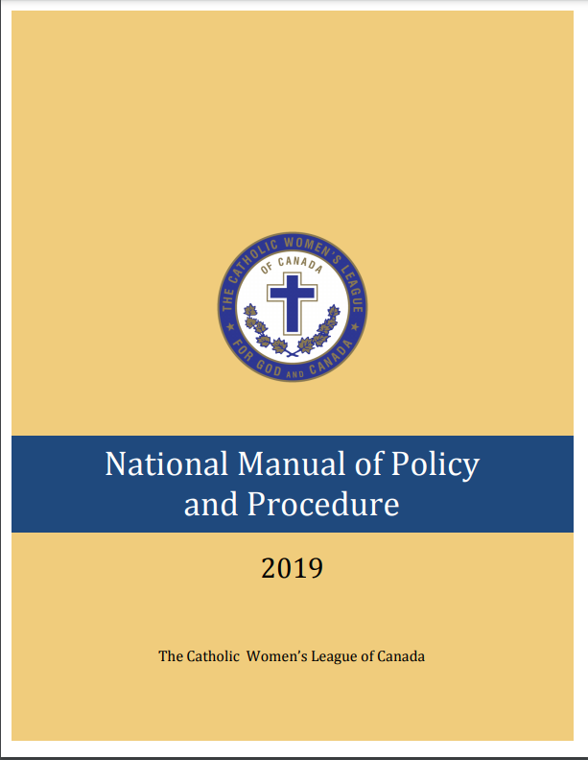
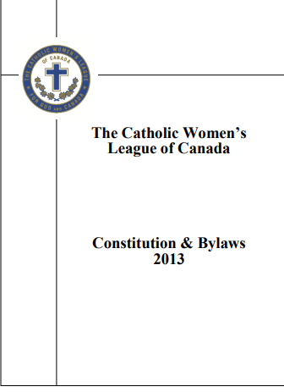
THE MESSAGE
REPORTS
Written Reports
Oral Reports
Activity Reports
Meetings
Monthly Reports
Convention
Notes:
Reports:
There are two ways of giving reports, written or oral.
The National Manual of Policy and Procedure (P&P) is one of the best resources to be used in conjunction with the Constitution & Bylaws.
“Officers are members of the executive and are expected to attend all meetings and report regularly. If an officer will be absent, she should inform the president and arrange to send a report …”. (P&P, page 73). This applies to all types of reports (monthly, annual, oral).
“Reports are an important means of communicating with others in the parish, community and country at large.” (P&P, page 76)
In the next few slides, we will talk about the most common written reports:
activity reports
meeting reports
The oral reports are for:
meetings
conventions

Slide 18
THE MESSAGE
WRITTEN REPORTS
Information they should be given
Actions to be taken
Activity Reports
Meeting Reports
OTHER WRITTEN MATERIALS
Notes:
Reports and other items produced:
For any oral or written report given, whether at a national, provincial, diocesan or parish level, the author should always keep in mind all the information they have received and any items they have acted on since they last reported and determine what information will be most important to members.
Depending on the position they hold, they should provide some action items that members can take away.
All written reports should have the same type of structure:
At the top of the page identify the committee, activity, author’s name and date of the report.
Content will vary depending on what the report is for.
The task of writing reports is sometimes overwhelming. Don’t forget you have many sisters to support you. Find a buddy or be a buddy in developing this skill. Perhaps a workshop on report writing is needed for your council executive.
Specific events could be summed up in an activity report. While informative for members, it may also assist in planning for future events. Here are ideas for the content of activity reports:
name the activity
list the date, time, location
how many attended
identify the goal
summarize how
summarize what worked
summarized what needs to be improved
summarize evaluations
make recommendations
any other persistent information
Maximum one page
The council should have a folder/binder/drop box with lists of contact people and service/product providers to use for activities.
MEETING REPORTS:
For monthly/quarterly meetings:
name of committee
date
author’s name
Under each duty of the committee chairperson (Constitution & Bylaws, pages 19-29):
Summarize news that needs to be shared from other levels of the League.
Actions to be taken on resolutions that fall under the position.
Summarize the activities that took place under the committee since the last meeting.
Remind members of ongoing initiatives.
Remind members of upcoming events.
Suggest activities.
Other written materials:
Liturgy booklets and presentation materials often contain information that has come from another source other than League material.
When using another person’s copyrighted items such as songs, prayers and images, be sure to obtain permission and retain the permission for future reference. Give proper acknowledgement of the source and the permission.

Slide 19
THE MESSAGE
ORAL REPORTS
Meetings
Conventions
summarize
be informative
stick to facts
resolutions
brief (2-3 minutes)
Notes:
ORAL REPORTS
At general meetings:
should be a summary of the written report
should only reflect news/events/initiatives since the last meeting
should be informative and factual – aim for brevity, accuracy and clarity (P&P, page 85)
should not be about you but rather League information
should take two to three minutes to deliver
After the oral report has been presented: (Not included in the two to three minutes, but the president must know this will take place).
question period, if time allows
distribute any relevant hand-outs/pamphlets/postcards
consider presenting an idea or resolution for consideration
At conventions:
Summarize the written report that has already been submitted to the recording secretary and president ahead of time.
Be informative and factual, not personal.
Only report on activities/events/initiatives of relevance since the beginning of the year. The annual report will have been included in the diocesan, provincial or national annual report book for the previous year.
The president can also ask chairpersons to present on a particular theme or question, but still only report on the current year.
Ask the president to confirm how much time there is to present the report (usually between two and three minutes).
After the oral report is presented: (Not included in the two to three minutes, but the president must know this will take place).
distribute any relevant hand-outs/pamphlets/postcards
present any resolutions for consideration (the executive must have approved this before it is presented to the assembly)

Slide 20
THE MESSAGE
SPECIAL EVENTS
advertise early and often
spark interest
look for opportunities to expand your audience
go virtual ?
Notes:
Special Events:
These could include guest speakers, training, spiritual programs, fundraisers or social activities.
Do not forget to consider if it could be done virtually. This may increase attendance and reduce costs.
Get the promotion out early and often. If you do not know all the details, but you have a time and date, start with a general advertisement with “more details to come” to spark interest.
Consider who the audience is and advertise accordingly. Always consider broadening the audience beyond members. This may attract a new member to attend. You could include a bit of a recruitment message during the event. Anytime is the right time to promote this wonderful organization. Anytime is the right time to join.
With many members having smartphones, encourage them to take short videos and share them with the council and the national executive/board for future marketing resources.

Slide 21
THE RECIPIENT
What is the responsibility of the recipient?
to listen
to understand
to take action (or not)
Notes:
So, what are the responsibilities of a recipient of the messages?
Listen/Read:
That may be by actual face to face communication at a meeting, through a telephone call.
It may be by receiving a message in a written form either by mail, e-mail or a handout at a gathering/meeting, or reading the information on a website. If it wasn’t important enough to read, it wouldn’t have been sent.
You can also choose not to hear the message by not attending meetings, not reading mail or e-mail, and not answering your telephone or visiting relevant websites.
Understand:
Once you have decided to listen to or read the message, you may still need to seek clarification.
You may want to go directly to the sender of the message if the message was just sent to you.
If the message was sent from another level, start with asking your council president. If she too requires clarification (maybe you are the president), she may go to the next level to seek this information.
Understanding the message is very important, especially if you are responsible to pass the message on to others.
Take action (or not)
Most messages you will receive ask for some type of action to be taken. It may be as simple as acknowledging that an e-mail has been received.
All national initiatives ultimately rely on parish councils to carry out the actions. Provincial, diocesan and even parish councils may put their own regional and local flavour to them, but the actions generally produce the intended results. One good example is the 100th anniversary tree planting project. Many kinds of trees were planted in many different places, but they all marked the historic 100th anniversary of the League.
Many resolutions ask for letter writing from members on identified issues. Councils may chose to educate themselves further on these issues with guest speakers and reading resources.
Each parish council, being unique in size, age and leadership will ultimately choose which initiatives to act on and which to file away. The important thing is that all messages should be brought forward for some discussion, at least at the executive level.

Slide 22
FEEDBACK
MESSAGE RECEIVED?
Ask for a response and give a deadline.
WHAT WERE THE RESULTS?
Ask councils to share their stories.
Notes:
So the message has been sent. How do you know if the message was received?
If you are conveying information, you could ask for an acknowledgement of receipt.
If you are asking for some specific information that you require, provide a deadline for response. Send a reminder. If it is urgent, make sure you identify it as such in the subject line.
If you are promoting an initiative, ask for reports on actions.
If it is a notice of a meeting or an event, check with some of the possible attendees to see if they are coming. (If they do not seem to be aware, you may have to do some more advertising).
What did you do with the information? Ask councils to send stories highlighting the actions they have taken.
National has several media options:
On the Spot
Facebook
Provincial and diocesan councils may have websites and Facebook pages.
Conventions and gatherings:
Ask councils to relay some of their happenings as part of the gathering and take note of successes to build on.
Reports should reflect feedback from activities undertaken, as well as challenges to take other actions.

Slide 23
FEEDBACK
ANNUAL REPORTS
Online
Written
Provincial
Diocesan
Parish Council
National
Notes:
Annual Reports
As The Catholic Women’s League of Canada is a not-for-profit organization, it is required by statutory regulation to report annually on the activity of members. As parish councils are in the communities where members reside and where activities are undertaken, this information must come from parish councils.
Each level of the League is required to participate in this process to fully meet the obligations of the reporting system.
This is the League’s best tool to receive feedback on whether the mission of the League is being carried out by members.
Parish councils must make every effort to participate in this reporting in some way. National office provides both manual and computer-based options. Technology should not be a barrier to this reporting. Diocesan chairpersons of organization are available to assist in anyway they can.
As each level reviews the survey results, the response should reflect whether important messages were heard and relevant actions taken, by what is being recorded in the reports.
Each individual executive position has an opportunity to share her accomplishments as well as indicate what her council chose not to partake in.
Sources to help you complete the parish annual report survey include monthly/quarterly reports, council minutes and activity reports.
NOTE:
Use the other section to highlight all the special endeavours and projects the council undertook during the year. Remember, this is the written history, so do not leave anything important and worth mentioning out! The national survey is used across the country and may not have touched on something of special importance to your council.
Parish councils without a diocesan council: Parish presidents may be asked to submit an annual report to the provincial level, summarizing her council’s activities under each committee.
It is a good idea for each parish president to write an annual report summarizing the year for the council’s archives. This report may also be used to report for the council’s annual general meeting.

Slide 24
FEEDBACK
ANNUAL REPORTS
National
Provincial
Diocesan
Parish Council
Notes:
Once these reports for each executive position are completed by the parish councils, the diocesan councils prepare their reports by summarizing the information gathered by the survey for each position, and adding in the activities of the diocesan level.
These diocesan reports are then given to the provincial council, that again summarizes the collective efforts of the diocesan council positions and adds in the activities of the provincial level. Each provincial position then forwards its reports to the respective national executive member who will summarize the provincial positions and add in her national activities.
At each level, the reports are collected by the chairperson of organization and they are compiled into an annual report booklet.
In addition to complying with its reporting obligations to government, the annual report produced by the national council, serves to report to members what has been accomplished collectively in the year.
These national annual reports are available on the national website.
Annual reports prepared by diocesan and provincial councils are distributed either in paper or digital format to all parish councils. These too may be available on diocesan or provincial websites.

Slide 25
CONCLUSION
“Communication is a two-way street starting with Jesus and flowing through to members and back to Him through prayer. If members have faith, trust in God, and seek the direction of the Holy Spirit, He will guide them. There must be openness and willingness to accept His direction.”
Doreen Gowans
National Second-Vice President and Chairperson of Communications
Oral Report at 99th Annual Convention
Notes:
I will end with a few more words from Doreen Gowans’ oral report at the 99th annual national convention in Calgary in 2019:
“Communication is a two-way street starting with Jesus and flowing through to members and back to Him through prayer. If members have faith, trust in God, and seek the direction of the Holy Spirit, He will guide them. There must be openness and willingness to accept His direction.”

Slide 26
COMMUNICATION

Slide 27
EXECUTIVE ORIENTATION
Modules:
History of the League (15 minutes)
Structure of the League and The Promise of the League (25 minutes)
Core Principles; Constitution & Bylaws; Policy and Procedure; Executive Handbook (20 minutes)
Duties of Officers (20 minutes)
Life Membership and Honorary Life Membership (20 minutes)
Strategic Plan Summary (30 minutes)
Communication (45 minutes) P
Budgets (15 minutes)
Member Recognition (10 minutes)
Public Presence and Member Development (30 minutes)
Notes:
Executive Orientation
Modules:
History of the League (15 minutes)
Structure of the League and The Promise of the League (25 minutes)
Core Principles; Constitution & Bylaws; Policy and Procedure; Executive Handbook (25 minutes)
Duties of Officers (20 minutes)
Life Membership and Honorary Life Membership (20 minutes)
Strategic Plan Summary (30 minutes)
Communication (45 minutes)
Budgets (15 minutes)
Member Recognition (10 minutes)
Public Presence and Membership Development (30 minutes)

